Slide 1

Carbon Cycle & Ecosystems Focus Area
Diane E. Wickland
Earth Science Division
NASA HQ
October 3, 2011

Slide 2


Outline
About the Carbon Cycle & Ecosystems (CC&E) Focus Area
  Science Questions
  Program Elements, Goals, Funding
  Collaborations, Interfaces & Partnerships
  Update on Current and Future Missions
  Other News
  Opportunities and Challenges Ahead
    Challenges, Opportunities
    Advance Planning, Future Priorities
    Anticipated Solicitations
About this Workshop

Slide 3
Carbon Cycle & Ecosystems Focus Area
Research and Analysis (R & A) Programs:
Biodiversity - Woody Turner
Land Cover and Land Use Change (LCLUC) - Garik Gutman
Ocean Biology and Biogeochemistry (OBB) - Paula Bontempi
Terrestrial Ecology (TE) - Diane Wickland
Applied Sciences Programs:
Agriculture; Water Resources - Brad Doorn
Ecological Forecasting - Woody Turner
Also relevant: Air Quality & Public Health, Disasters

Slide 4
Carbon Cycle & Ecosystems Questions
How are global ecosystems changing?
What changes are occurring in global land cover and land use, and what are their causes?
How do ecosystems, land cover and biogeochemical cycles respond to and affect global environmental change?
What are the consequences of land cover and land use change for human societies and the sustainability of ecosystems?
What are the consequences of climate change and increased human activities for coastal regions?
How will carbon cycle dynamics and terrestrial and marine ecosystems change in the future?

Slide 5
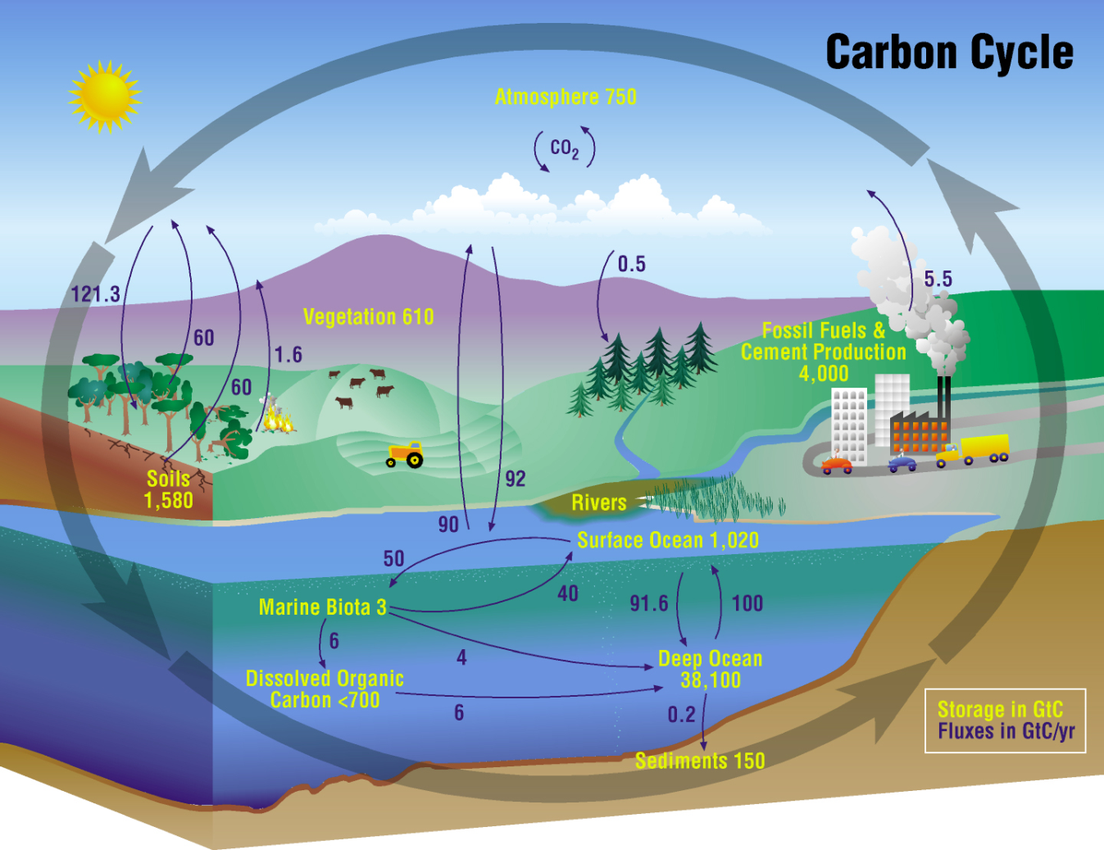
NASA Carbon Cycle Research
To improve understanding of the global carbon cycle and to quantify changes in atmospheric CO₂ and CH₄ concentrations as well as terrestrial and aquatic carbon
storage in response to fossil fuel combustion, land use and land cover change, and other human activities and natural events.

Slide 6
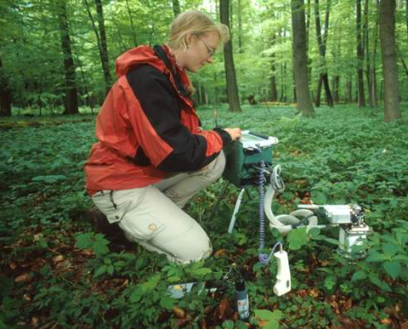
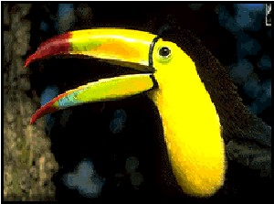
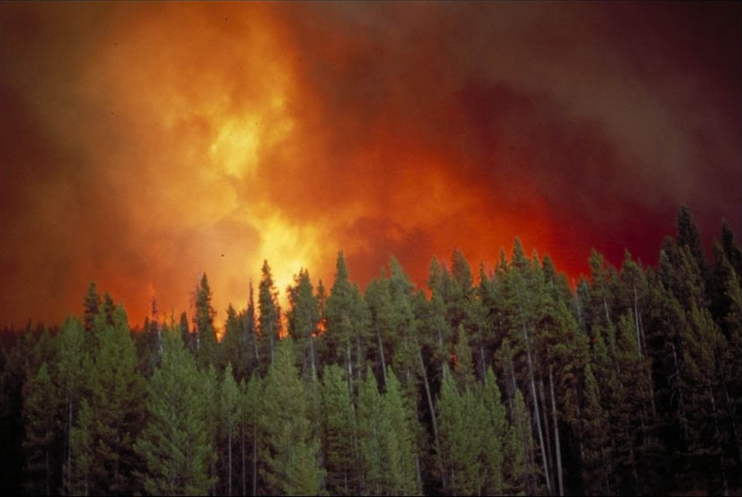
NASA Ecosystems Research
To understand how ecosystems respond to changes in climate in combination with other contemporary environmental changes such as changes in land use and management, invasions of exotic species, nitrogen deposition, and acidification of the ocean.
To understand ecosystem controls on and feedbacks to the Earth system.

Slide 7
NASA’s Approach to CC&E Research
NASA’s approach to investigating global ecosystems and the carbon cycle is broad-based, emphasizing NASA’s unique capabilities and strengths. NASA research:
Focuses on utilizing existing satellite data and developing new capabilities for space-based global observations of land cover, ocean color, greenhouse gases, carbon stocks, primary productivity, vegetation composition, physiology, phenology, successional processes, biodiversity, and the biophysics of remote sensing these phenomena.
Uses spatial information from remote sensing data to scale up site-based measurements to regional and global scales
Analyzes time series remote sensing data records to document and understand variability and changes over time in ecosystems, land cover, and carbon cycling
Conducts calibration/validation of satellite data; algorithm development; airborne field campaigns; process investigations; and data analysis/integration/assimilation
Develops and exercises advanced, quantitative carbon and ecosystems models, data assimilation models, and coupled land-ocean-atmosphere models
Demonstrates innovative uses and practical benefits of NASA Earth science data, scientific knowledge, and technology
Develops and demonstrates technologies that enable improved future capability for the nation

Slide 8
NASA CC&E Research Cooperation
NASA conducts its ecosystems and carbon cycle research in close coordination with other U.S. agencies, other nations, and relevant international programs. Important cooperation includes:
Close partnerships with other federal agencies (principally USDA, NOAA, USGS, DOE, and NSF), especially for ensuring efficient links to surface measurement networks, process studies, and decision support (coordination is primarily through the U.S. Global Change Research Program’s Interagency Working Groups)
The International Ocean Color Coordinating Group (IOCCG)
The Global Carbon Project (GCP) of IGBP, WCRP, IHDP; Global Land Project (GLP) of IGBP and IHDP, Integrated Land Ecosystem-Atmosphere Processes Study (iLEAPS) of IGBP, and Analysis, Integration and Modeling of the Earth System (AIMES) project of IGBP
The Group on Earth Observations (GEO) Carbon Community of Practice (and Forest Carbon Tracking Project) and the U.S. SilvaCarbon program in support of FCT and United Nations Collaborative Programme on Reducing Emissions from Deforestation and Forest Degradation in Developing Countries (REDD+)
DIVERSITAS and the GEO Biodiversity Observation Network (GEO BON)
The Committee for Earth Observing Satellites (CEOS) and its Carbon Task Force; virtual Constellations for Land Surface Imaging, Ocean Color, and Atmospheric Composition; and Working Groups on Calibration/Validation and Information Systems
CarbonNA for Canada-Mexico-U.S. cooperation on North American carbon dynamics

Slide 9
R & A: Ocean Biology and Biogeochemistry Program
Goals & Objectives
To describe, quantify, understand, predict the biological and biogeochemical regimes of the upper ocean using observations of aquatic optical properties from space, aircraft, and other suborbital platforms.
  Observe aquatic ecosystem(s), their function and feedbacks/responses to climate/environmental forcings
  field campaigns, modeling
Missions & Instruments
Systematic: SeaWiFS (R.I.P); MODIS-Aqua; NPP/JPSS (VIIRS)
Exploratory: Aquarius; HICO; OCO-2; AVHRR; QuikSCAT
Decadal Survey: ACE; GEO-CAPE; HyspIRI; ASCENDS
Climate Initiative: PACE
Airborne: PRISM (TBD)
Funded Research (FY2011)
OB&B R&A: $7.8M
  Ocean Biogeochemistry
  Ocean Ecology
  Biological Oceanography
Carbon Cycle Science $ 1.5M
Terra/Aqua Science $ 3.9M
NPP Science Team $ 0.7M
Interdisciplinary Science $ 2.0M
Carbon Monitoring System $ 0.3M
Key Interactions
Ocean Biology Processing Group NASA GSFC
IOCCG - ISRO, ESA, CNES, JAXA
CEOS OCR-VC and INSITU-OCR
USGCRP Carbon Cycle Interagency Working Group (also Ecosystems IWG)
NSF, NOAA
OCB
IGBP IMBER, SOLAS

Slide 10
R & A: Land-Cover/Land-Use Change (LCLUC) Program
Goals & Objectives
Develop the capability to perform repeated global inventories of land-use and land-cover from space
Develop the scientific understanding and models necessary to simulate processes taking place
Evaluate consequences of observed and predicted changes
Further understanding of consequences of land-use/cover changes on environmental goods and services, the carbon and water cycles and management of natural resources
Improve understanding of human interaction with the environment and provide a scientific foundation for sustainability, vulnerability, and resilience of land systems
Missions & Instruments
Terra/Aqua MODIS
Landsat
Radars, lidars
EO-1 Hyperion
SRTM
Non-US missions/sensors
Funded Research FY2011
ROSES-2008 $2.8M
Carbon-2010 $0.5M
ROSES-2009 $2.1M
USPI-2010 $0.4M
GLS products $0.4M
Key Interactions
NASA: ESD programs
National: USGCRP LUIWG
International: IGBP/IHDP GLP
GTOS GOFC-GOLD
GEO
CEOS

Slide 11
R & A: Biodiversity Program
Missions & Instruments
Terra/Aqua
  MODIS: land and ocean surface measures
  ASTER: land surface (vegetation, T), elevation
  AMSR-E: sea ice
Landsat
  TM/ETM+: land surface, coral reefs, kelp
TRMM
  Precipitation Radar: rainfall
EO-1
  ALI/Hyperion: land surface
Jason/OSTM: SSH
QuikSCAT: wind speed, land surface parameters
Biodiversity - the variability of life on Earth at all levels, including: ecosystems, species, and genes.
Goals & Objectives
Use NASA observations and related models to improve our understanding of biodiversity within the Earth system and its effects on the Earth system. For example:
  What drives the diversity of life?
  How is biodiversity changing and why?
  How do elements of biodiversity (e.g.: species richness) affect other elements of the Earth system?
  Why do organisms/ecosystems exist where they exist? What drives their abundance/condition?
Key Interactions
CENRS Subcommittee on Ecological Systems
US Global Change Research Program
Group on Earth Observations (GEO) Biodiversity and Ecosystems Tasks
National Climate Assess. Biodiversity/Ecosystems
NSF, USGS, NOAA
Academia, Non-profit sector
GSFC, ARC, JPL
LDCM; HyspIRI, PACE/ACE, GEO-CAPE, DESDynI, SMAP Decadal Survey Missions
Funded Research
27 projects in various stages of work
Funding ~$4.8M per year (includes projects under Biodiversity, IDS, Climate and Biological Response, and HyspIRI activities)

Slide 12
R & A: Terrestrial Ecology Program
Goals & Objectives
To improve understanding of the structure and function of global terrestrial ecosystems, their interactions with the atmosphere and hydrosphere, and their role in the cycling of the major biogeochemical elements and water.
  remote sensing to observe terrestrial ecosystems/carbon and their responses
  field campaigns and related process studies to elucidate ecosystem/carbon cycle function; and
  modeling to analyze and predict responses
Missions & Instruments
Systematic: Terra/Aqua MODIS, AMSR-E; AVHRR; Landsat/LDCM; NPP/JPSS (VIIRS)
Exploratory: Terra MISR, ASTER, MOPITT; EO-1, OCO-2
Decadal Survey: DESDynI-Radar, HyspIRI, SMAP, ICESat-2, ASCENDS, others
Climate Initiative:
Airborne: AVIRIS; users of LVIS and UAVSAR
Funded Research (FY2011)
Terrestrial Ecology R&A: $12.8M
  Carbon
  Ecosystems
  Remote Sensing Science
Carbon Cycle Science $ 1.9M
Terra/Aqua Science $ 3.5M
NPP Science Team $ 1.7M
Interdisciplinary Science $ 3.7M
Carbon Monitoring System $ 2.4M
Key Interactions
ORNL DAAC, others
Carbon Cycle Interagency Working Group (also Ecosystems IWG)
USDA, NSF, DOE
GEO Carbon Community of Practice
CEOS Carbon Task Force
CarboNA

Slide 13
Applied Sciences: Ecological Forecasting
Missions & Instruments
Terra/Aqua
  MODIS: land and ocean surface measures
  ASTER: land surface (vegetation, T), elevation
  AMSR-E: sea ice
Landsat
  TM/ETM+: land surface, coral reefs, kelp
TRMM
  Precipitation Radar: rainfall
EO-1
  ALI/Hyperion: land surface
Jason/OSTM: SSH
QuikSCAT: wind speed, land surface parameters
Goals & Objectives
Ecological Forecasting is an applications (i.e., NASA Applied Sciences) program seeking to provide environmental managers and other decision makers with reliable forecasts, based upon NASA products, to project changes in ecosystems and among species of management concern. These forecasts should incorporate knowledge of uncertainty and error estimates and allow decision makers to compare outcomes of alternative policies.
Particular focus: Conservation Biology applications
Funded Research
21 projects in various stages of work
Funding ~$5M per year
Key Interactions
NOAA National Marine Fisheries Service
U.S. National Park Service
U.S. Fish and Wildlife Service
U.S. Geological Survey
USDA Forest Service
NOAA NESDIS
ARC, MSFC/SERVIR (and internationals), GSFC, JPL
Academia, Non-profit and For-profit sectors
Group on Earth Observations (GEO) Biodiversity and Ecosystems Tasks

Slide 14
Applied Sciences: Water Resources and Agriculture
Goals & Objectives
Water Resources and Agriculture are applications (i.e., NASA Applied Sciences) programs seeking to integrate and adapt NASA mission and science products into water resource and agriculture mngt and policy making. Specific focus on complementing the CCE mission is in forest mngt other agriculture-related biomass information products that would support carbon monitoring systems. Hydrologic models and info products are key to predicting in-season biomass change.
Missions & Instruments
Terra/Aqua
  MODIS: land surface
  AMSR-E: precipitation
Landsat
  TM/ETM+: land surface
TRMM
  Precipitation Radar
EO-1
  ALI/Hyperion: land surface
Jason/OSTM: In-land water body heights
Funded Research
27 projects in various stages of work
Funding ~$6M per year
Key Interactions
USDA
USGS
USAID-DoS
EPA
USACE
NOAA
World Bank
Academia, Non-profit and For-profit sectors
Group on Earth Observations Agriculture and Water Tasks

Slide 15

Missions for Focus Area Science

Slide 16
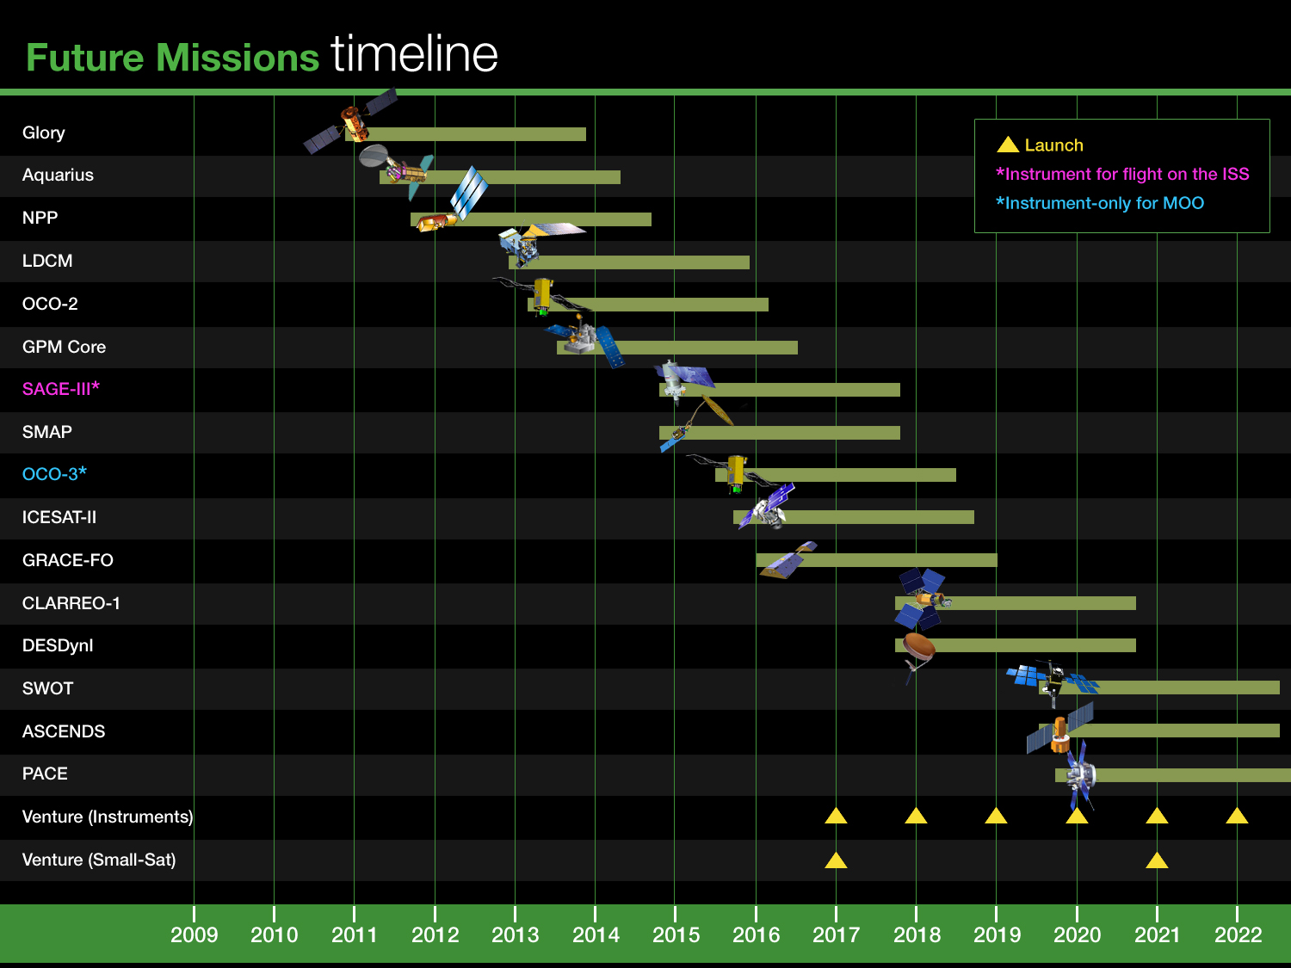
Future Orbital Flight Missions – 2011 – 2022
XX
XXXXXXXXXX
(Important for CC&E)
? - earthquake
Notes:
16

Slide 17
Updates on Decadal Survey Mission Status
SMAP – All is well. In formulation (Phase B). Preparatory research for TE uses underway
ICESat-2 – In formulation, now in Phase B. Still studying cability of photon counting for canopy height estimation using airborne simulators
DESDynI – Still reeling from cancellation of lidar. A potential path forward for an “affordable” DESDynI-Radar being pursued – including solicitation for a Science Definition Team (SDT). Radar interferometry now appears to be our only hope for biomass in medium-high biomass forests
ASCENDS – Accelerated for 2019 launch. Technology options / readiness being actively studied.

Slide 18
Updates on Decadal Survey Mission Status
HyspIRI – Pretty much ready to start any time, still Tier 2, but not accelerated (yet). Science Study Group is doing wonderfully; Earth-shaking results at 8/23/11 workshop.
ACE – All is well; Science Working Groups moving through studies (aerosols, cloud, ocean ecosystem, atmosphere-ocean interaction). Field campaign planning underway.
GEO-CAPE – Field campaign in Chesapeake Bay complete; article submitted to BAMS; Community Workshop in April/May 2012; divorce of ocean and atmosphere efforts

Slide 19
Updates on Other Mission Status
NPP – Scheduled for launch October 25, 2011.
LDCM – LDCM is ready to formally move into implementation Phase D and proceed to launch. All is well, but launch window is tight.
OCO-2 – Now in implementation (Phase C). All is well. Spare parts being assembled for OCO-3. OCO-2 Science Team just selected.
PACE – Part of NASA Climate Initiative. First systematic mission to be competed in a long time (potential mission + instruments). Science Definition Team selection anticipated October 2011 (Dear Colleague Letter via NSPIRES list issued in July). Announcement of Opportunity (AO) anticipated for 2013, with a Launch Readiness Date (LRD) in FY2019.

Slide 20
Other News

Slide 21
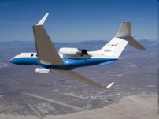
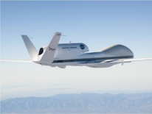
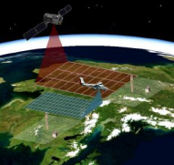
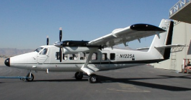
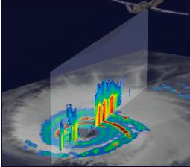

Two NASA Earth Venture-1 Suborbital Missions Relevant to CC&E
Airborne Microwave Observatory of Subcanopy and Subsurface (AirMOSS) - Univ Mich/JPL
North American ecosystems are critical components of the global exchange of the greenhouse gas carbon dioxide and other gases within the atmosphere. To better understand the size of this exchange on a continental scale, this investigation addresses the uncertainties in existing estimates by measuring soil moisture in the root zone of representative regions of major North American ecosystems. Investigators will use NASA's Gulfstream-III aircraft to fly synthetic aperture radar that can penetrate vegetation and soil to depths of several feet.
Airborne Tropical Tropopause Experiment (ATTREX) - ARC
Water vapor in the stratosphere has a large impact on Earth's climate, the ozone layer and how much solar energy the Earth retains. To improve our understanding of the processes that control the flow of atmospheric gases into this region, investigators will launch four airborne campaigns with NASA's Global Hawk remotely piloted aerial systems. The flights will study chemical and physical processes at different times of year from bases in California, Guam, Hawaii and Australia.
Carbon in Arctic Reservoirs Vulnerability Experiment (CARVE) - JPL
This investigation will collect an integrated set of data that will provide unprecedented experimental insights into Arctic carbon cycling, especially the release of the important greenhouse gases such as carbon dioxide and methane. Instruments will be flown on a Twin Otter aircraft to produce the first simultaneous measurements of surface characteristics that control carbon emissions and key atmospheric gases.
Deriving Information on Surface Conditions from COlumn and VERtically
Resolved Observations Relevant to Air Quality (DISCOVER-AQ) - LaRC
The overarching objective of the DISCOVER-AQ investigation is to improve the interpretation of satellite observations to diagnose near‐surface conditions relating to air quality. NASA's B-200 and P-3B research aircraft will fly together to sample a column of the atmosphere over instrumented ground stations.
Hurricane and Severe Storm Sentinel (HS3) – GSFC/ARC
The prediction of the intensity of hurricanes is not as reliable as predictions of the location of hurricane landfall, in large part because of our poor understanding of the processes involved in intensity change. This investigation focuses on studying hurricanes in the Atlantic Ocean basin using two NASA Global Hawks flying high above the storms for up to 30 hours. The Hawks will deploy from NASA's Wallops Flight Facility in Virginia during the 2012-14 Atlantic hurricane seasons.

Slide 22
NASA Carbon Monitoring System Pilot Initiative
The Fiscal Year 2010 Congressional Appropriation required NASA to initiate work towards a Carbon Monitoring System (CMS), and provided specific direction, including that NASA replicate state and national carbon and biomass inventory processes and carry out pilot initiatives for the development of a CMS.
NASA’s plan is to generate, distribute, and evaluate two pilot products and carry out one scoping study:
  Terrestrial Biomass Pilot Product
      Utilizing satellite and in situ data, produce national quantitative estimates (and uncertainties) of aboveground terrestrial vegetation biomass
      Assess the ability of these results to meet the nation’s need for monitoring carbon storage / sequestration.
  Integrated Emission/Uptake (“Flux”) Pilot Product:
    Combine satellite data with modeled atmospheric transport initiated by observationally-constrained terrestrial and oceanic models to tie the atmospheric observations to surface exchange processes.
    Estimate the atmosphere-biosphere CO₂ exchange processes
  Scoping Study: Identify research, products, and analysis system evolutions to support carbon policy and management as global observing capability increases

Slide 23
New USGCRP Strategic Plan Released for Public Comment
The UNITED STATES GLOBAL CHANGE RESEARCH PROGRAM STRATEGIC PLAN 2012–2021 was released for public comment on September 30, 2011. Comments are due November 29,2011.
The following goals frame the U.S. Global Change Research Program Strategic Plan:
Goal 1: Advance Science: Advance scientific knowledge of the integrated natural and human components of the Earth system
Goal 2: Inform Decisions: Provide the scientific basis to inform and enable timely decisions on adaptation and mitigation
Goal 3: Sustained Assessments: Build sustained assessment capacity that improves the nation's ability to understand, anticipate, and respond to global change impacts and vulnerabilities
Goal 4: Communicate and Educate: Advance communications and education to broaden public understanding of global change, and empower the workforce of the future
To download the draft Strategic Plan, visit: http://strategicplancomments.globalchange.gov. Respondents are encouraged to submit comments through the same website. Comments may also be sent to strategicplancomments@usgcrp.gov.

Slide 24
NASA Support of the
National Climate Assessment
The National Climate Assessment (NCA) is being conducted under the auspices of the Global Change Research Act of 1990, which requires a quadrennial report to the President and the Congress that evaluates, integrates and interprets the findings of the U.S. Global Change Research Program (USGCRP), analyzes the effects of global change on various sectors, and analyzes current trends in global change.
The next report is due in 2013 that will have regional and sectoral assessments, but there is a new emphasis on developing a sustainable process with multiple products over time.
In Support of the NCA NASA is:
Participating in the Interagency National Climate Assessment Taskforce to connect NASA-funded research and applications to the assessment, for both the 2013 report and the long term process.
Providing financial and technical support to the NCA coordination office, taking the lead on several process workshops related to developing national indicators of climate change, and supporting various regional and sectoral assessments.
Funding PIs at NASA Centers, via an internally competed call, to develop assessment products and enabling tools for the 2013 report and long-term process.
Planning a solicitation for broader community to get involved during the upcoming year.
For more information:
Attend the NCA overview session at 5:30 on Tuesday
http://www.globalchange.gov/what-we-do/assessment

Slide 25
Also Of Interest for Focus Area
Enhancing the Capability of Computational Earth System Models and NASA Data for Operation and Assessment
  Every two years with High End Computing and OB&B, transitioning NASA data products in to a fully operational model (e.g., IPCC AR, fisheries forecasting, etc.)
The Interagency Climate and Biological Response Solicitation (joint with USGS, NPS, FWS, and Smithsonian—as well as NASA R&A and Applied Sciences) funded 17 new projects.
  These studies will use models to relate time series of climate and biological data to understand the impacts of changing climate on the distributions and/or abundances of species and the sustainability and/or connectivity of ecosystems.

Slide 26
Also Of Interest for Focus Area
Arctic-Boreal Vulnerability Experiment (ABoVE) concept for future Terrestrial Ecology Field Campaign has been assessed as of high merit and ready to move toward implementation.
  Primary recommendation is that NASA should move ahead with this field campaign, but consider broadening its scientific scope to allow for a more whole-system (land-ocean-atmosphere-humans), integrative study of change. [There will be an opportunity to discuss next steps at the Terrestrial Ecology Program meeting on Thursday.]

Slide 27
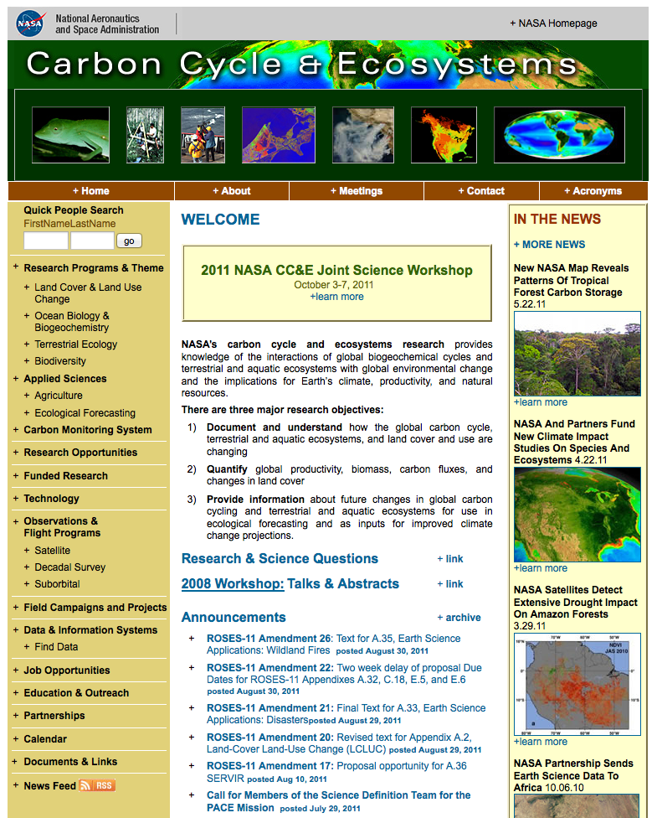
cce.nasa.gov
New
Updated regularly
http://cce.nasa.gov
Notes:
NEW
-- Quick People Search – Results include contact information and Activities they are associated with (research projects, meetings attended, committees, etc.)
-- Carbon Monitoring System – Summary page links to the new carbon.nasa.gov Web site (Slide 2)
-- Funded Research – Projects updated as of July 2011; NEW Search projects by PI or Free Text or both (Slide 3)
UPDATED REGULARLY
-- Research Opportunities (NASA)
-- Job Opportunities
-- Calendar of Meetings (CC&E related NASA and others) & Meetings section with only NASA meetings
-- News Feed (Sends out updated info if you subscribe)
-- Announcements
-- In the News – PAO stories

Slide 28
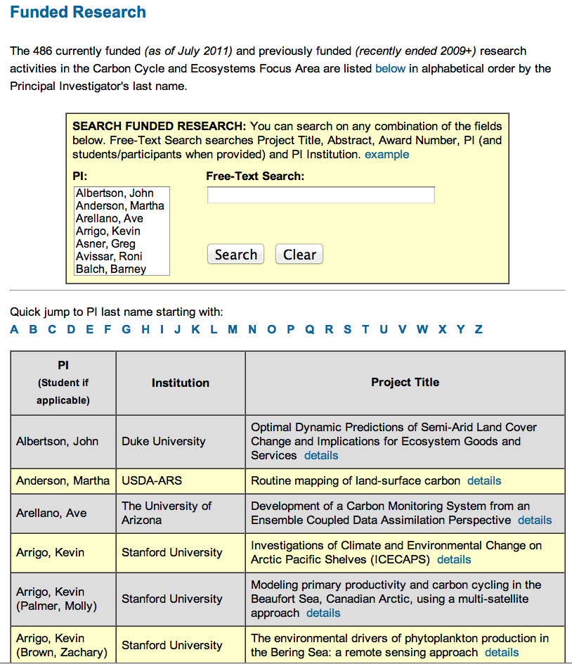
cce.nasa.gov
New Search Feature & Results
Notes:
Use to find collaborators and what research they are doing
New Search Feature
--Search by PI to list associated projects
--Search by Free-Text
Resulting Projects Details
-- Project Title
-- PI
-- Student name if applicable
-- Start Year
-- Duration
-- Abstract from NSPIRES
-- JSW Poster abstract and poster file if uploaded to Web site (Includes separate 2010 TE meeting)

Slide 29
Opportunities and Challenges Ahead

Slide 30
Opportunities
There is a compelling call out for problem-oriented global change research with strong elements of both social and natural sciences (can our colleagues here working on applied science questions and in the LCLUC program help help us to respond?).
Creating and optimizing synergies across Earth science missions, field programs, data collections, basic and applied research.
Defining the next generation of field campaigns and/or focused, integrative studies within the Focus Area.

Slide 31
Major Issues
Securing the long-term time series observations of land cover, vegetation properties, ocean color/biological/biogeochemical properties, and fire. NPP, JPSS, and LDCM are the path forward for most of these. We carry a major worry about ocean color, with concerns about VIIRS, PACE not due to launch before 2019, and complexities of international data exchanges.
Filling the gap in our carbon observation strategy caused by the cancellation of the DESDynI lidar.
Flying HyspIRI (an imaging spectrometer and a thermal infrared sensor) sometime in the foreseeable future.
Bringing the research and applied sciences communities closer together; also natural and social scientists in key topic areas
Providing appropriate and useful documentation of errors and uncertainties associated with our data, data products, analyses, and model results.

Slide 32
Major Program Management Challenges
Timely obligation and costing of funded projects (we have been losing funds due to “excessive” uncosted carryover every year!) [Definition: Costing is what happens when an institution receiving NASA funding reports back to NASA through official financial channels that that it has spent funds awarded. If you have not spent or reported back some of your year’s allocation, that amount will be considered “uncosted.”]
Reporting our accomplishments both within and outside the agency. We need help!
  Copies of publications, ideally with an accompanying ppt slide(s) and narrative explaining the result(s) and their scientific and societal significance would be most helpful [at time of publication, or, if newsworthy, at time of acceptance for publication]
  Growing pressure to compile lists of publications?
Data stewardship, in all of its forms, has presented us with many challenges (archiving research data and data products; creating custom products for priority end uses; selecting new products to produce; ATBD reviews, and, especially, setting priorities)

Slide 33
Major Program Management Challenges
Transition from products to operational applications in Applied Sciences program elements (e.g., partnering, tracking progress)
Nurturing , promoting and maintaining a healthy, constructive, and cooperative discourse within the CC&E community so as to foster interdisciplinary collaboration and ensure our scientific results are properly understood and receive appropriate recognition.
Your Program Managers’s time: bureaucratic overhead has gone up; demands to support the mission planning for future satellites has greatly increased; needs for interagency and international coordination have never been greater; and science program management workload remains pretty much the same . . .

Slide 34
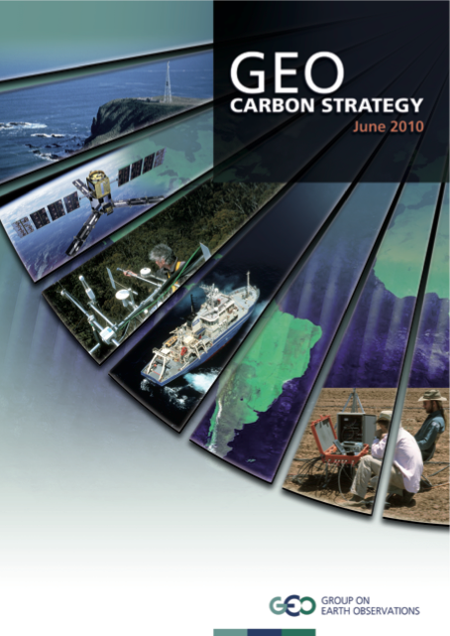
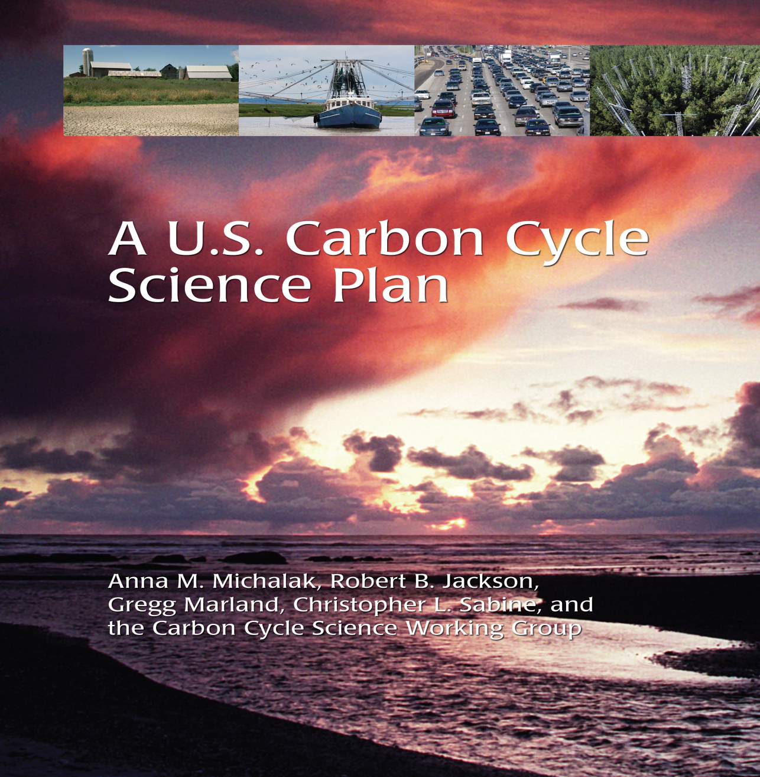
Science Priorities for the Future
  There are excellent, up-to-date plans available for carbon cycle research. Defining NASA’s role is our main challenge.
Coming soon!

Slide 35
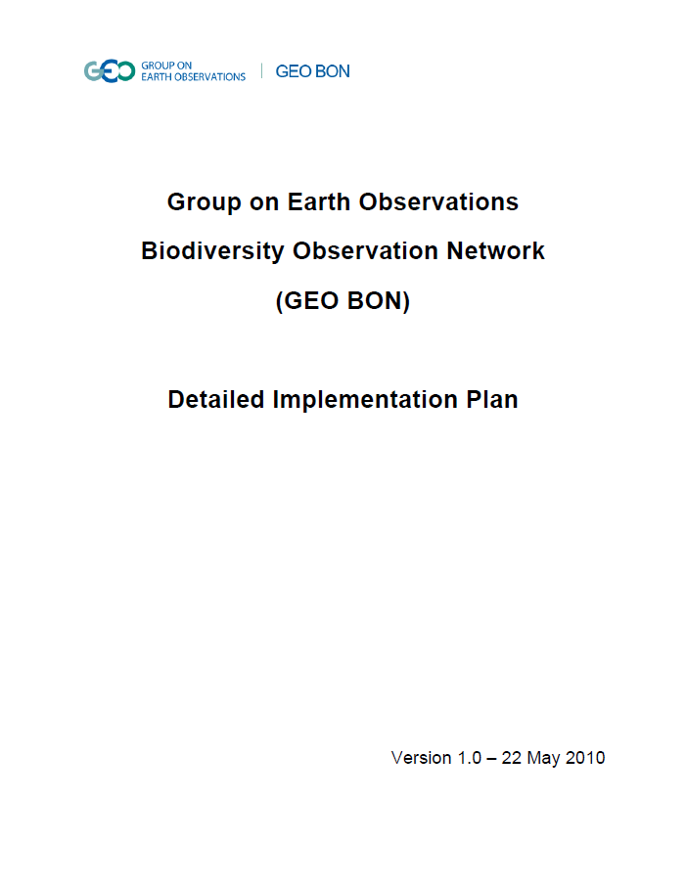
Science Priorities for the Future
Biodiversity research can be guided in part by the GEO BON report.
U.S, Ocean Policy Committees will have nine Strategic Action Plans coming out in early 2012.
We lack such comprehensive plans for the rest of ecosystems and land cover science would benefit from some advance planning in this area . . .

Slide 36
Science Priorities for the Future
Advancing our models; many needs, several perspectives on what NASA should address (data set needs, model interoperability and integration, improve existing models, develop a new community model . . .)
Integrating applications users and their needs into mission development processes
Integration of in situ data on organisms with satellite imagery – a better framework is needed to tackle the ongoing issue of working across spatial scales; identifying the best methods to study organisms and small-scale ecological processes using remotely sensed data
Conducting more integrative, cross-disciplinary research, focusing on major societal problems (e.g., land-ocean-atmosphere; carbon, water, people)

Slide 37
NASA Solicitations Anticipated in the Upcoming Year
Research Opportunities in Space and Earth Science:
Land Cover and Land Use Change
Ocean Biology & Biogeochemistry
Terrestrial Ecology
Carbon Monitoring System
Dimensions of Biodiversity (joint with NSF)
HyspIRI Airborne Science
Remote Sensing of Water Quality (joint between NASA Terrestrial Hydrology and Ocean Biology and Biogeochemistry Programs)
Airborne Instrument Technology Transition (AITT) Program
Opportunity for US PIs on non-U.S. satellite science teams
Opportunity for work in support of the National Climate Assessment (NCA)
“E.2” for workshops, meetings, etc .
Fellowships (NESSF) & NIP, as usual
→ TE in 2011 and likely OBB in 2012 offer opportunities to for remote sensing research on the 2010 Gulf of Mexico oil spill.

Slide 38
About this Workshop

Slide 39
2011 Carbon Cycle and Ecosystems Focus Area Joint Science Workshop
Workshop Objectives:
To share scientific research results and foster interdisciplinary interactions within the Carbon Cycle & Ecosystems (CC&E) Focus Area
To serve as the next regular science team meeting for each of these programs: Biodiversity and Ecological Forecasting, Land Cover and Land Use Change, Ocean Biology and Biogeochemistry, and Terrestrial Ecology
Desired Outcomes:
Days 1-3: New ideas and collaborations; an informal assessment of NASA program accomplishments and progress toward goals; perhaps some suggestions on how to improve program content and management; a refreshed community (i.e., we want you to have fun!)
Day 4: For some, additional sharing of scientific results; for others, receive program updates and participate in problem solving; make recommendations for program activities and new directions (i.e., we are hoping you can help us address some problems, react to new ideas, and/or set new priorities)

Slide 40
2011 Carbon Cycle and Ecosystems Focus Area Joint Science Workshop: Format
Plenary Sessions Organized around Themes:
  Coupled Processes at Land-Atmosphere-Ocean Interfaces
  Global Change Impact & Vulnerability
  Science in Support of Decision Making
Plenary Sessions Include
  Invited Synthesis Talks
  Invited Data Talks
  Speed Talks about Posters
  Panel Discussions
Poster Sessions (this is where all the primary research will be reported!)
Bonus Events (National Climate Assessment Listening Session, Invited Keynote Talk)
Wrap-Up Panel to Summarize Main Messages from Workshop
Generous breaks and lunch periods to allow for community interactions
No Break-out Discussions
NEW

Slide 41
2011 Carbon Cycle and Ecosystems Focus Area Joint Science Workshop
Discipline Science Team Meetings All On Thursday, except for Biodiversity and Ecological Forecasting, which starts at 2:00 pm Wednesday afternoon and runs through Thursday.
Other Attractions Open to the Community:
Carbon Monitoring System Community Forum - Wednesday afternoon, 2:00 – 6:30 pm
Overview and Q&A on the Coastal Ecosystem Dynamics component of the Geostationary Coastal Air Pollution Events (GEO-CAPE) Mission
- Tuesday, 12:40 - 2:00 pm
Terrestrial Carbon Flux Upscaling Synthesis Effort – Tuesday, 7:00 - 9:00 pm
PolInSAR Methods for Ecosystem Science - Friday, 8:30 am - 12:00 pm

Slide 42
2011 CC&E Focus Area Joint Science Workshop Steering Committee
Paula Bontempi / Carlos Del Castillo, NASA HQ
Jim Collatz, NASA GSFC
Brad Doorn, NASA HQ
Carla Evans, NASA GSFC / Sigma Space
Gary Geller . JPL
Peter Griffith, NASA GSFC / Sigma Space
Garik Gutman, NASA HQ
George Hurtt, University of Maryland
Chris Justice, University of Maryland
Allison Leidner, NASA HQ (AAAS Fellow)
Jeff Masek, NASA GSFC
Volker Radeloff, University of Wisconsin-Madison
Woody Turner, NASA HQ
Maria Tzortziou, NASA GSFC / University of Maryland
Diane Wickland, NASA HQ
Thank you!

Slide 43
Thank you!

