Slide 1
Inherently Obvious Progress (IOP): New Ocean Data Products for Carbon Cycle Research
James Acker
NASA Goddard Earth Sciences Data and Information Services Center/Wyle IS LLC

Slide 2
1978-1986: Coastal Zone Color Scanner
“Proof –of-concept” provided pigment concentrations, ocean patterns of
biological activity, initial views of large-scale processes like El Niño; discontinuous observational coverage
1996-2010: Sea-viewing Wide Field-of-view Sensor, SeaWiFS
[with help from the Ocean Color and Temperature Scanner (OCTS)]
Global estimation of chlorophyll a concentration, full-time global scanner, complete observation of La Niña and El Niño impact; decreased accuracy in productive coastal waters
1999-present: Moderate Resolution Imaging Spectroradiometer (MODIS) and Medium Resolution Imaging Spectrometer (MERIS)
Higher spatial resolution data globally, new data products allowing better discrimination of chromophoric components, more bands, innovative algorithms; potential for better quantification of ocean carbon cycle

Slide 3
The current focus of much ocean color research is on the
development of semi-analytic algorithms, in contrast to
empirical algorithms.
These algorithms provide data that is more diagnostic of the
relative contributions of the chromophoric components that
contribute to the total ocean color signal.
So, in contrast to phytoplankton chlorophyll concentrations,
the total signal can be deconvoluted into contributing
elements using inherent optical properties (IOPs):
Absorption by dissolved and detrital material (a_{dg})
Absorption by phytoplankton chlorophyll (a_{ph})
Backscattering by suspended matter (b_{bp})

Slide 4
New standard data products from NASA
Algorithm development has resulted in several new standard
data products from NASA, in addition to chlorophyll
These products are:
Particulate Organic Carbon (POC)
Particulate Inorganic Carbon (PIC) – aka CaCO₃
Photosynthetically Available Radiation (PAR)*
Normalized fluorescence line height (NFLH)
Colored Dissolved Organic Matter (CDOM) Index
* employed in primary production calculations

Slide 5
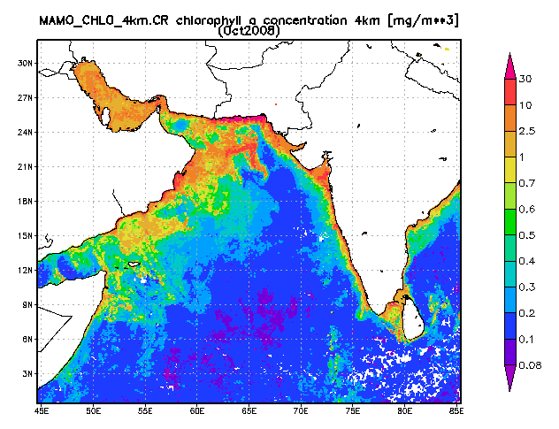
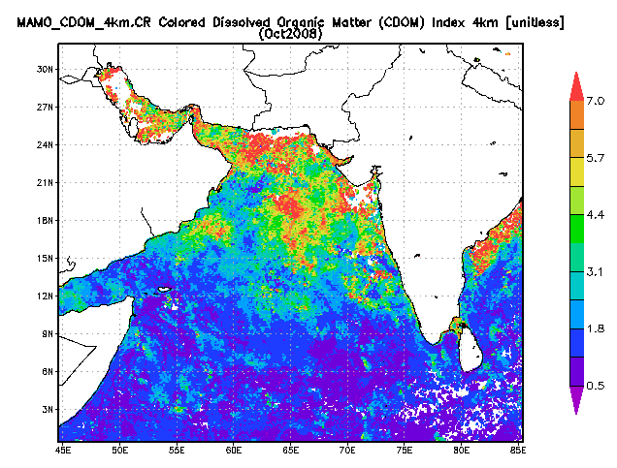
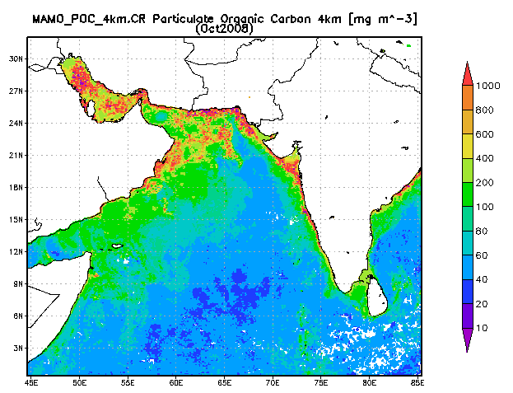
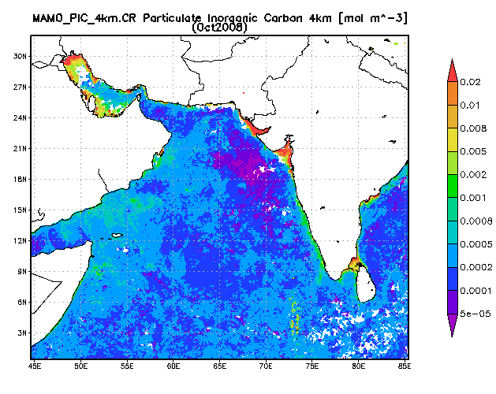
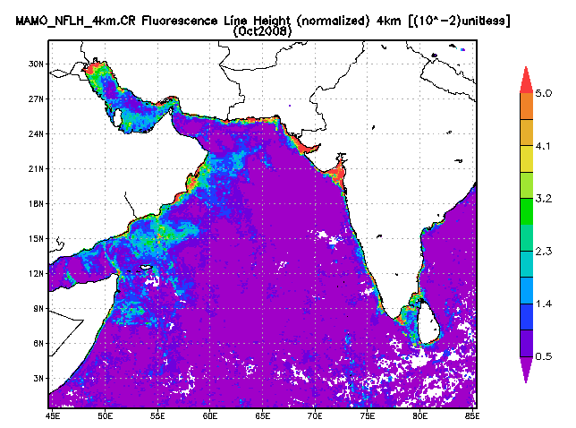
These products provide multi-faceted views of ocean processes. The example shown is the Arabian Sea in October 2008, near the end of the summer monsoon season.
CDOM Index
POC
PIC
NFLH
Created with the NASA
Giovanni system

Slide 6
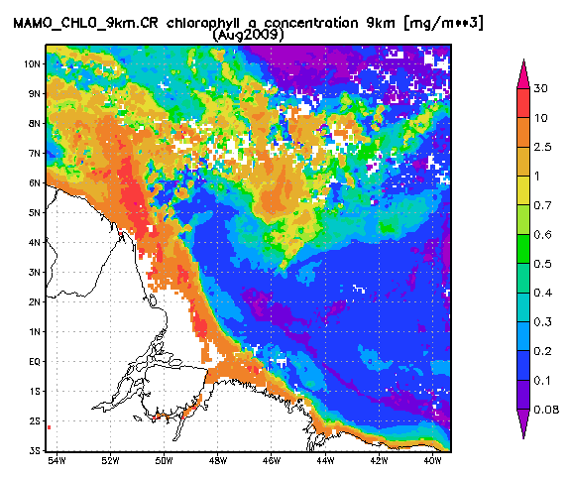
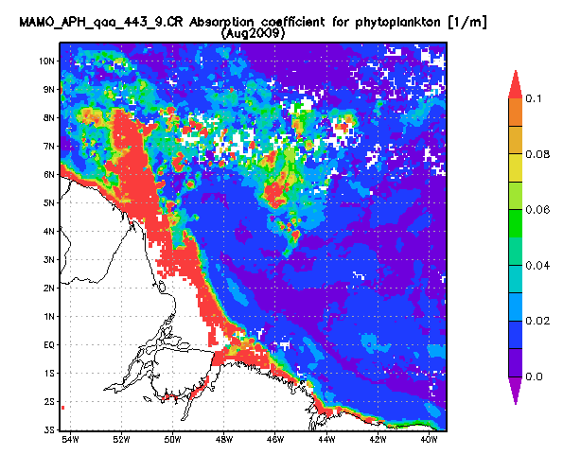
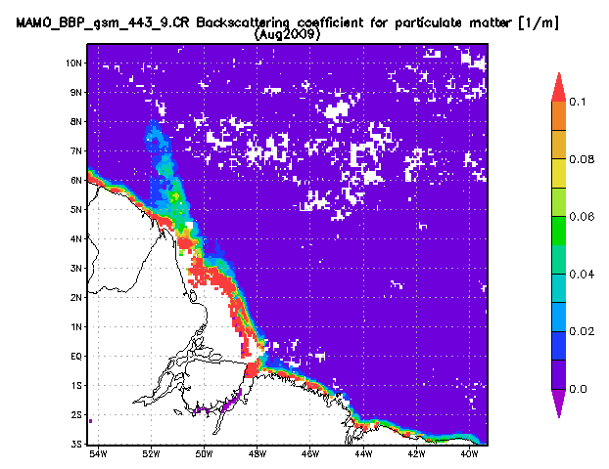
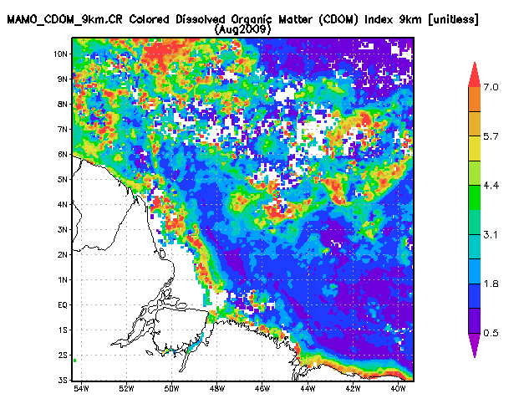
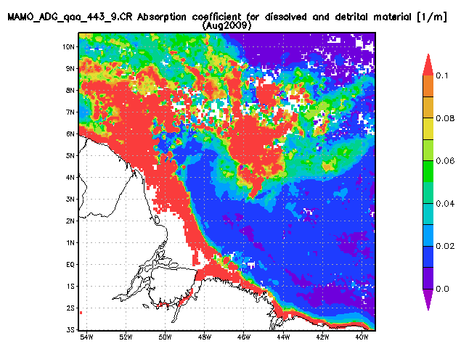
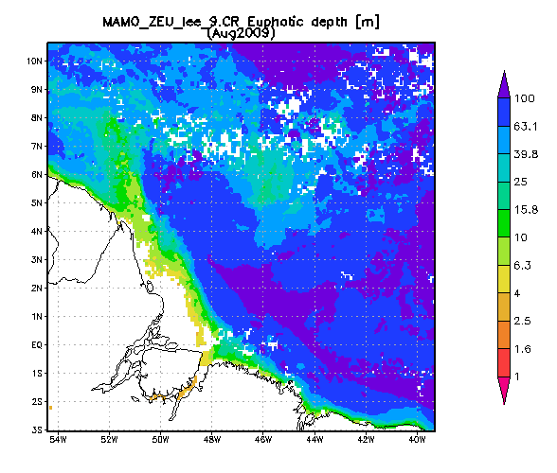
The IOP-based products, absorption and backscattering
coefficients, provide additional insight into the
constituents of color, particularly in the coastal zone.
a_{ph}
b_{bp}
CDOM
Index
a_{dg}
Euphotic
depth
Created with the NASA
Giovanni system

Slide 7
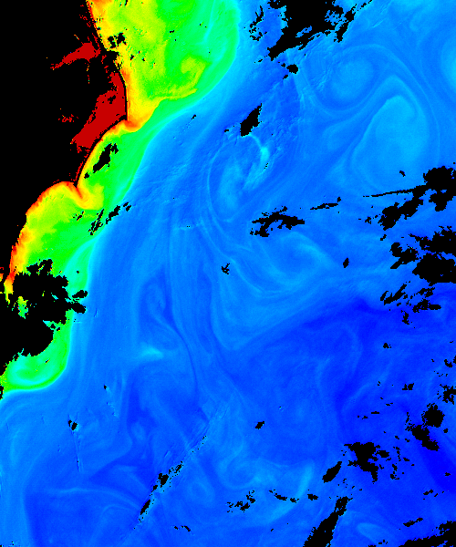
Current fields of fruitful research
Global dissolved organic matter budgets
Refinement of particulate inorganic carbon estimates
Advanced algorithms for chlorophyll utilizing fluorescence
line height
Detection of phytoplankton functional groups
Better estimates in oligotrophic (low concentration) waters
(subject of Chuanmin Hu’s presentation Thursday)
Ultimately trying to achieve better estimates of global net primary productivity

Slide 8
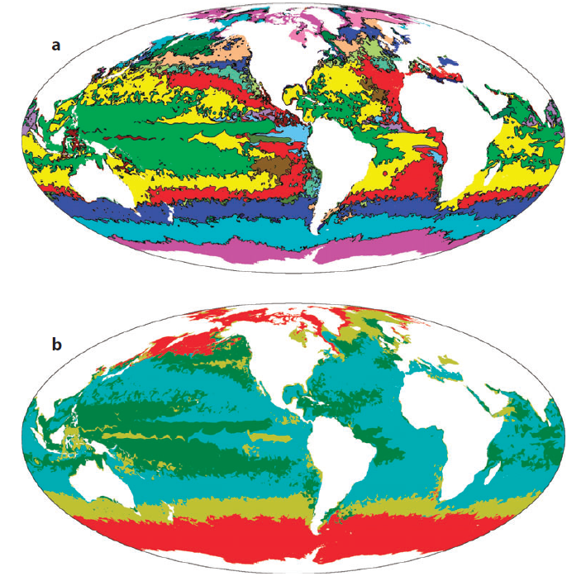
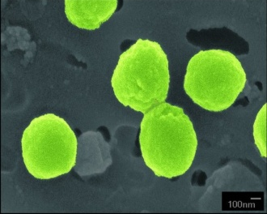
Biogeographical provinces
defined by dominant species
Species diversity in the global ocean
complicates NPP estimation;
Species dominance will shift with
climate change and general warming
of ocean waters
Diatoms (red )
Large phytoplankton (yellow)
Small phytoplankton (blue)
~ Prochlorococcus ( green)
Modeling Diverse Communities of Marine Microbes
Michael J. Follows and Stephanie Dutkiewicz
Annual Reviews in Marine Science 3, 427-451.

Slide 9
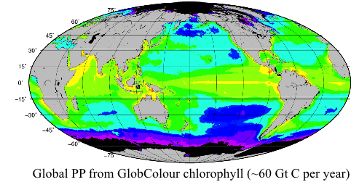
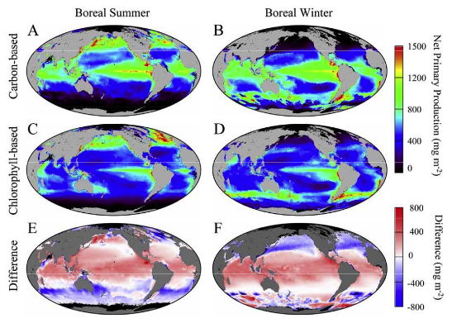
Net Primary Production
Several models exist
Chl-based mostly (+ SST, PAR)
Carbon-based estimates are recent
Not fully reconciled
Figures courtesy of
Stephane Maritorena
Notes:
PP model with different phytoplankton size classes

Slide 10
Five great questions still to be answered (definitively):
Can we continue to improve estimates of the pools of carbon in the oceans – living phytoplankton, POC, PIC, dissolved organic carbon – with current remote sensing capabilities? How much better are estimates based on new products, such as a_{ph}?
How much better can ocean primary productivity estimates be made utilizing “physiological” data, such as NFLH? Does this enable better quantification of iron stress in low-Fe waters?
How much will coastal zone primary productivity estimates change with improved chlorophyll algorithms?
Will ocean primary productivity ultimately increase or decrease with increasing surface temperatures associated with climate change? How will altered species composition and distribution affect this?
Beyond ocean color radiometry, what other kinds of data – both in situ and remotely-sensed – are most vital to aid quantification of the ocean carbon cycle?

Slide 11
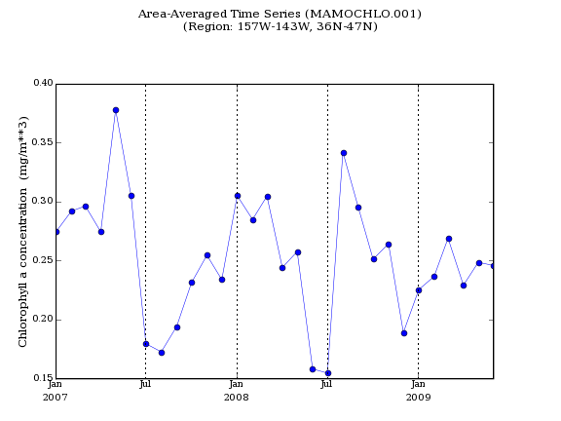
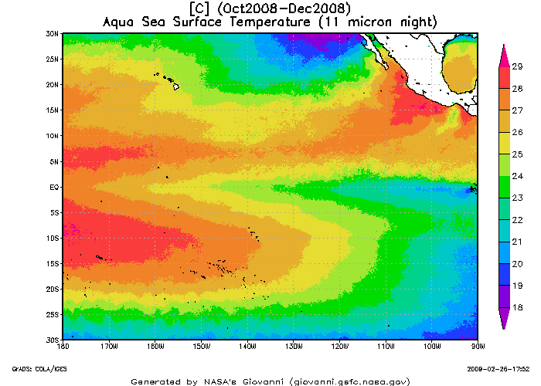
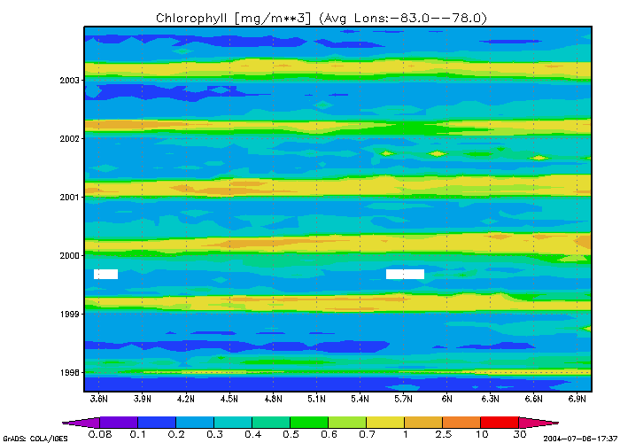
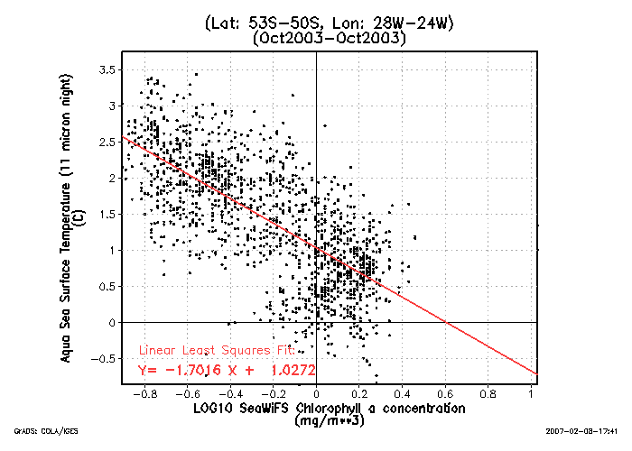
Improving data product ease-of-use:
NASA OBPG and Water Quality for Coastal
and Inland Waters data products available in Giovanni
Bio-optical profiling buoy (NOPP) users will be able to access data for any profile location
Giovanni has been used for many ocean ecosystem
studies to provide oceanographic context!

