Slide 1
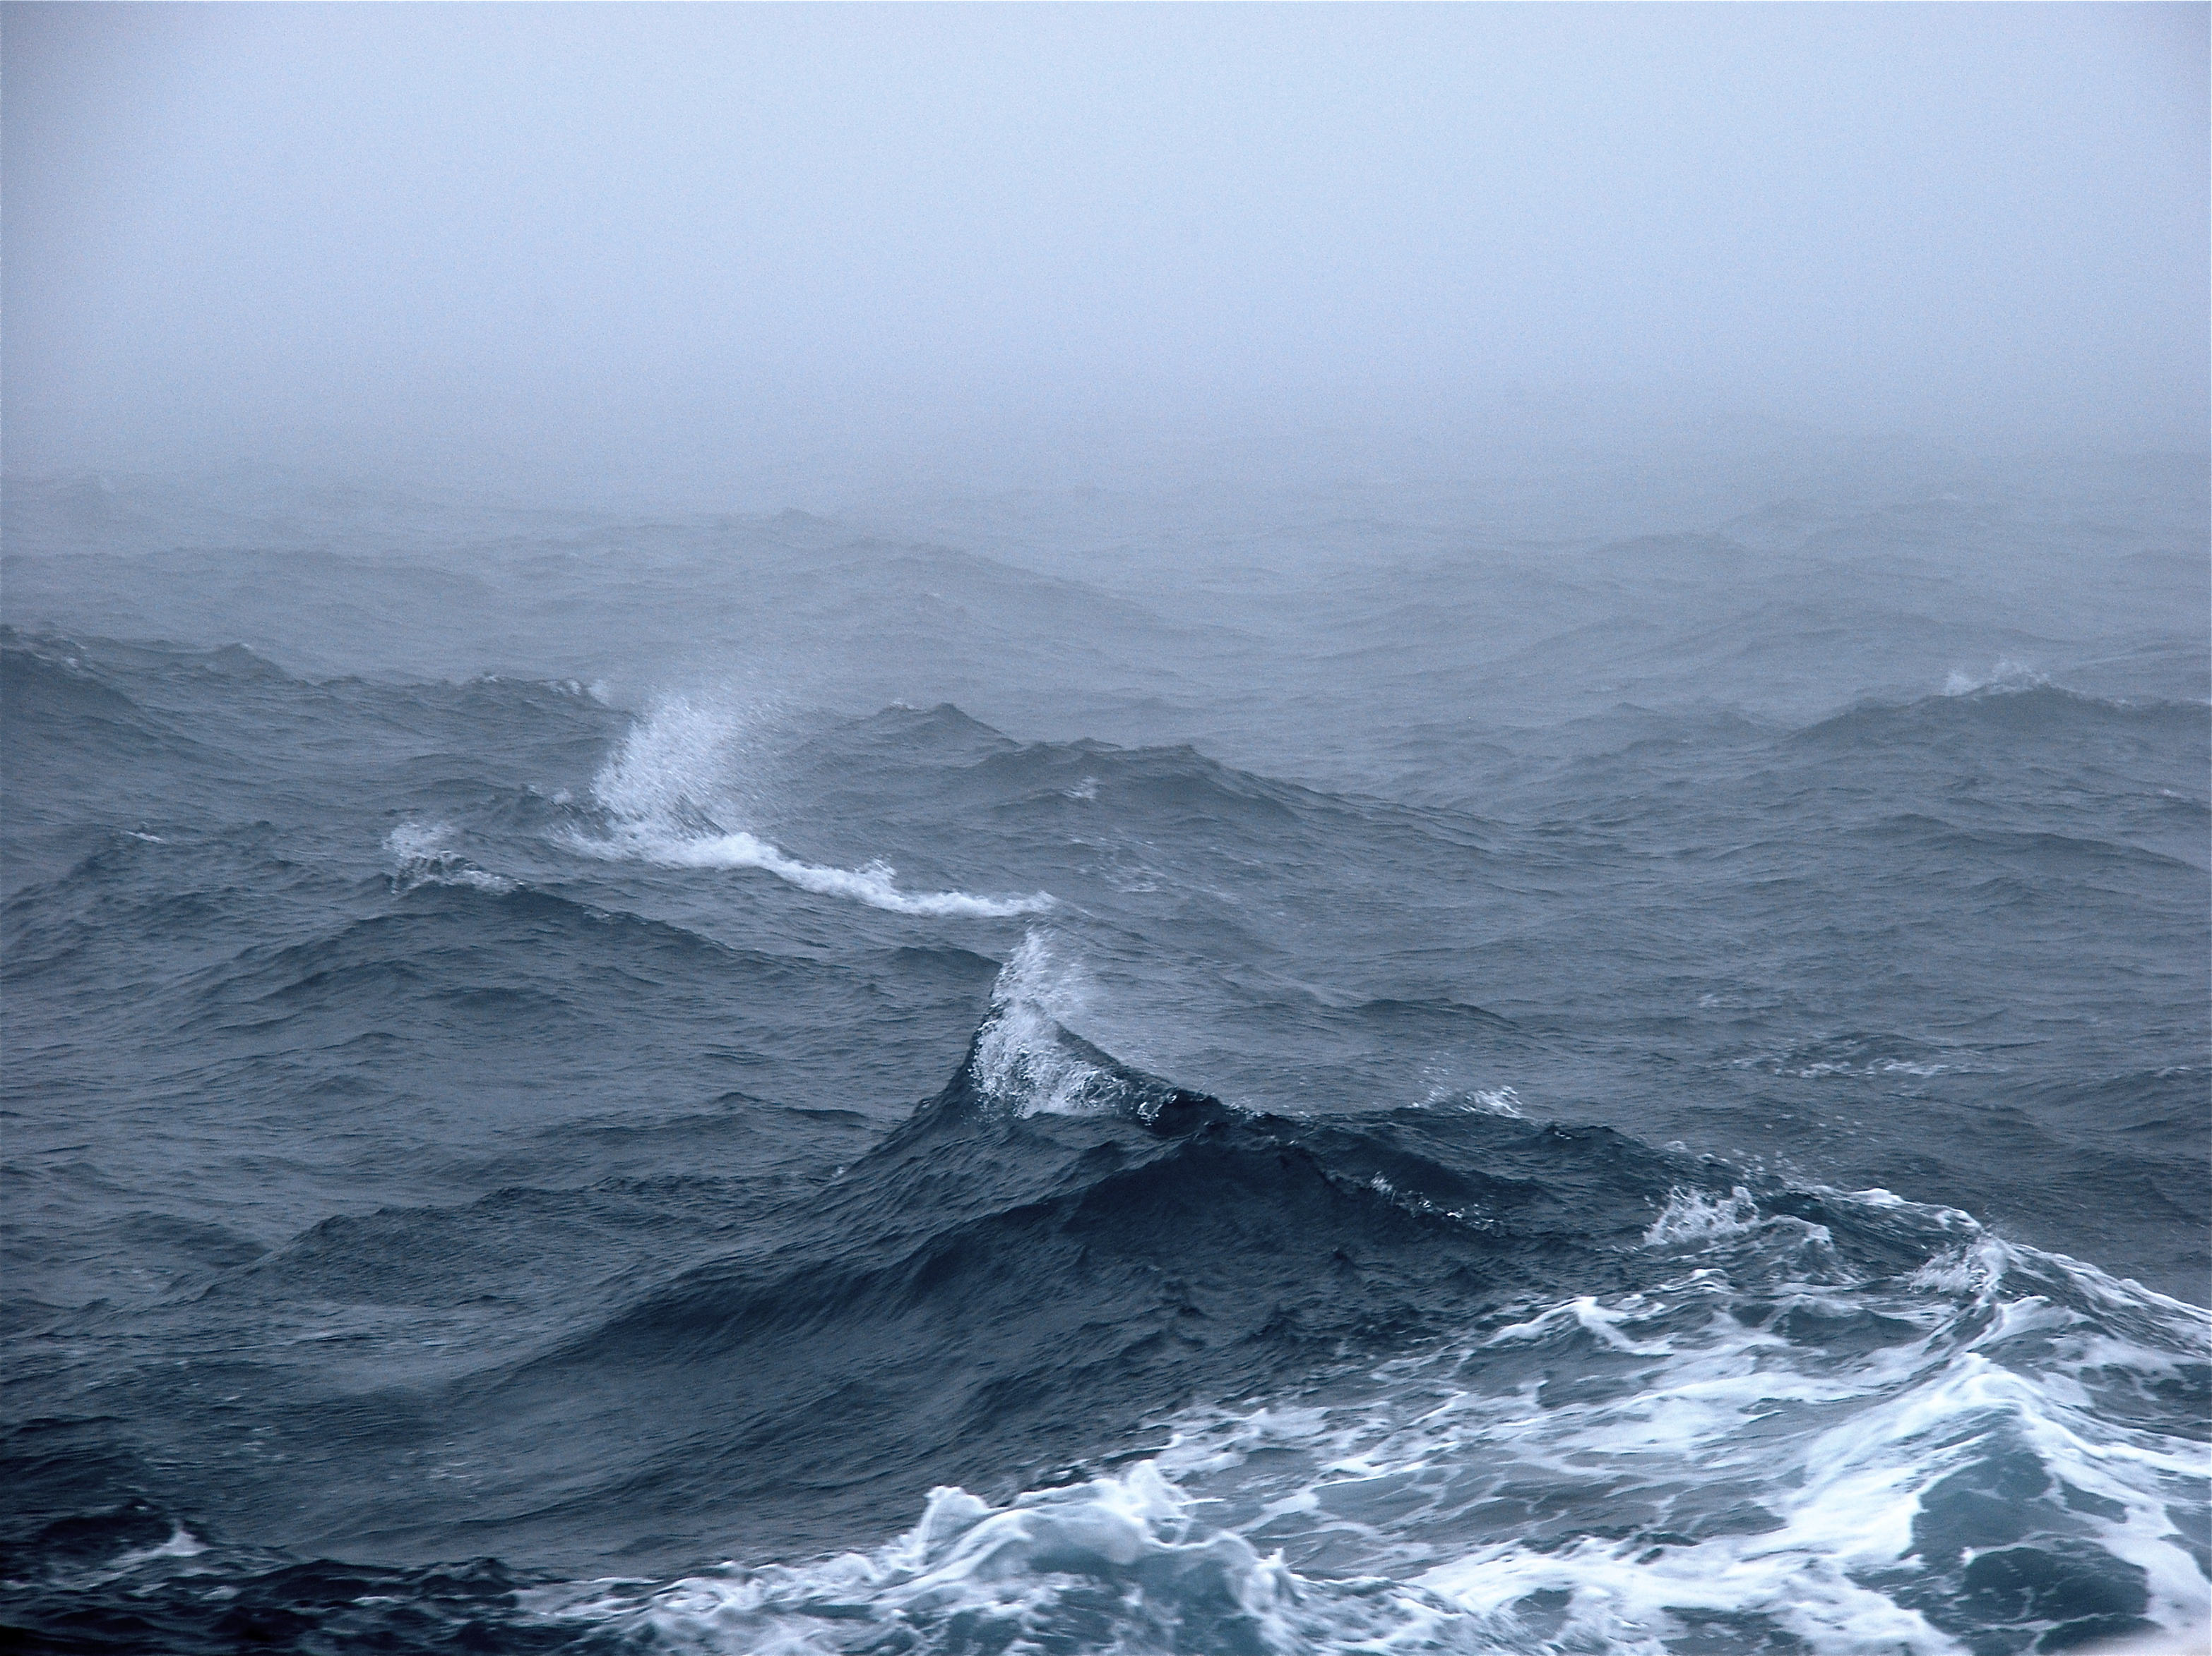




Southern Ocean
Gas Exchange Experiment
Carlos E. Del Castillo
The Johns Hopkins University
Applied Physics Laboratory

Slide 2
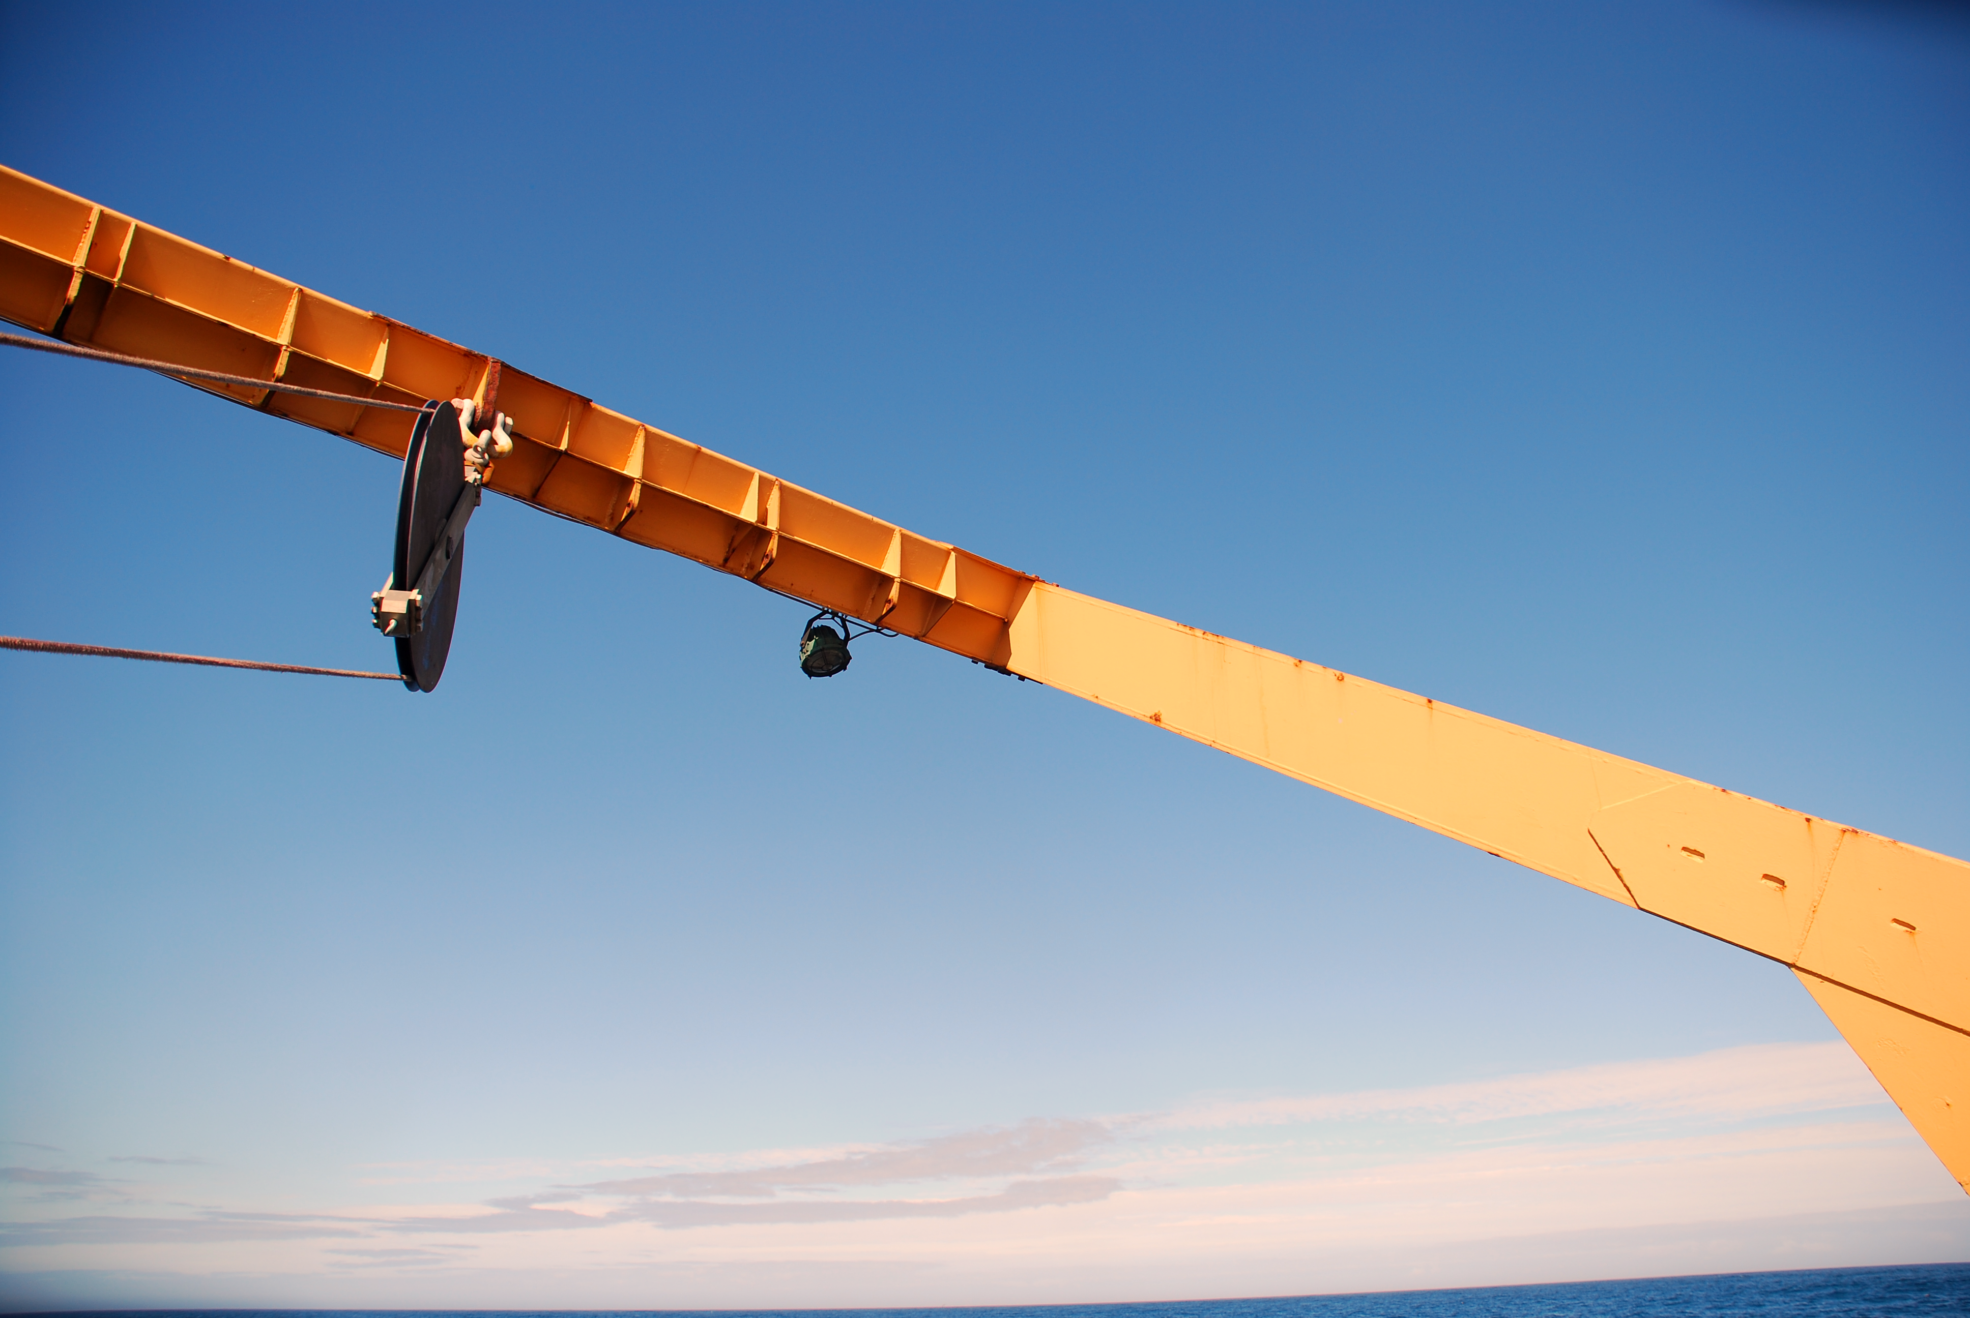
Re
Outline
Research Questions
Funded Projects
Why this region?
Cruise Track
Activities
Research Results
Conclusions

Slide 3

SO GasEx Research Questions
What are the gas transfer velocities at high winds?
What is the effect of fetch on the gas transfer?
How do other non-direct wind effects influence gas transfer?
How do changing pCO₂ and DMS levels affect the air-sea CO₂ and DMS flux, respectively in the same locale?
Are there better predictors of gas exchange in the SO than wind?
What is the near surface horizontal and vertical variability in turbulence, pCO₂, and other relevant biochemical and physical parameters?
How do biological processes influence pCO2 and gas exchange?
Do the different disparate estimates of fluxes agree, and if not why?
With the results from Southern Ocean GasEx, can we reconcile the current discrepancy between model based CO2 flux estimates and observation based estimates?

Slide 4



Funded Projects
Gas Exchange
Quantifying air-sea gas exchange at high wind speeds using a dual gas tracer (³He/SF6) technique during the Southern Ocean Gas Exchange Experiment, (David Ho)
Southern Ocean air-sea carbon dioxide exchange, (Wade McGillis)
Measurement and parameterization of air-sea DMS transfer over the Southern Ocean in GasEx-III, (Barry Huebert)
Measurement and parameterization of air-sea gas transfer over the Southern Ocean in GasEx-III, (Chris Fairall)
Quantifying the surface physical controls on CO2 transfer during the Southern Ocean Gas Exchange Experiment, (Will Drennan)
Gas tracers of productivity and bubble-mediated gas exchange during the SO GasEx Experiment (Roberta Hamme)
Biogeochemistry
CO2 and hydrographic measurements during the GasEx-III Experiment, (Dick Feely)
Closing the mixed layer carbon budget during Southern Ocean GasEx, (Burke Hales)
Autonomous multi-parameter measurements from a drifting buoy during the SO GasEx Experiment, (Chris Sabine)
Measurement of seawater DMS during SO GasEx (Steve Archer)
Measurement of nutrients during the Southern Ocean Gas Exchange Experiment (GasEx III), (Jia-Zhong Zhang)
On the distribution of colored dissolved organic matter in the Southern Ocean and the potential for photoproduction of CO2 and CO, (Carlos del Castillo)
Remote Sensing
Phytoplankton absorption and carbon dioxide drawdown in the Southern Ocean: A consortium of observations, (John Marra)
Optical properties in the Southern Ocean: In situ and satellite observations in support of Southern Ocean Carbon Program, (ZhongPing Lee)
Optical properties in the Southern Ocean: In situ measurements of phytoplankton absorption using the pFPT-TR instrument in support of the Southern Ocean Carbon Program, (Bruce Hargreaves)
Differentiating sources of backscattering in the Southern Ocean: Calcite, bubbles, and other optical constituents, (Heidi Dierssen)

Slide 5
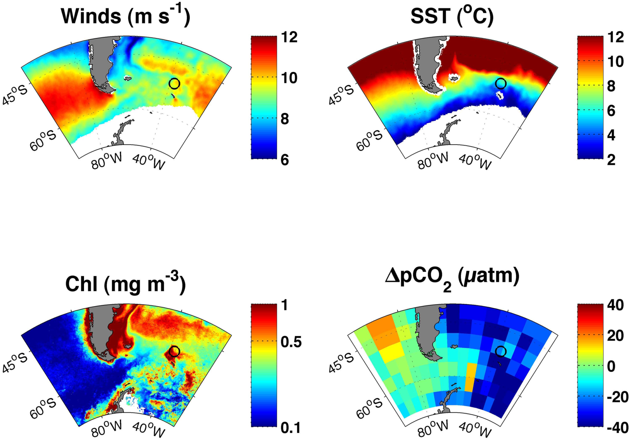
SO GasEx Study Site
The study location should capture the germane aspects of the Southern Ocean forcing and biogeochemistry while providing a suitable environment to perform the study.
The South Atlantic sector of Southern Ocean was chosen based on the following criteria:
Delta pCO₂ of at least 40 µatm to ensure a large enough signal to noise for direct eddy-covariance measurements of CO₂.
Relatively stable water mass (i.e., relatively weak currents and low mesoscale eddy variability) to allow ³He/SF₆ patch to be followed for up to 25 days.
Mixing layer depth less than 50 to 70 m.
High wind speeds, long fetch and large waves.
Proximity to Punta Arenas and Montevideo to minimize transit time.
From Ho et al, 2011 JGR

Slide 6
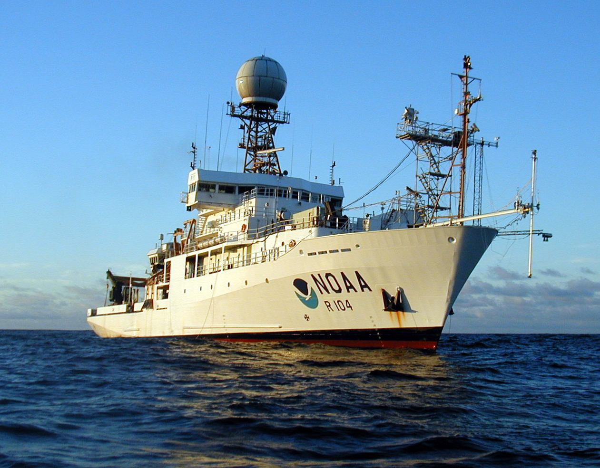
NOAA SHIP RONALD H BROWN
Atlantic sector of Southern Ocean
Austral Fall (February 28 to April 9, 2008)
31 Scientist

Slide 7
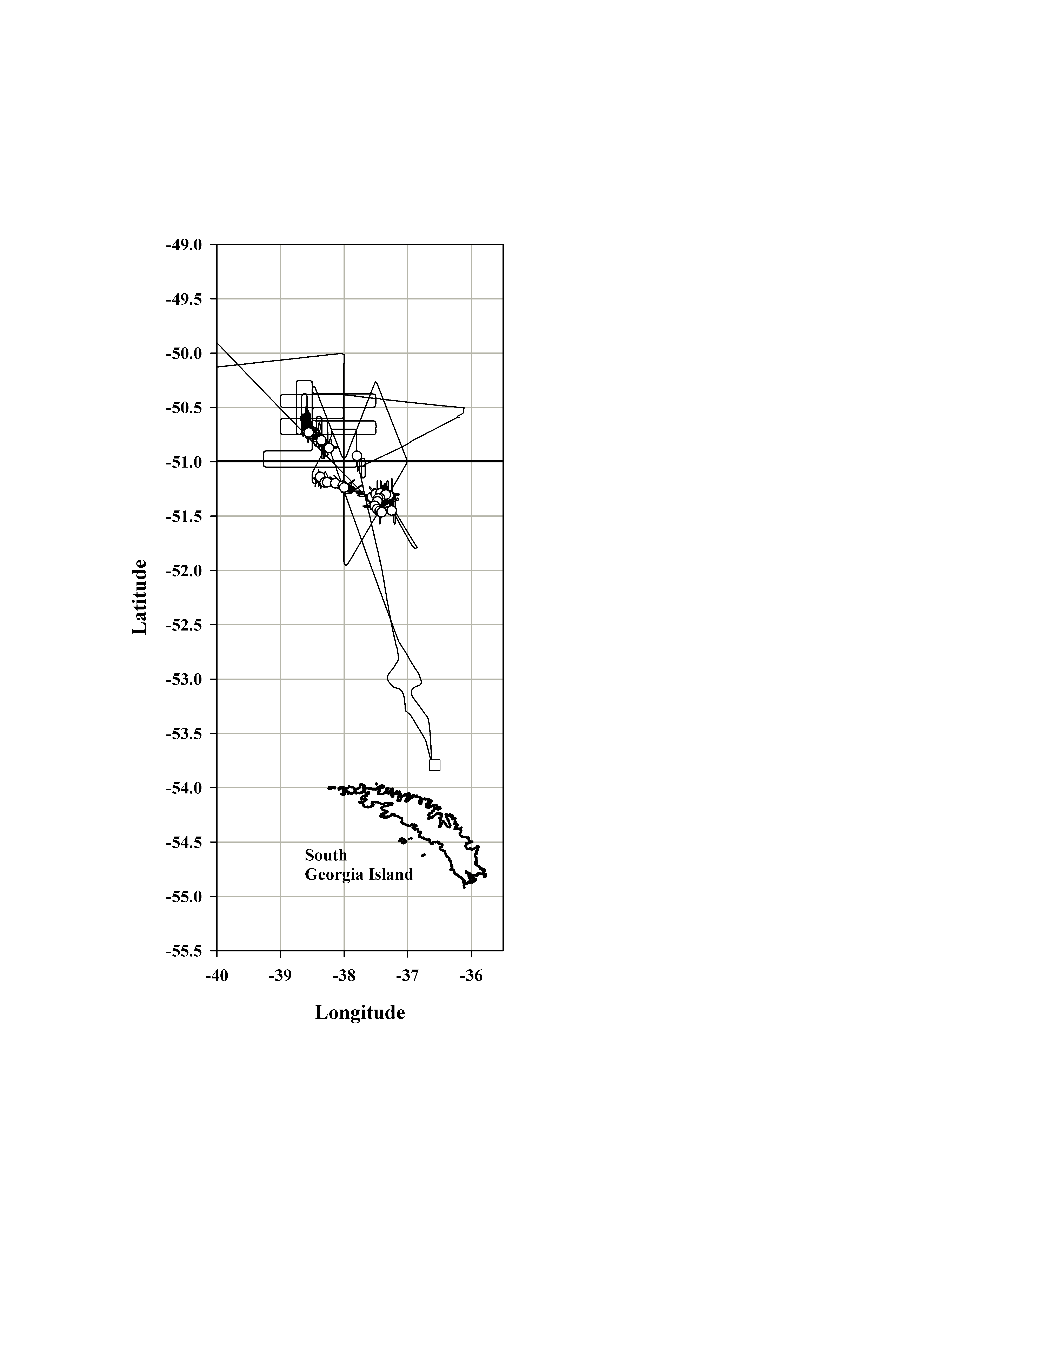
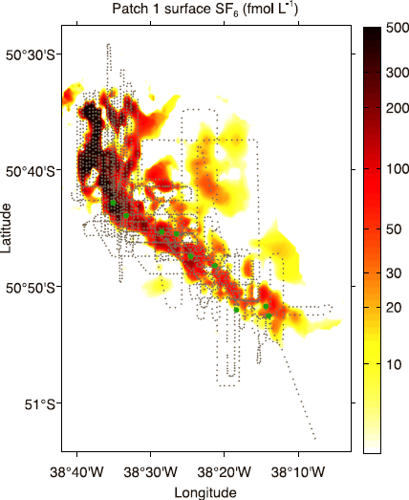
Cruise Track
Two injections of ³He-SF₆ dual tracers first on March 8, 2008 and studied for 6 days. Second on March 8, 2008 studied for 15 days
From Ho et al, 2011 JGR

Slide 8
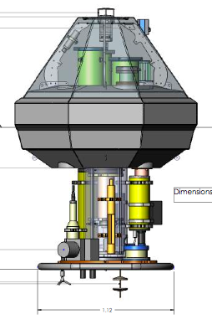
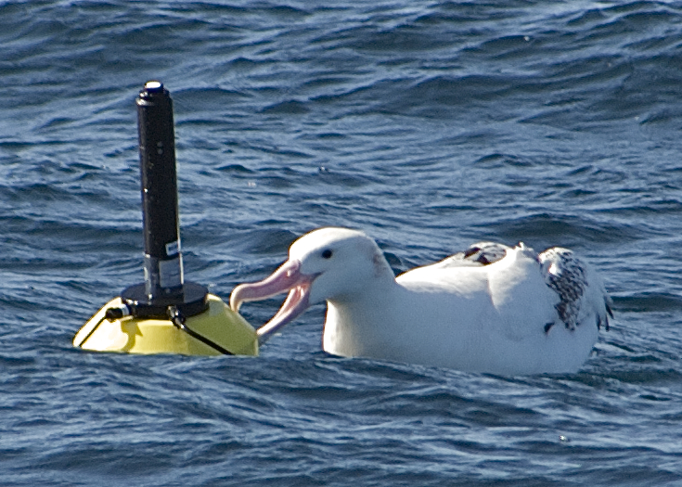
Activities
Underway surveys
XBT, pCO₂, ADCP, F_{chl}, T, Sal(PSS78), SeaSoar (CTD, O₂, pCO₂), a_{g}(λ), labile calcite, O₂/Ar, ³He/SF₆, wind, air temperature, and humidity, high definition cameras, 2D wave radar, PAR, I₀(λ), aerosols etc….
Drifters
MAPCO₂ and ASIS buoys
CTD stations
salinity, O₂, Ar, TSM, CDOM, DOC, Chl, DIC, NUTS
Optical casts (WetLabs MASCOT, optical buoy,
above water radiometry
Experiments
PP incubations
Graber et al., 1999
R.L. Miller, 2008

Slide 9
Results from manuscripts submitted to the JGR Special Session
Published
In Press
The contribution of coccolithophores to the optical and inorganic
carbon budgets during the Southern Ocean Gas Exchange
Experiment: New evidence in support of the “Great Calcite Belt”
hypothesis
W. M. Balch, D. T. Drapeau, B. C. Bowler, E. Lyczskowski, E. S. Booth, and D. Alley
Direct Covariance Measurement of CO2 Gas Transfer Velocity during the2008 Southern Ocean Gas Exchange Experiment: Wind Speed Dependency
J. B. Edson1, C. W. Fairall, L. Bariteau, C. J. Zappa, A. Cifuentes-Lorenzen1, W. R.
McGillis, S. Pezoa, J. E. Hare and D. Helmig
Implementation of the COARE flux algorithm with CO2, DMS, and O3
C.W. Fairall1, Mingxi Yang, Ludovic Bariteau, J.B. Edson, D. Helmig, W. McGillis, S.
Pezoa1, J.E. Hare, B. Huebert, and B. Blomquist
Horizontal and vertical distributions of colored dissolved organic
matter during the Southern Ocean Gas Exchange Experiment Carlos E. Del Castillo and Richard L. Miller
Southern Ocean Gas Exchange Experiment: Setting the Stage
David T. Ho1, Christopher L. Sabine, David Hebert, David S. Ullman, Rik Wanninkhof,
Roberta C. Hamme, Peter G. Strutton, Burke Hales, James B. Edson, Bruce R. Hargreaves
Upper ocean state estimation in the Southern Ocean Gas Exchange Experiment region using the four‐dimensional variationaltechnique
S. Dwivedi, T. W. N. Haine, and C. E. Del Castillo
Sea Surface pCO2 and O2 in the Southern OceanDuring the Austral Fall, 2008
T. S. Moore, et al.
Toward a universal relationship between wind speed and gas
exchange: Gas transfer velocities measured with 3He/SF6
during the Southern Ocean Gas Exchange Experiment
David T. Ho, Rik Wanninkhof, Peter Schlosser, David S. Ullman, David Hebert,
and Kevin F. Sullivan
In Review or in preparation (not exhaustive)
Dissolved O2/Ar and other methods reveal rapid changes in productivity during a Lagrangian experiment in the Southern Ocean
Roberta C. Hamme1, Nicolas Cassar, Veronica P. Lance, Robert D. Vaillancourt, Michael L. Bender, Peter G. Strutton, Tommy S. Moore, Michael D. DeGrandpre, Christopher L. Sabine, David T. Ho, and Bruce R. Hargreaves
An assessment of optical properties and primary production
derived from remote sensing in the Southern Ocean (SO GasEx)
Zhongping Lee, Veronica P. Lance, Shaoling Shang, Robert Vaillancourt,
Scott Freeman, Bertrand Lubac, Bruce R. Hargreaves, Carlos Del Castillo,
Richard Miller, Michael Twardowski, and Guomei Wei
Photoproduction of CO2 and CO in the Southern Ocean.
Del Castillo, C.E., R.L. Miller, W. Gregg, Dwivedi S., and T.W.N. Haine
Air‐sea exchange of dimethylsulfide in the Southern Ocean:
Measurements from SO GasEx compared to temperate
and tropical regions
M. Yang, B. W. Blomquist, C. W. Fairall, S. D. Archer, and B. J. Huebert
Biogeochemical Ocean Data Assimilation in the Southern OceanGas Exchange Experiment Region
S. Dwivedi, T. W. N. Haine and C. E. Del Castillo
SOGasEx Bubble Measurements
Heidi Dierssen, Michael Twardowski, Kate Randolph, Christopher Zappa, & Alejandro Cienfuentes

Slide 10
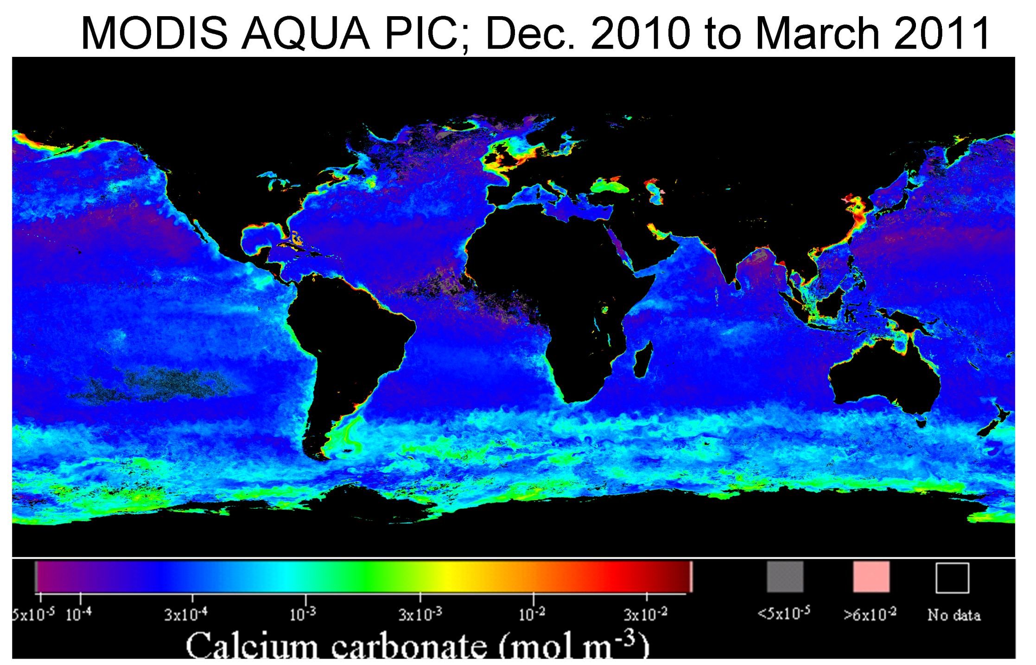
Southern Ocean Remote Sensing Imagery Typically Shows High Reflectance. This could be coccoliths of bubble injection
Balch et al. data support hypothesis that high reflectance feature observed during S.O. Gas-Ex is part of a much larger feature of elevated PIC observed annually for entire AQUA mission, “The Great Calcite Belt”. Additional cruises underway to test this hypothesis.
Balch, Bigelow Laboratory
Notes:
Study area for accompanying remote sensing PIC images shown with dashed line. Results from SO Gas Ex demonstrated using radiometry (above water radiance measurements), IOP measurements (acid-labile backscattering), microscopy (polarized light microscopy) and analytical PIC measurements (made using Inductively coupled plasma optical emission spectroscopy) that PIC indeed was present at elevated concentrations in the “Great Calcite Belt”.

Slide 11
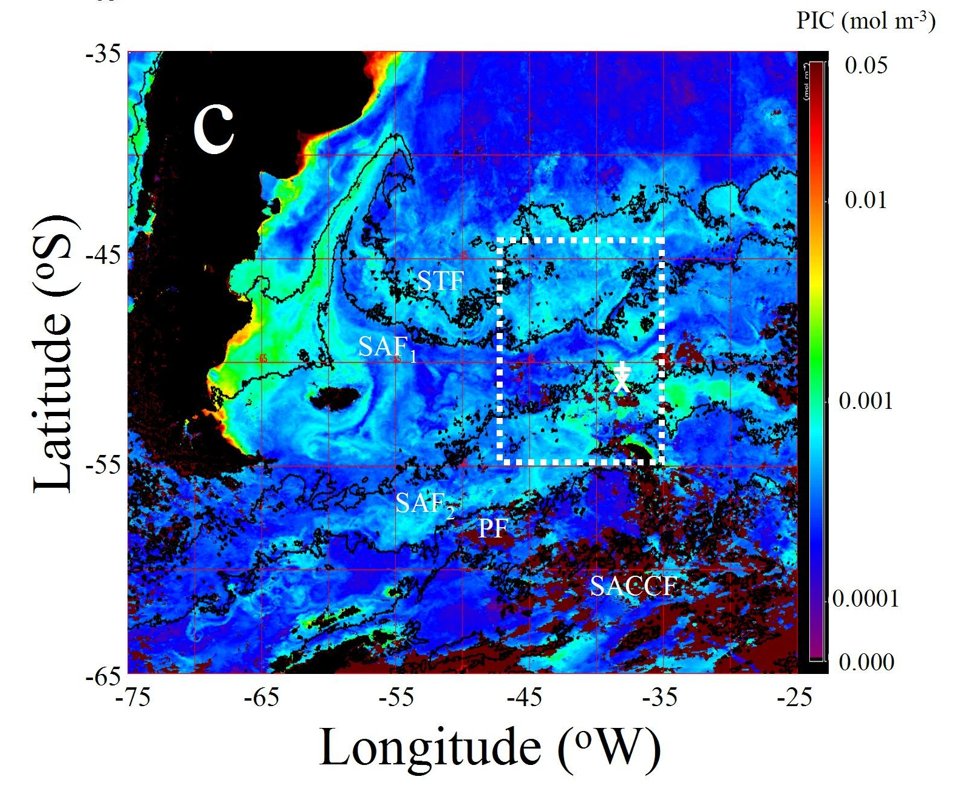
Patagonian shelf coccolithophore bloom
March 2008- MODIS Aqua monthly composite
Balch et al., 2011
Notes:
Figure shows the MODIS PIC product. Dashed line shows study region and locations of the two Gas-Ex sites within. Black lines show the positions of fronts based on MODIS SST images. Figure shows the position of the Sub tropical front (STF), and two sub-antarctic fronts (SAF1 and SAF2), polar front (PF) and the Southern part of the Antarctic Circumpolar Current Front (SACCF), as determined using MODIS thermal bands. S. Ocean Gas-ex sites shown with a white + and X symbols, respectively. Note extraordinary co-location of PIC boundaries and temperature fronts over much of the region. Also note how SO Gas-Ex sites were right at the SAF2, region of high PIC.

Slide 12
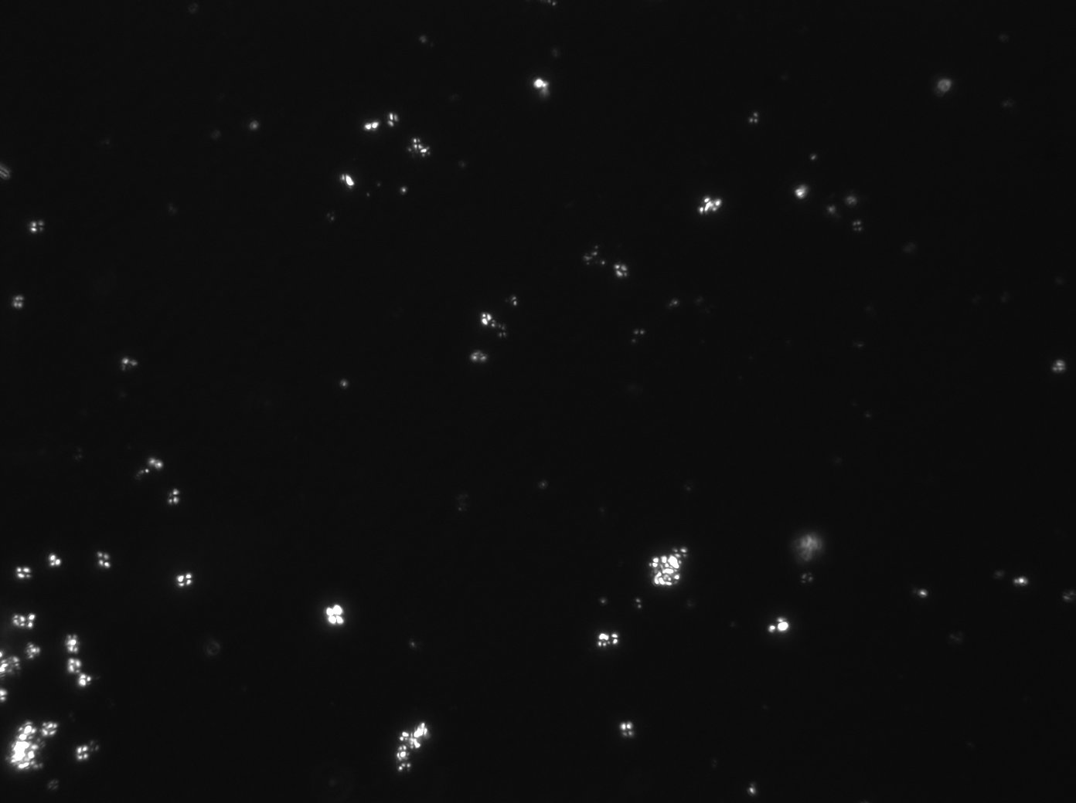
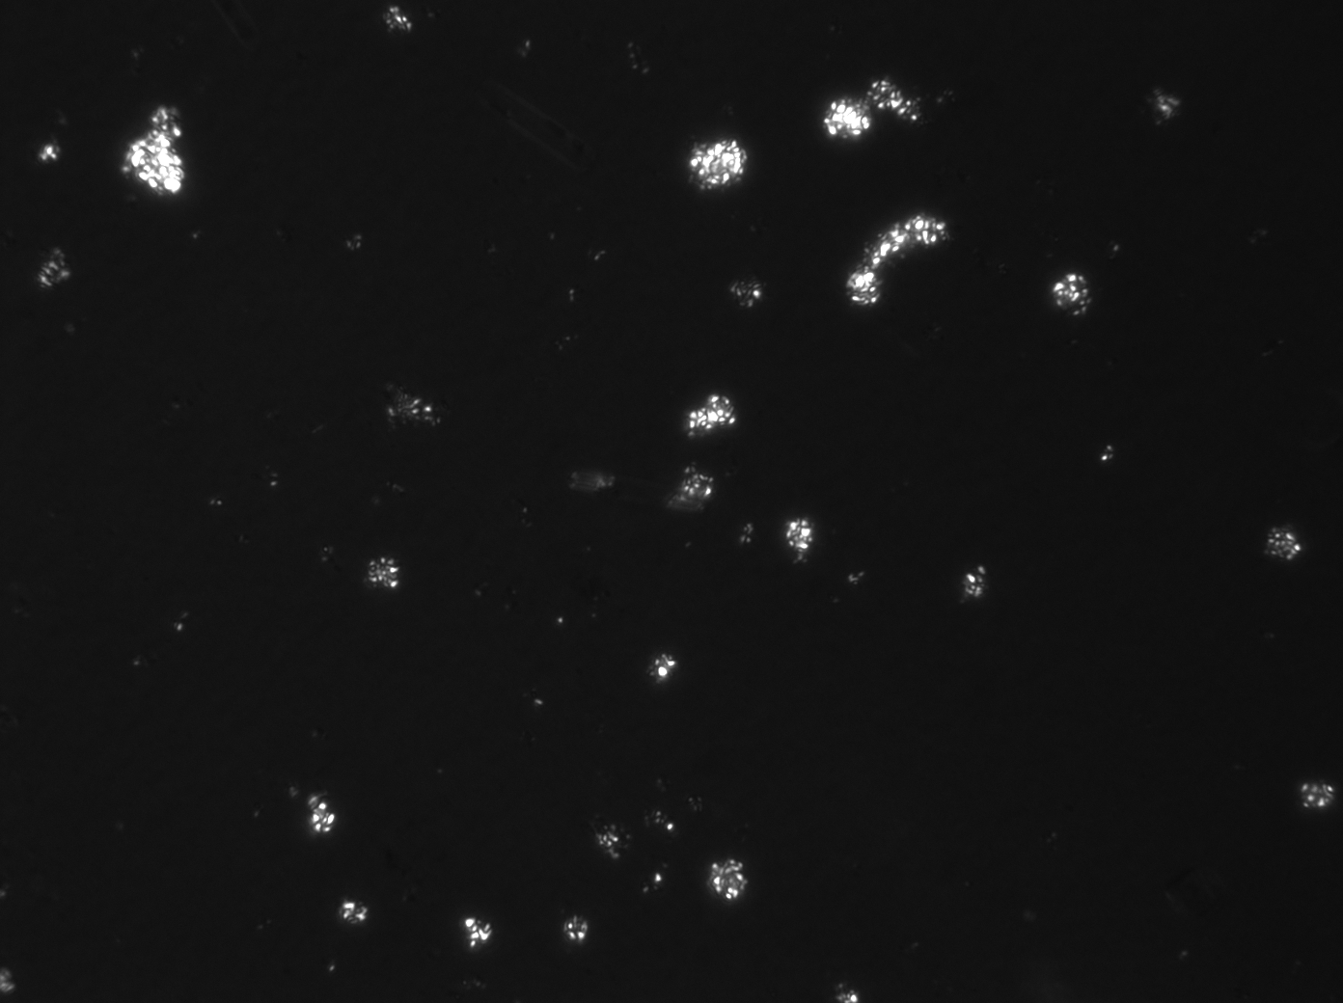
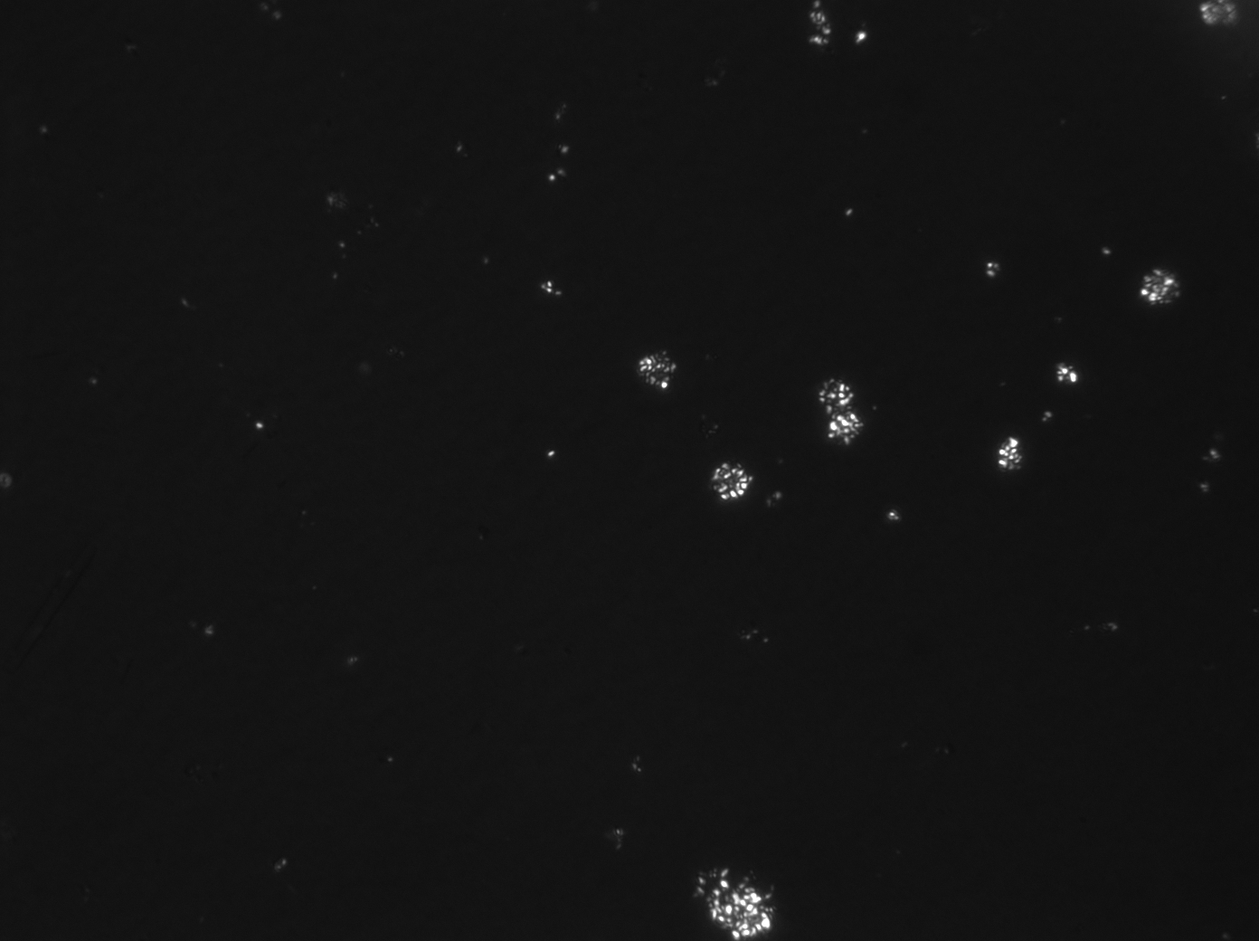
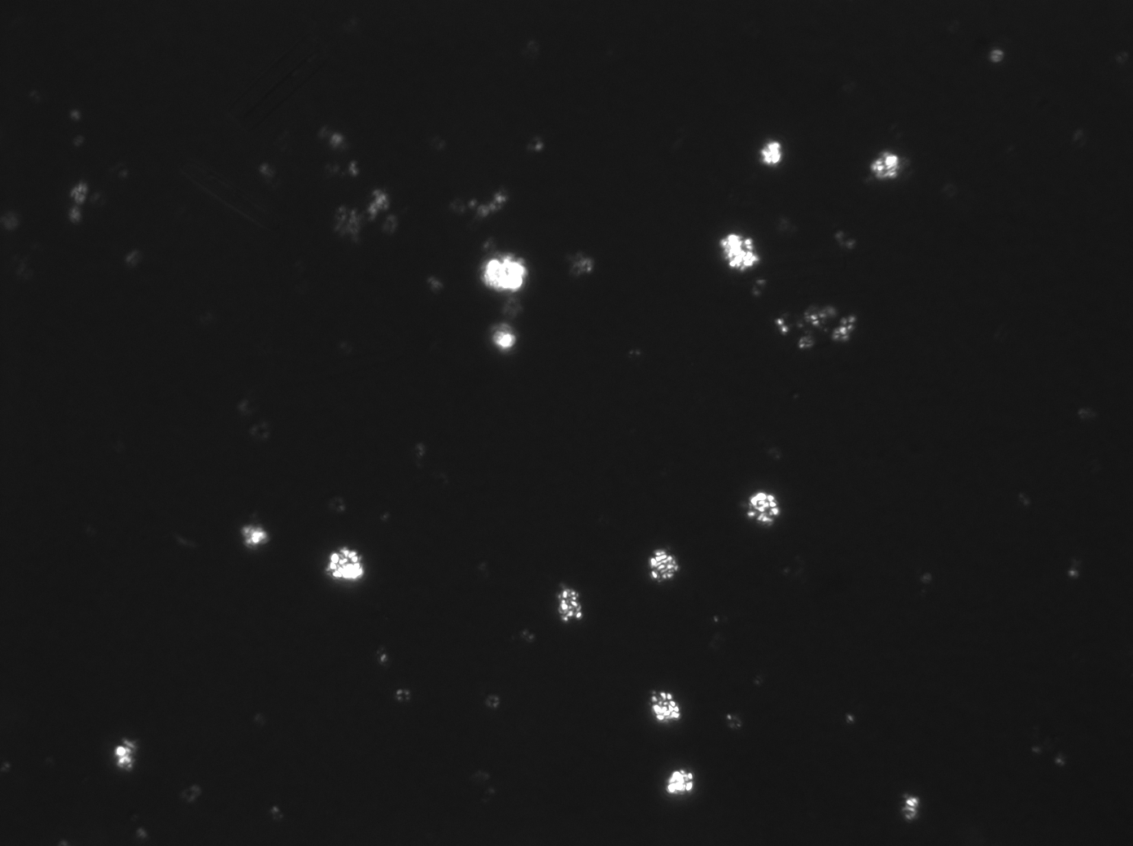
Coccolithophores and detached coccoliths were highly abundant at the So Ocean Gas-ex site. Pictures say a thousand words…
Typical coccolith concentrations:
10,000-40,000
per mL
Plated cells:
200-500 per mL
Plated coccolithophore
Detached coccolith
10μm
Stn 136; image 104
Stn 140; image 112
Stn 120; image 61
Stn 108; image 116
Birefringence polarized-light micrographs
Balch, Bigelow Lab, 2011
Notes:
Birefringent micrograph showing plated coccolithohpores and detached coccoliths at multiple stations during SO- Gas-Ex. Images made at 400X magnification under cross polarized light. Scale bar at left.

Slide 13
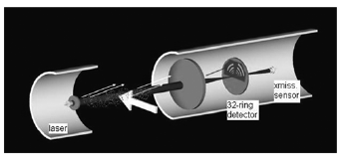
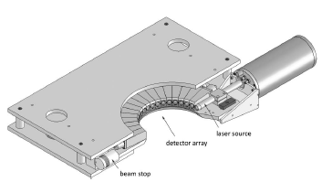
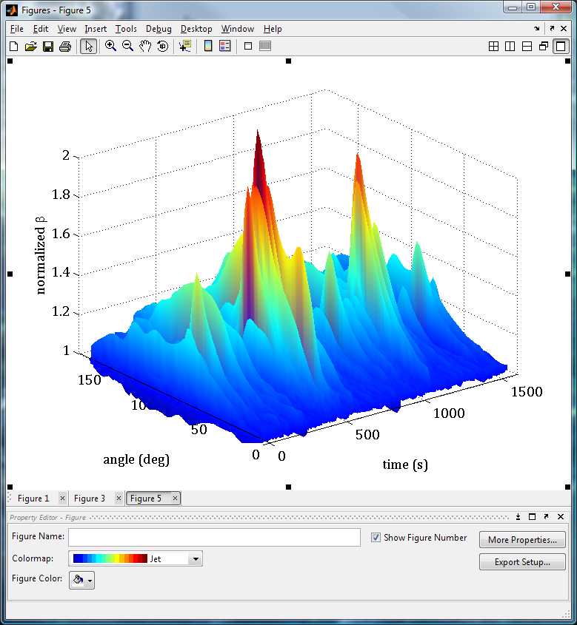
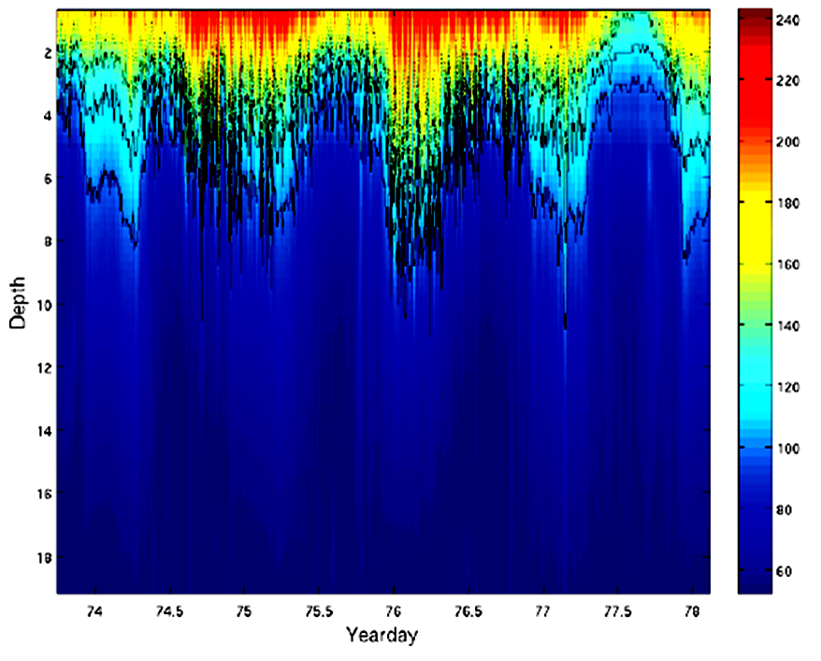
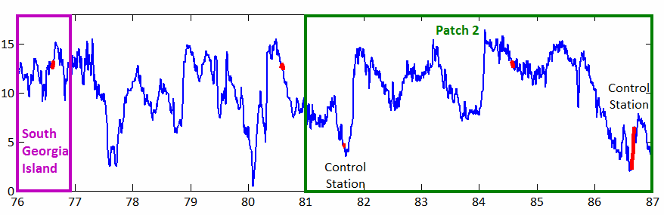
SOGasEx Bubble Measurements
Heidi Dierssen, Michael Twardowski, Kate Randolph, Christopher Zappa, & Alejandro Cifuentes
from Agrawal et al., 2008
LISST
Particle size distribution
by laser diffraction,
MASCOT
Volume scattering function
Bubbles (n’ < 1)
Unique scattering properties—total reflection at the critical scattering angle (θc≈83°)
Deep bubble plumes were identified using multiple instruments which measure the optical volume scattering function, in particular at the very near forward angles and at the critical scattering angle for bubbles between 60° and 80°.
Notes:
Optical techniques were used to determine bubble size distributions (BSDs) from 1-125 μm radius at 6-9 m depths under sustained high wind conditions (13-15 m s-1, Hs 3-5 m) and during large-scale wave breaking in an effort to both capture the size distribution of small bubbles and to determine the bubble contribution to backscattering in the Southern Ocean. Deep bubble plumes were identified using multiple instruments which measure the optical volume scattering function, in particular at the very near forward angles and at the critical scattering angle for bubbles between 60° and 80° (see bottom surface plot). For three stations, two to three-fold enhancements in critical angle scattering are observed in the measurements periodically throughout the 30-minute deployment and then fell off abruptly thereafter. The presence of air bubbles is the only natural mechanism known to produce this critical angle scattering. Concomitant enhancements in particle size distribution and critical angle scattering during wave breaking events were used to differentiate the concentration of bubbles from other particles (plot at right where blue lines are normalized critical angle scattering and green lines are numbers of 2.5 um particles L-1 um-1).
13

Slide 14
CDOM abundances in the GasEx area were higher than average values for the Southern Ocean. Biogeochemical and optical conditions may not be typical.
Del Castillo and Miller, 2011

Slide 15
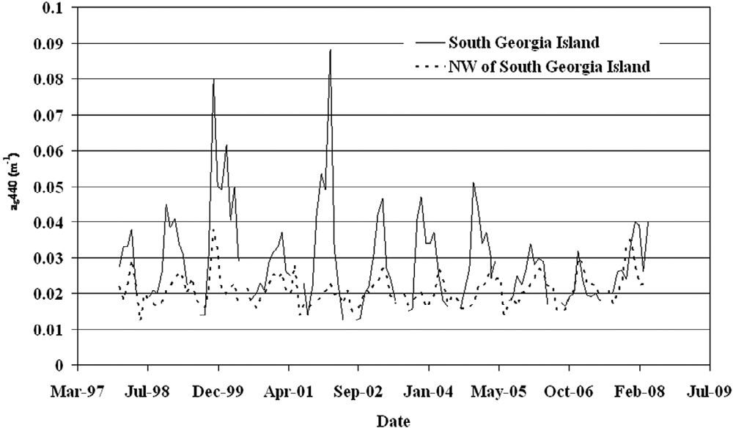
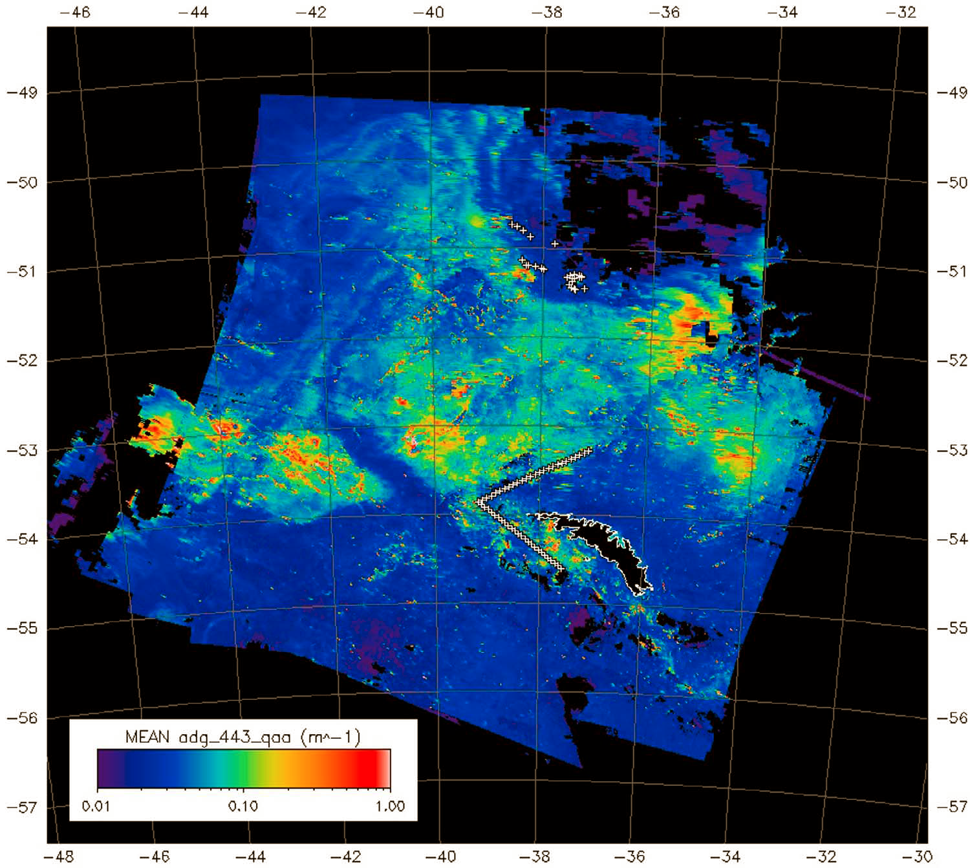
Island mass effect from south Georgia Island, and likely runoff contributes to high chlorophyll and surface CDOM. Neither in-situ production, nor runoff can explain high CDOM values.
Del Castillo and Miller, 2011

Slide 16
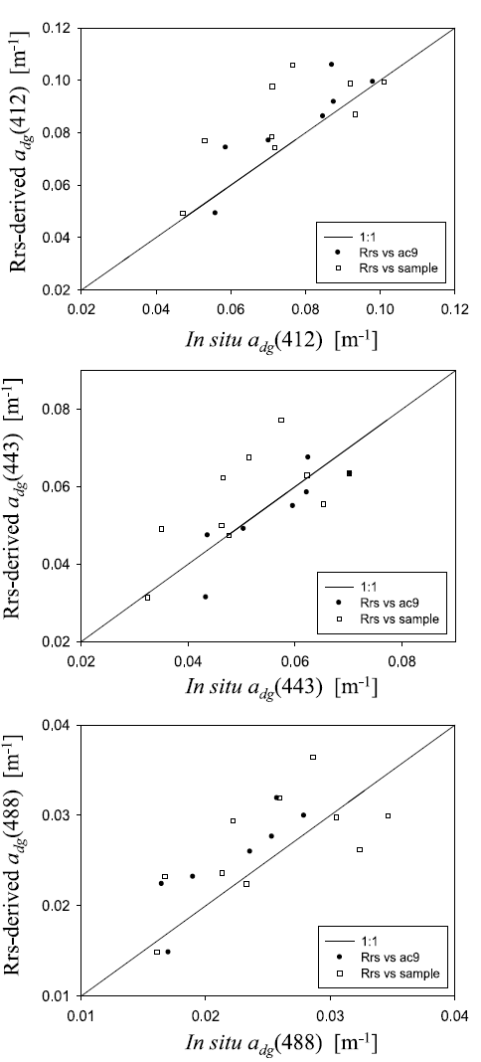
Can we get reasonable estimates of IOP in the SO using remote sensing?
Lee et al., 2011

Slide 17
Estimating PP from space
Aph-PP
Chl-PP_{B}
Chl-PP_{A}
Chl-PP_{B} = Beherenfeld and Falkowski, 1997
Chl-PPa = Arrigo et al. 2008
Aph-PP = Lee et al., 1996
Lee et al., 2011

Slide 18
Determination of Gas Transfer Velocities During GasEx
³He/SF₆ dual‐tracer results from SO GasEx are similar to those from other areas in both the coastal and open ocean and are in agreement with existing parameterizations between wind speed and
gas exchange. This suggests that wind forcing is the major driver of gas exchange for slightly soluble gases in the ocean and that other known impacts are either intrinsically related to wind or have a small effect (<20% on average) on time scales of the order of days to weeks.
Ho et al., 2011

Slide 19
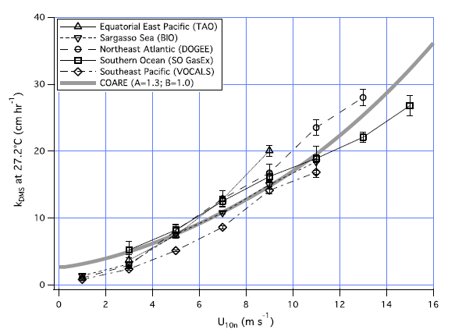
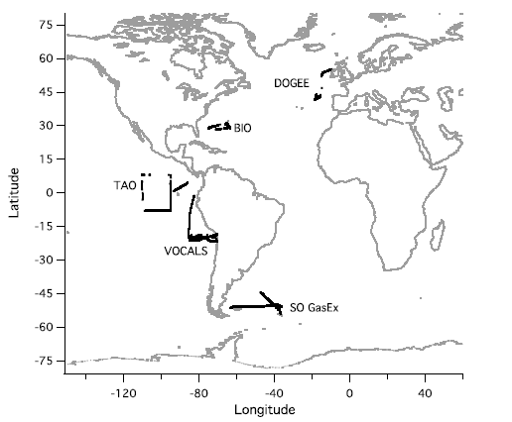
Gas transfer velocities for DMS
Normalized transfer velocities for DMS at low to moderate winds are similar to those measured elsewhere. At high wind speeds, like those found in the SO, K_{DMS} is significantly lower. This is probably due to solubility dependence in bubble mediated exchange (DMS is more soluble in waser than CO₂)
Yang et al., 2011

Slide 20
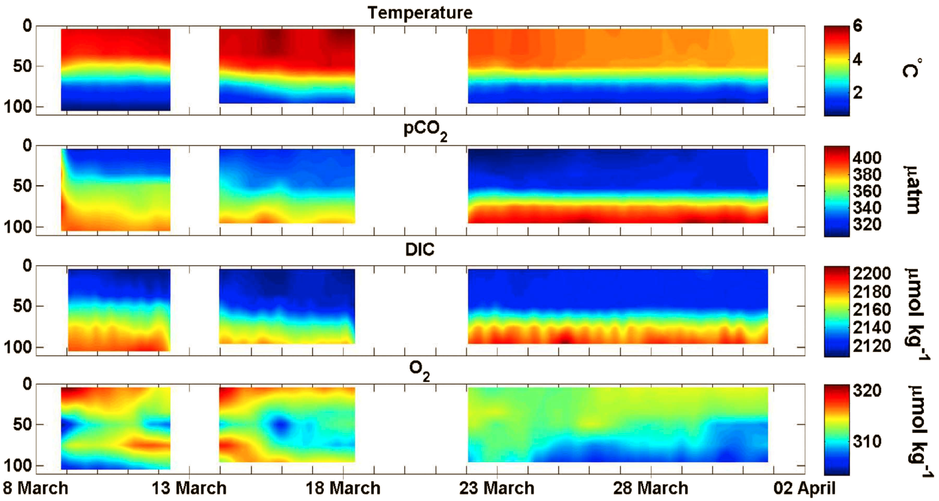
Air-Sea CO₂ Exchange during GasEx
Based on MAOPCO₂, ASIS, and shipboard data
The surface ocean pCO2 was always less than atmospheric pCO2 (-50.4 to -76.1 atm), and the ocean was a net sink for CO2 with fluxes averaging between 16.2 and 17.8 mmol C m−2 d−1. Net community production (NCP) was low during this study, with mean fluxes of 3.2 to 6.4 mmol C m−2 d−1 during the first deployment and non-detectable (within uncertainty) in the third. During the second deployment the NCP was not separable from lateral advection. Overall, this study indicates that in the early fall the area is a significant sink for atmosphericCO2.
Moore et al., 2011; Hamme et al., 2011

Slide 21

Data Assimilation – 4D-Var technique
Dwivedi et al., 2011

Slide 22
Applying data assimilation to model IOP’s and tracer
Dwivedi et al., in prep.

Slide 23
Conclusions
Very difficult to do matchups between satellite measurements and field data. However….
    Current algorithms(e.g. QAA) can produce reasonable retrievals of IOP’s
    Retrievals of Chl and CDOM from satellite imagery are very reasonable – well within what we measured in the field.
    Absorption-based PP algorithm performs well.
Sampling area may not be typical of the Southern Ocean due to Island Mass effect from South Georgia Island. However, this seems to be of no consequence to processes measured during GasEx.
Over the timescales of GasEx, wind speed controls gas exchange. No evident effect of biology. Somewhat similar, CDOM controlled by mixing and photodegradation.
Assimilation of remote sensing data into models shows promise. Can be useful during field campaigns – (e.g. better understanding of mixed layer depths, fill in the blanks for surface parameters when imagery is not available.

Slide 24
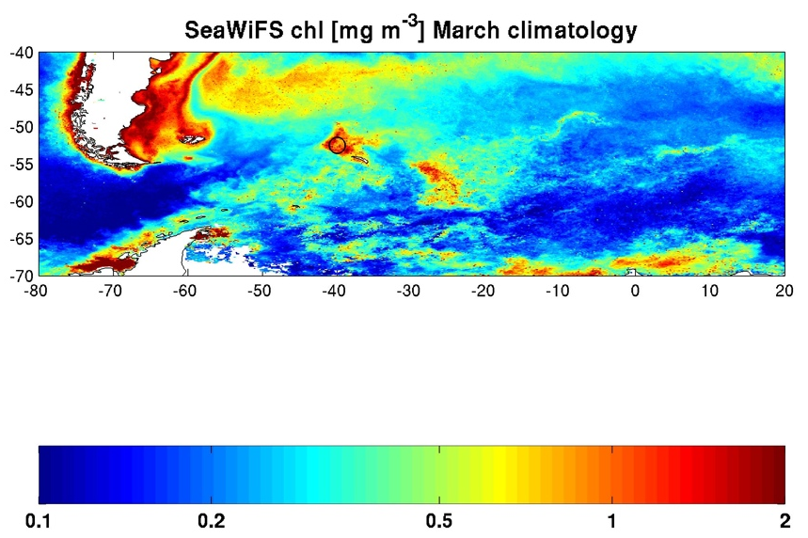
Courtesy of P. Strutton

