Slide 1
Combining Ecological and Atmospheric Observations to Understand Carbon Budgets Using Models with MODIS, LANDSAT, and GOSAT data Scott Denning, Ian Baker, Kathy Corbin Haynes, Nick Parazoo, David Baker, Taka Ito, James Collatz, Randall Kawa, Becky McKeown, and Tomohiro Oda

Slide 2
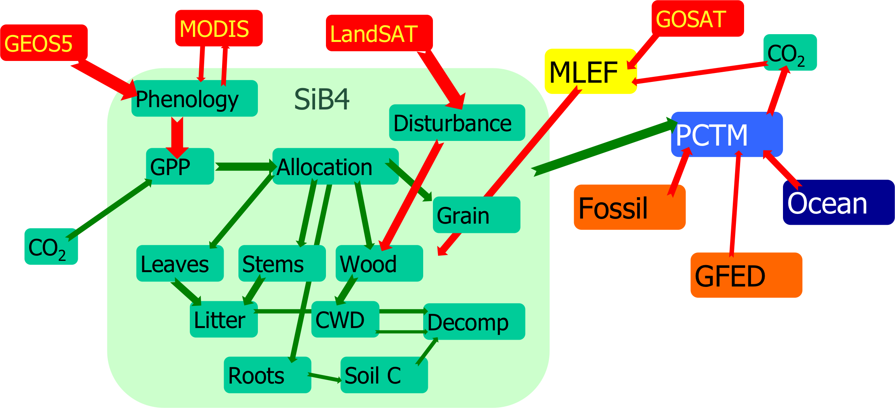
Overall Design

Slide 3
Terrestrial Ecosystem Module (Extension of SiB)
Prognostic phenology w/MODIS data assimilation for fPAR/LAI
Crop physiology, phenology, and mapping
Time-scale separation of GPP & Resp
Allocation, storage, disturbance
Initialization using LandSat-based NAFD
Optimization of state variables

Slide 4
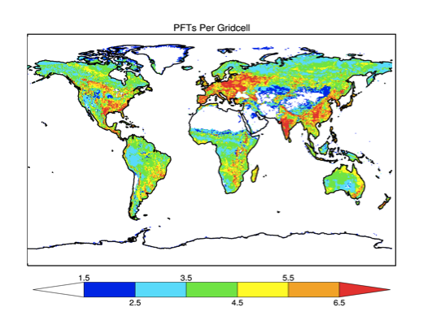
Heterogeneity

Slide 5
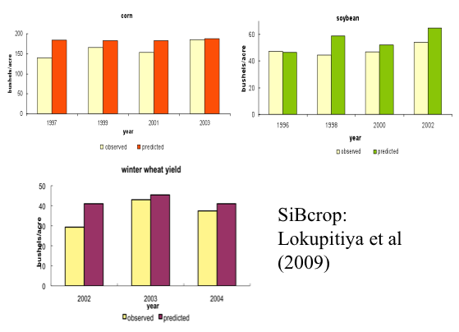
Crops

Slide 6
Maximum Likelihood Ensemble Filter
Prior b=0.0; s_{bland}=0.2; s_{bocean} = 0.1
N_{ens} = 100; Assimilation Window = 2 weeks
Covariance Propagation using persistence
Covariance smoothing for “cold start” only

Slide 7
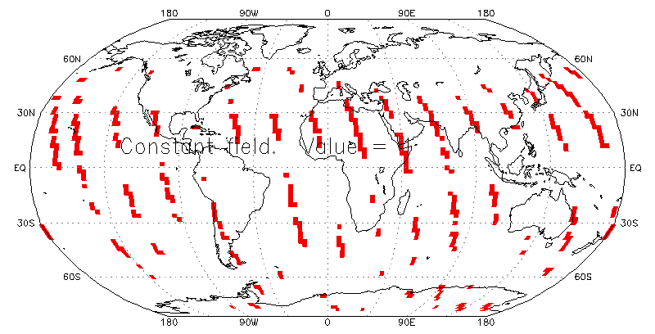
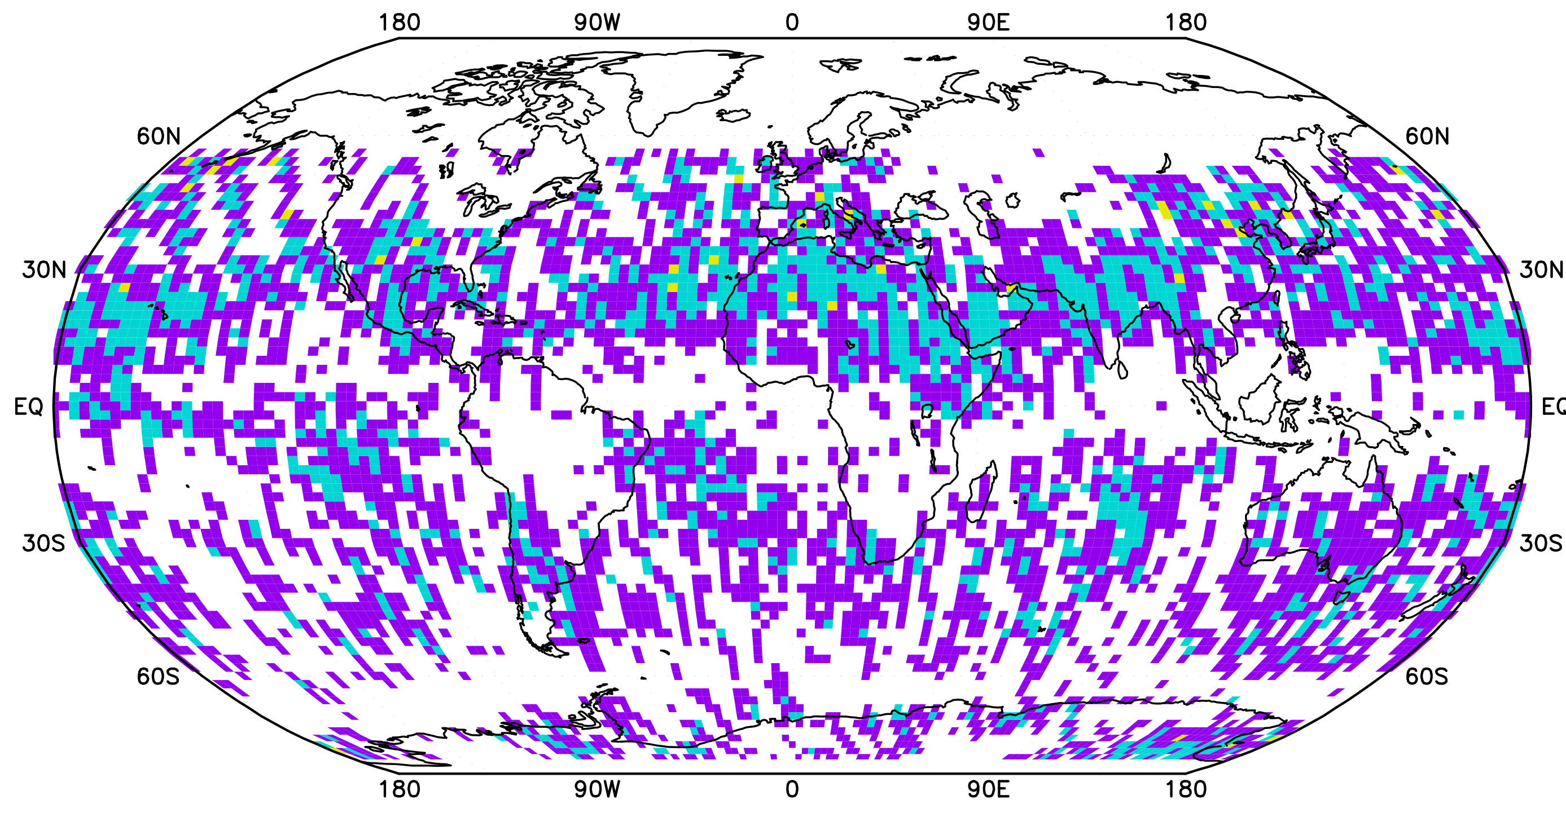
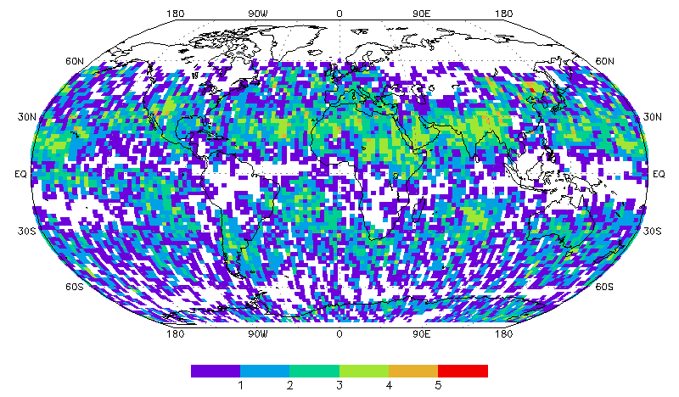
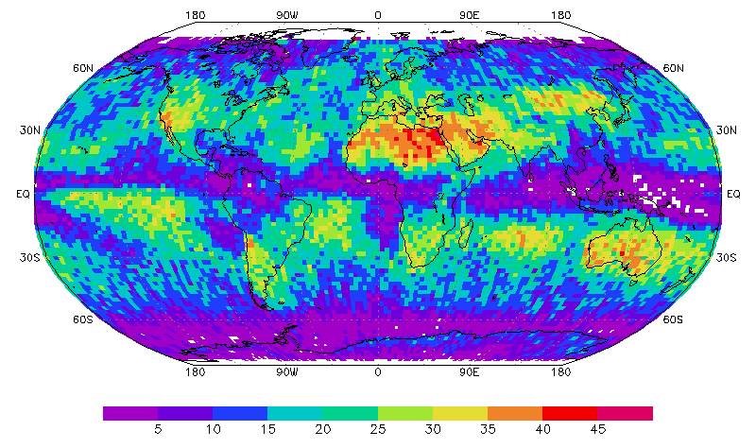
Observation Operator
1 Day
14 days
1 Month
Pressure-weighted atmospheric column sampling on 1 PM EQT polar orbit
NCEP cloud mask
1, 2, and 3 ppm random error in grid cells w/ < 30% cloud
1 Year

Slide 8
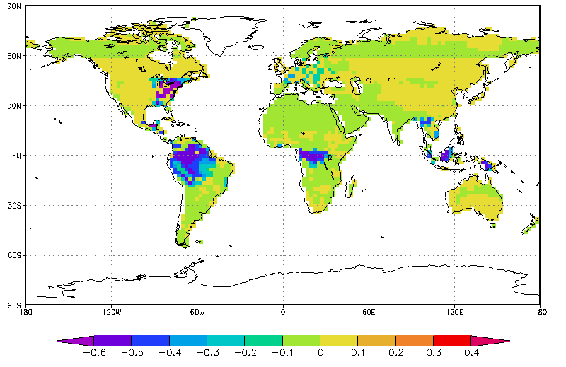
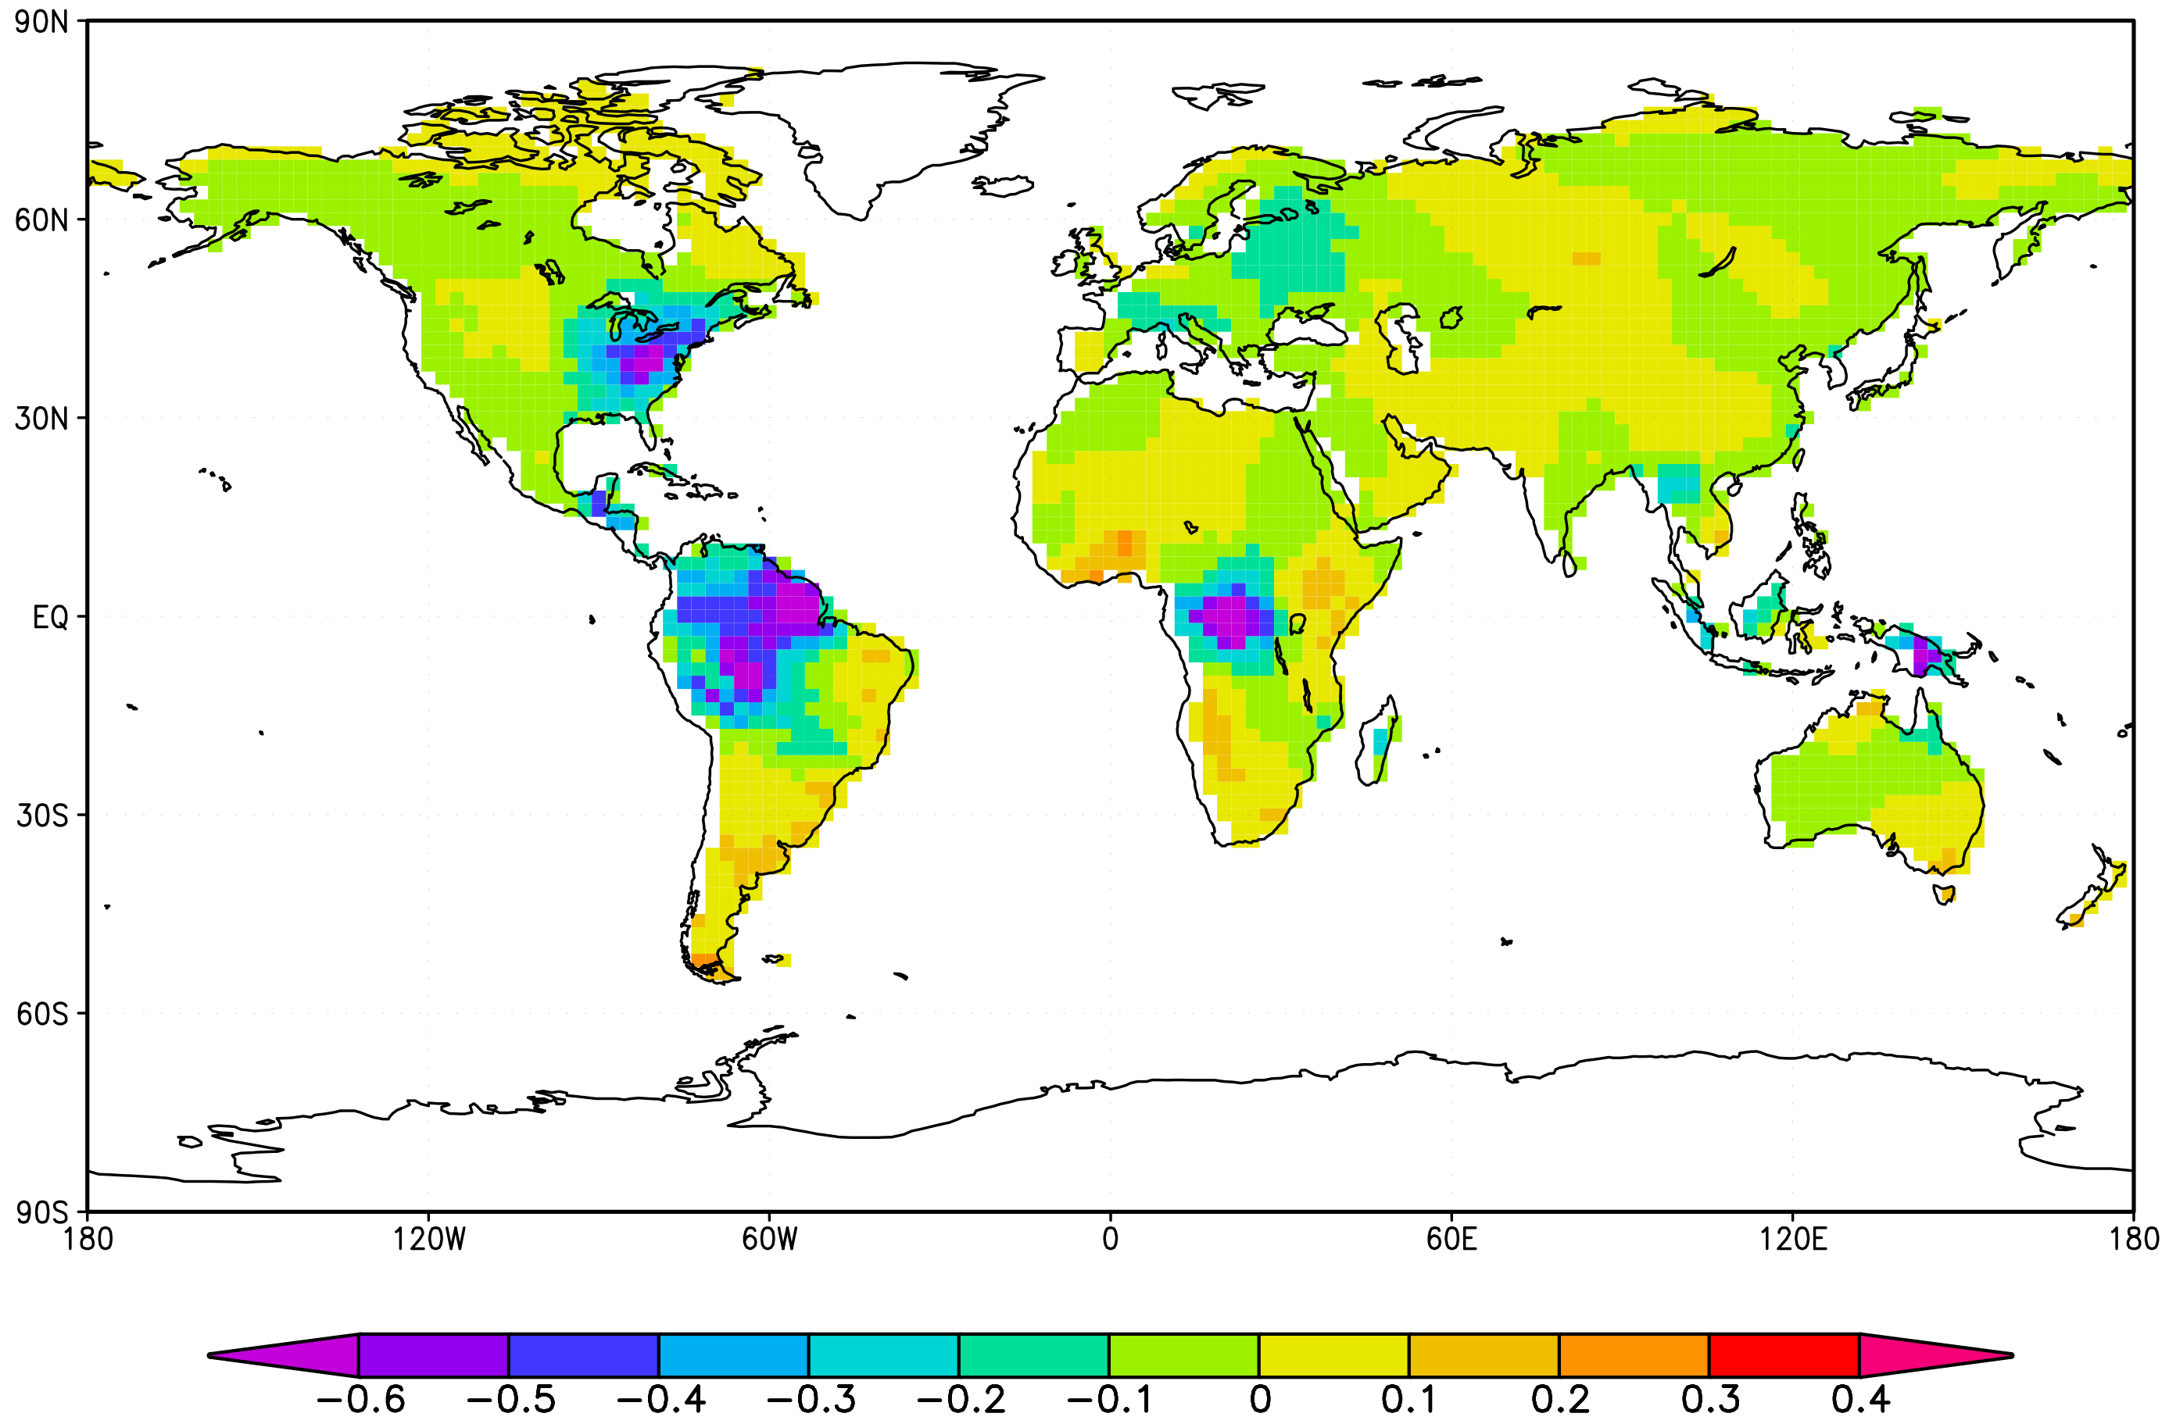
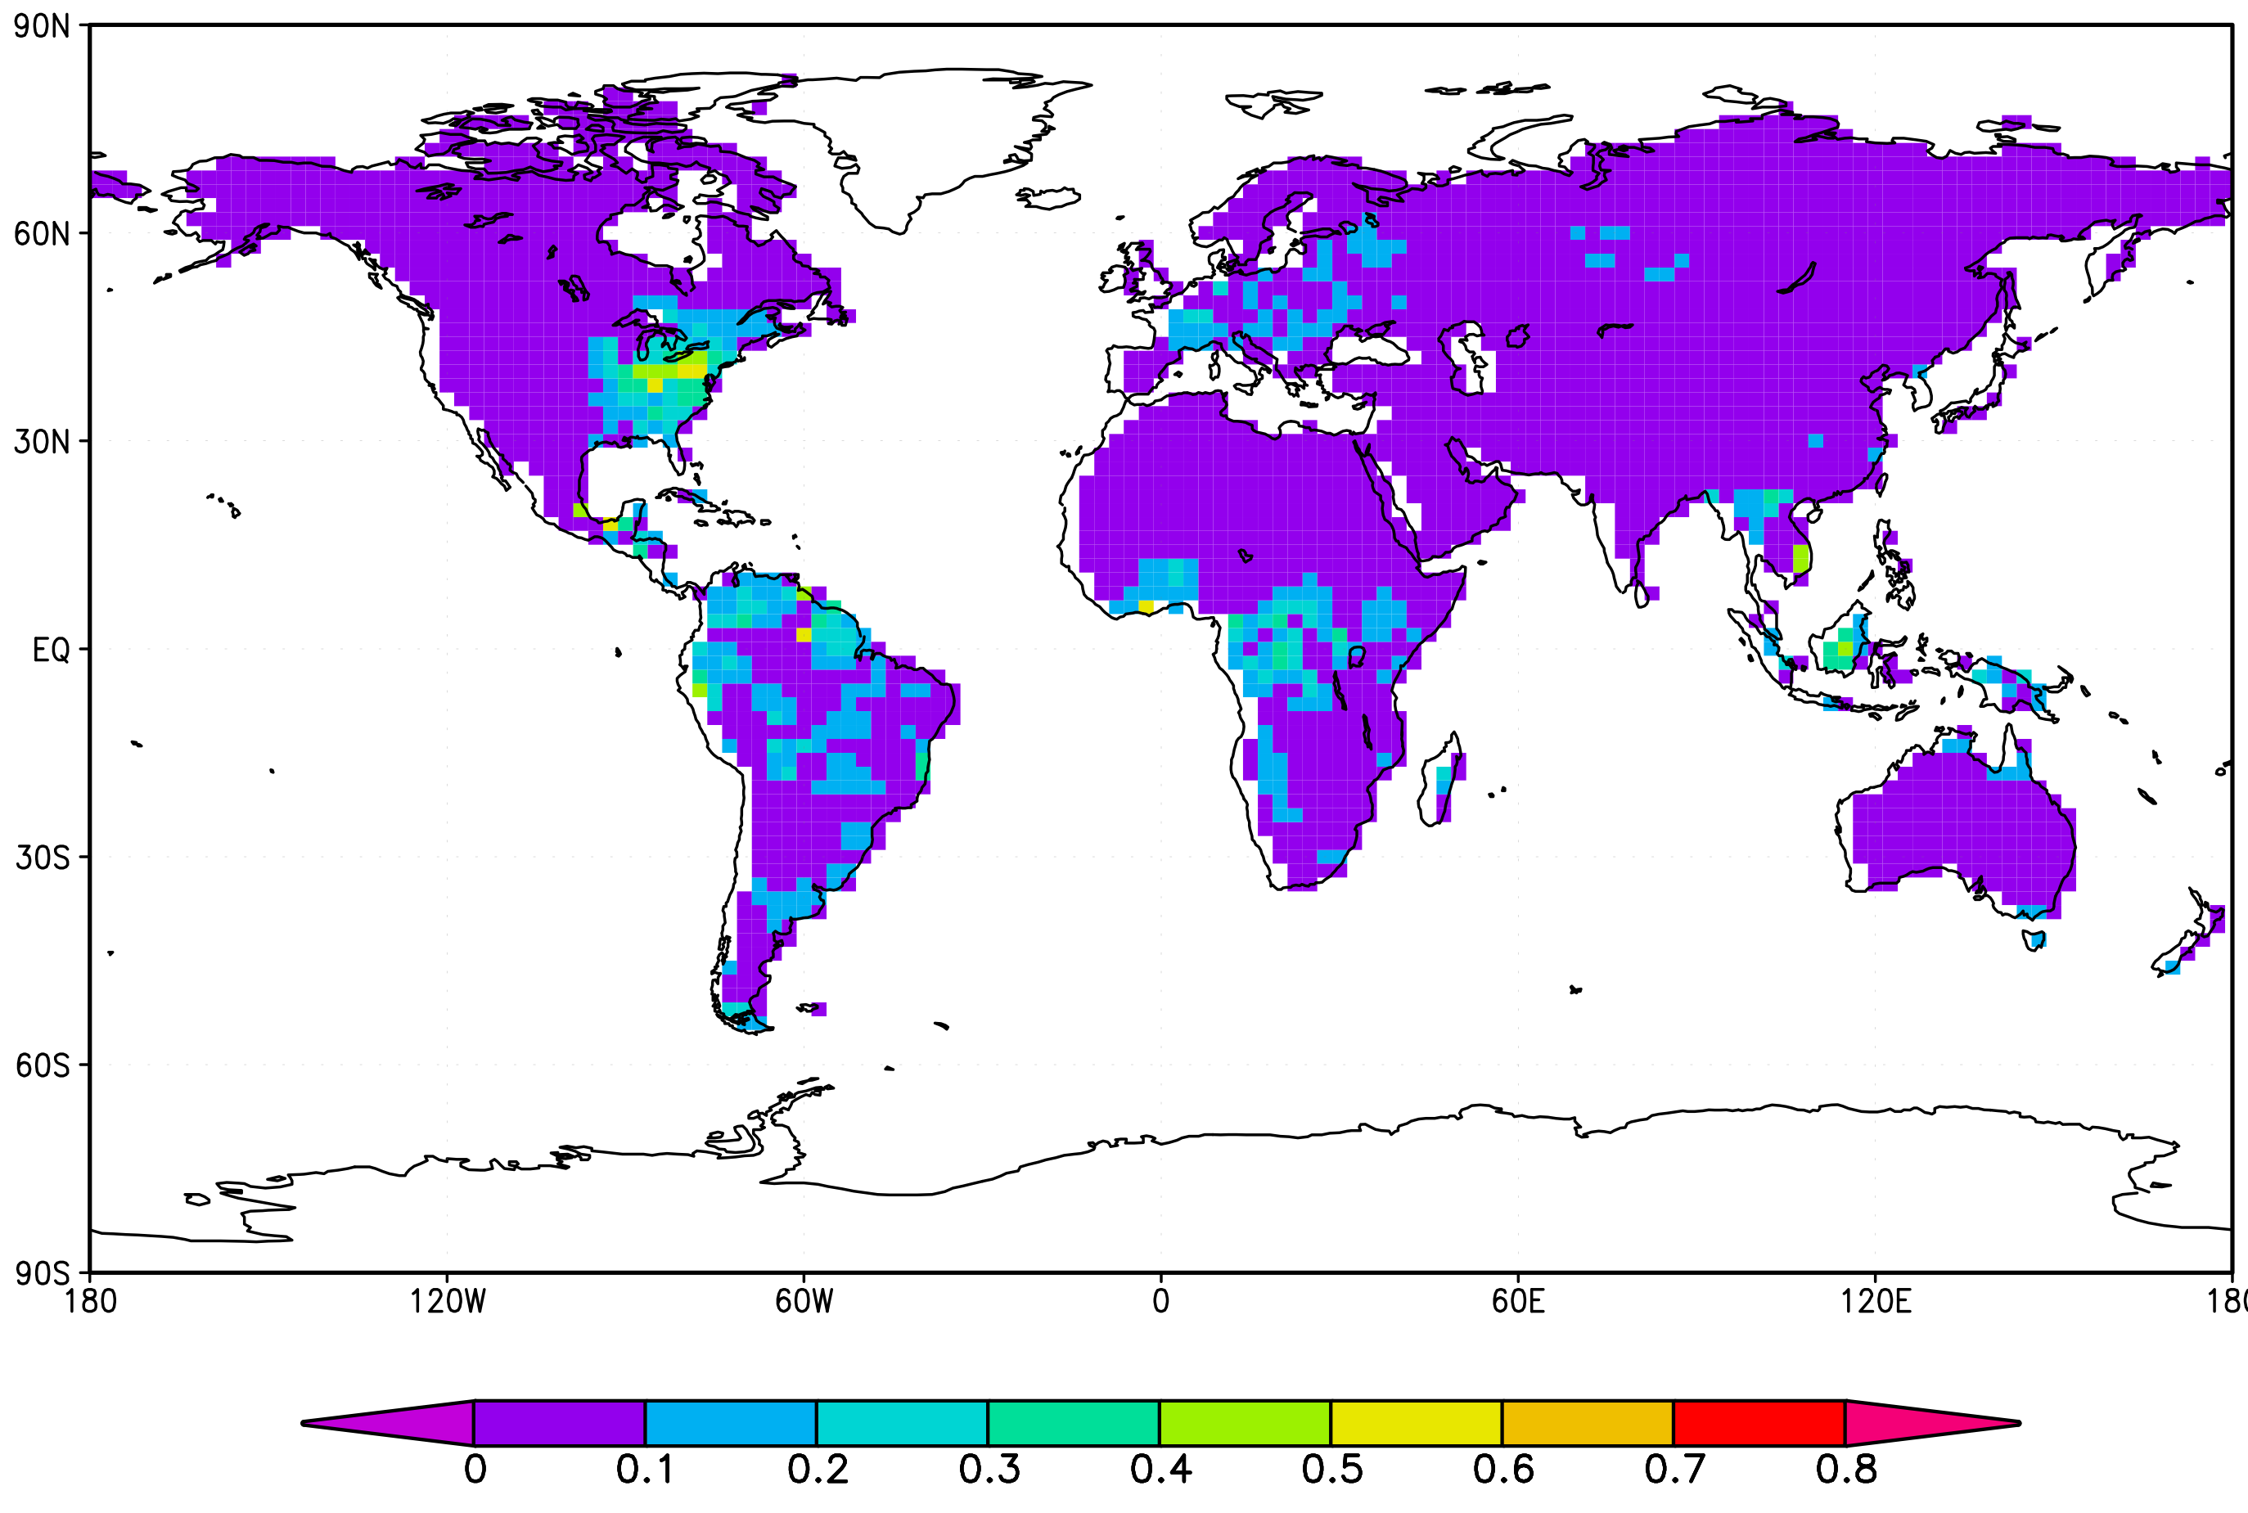
Result: Annual Terrestrial NEE
SciFi Truth
Retrieval
Difference
Retrieval error = 3 ppm

