Slide 1
Lessons learned through Model Intercomparison (MIP) Studies:
Land-atmosphere-ocean interactions and the challenges of coupled modeling through model intercomparison activities
James Randerson, Forrest Hoffman, Steven Wofsy, Deborah Huntzinger, Kevin Gurney, Britton Stephens, Scott Doney, & William Riley

Slide 2
Talk Overview
Introductory Remarks
Lessons from Model Intercomparison Projects:
  Fully coupled models: C4MIP, CMIP5
  Atmospheric transport: TRANSCOM and beyond …
  Land: C-LAMP, NACP Regional Interim Synthesis, MsTIMP
  Ocean: CCSM evaluation
Concluding Remarks and Future Directions

Slide 3

State of the Art:
Coupled Land-Ocean-Atmosphere MIPs
Keith Szafranski/istockphoto

Slide 4
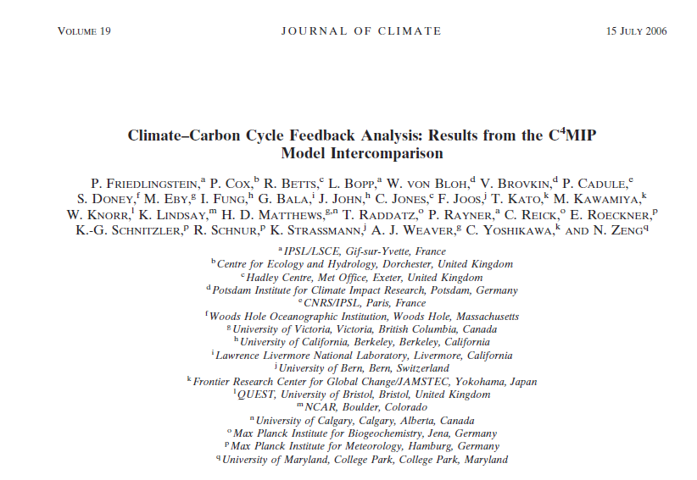
C4MIP was the first model intercomparison for fully coupled climate-carbon models

Slide 5
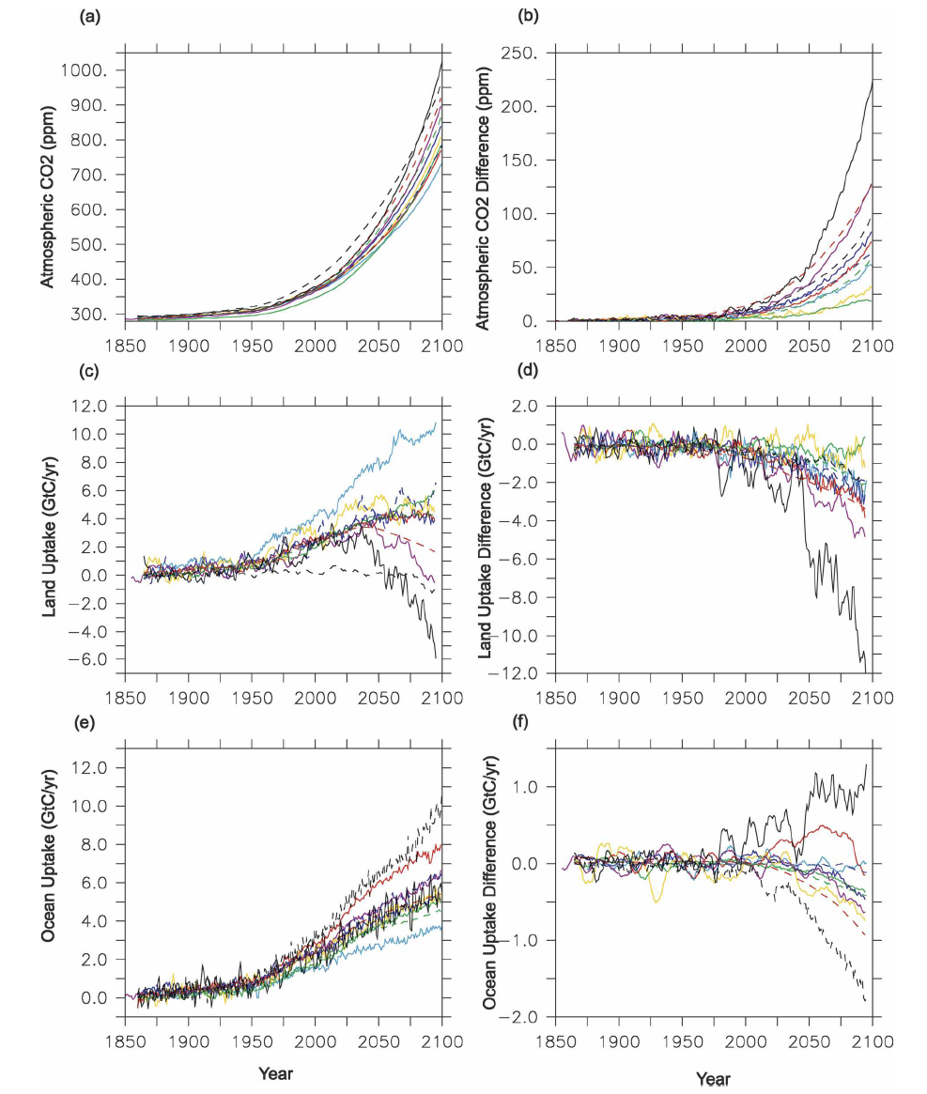
Coupled models
Effect of climate change

Slide 6

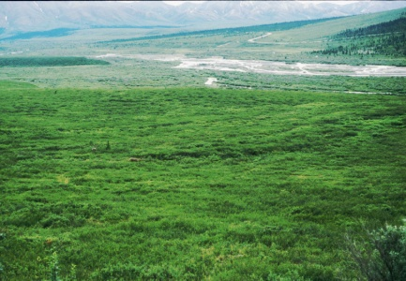

Lessons learned from C⁴MIP
Direct:
  Elegant framework for separating the climate-carbon feedback into climate sensitivity, carbon storage sensitivity to atm. CO₂, and carbon storage sensitivity to climate components appears to work reasonably well across models
Indirect effects on modeling community:
  All the models showed strong carbon uptake at high northern latitudes, yet none had an explicit representation of permafrost carbon processes
  Losses of carbon from the terrestrial biosphere were triggered more by tropical NPP responses to drought than temperature-driven increases in heterotrophic respiration
Notes:
8 fold difference among models for gain, 9 fold difference for gamma land, and 14 for beta land

Slide 7
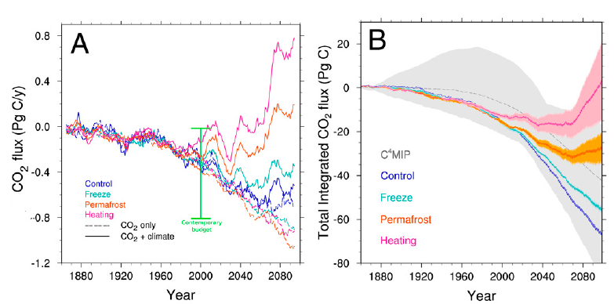
C⁴MIP has provided motivation for improving high latitude permafrost processes in climate models
Koven et al. 2011 PNAS

Slide 8
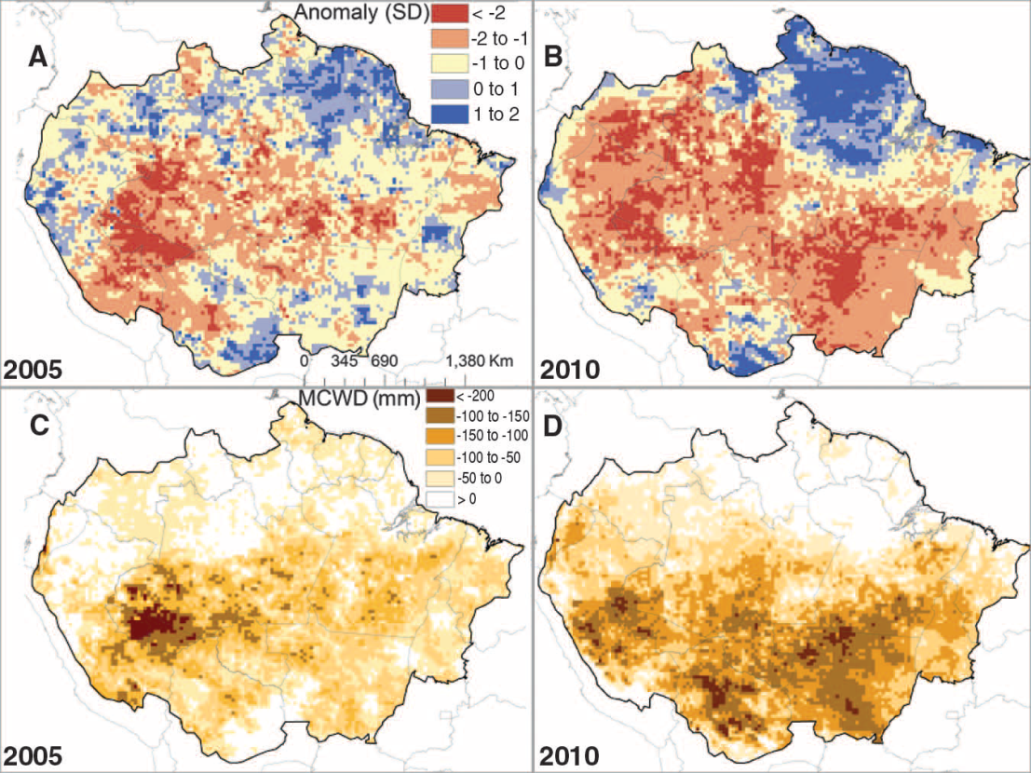
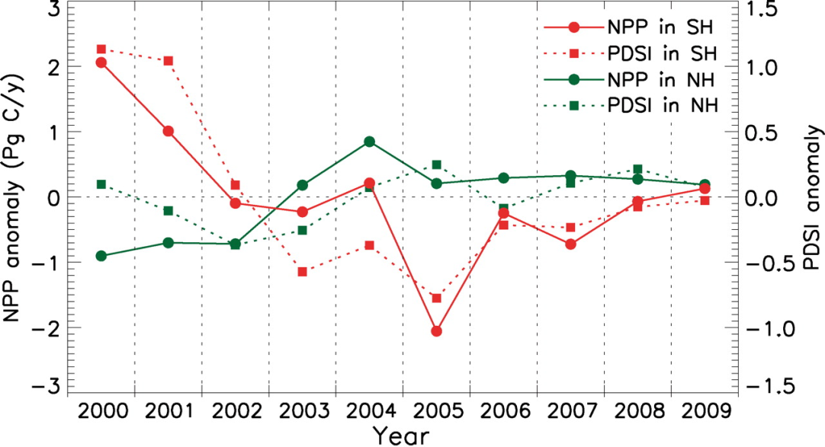
C⁴MIP also has provide some motivation for understanding drought effects in tropical ecosystems
Zhao and Running (2010)
Lewis et al. (2011)
Notes:
Drought effects on leaf area, npp, aboveground biomass, mortality, and what is shown here - fires

Slide 9
Drought stress also lowers ET and regional water vapor during the dry season, with consequences for fires
Large droughts
Deforest.
Level:
In the Brazilian Amazon, fires in
tropical forests have not declined at the same rate as deforestation
Chen et al. submitted GCB
Notes:
Drought effects on leaf area, npp, aboveground biomass, mortality, and what is shown here - fires

Slide 10
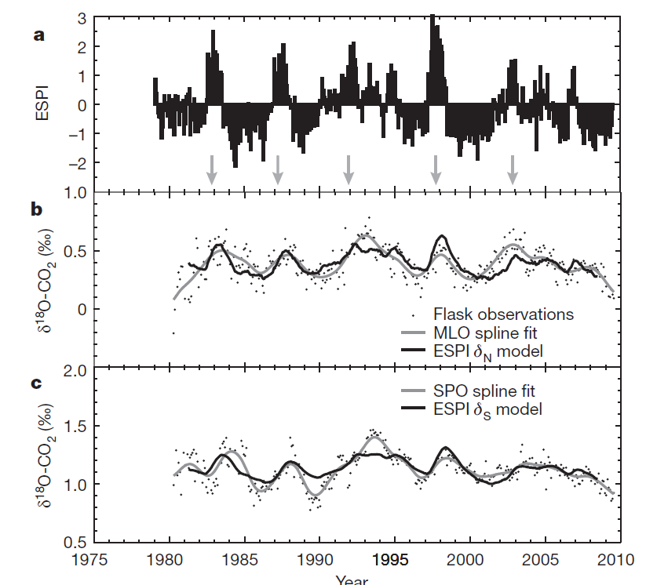
Isotope tracers also provide insight about ecosystem processes and their response to drought
1. GPP may be higher than recent estimates
2. At a global scale, relative humidity is reduced across the tropics in terrestrial ecosystems during El Nino
Welp et al. (2011)
Notes:
Drought effects on leaf area, npp, aboveground biomass, mortality, and what is shown here - fires

Slide 11
Extending the C4MIP conceptual framework:
It may be possible to separate β_{L} into more easily digestible components:
β_{L} is the carbon uptake (NECB) sensitivity to elevated levels of atmospheric CO₂
Where C is a constant (units of 1/ppm)
NPP₀ * τ₀ is equivalent to the total carbon stock within the ecosystem

Slide 12
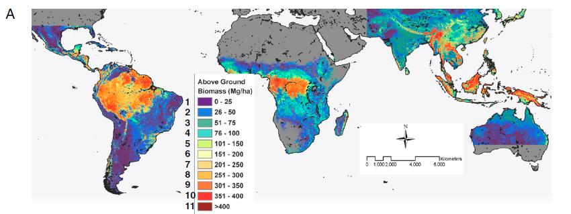
New syntheses of aboveground biomass constrain the carbon uptake potential of ecosystems in coupled models to both elevated CO₂ (β_{L}) and climate
Saatchi et al. (2011)
Notes:
Derived from GLAS and ground lidar

Slide 13
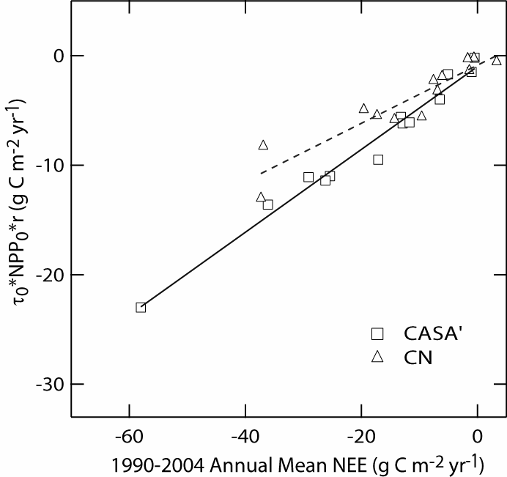
Example application:
Explaining model-to-model differences in their responses to historical changes in atmospheric CO₂ and N deposition
The Y axis is a prediction of β_{L} based on initial NPP, residence times, and relative changes in NPP
Transient historical runs from 1800-2004
Each point is a biome mean
The predictive equation explains intra- and inter model variability in β_{L}
May work well for models in which allocation is not strongly modified by elevated CO₂ or N deposition
(same as β_{L})

Slide 14
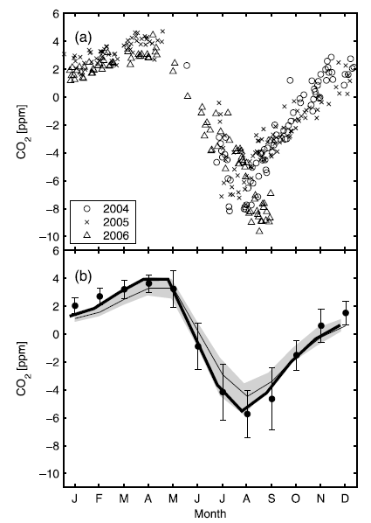
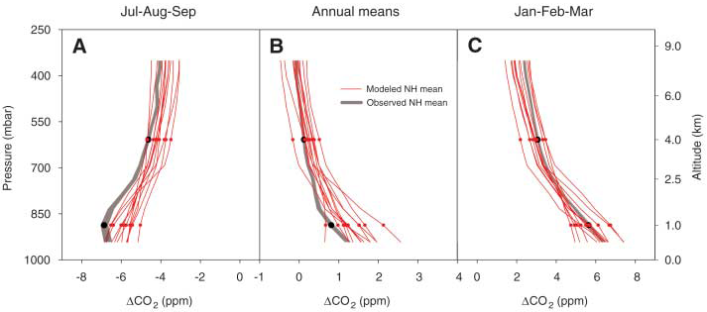
Lessons and legacies of atmospheric transport model intercomparison
Gurney et al. (2004) showed that seasonal amplitude of forward model estimates related to the size of the annual mean sink obtained by inversion
Interannual variability of sources and sinks more consistent across models than annual mean estimates for a given region (Baker et al., 2005)
Vertical profiles from aircraft and the TCCON network indicated that transport away from the NH surface maybe too weak in some models
Stephens et al. (2007)
Yang et al. (2007)

Slide 15
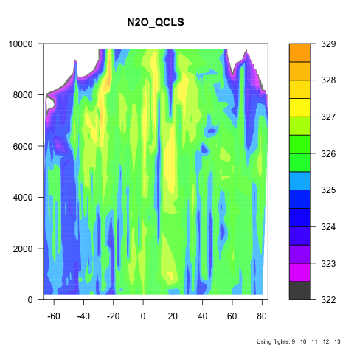
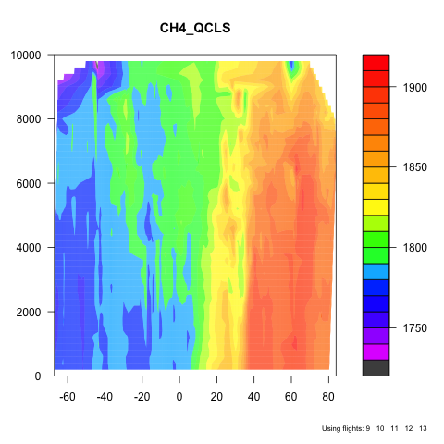
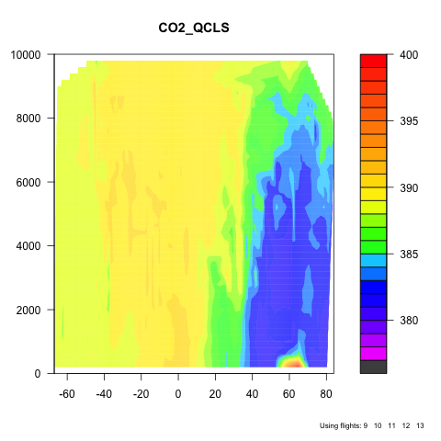
HIAPER Pole to Pole Observations:
Latest transects from Sept 2011
N₂O CH₄ CO₂
S. Wofsy

Slide 16
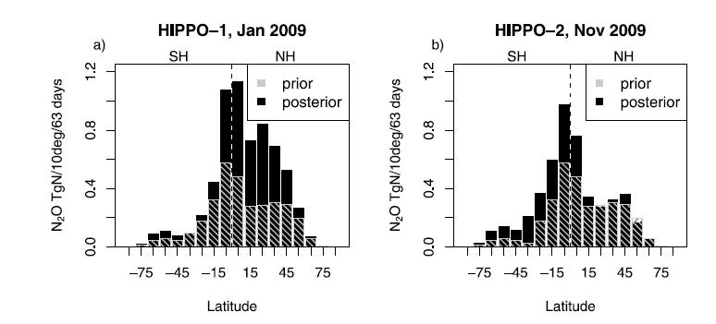
New constraints on N₂O emissions from atmospheric measurements
HIPPO profile observations provide evidence for strong episodic emissions from tropical regions
Inversion of continuous and daily flask measurements from tall towers in the U.S. indicate that agricultural emissions from EDGAR and GEIA inventories are too low (Miller et al. submitted, JGR-A)

Slide 17
Why Benchmark?
Ordering from least to most controversial!
Show the broader science community and the public that the representation of ecosystems and the carbon cycle in climate models is improving
In Earth System models, provide a means to quantitatively diagnose impacts of model development in related fields on carbon cycle and land surface processes
Guide synthesis efforts (such as the IPCC) towards the review of mechanisms of global change in models that are broadly consistent with available contemporary observations
Increase scrutiny of key datasets used for model evaluation
Identify gaps in existing observations needed for model validation
Provide a quantitative, application-specific set of minimum criteria for participation in model intercomparison projects (MIPs)
Provide an optional weighting system for multi-model mean estimates of future changes in the carbon cycle

Slide 18
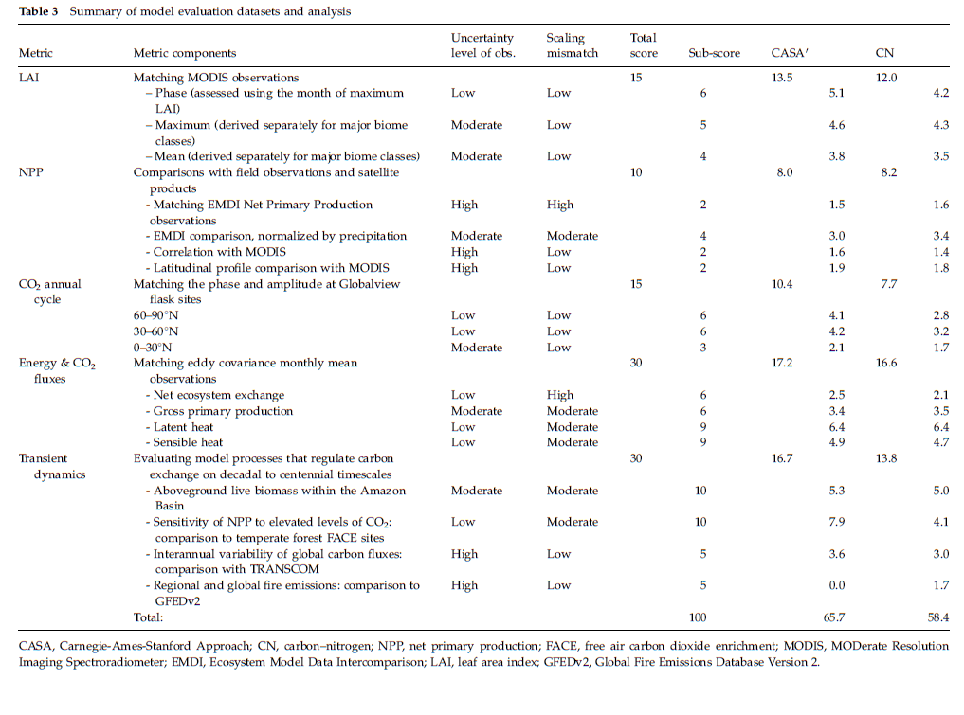
Example of an early carbon benchmarking system:
C-LAMP
Models
BGC &
ecosystem
datasets
Randerson et al. (2009) GCB

Slide 19
Use of the most robust aspects of observations important for reducing model uncertainties
Lessons from C-LAMP
Month of peak leaf area
Randerson et al. (2009) GCB

Slide 20
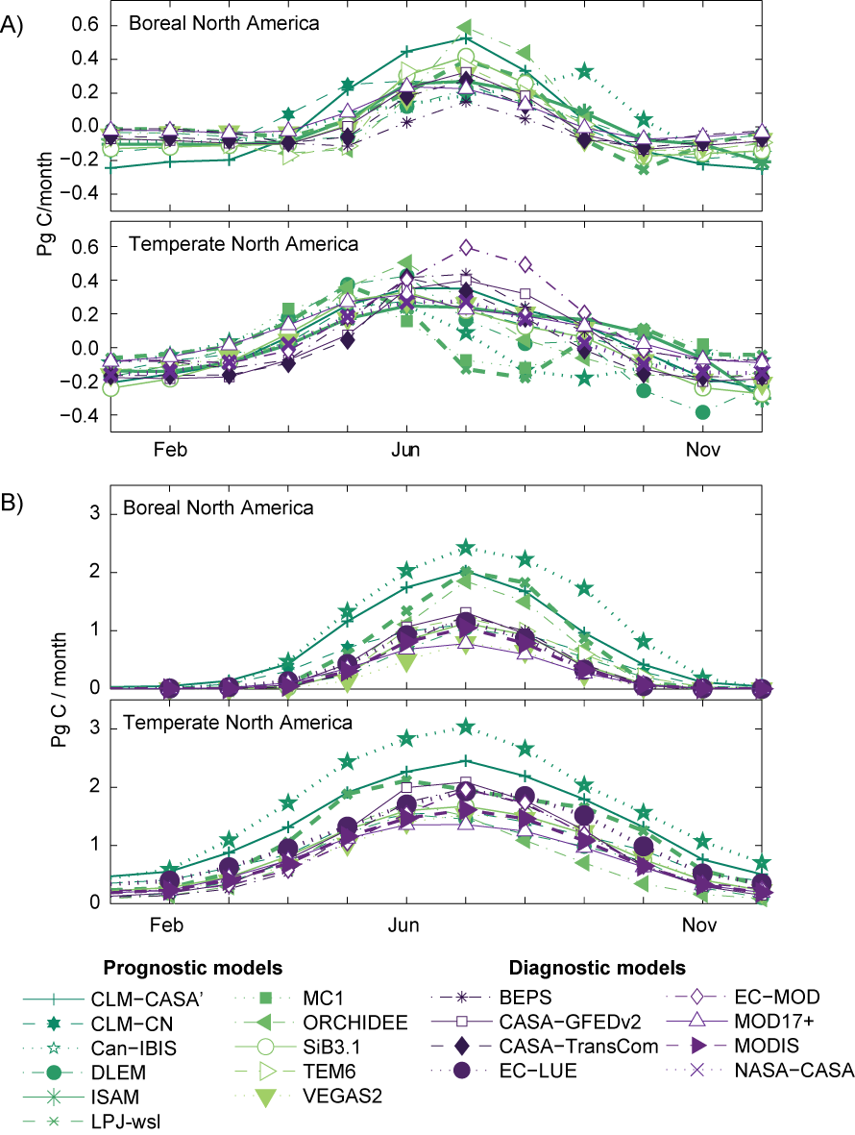
Lessons from NACP (NACP) Regional Interim Synthesis: Terrestrial Biospheric Model Intercomparison
GPP
Huntzinger et al.
In prep.
Wide spread in model estimates of gross primary production driven by different approaches for scaling from the leaf to canopy, prognostic phenology, representation of nitrogen limitation and different model drivers
Notes:
We expect driver variables, such as precip, solar radiation and temperature to have biases

Slide 21
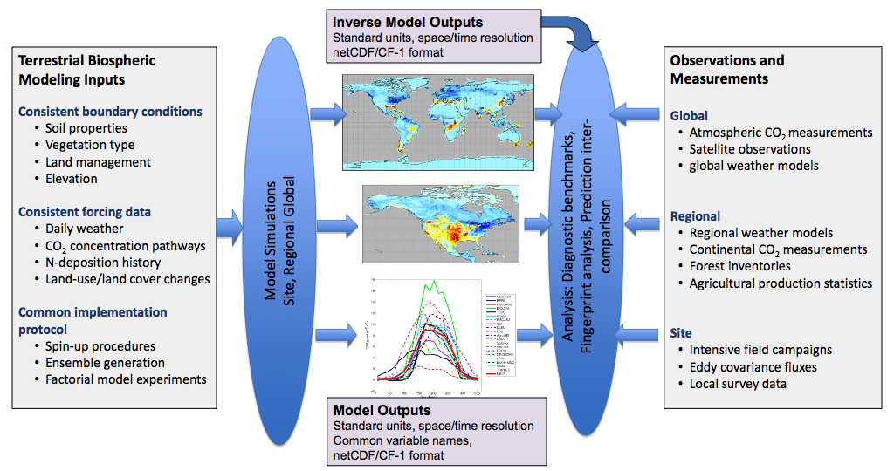
Multi-Scale Synthesis and Terrestrial Biospheric Model Intercomparison Project (MsTMIP)
MsTMIP Team: | Deborah Huntzinger (Science PI) | Northern Arizona University
 | Anna Michalak (PI) | Carnegie Institute for Sciences
 | Kevin Schaefer | NSDC, Univ. of Colorado
 | Andrew Jacobson | NOAA, Univ. of Colorado
 | Mac Post; Robert Cook; Yaxing Wei | Oak Ridge National Lab
Collaborators | Peter Thornton, Forrest Hoffman, Rama Nemani, Weile Wang, Josh Fisher, Philippe Ciais, Nicolas Viovy, Philippe Peylin

Slide 22
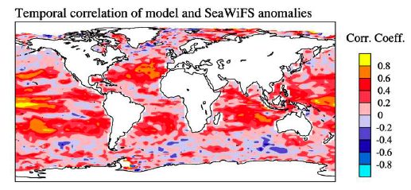
Ocean Model-Data Skill
Quantitative skill measures
bias, correlation, rms error
Taylor diagrams, modeling efficiency & reduced χ²
Partition by time-scales
spatial mean, seasonal cycle & interannual variability
Temporal correlation of model and SeaWiFS Chlorophyll Anomalies
Doney et al. & Stowe et al. J. Mar. Systems 2009

Slide 23
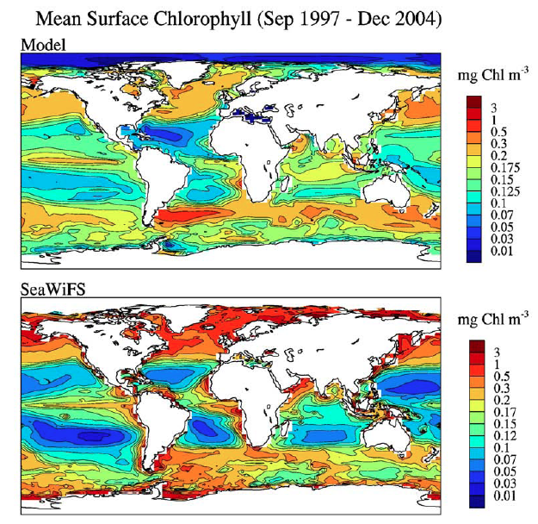
MARine Ecosystem Model Intercomparison Project" (MAREMIP) is curently underway
Doney et al., 2009

Slide 24
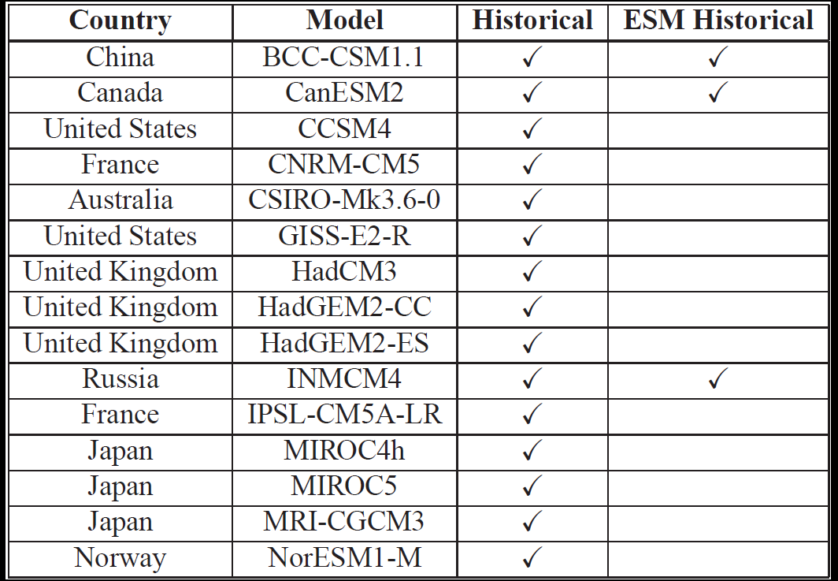
CMIP5 for the IPCC 5th Assessment is fundamentally different from C4MIP: historical transient model simulations forced with observed trajectories of atmospheric composition and land use are now available

Slide 25
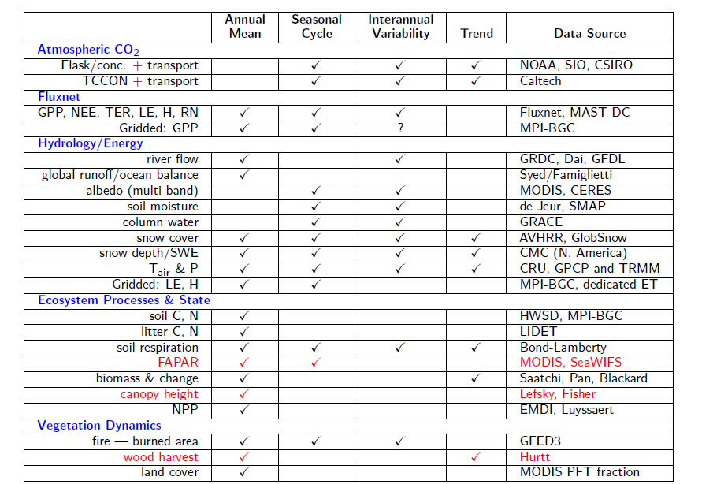
ILAMB 1.0 benchmark is now under development
NASA observations will contribute to many of the components

Slide 26
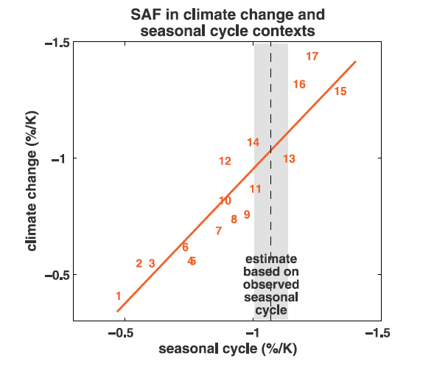
Challenge for the future:
How do we constrain future scenarios of carbon cycle change using contemporary observations?
Snow – albedo feedback
End of 21st century feedback
Contemporary observations
Hall and Qu 2006

Slide 27
Concluding remarks
Coupled models
  We can improve the efficacy of future MIPs by increasing investment in high quality driver data sets and reusable open-source benchmarking systems
Atmospheric transport models
  New observations from TCCON, HIPPO, CARVE, and OCO-2 provide a fundamentally new level of constraint on surface fluxes and atm. transport
  Future progress in reducing uncertainties will require closer collaboration with experts in areas of atm. dynamics, convection and data assimilation (e.g., Kalnay-Fung NCEP collaboration)
Land and ocean models
  Both data-driven and coupled model intercomparison projects are underway – benchmarking requirements are similar
  Significant improvements in process level understanding making their way into models, slowly!

Slide 28
Backup Slides

Slide 29
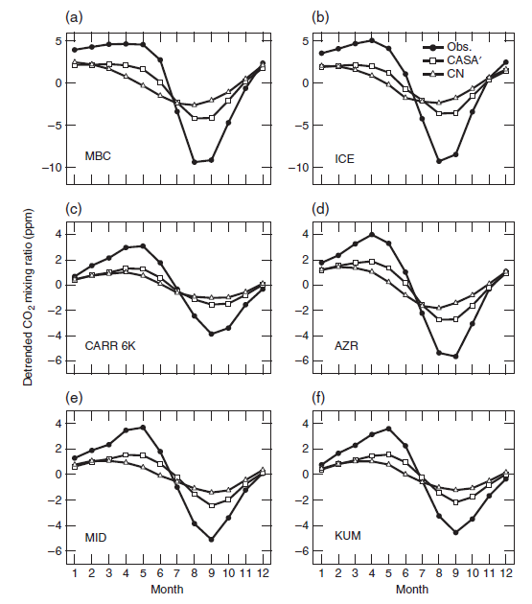
What is a benchmark?
A quantitative test of model function, for which the uncertainties associated with the observations can be quantified
Acceptable performance on benchmarks is a necessary but not sufficient condition for a fully functioning model
Since all datasets have strengths and weaknesses, an effective benchmark may be one that draws upon a broad set of independent observations to evaluate model performance on multiple temporal and spatial scales

Slide 30
International Land Model Benchmarking (ILAMB) Project Goals
Develop benchmarks for land model performance, with a focus on carbon cycle, ecosystem, surface energy, and hydrological processes. The benchmarks should be designed and accepted by the community.
Apply these benchmarks to global models
Support the design and development of a new, open-source, benchmarking software system for either diagnostic or model intercomparison purposes
Strengthen linkages between experimental, monitoring, remote sensing, and climate modeling communities in the design of new model tests and new measurement programs

Slide 31
Why develop a new, open-source, benchmarking software system via ILAMB?
GCP TRENDY
CMIP5
Future MIPs
IPCC AR6
…
Human capital costs of making rigorous data-model comparisons is considerable and constrains the scope of individual MIPs
Many MIPs spend resources “reinventing the wheel” in terms of variable naming conventions, model simulation protocols, and analysis software
Need for ILAMB: Each new MIP has access to the data-model comparison modules from past MIPs through ILAMB (i.e., MIPs use one common modular software system). Standardized international naming conventions also increase MIP efficiency

