Slide 1
NASA CCE Joint Science Workshop
Alexandria, VA. October 3-7, 2011
Vegetation Phenology and Vegetation Index Products from Multiple Long Term Satellite Data Records (VIP)
VIP Data Explorer: 30 Years of VI and Phenology Observations
Kamel Didan, et al.
The University of Arizona
Poster #304

Slide 2
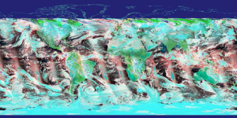
Project Overview
AVHRR record, ‘81 – ‘’99
MODIS record, ‘00 – ’13
‘98-’02 SPOT- VGT Data to
Bridge AVHRR & MODIS records
Data retention filter.
Only retain high quality data
VIIRS ?
Homogenous clusters map.
Areas with same characteristics
NDVI + EVI2 (minus Blue)
Independent of sensor
Derive phenology metrics
Continuity Transfer Functions map
1981 -2013 sensor independent VI and Phen. ESDRs
NASA CCE Joint Science Workshop, Alexandria, VA. Oct. 3-7, 2011
Notes:
The goal of our project is to combine the AVHRR (1981-1999), MODIS (2000-2013) and VIIRS (when available) into a single seamless data record.
This requires developing a set algorithms to address the across sensors continuity (different spectral and radiometric characteristics).
Because of the lack of overlap between AVHRR and MODIS, we’re using SPOT-VGT to bridge this gap and support the continuity work.
The continuity algorithms are based on the homogeneous clusters approach. Areas with similar vegetation, elevation, precipitation, temperature regimes, etc… are expected to have the same VI temporal patterns. We’re developing continuity transfer functions for each of these homogeneous clusters from the periods of overlap. Using these continuity transfer functions we will transform the AVHRR record into a MODIS like record, and consequently a sensor independent records.

Slide 3
Spectral Transformation Equations to MODIS-equivalents (TOC, CMG)
NDVI (x variable) | Equation | Uncertainty (95% PI)
N-7 AVHRR, ROW, GAC | y = -0.0646111 + 1.2409713x - 0.0304219x² | ±0.0138
N-9 AVHRR, ROW, GAC | y = -0.0621082 + 1.2487272x - 0.0307315x² | ±0.0138
N-11 AVHRR, ROW, GAC | y = -0.0606805 + 1.2456808x - 0.0335204x² | ±0.0138
N-14 AVHRR, ROW, GAC | y = -0.0571829 + 1.2372178x | ±0.0138
S-4 VEGETATION, TOC, CMGV | y = 0.0156834 + 1.0610148x | ±0.061
EVI2 (x variable) | Equation | Uncertainty (95% PI)
N-7 AVHRR, ROW, GAC | y = -0.0403338 + 1.2400319x | ±0.088
N-9 AVHRR, ROW, GAC | y = -0.0403338 + 1.2400319x | ±0.088
N-11 AVHRR, ROW, GAC | y = -0.0403338 + 1.2400319x | ±0.088
N-14 AVHRR, ROW, GAC | y = -0.0403338 + 1.2400319x | ±0.088
S-4 VEGETATION, TOC, CMGV | y = 0.0085842 + 1.1557716x | ±0.037
NASA CCE Joint Science Workshop, Alexandria, VA. Oct. 3-7, 2011

Slide 4
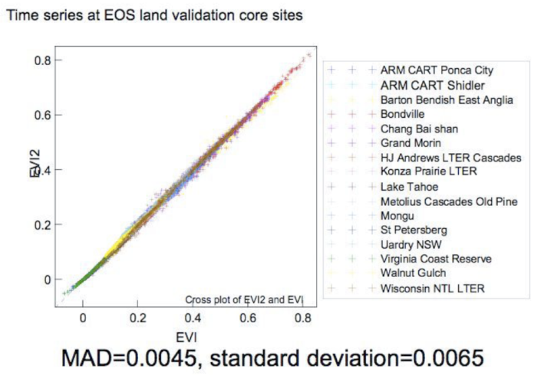
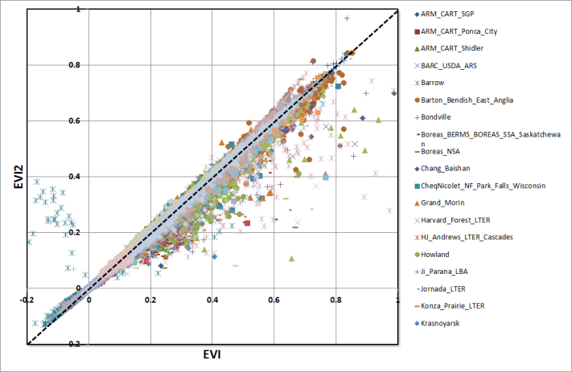
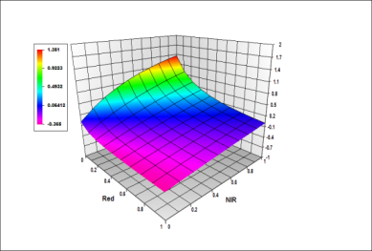
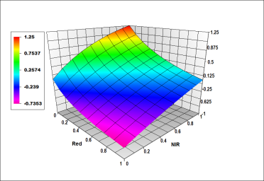
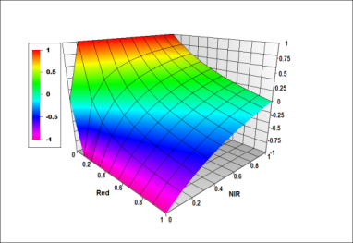
Comparison of EVI and EVI2
Unconstrained data
Constrained data
EVI EVI2 NDVI
NASA CCE Joint Science Workshop, Alexandria, VA. Oct. 3-7, 2011

Slide 5
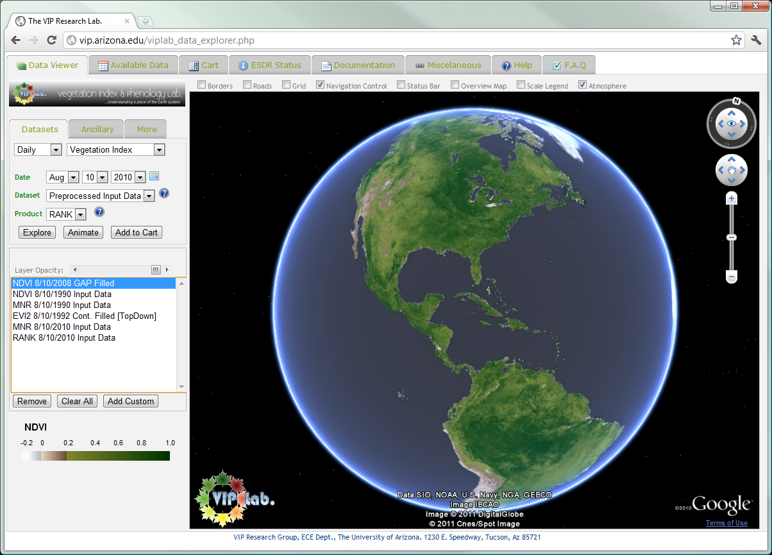
VIP Data Explorer Interface
DB and Cart System
Status and Documentations
Time series
GE Standard navigation tools
Additional data
Data Selection
Overlay control
Current Layers
User uploaded data
Legend or additional info
NASA CCE Joint Science Workshop, Alexandria, VA. Oct. 3-7, 2011

Slide 6
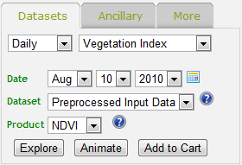
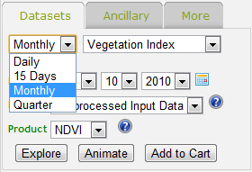
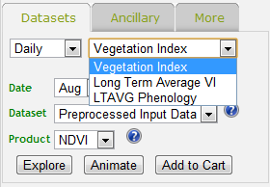
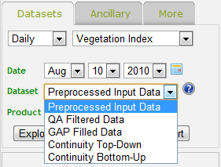
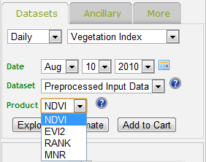
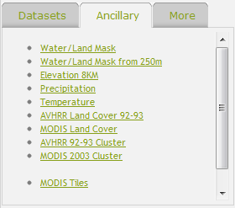
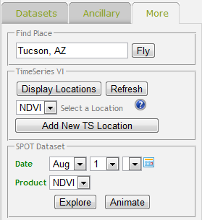
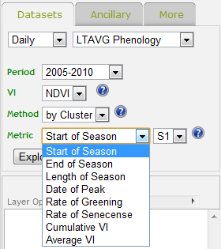
Datasets and Options
NASA CCE Joint Science Workshop, Alexandria, VA. Oct. 3-7, 2011

Slide 7
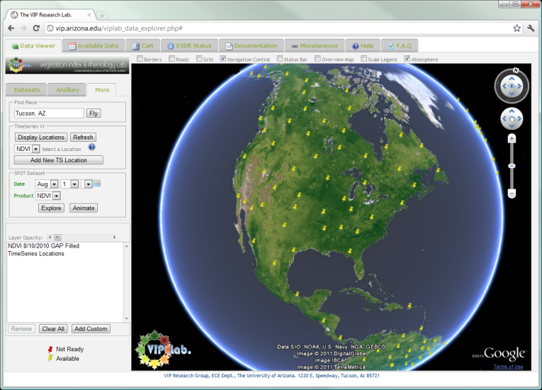
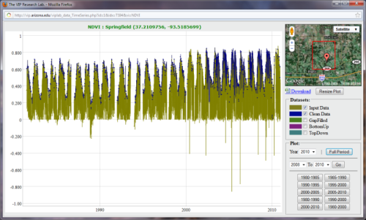
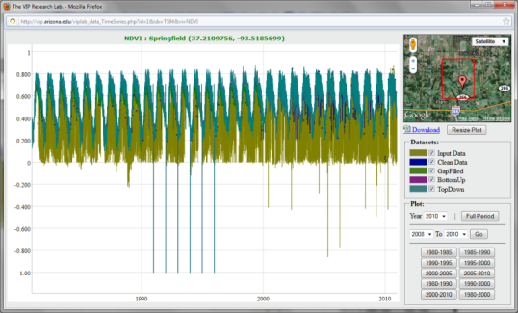
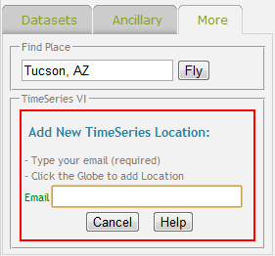
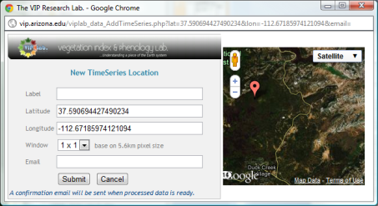
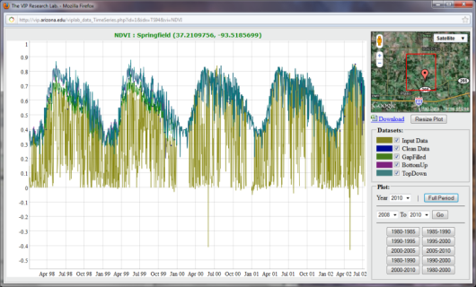
Global Database of Time Series
NASA CCE Joint Science Workshop, Alexandria, VA. Oct. 3-7, 2011

Slide 8
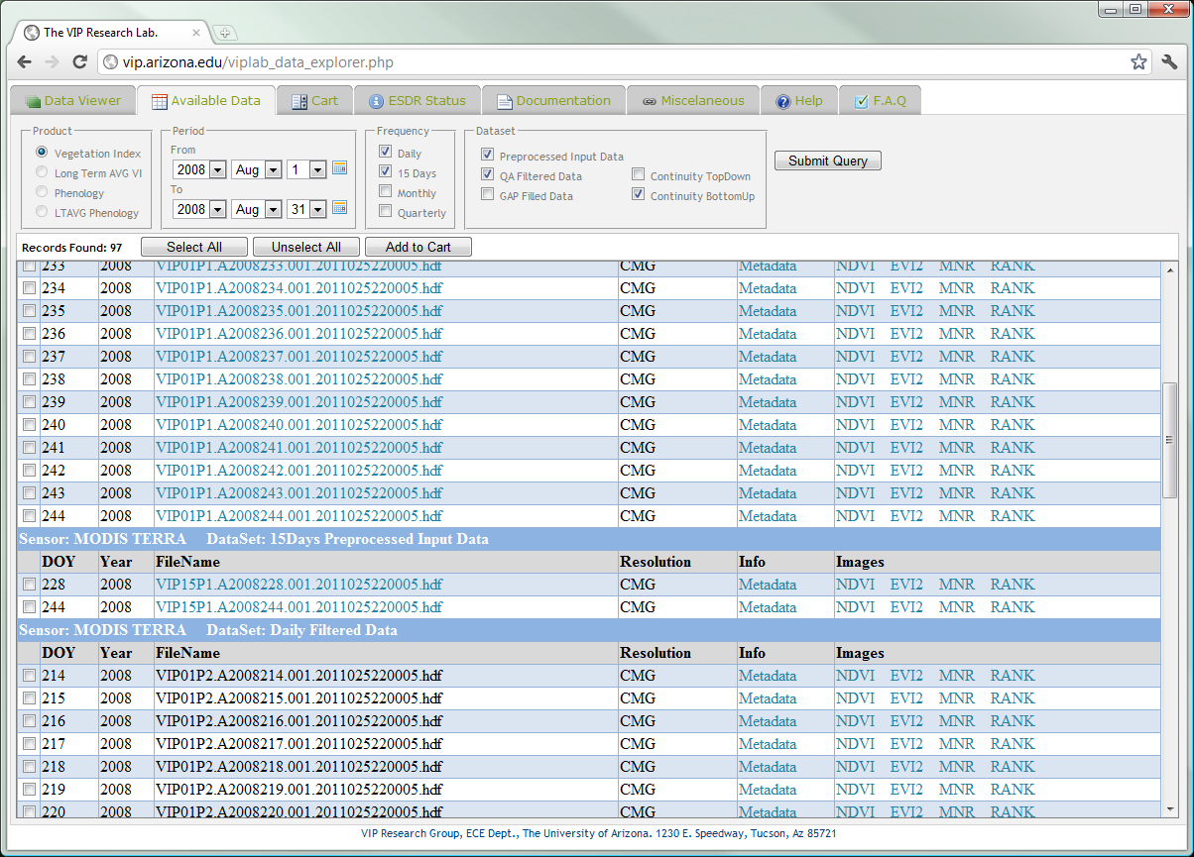
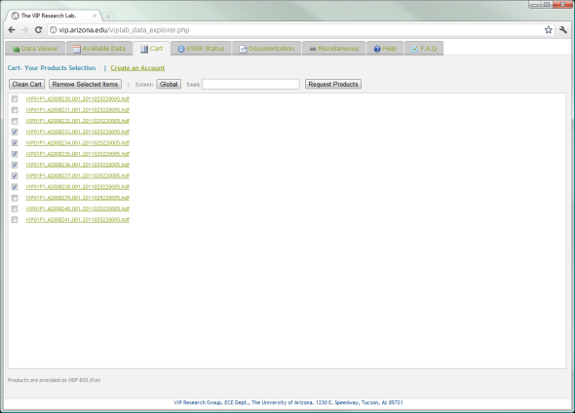
Direct Database Search and Order
NASA CCE Joint Science Workshop, Alexandria, VA. Oct. 3-7, 2011

Slide 9
vip.arizona.edu
Poster #304

Slide 10
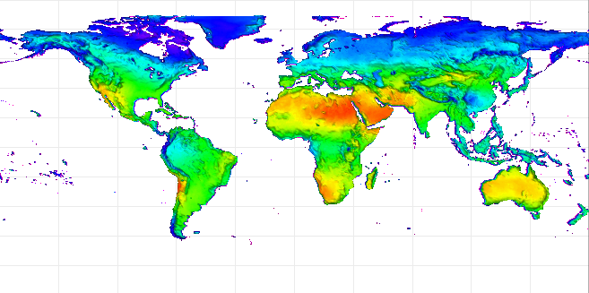
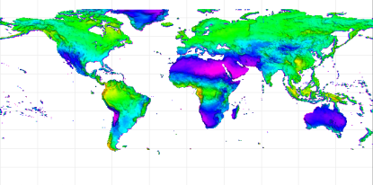
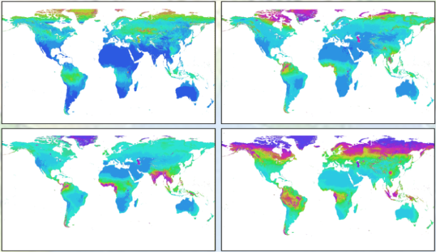
Limit imposed by Synoptic RS
% Cloudy observations
Based on the 30-year combined AVHRR/MODIS VI record. Most vegetated biomes reveal a considerable lack of useful data, in particular the high latitudes and the tropics.
% valid observations
Seasonal mean of the number of days between ‘useful’ observations based on the analysis of the 10-year Terra MODIS daily observations record.
JFM AMJ
JAS OND
NASA CCE Joint Science Workshop, Alexandria, VA. Oct. 3-7, 2011

