Slide 1
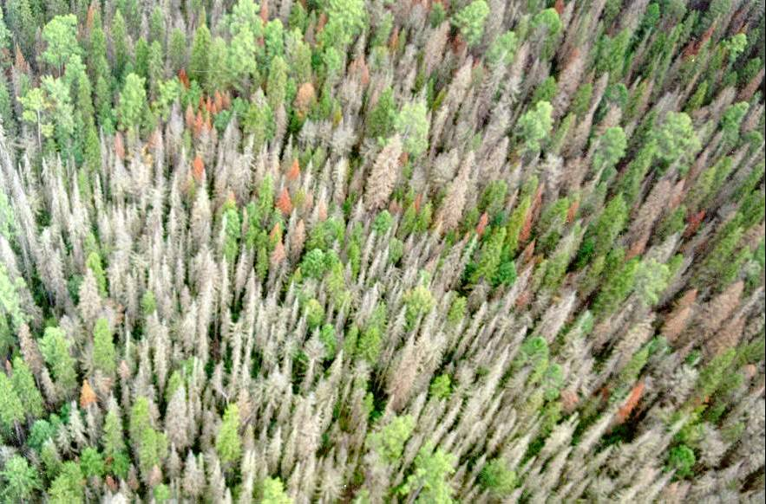
Impacts of Ecosystem Disturbance and Vulnerability Trends
Tatiana Loboda
Jacquelyn Shuman
Robert E. Kennedy
Zhiqiang Yang
Warren B. Cohen
Sam Goward
Jeff Masek
Jeff Chambers
Hank Shugart
Nancy French
Eric Kasischke
Olga Krankina
Steve Running
Phil Townsend
Jeff Richey
Matt Hansen
Mike Behrenfeld
Dick Barber
Joaquim Goes
And many others
3rd NASA Carbon Cycle and Ecosystems Joint Science Workshop.
October 3 - 7, 2011
Hilton Alexandria Mark Center, Alexandria, Va.

Slide 2


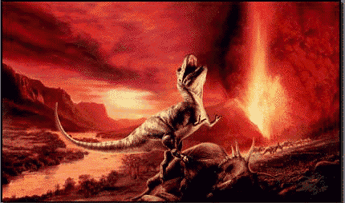
What is a disturbance?
Disturbances are significant, often abrupt and violent changes in the environment of an ecological system.
Both time in terms of periodicities) and space scale (resolution andn extent) define a disturbance. When changes are sufficiently small or frequent, they are incorporated into the environment of the ecosystem; when they are sufficiently large and infrequent, they are catastrophes. Disturbances lie between these temporal bounds.
Sunrise
Size
Catastrophes
Periodicity

Slide 3
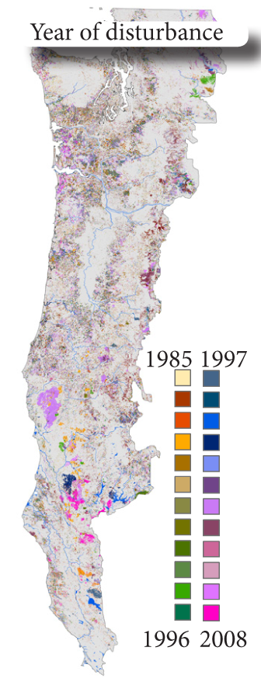
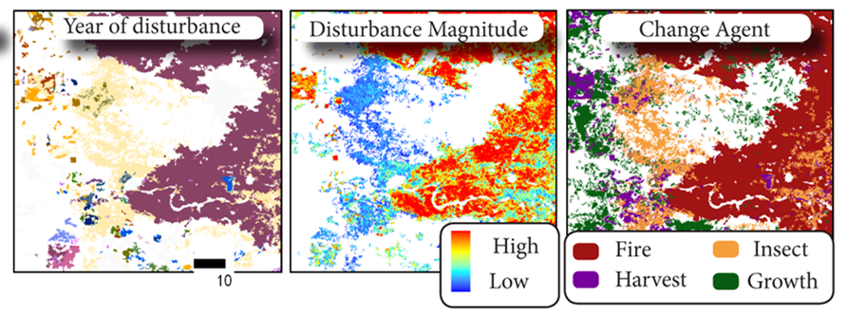
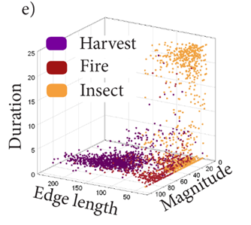

Slide 4
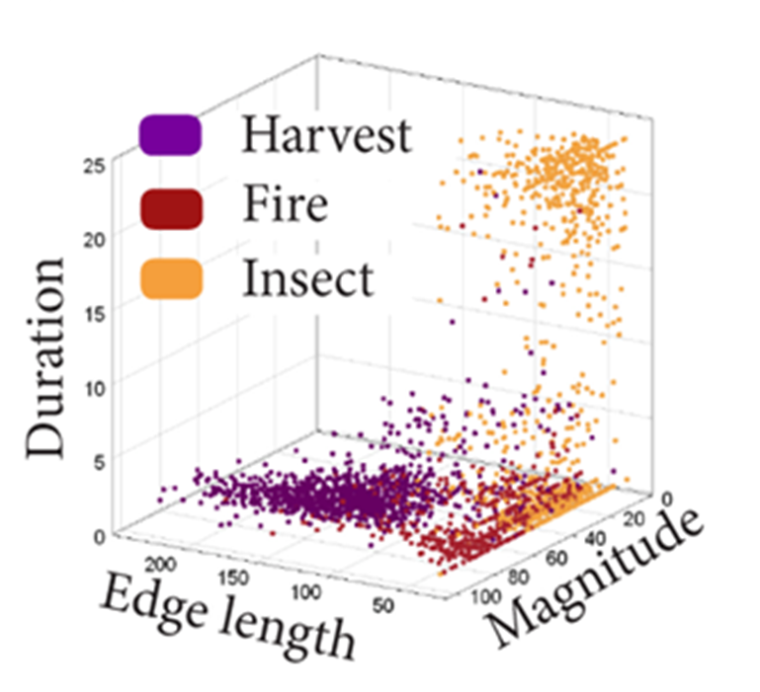

Along with being an excellent example of multiple disturbances operating over a large region, this also allows some conceptual “filling in the dots” on disturbance scale … or is that “dotting in the fills”?
Disturbance Scale
.
.
.

Slide 5
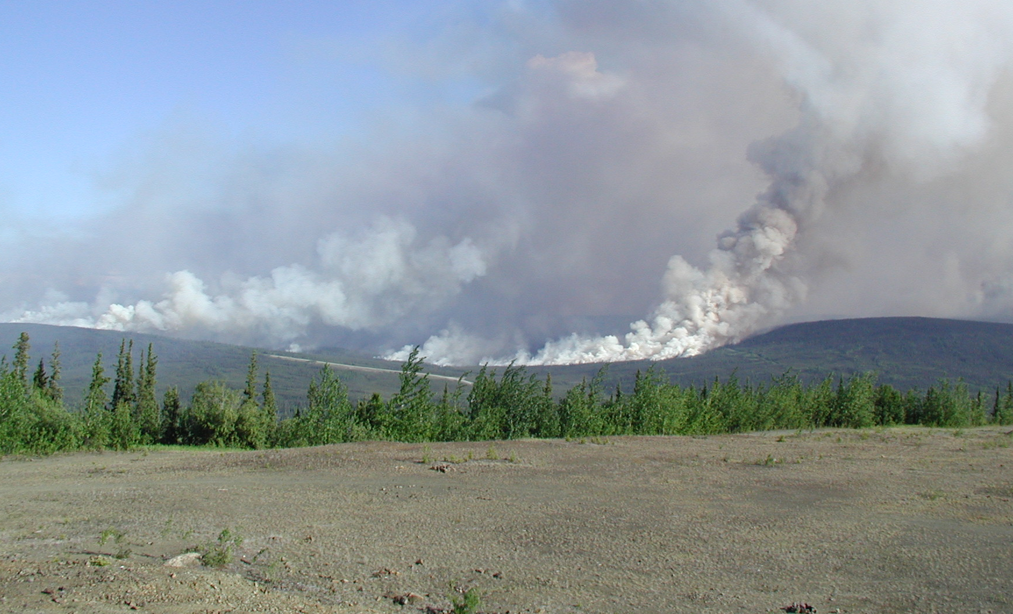
Disturbance Effects on Ecosystems
Notes:
The research our group has carried out for NASA’s Carbon Cycle Science Program has focused on the impacts of changes to Alaska’s fire regime on ecosystems and carbon cycling.
This research is from two separate projects funded by Diane Wickland:
Remote Monitoring of Changes in Forest Functional Types after Disturbance from Fire in the North American Boreal Region: Implications for Interpreting the Effects of Satellite-Observed Changes in Vegetation Greenness on the Terrestrial Carbon Budget
Assessing the Impacts of Fire and Insect Disturbance on the Terrestrial Carbon Budgets of Forested Areas in Canada, Alaska, and the Western United States
This research has had 3 key components
Field-based research coordinated with other Alaskan researchers via the Bonanza Creek LTER and USGS on the impacts of fire on burning of organic soils and the impacts of variations in depth of burning on post-fire succession in black spruce forests
Development of information products (including Remote sensing products) to map fire severity
Development of new approaches to estimate carbon consumption/emissions at fine spatial (60 m resolution) and temporal (daily time intervals) scales
Much of this research has come together over the past year, and resulted in a number of journal articles that are referenced in the 3 slides describing the major findings from this research.

Slide 6
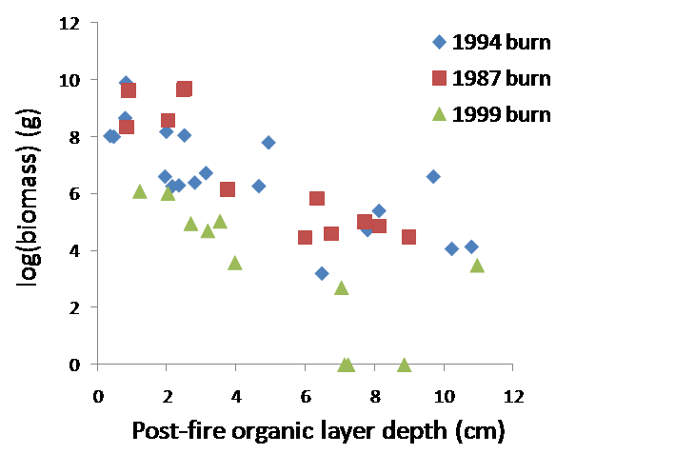
Field-Based Studies
Factor controlling depth of burning/fire severity in black spruce forests – Topography, seasonal permafrost thaw, fire year size)
Deep burns lead to invasion and growth of aspen in black spruce stands
Aspen biomass
Turetsky et al., Nature Geoscience, 2011
Shenoy et al. Forest Ecol. Mgmt., 2011
Notes:
A key to understanding fire impacts in black spruce forests is determining what factors control depth of burning in black spruce forests. This study involved integration of field data sets from over 30 fire events and 178 sites that were collected by multiple groups. This data set was sufficient to identify the critical factors controlling depth of burning in Alaska black spruce forests (Turetsky et al.)
Over the past decade, a number of studies have documented the impact of fire severity (e.g., the depth of the organic layer remaining after a fire, or the residual organic layer depth) on changes in post fire succession in black spruce forests. In summary, these studies show that residual OL depths < 3 cm provide conditions for recruitment and growth of deciduous species at high enough levels that the post fire recovery will be dominated by deciduous species. OL depths between 3 and 6 cm can lead to lesser levels of deciduousness (Shenoy et al.)

Slide 7
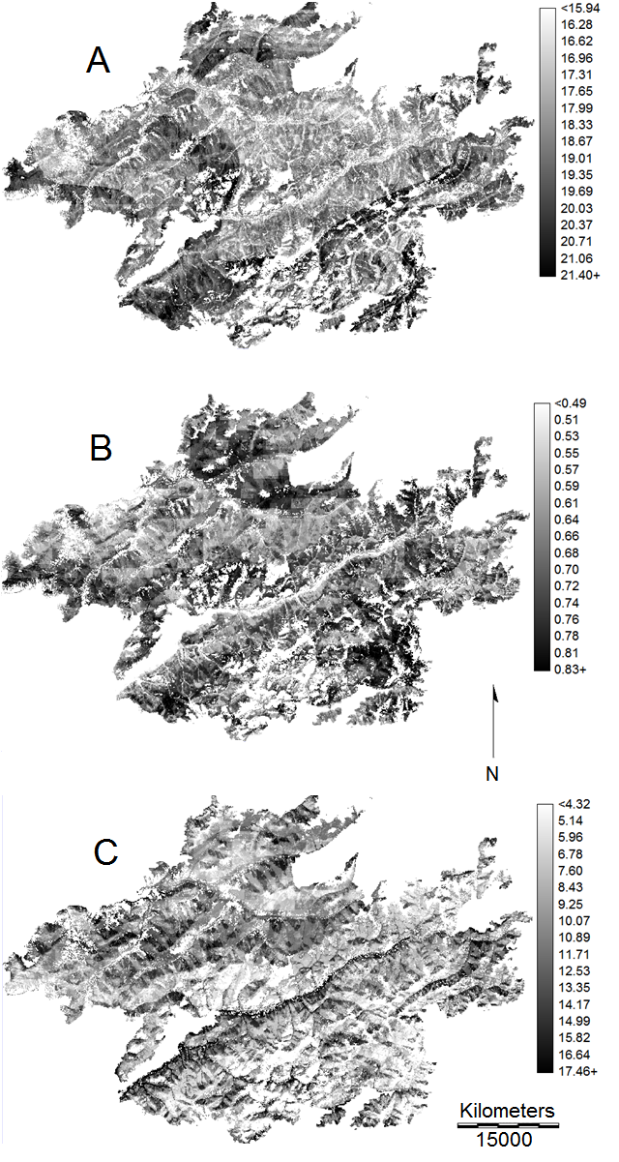
Deep Burning in Black Spruce Stands
Results from 2004 Alaska fires showed that 14% of the black spruce forests experienced fire severe enough to produce conditions for a switch to deciduous forests, where an additional 25% experienced fire severity that would increase deciduous cover post fire
Predicted post-fire organic layer depth
From application of a method to map depth of burning that by combines field data with a combination of geospatial data, including Landsat TM/ETM+ spectral data
Barrett et al., Ecol. App., in press

Slide 8
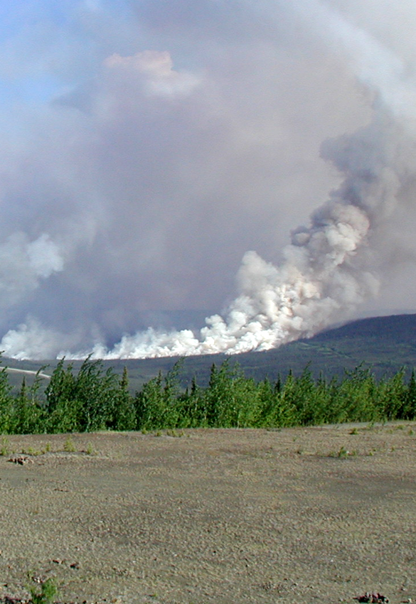
One obvious general question regards the variability of predictions from the same models ingesting the same data. This is being explored for carbon emitted during a fire disturbance event.

Slide 9
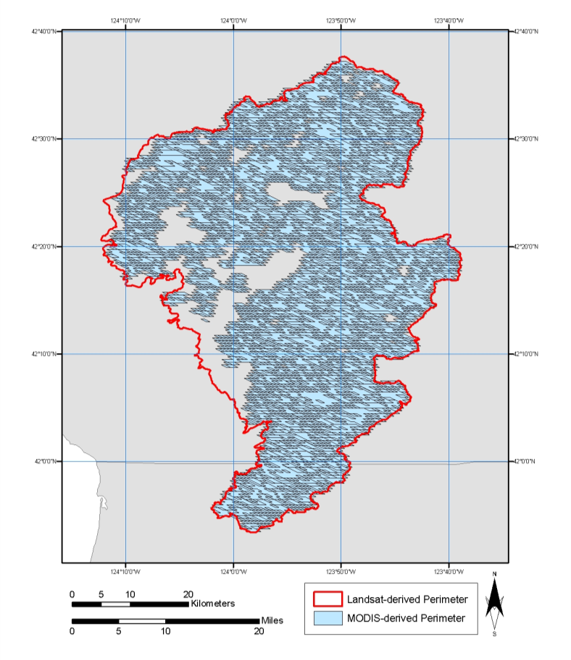
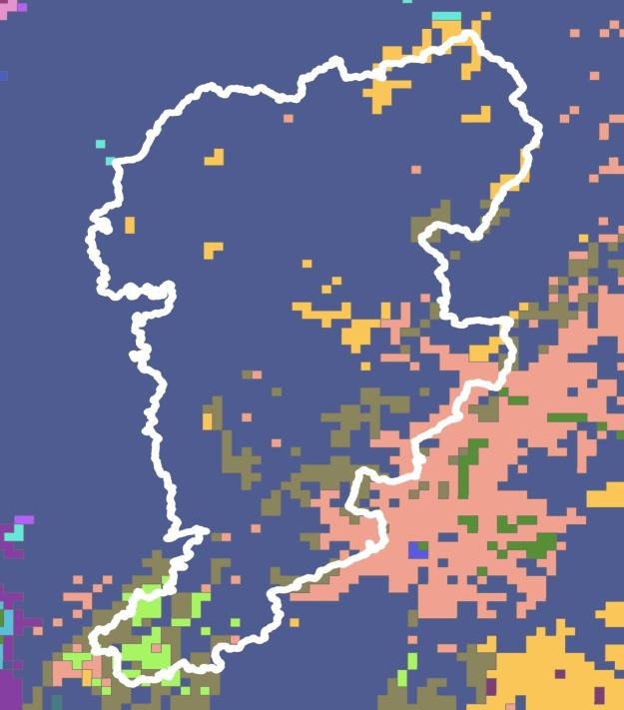
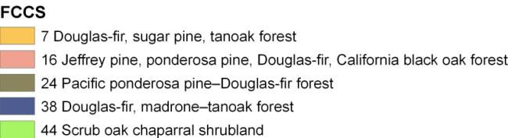
Spatial Datasets
Burn Area
Fuel (vegetation) type and biomass

Slide 10
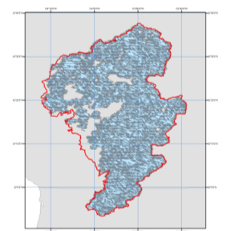
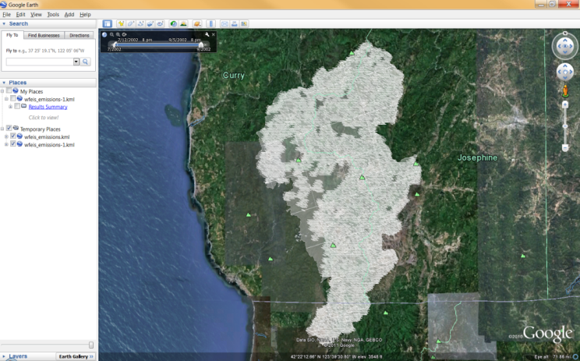

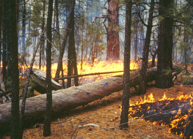
Spatial Estimation of Fire Emissions
Location and day of fire
Consumption & Emissions model (GFED, Consume, FOFEM, CanFIRE)
Output: Spatial representation of emissions
Daily weather
→ Fuel moisture
Fuel load (biomass) and fire behavior
Fuel (vegetation) type

Slide 11
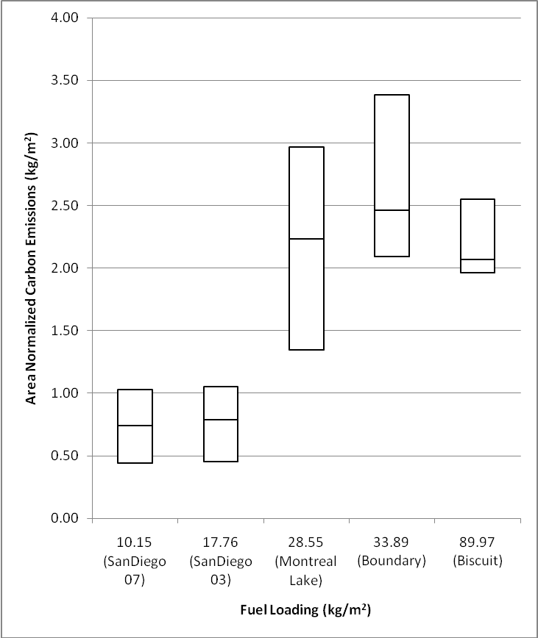
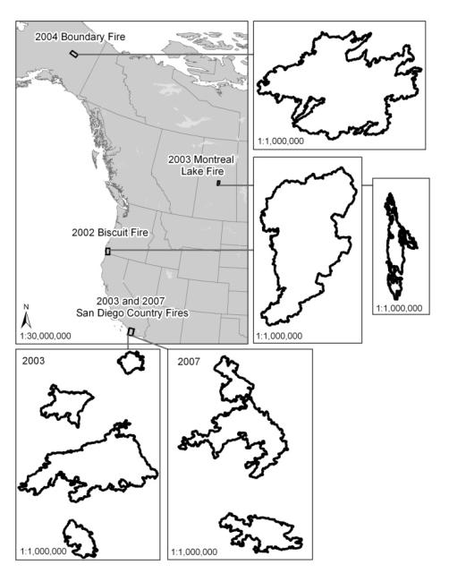
Estimated Carbon Emissions from Six Models
Five Test Sites
High biomass forests
Low biomass shrublands
French, N.H.F. et al. 2011. Model comparisons for estimating carbon emissions. Journal of Geophysical Research 116, doi: 10.1029/2010JG001469.

Slide 12
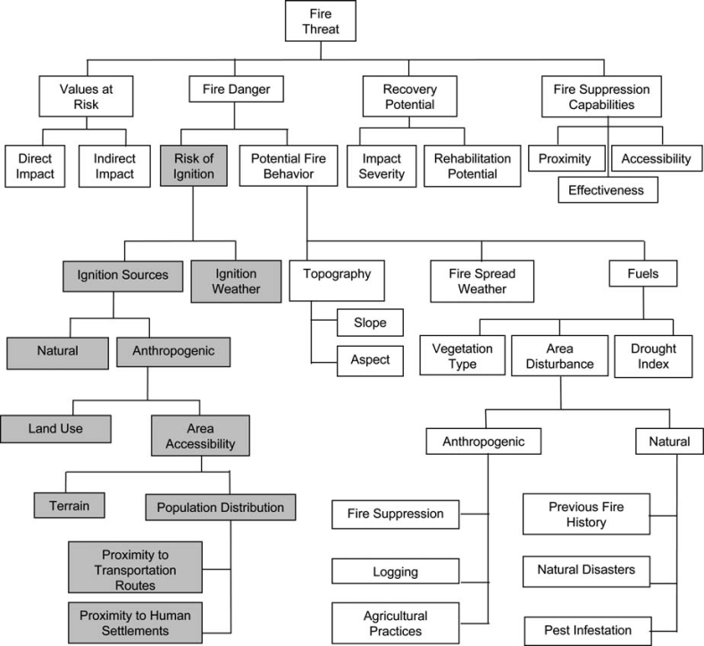
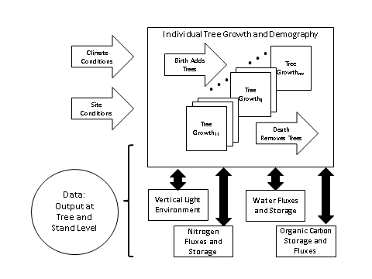
Disturbance Modeling
Event Models
Response Models

Slide 13
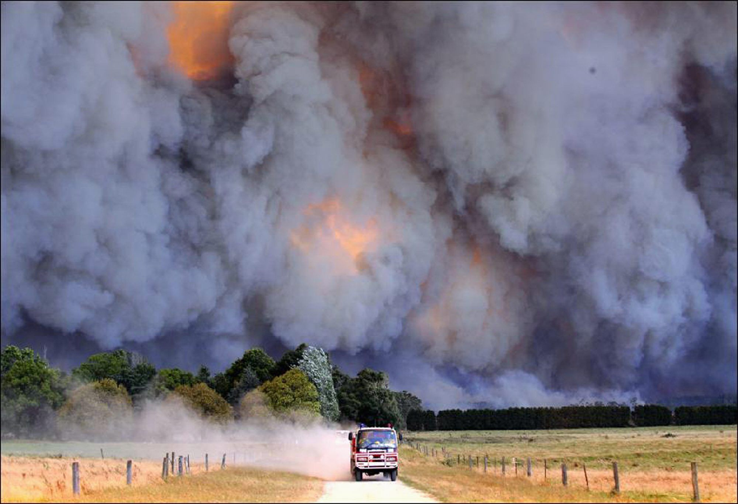
Disturbance Probability Models

Slide 14
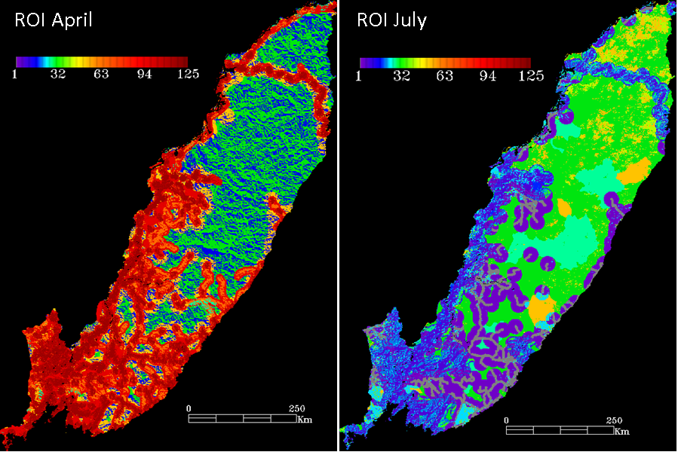
Model fusion of topographical data from the Shuttle Radar Topography Mission, satellite-based assessment of percent tree cover, satellite burned area record using Loboda et al (2007) algorithm to create regionally specific burned areas in the Russian Far East, and satellite active fire detections (2001-2009).
The active fires were reprocessed using Fire Spread Reconstruction algorithm to obtain the set of ignition points.
Exploring the effects of disturbance periodicity requires long records and is of the product of model or statistical analyses.
Exploring the effects of disturbance periodicity requires long records and is of the product of model or statistical analyses.
Risk of Ignition April
Risk of Ignition July

Slide 15
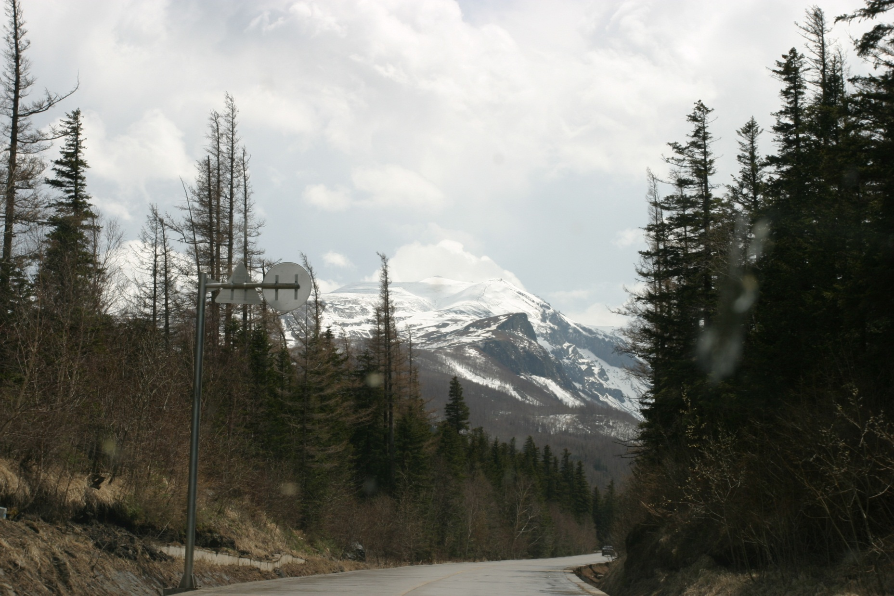
Models of the Response of Ecosystems to Disturbance
Changbaishan (Always White Mountain) on the Chinese-Korean Border

Slide 16
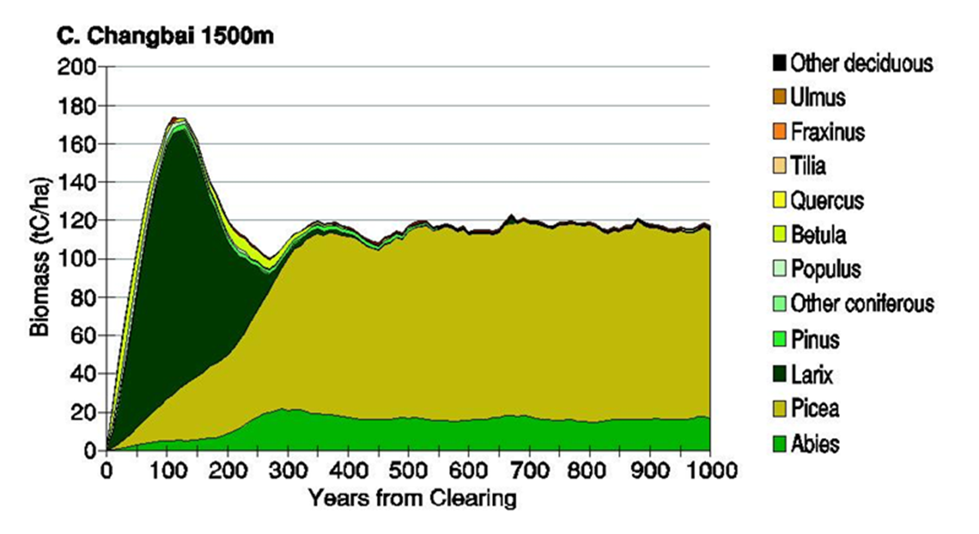
Exploring the effects of disturbance periodicity requires long records and is of the product of model or statistical analyses.
The simulated forest species composition dynamics expressed as cumulative biomass (tC/ha) for succession from bare ground Changbai Mountain (People’s Republic of China/Democratic People’s Republic of Korea) at 1500m in elevation .

Slide 17
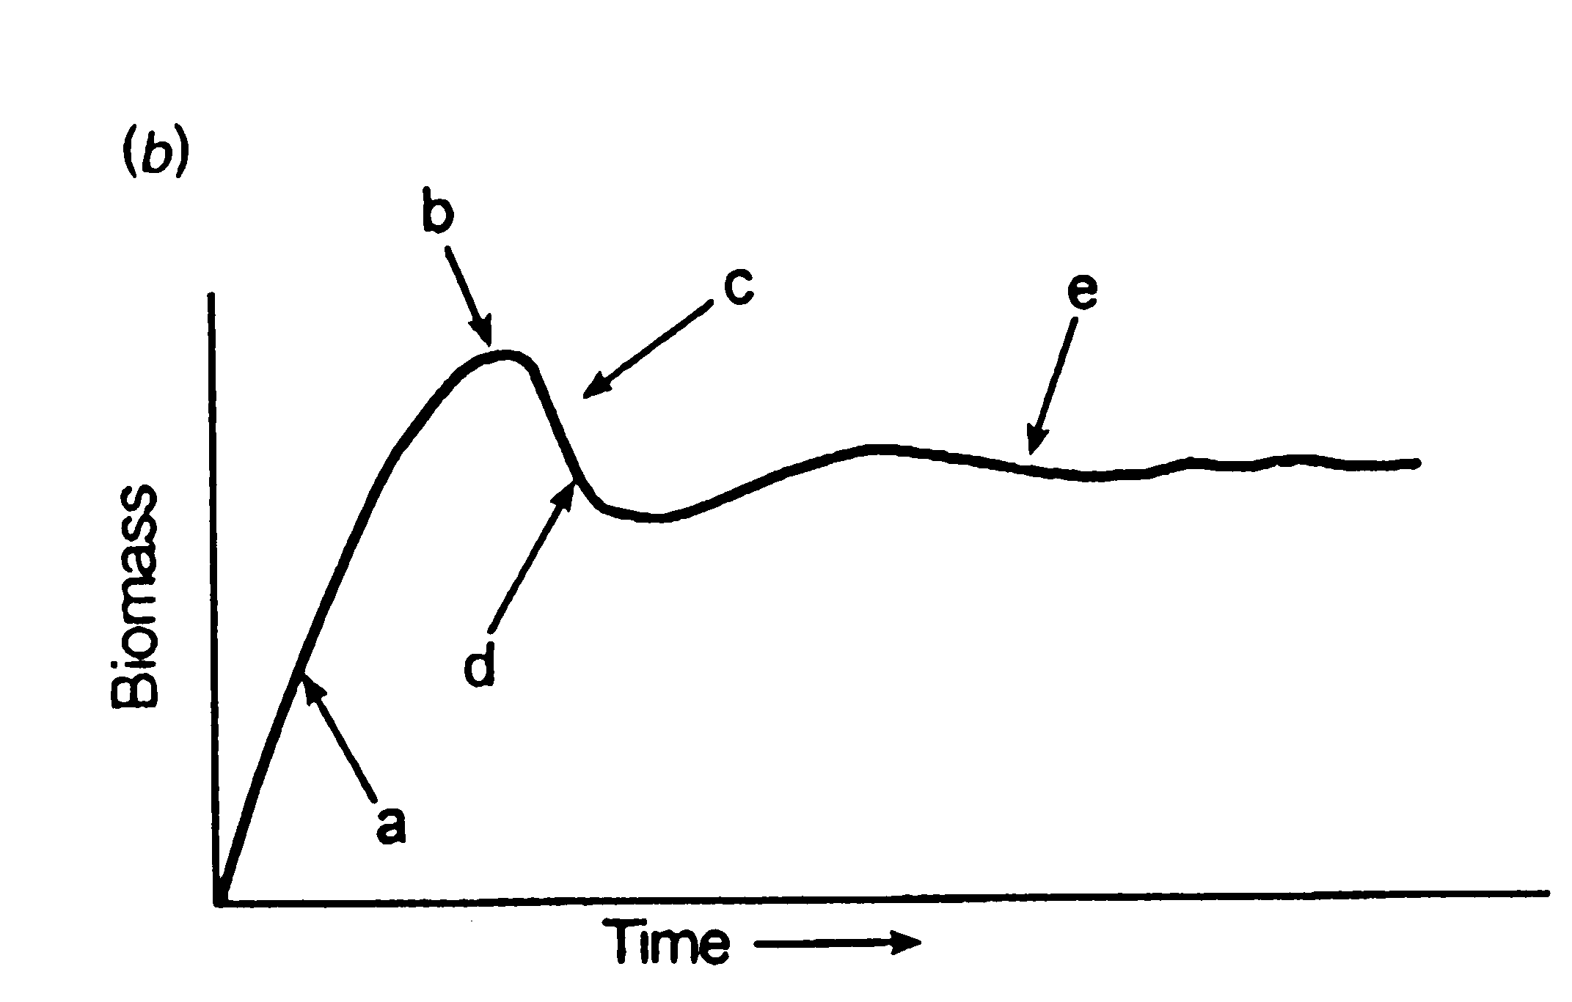



Expected Biomass Change
Recovery from Disturbance
Carbon disturbance recovery dynamics are non-linear as the all-aged successional patches become desynchronized to produce the mixed-aged mature-forest mosaic.
Carbon Source
Weak Carbon Sink
Carbon Sink
Mature forest is a mosaic.
Successional patches recovering from disturbance
time

Slide 18
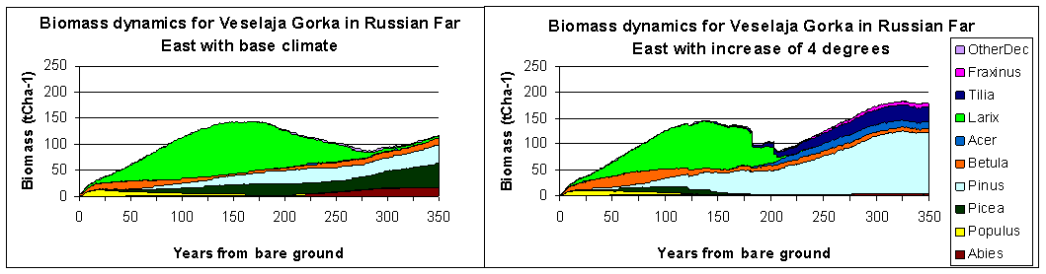
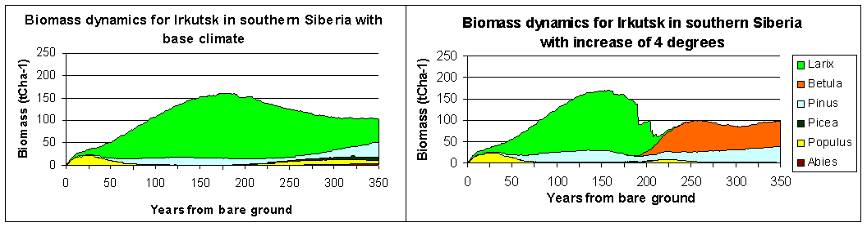
Cumulative biomass (tC ha⁻¹) of species from model simulations for two locations in Russia.
BASE
CASE
WARMING
Each graph displays composition by the dominant genera. The base cases in each of the pairs of graphs represent the successional dynamics from a bare ground condition in year 0 for 350 years of ecological succession.

Slide 19
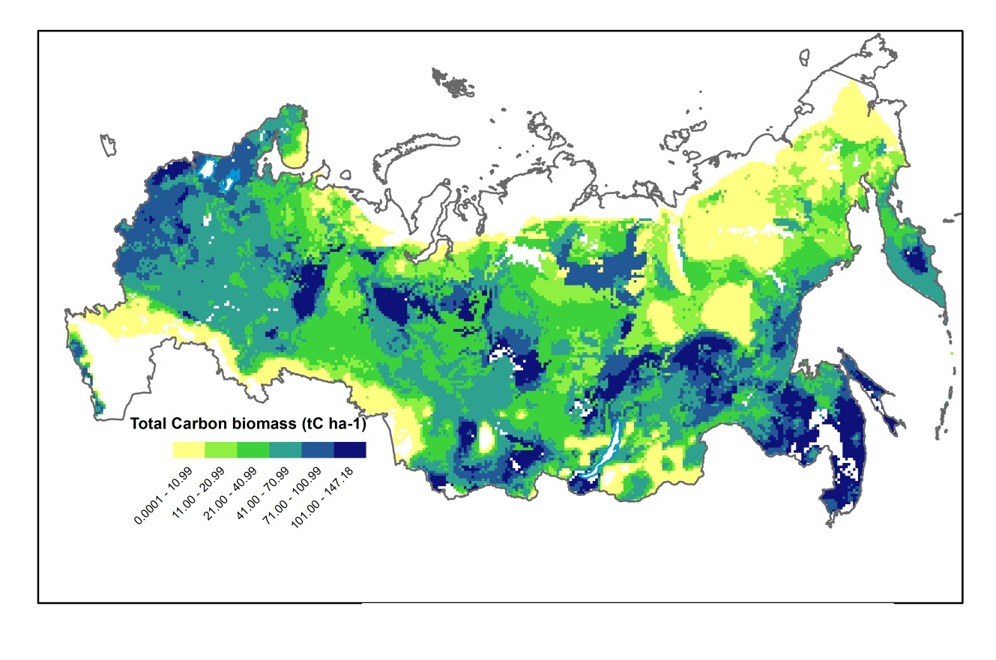
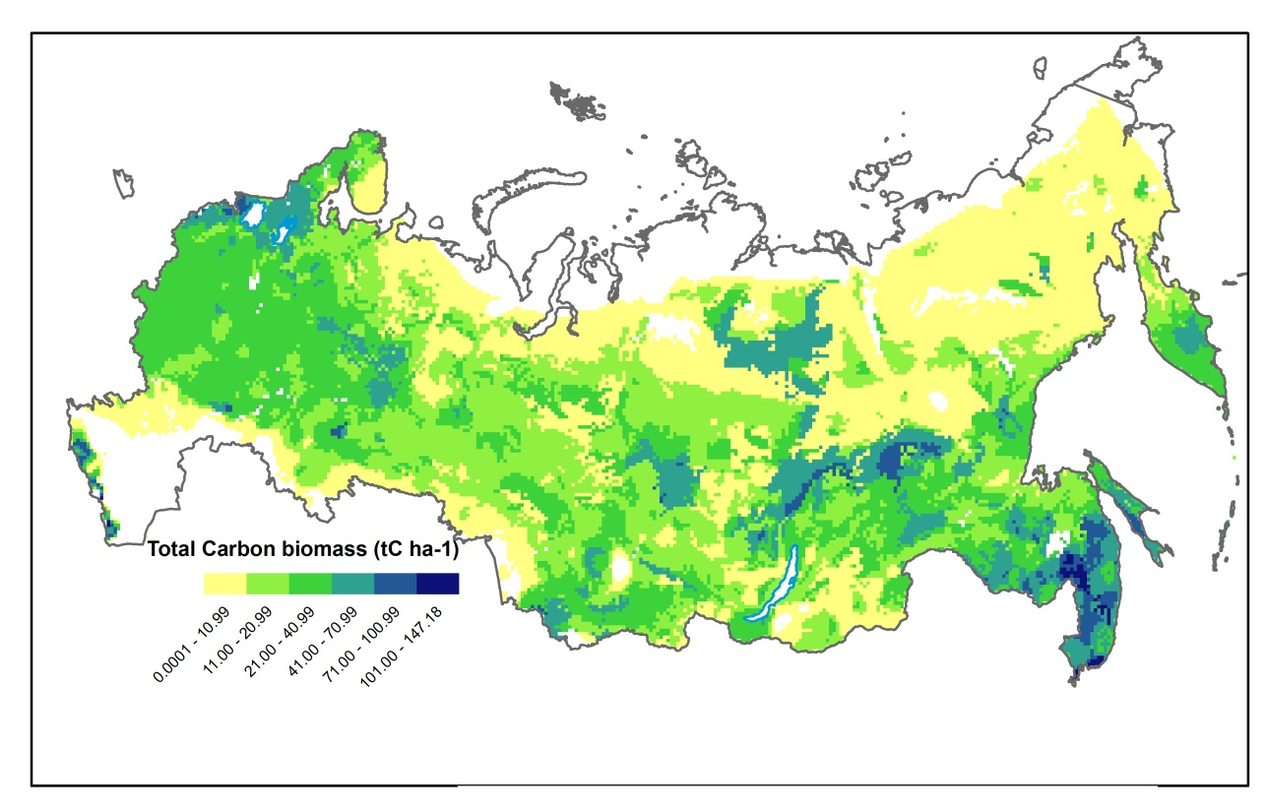
240 Years
Expected Carbon Storage at Different Ages after Disturbance for Russian Forests
40 Years

Slide 20
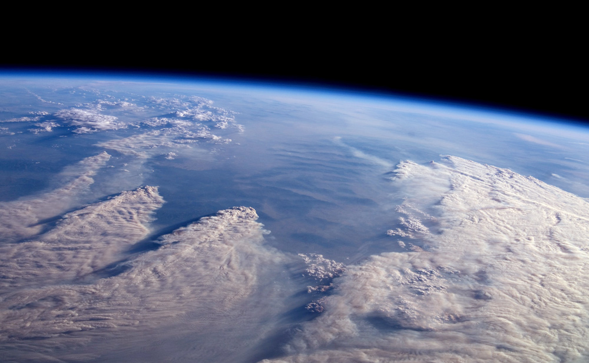
Montana Fires from the
Space Shuttle August 13, 2007
DISTURBANCE MONITORING
Livingston,MT

Slide 21
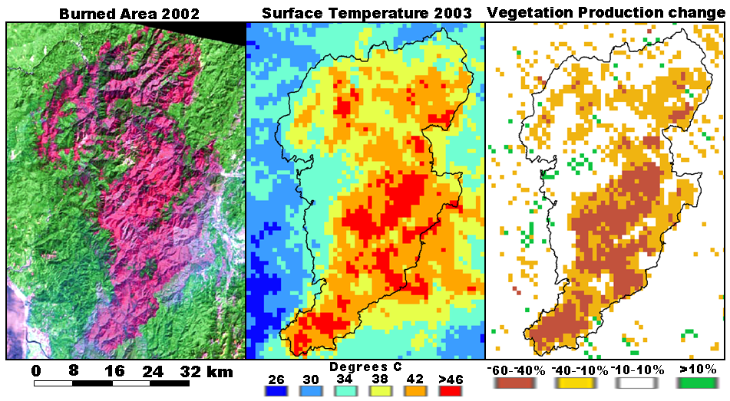
Disturbance Impact on Land Biophysics
Running, S. Science 321, Aug 2008

Slide 22
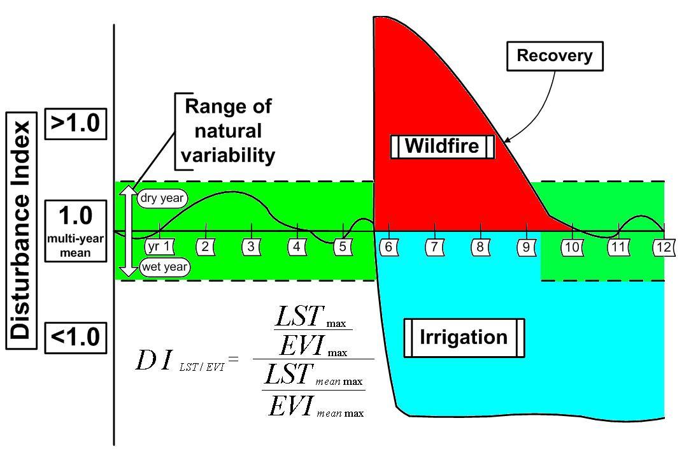
GLOBAL Generalized Disturbance Index
Mildrexler et al 2006

Slide 23
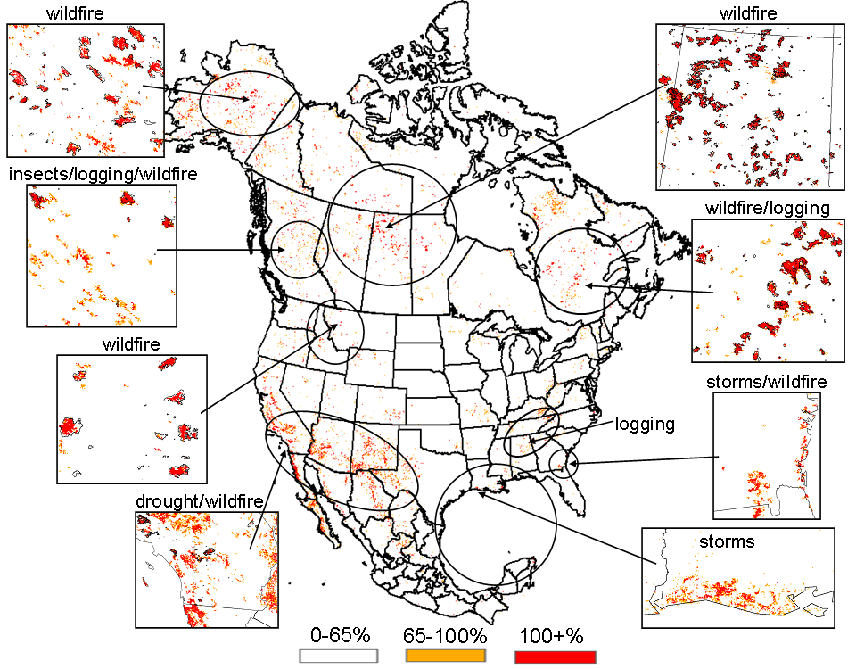
MODIS Annual Disturbance Index
Mildrexler et al 2007, 2009

Slide 24
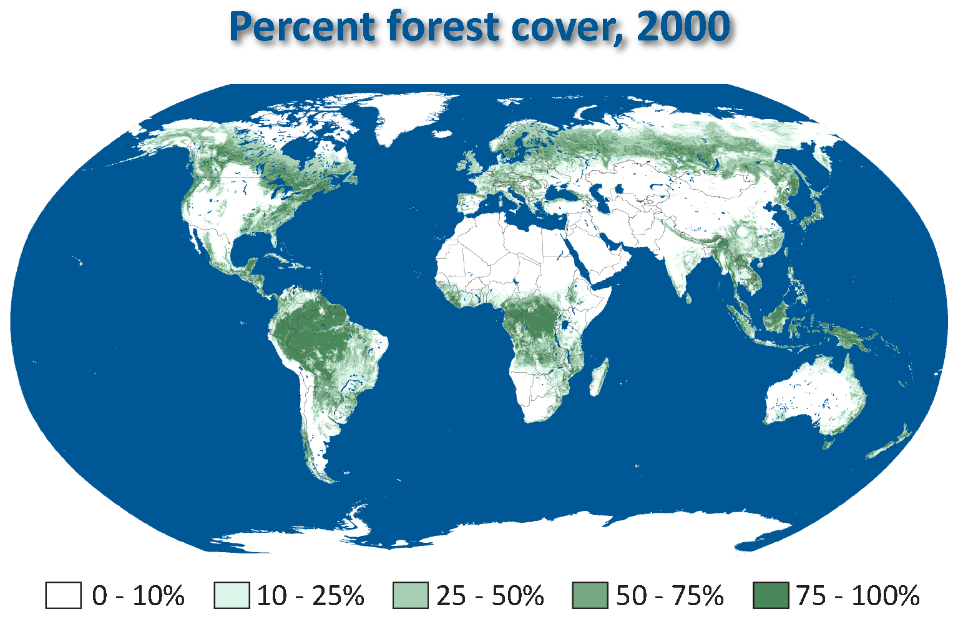
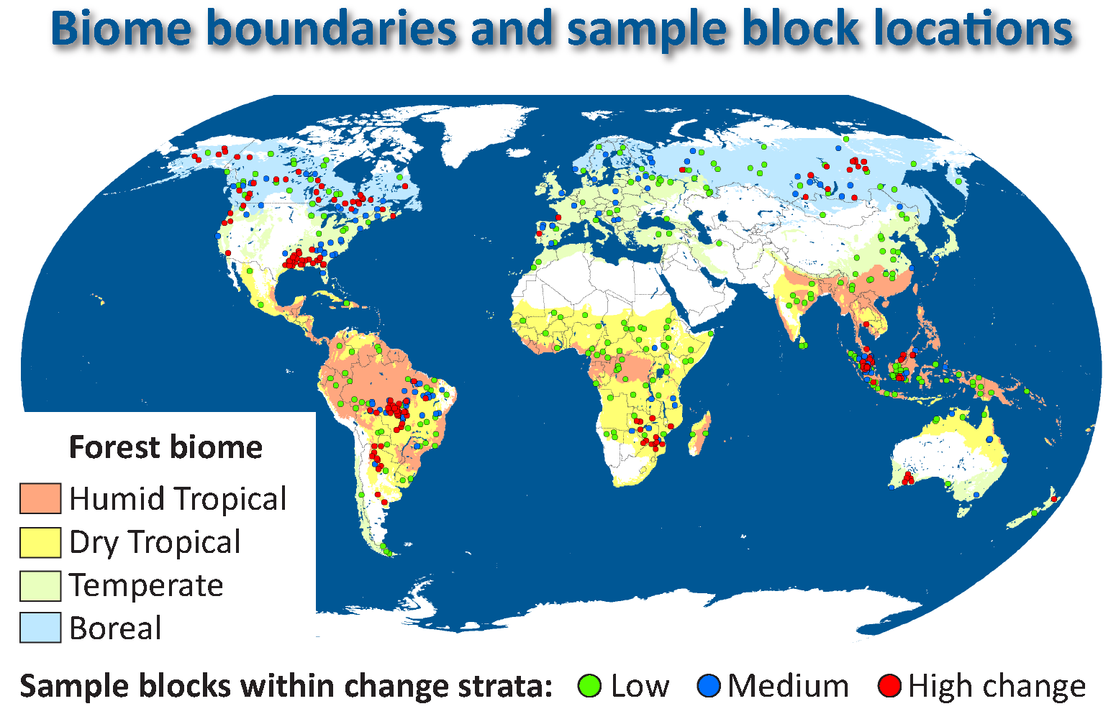
MODIS-stratified Landsat Samples
Percent forest cover, 2000
PNAS, in press
PNAS, 2010

Slide 25
Percent Forest Cover, 2000
PNAS, 2010

Slide 26
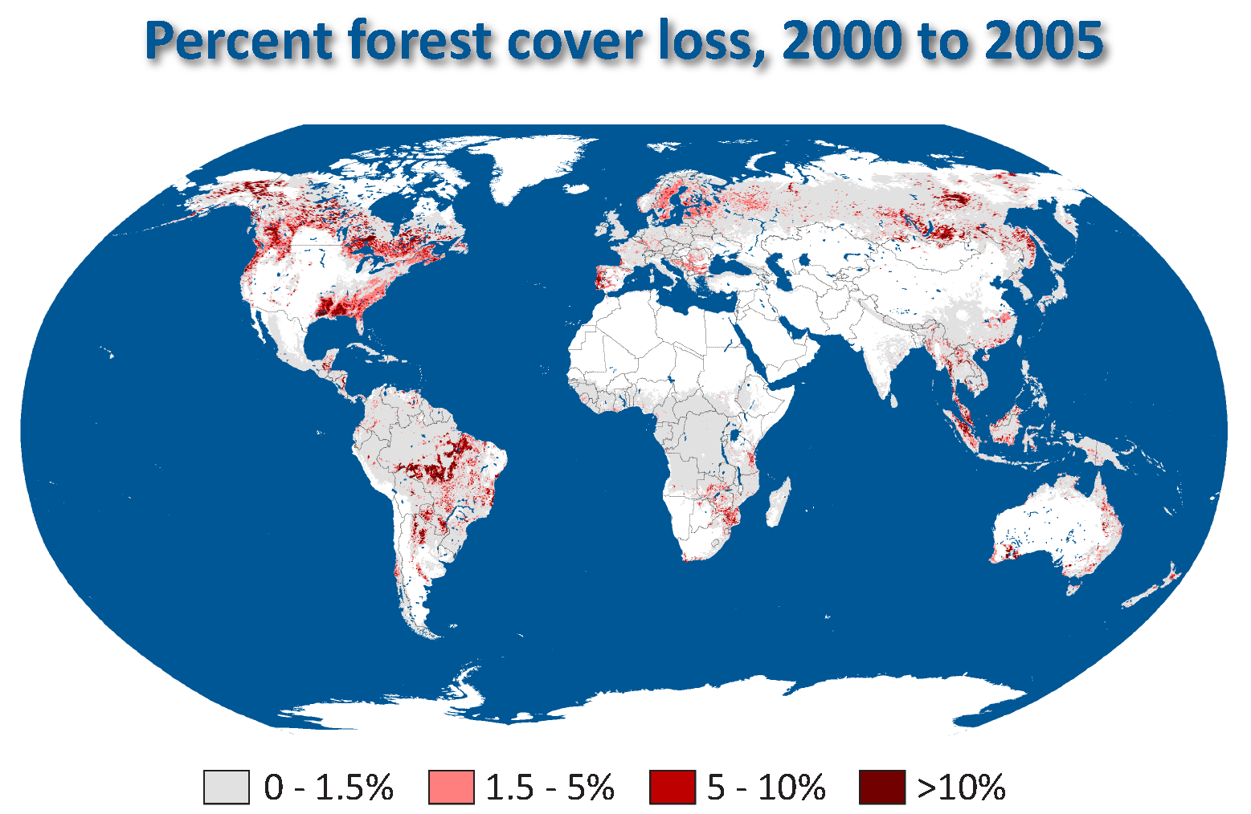
Percent Gross Forest Cover Loss, 2000 to 2005
PNAS, 2010

Slide 27
Loss of Forest Cover Due to Disturbances

Slide 28
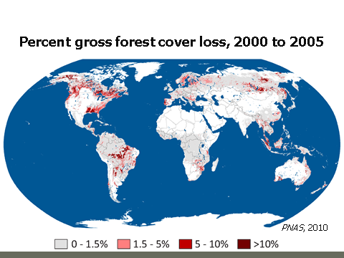
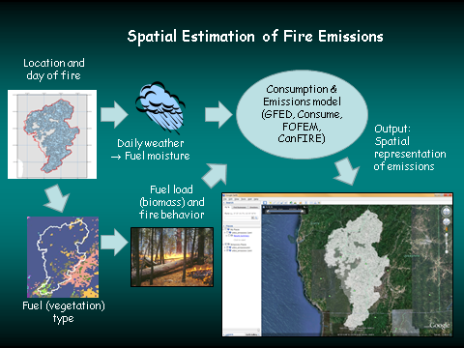
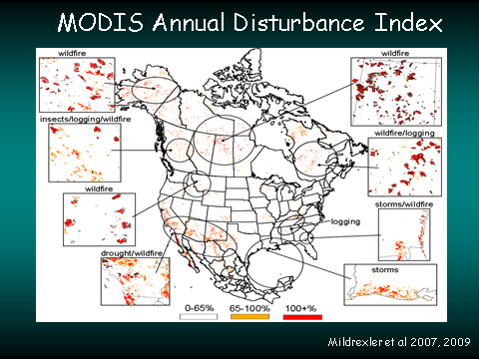
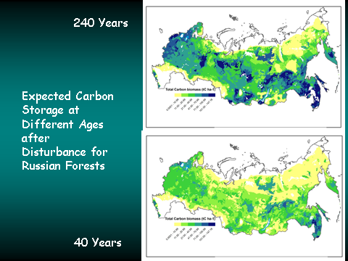
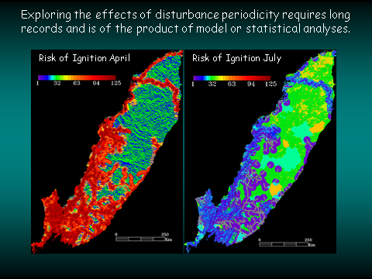
Fusion of NASA capabilities

Slide 29
THE END

