Slide 1

Remote Sensing for Biodiversity Conservation, Land cover and Land use Change and Carbon/Ecosystem Management
Catherine Graham
Stony Brook University
(many contributions – individual slides)

Slide 2
Remote Sensing for Biodiversity Conservation, Land cover and Land use Change and Carbon/Ecosystem Management
Catherine Graham
Stony Brook University
(many contributions – individual slides)

Slide 3
Improving assessment and modelling of climate change impacts on global terrestrial biodiversity – McMahon et al. 2011
Critical challenges were presented at the IPCC Working Group 2 (2007) – still many gaps in knowledge remain.
“In common with other areas of global change science, the credibility of these predictions is limited by incomplete theoretical understanding, predictive tools that are acknowledged to be imperfect, and insufficient data to test, develop and improve model predictions.”
What are these gaps? and How is NASA science filling them?

Slide 4
CURRENT BIOLOGY
FORCASTING
Monitoring programs
Range models
Integrative models
Species’ ability to adapt
Community structure and dynamics
ECOSYSTEM MANAGEMENT
Modified (slightly) from McMahone et al. 2011 Trends in Ecology and Evolution

Slide 5
CURRENT BIOLOGY
FORCASTING
Monitoring programs
Remote-sensing
Biological data
Phenology
Rates
Monitoring programs
Range models
Integrative models
Species’ ability to adapt
Community structure and dynamics
ECOSYSTEM MANAGEMENT

Slide 6
CURRENT BIOLOGY
FORCASTING
Monitoring programs
Range models
Integrative models
Species’ ability to adapt
Species’ ability to adapt
Genetic variation
Phenotypic plasticity
Migration
Community structure and dynamics
ECOSYSTEM MANAGEMENT

Slide 7
CURRENT BIOLOGY
FORCASTING
Monitoring programs
Range models (species/functional group)
Correlative
Physiological
Population dynamics
Range models
Integrative models
Species’ ability to adapt
Community structure and dynamics
ECOSYSTEM MANAGEMENT

Slide 8
CURRENT BIOLOGY
FORCASTING
Monitoring programs
Range models
Integrative models
Species’ ability to adapt
Community structure and dynamics
Species interactions –(disease, competition)
Food webs
Community structure and dynamics
ECOSYSTEM MANAGEMENT

Slide 9
CURRENT BIOLOGY
FORCASTING
Monitoring programs
Range models
Integrative models
Biogeochemical models
Extinction risk models
Invasive/disease species spread models
Changes in distribution of species and functional groups
Influence of disturbance (disease/fire) on productivity
Integrative models
Species’ ability to adapt
Community structure and dynamics
ECOSYSTEM MANAGEMENT

Slide 10
CURRENT BIOLOGY
FORCASTING
Monitoring programs
Remote-sensing
Biological data
Phenology
Rates
Monitoring programs
Range models
Integrative models
Species’ ability to adapt
Community structure and dynamics
ECOSYSTEM MANAGEMENT

Slide 11
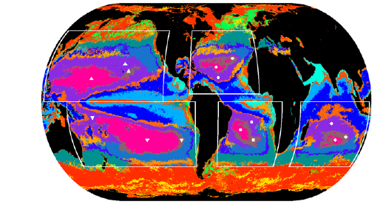
Are ocean deserts getting larger?
RS data used:
SeaWiFS/AVHRR
Irwin and Olivier. 2009. Geophysical Research Letters.
Notes:
Climatological provinces based on SeaWiFS/AVHRR annual average for 2007. Boxes identify ocean basins
(North and South Pacific, North and South Atlantic and Indian) in which oligotrophic provinces (indicated by symbols) are
studied. Colors were chosen to accentuate contrast between neighboring provinces.

Slide 12
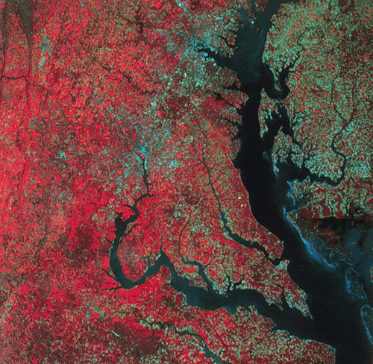
Disturbance and bird biodiversity (BBS data)
- Forest harvest
Landsat used to quantify land cover change
1985-2006
Rittenhouse et al. 2010 PLoS
Notes:
We assessed land cover change for 22 study areas within the US from a series of annual or biennial Landsat TM/ETM+ imagery for the period 1985-2006. Each study area was a landsat scene, and contained at least 15% forest cover.
We assessed changes in acian community structure for the period 1985-2006, using the NA BBS. We averaged data from the years 1985-87 and used this as our baseline, and defined community similarity for each subsequent year relative to the baseline.

Slide 13
Current and past forest disturbances affect progressive similarity of forest birds
Progressive similarity - community similarity for each subsequent year relative to the baseline
All forest birds Midstory and canopy
Neotropical migrants Ground
Temperate migrants Cavity
Permanent residents Interior forest
Rittenhouse et al. 2010 PLoS
Notes:
Progressive change in community similarity values compares proportional abundance of species for each Breeding Bird Survey route and year to the route’s baseline forest bird community.
We found support fo current and past forest disturbances affecting progressive similarity for nearly all forest bird guilds examined. (Least for temperate migrants).

Slide 14
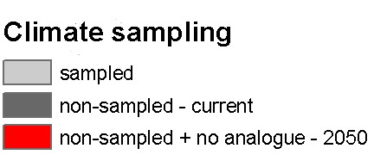
Gaps in our knowledge of global ant diversity
Not so many data
Lots of ant data
Jenkins et al. (2011) Diversity and Distributions.
No-analogue
climates
Notes:
Upper-right figure shows the places where we have good, quantitative samples of ant diversity.
Upper-left figure shows the world’s existing biomes (forest, grassland, desert, etc.) in a classic Whittaker plot (annual precip vs. annual temp) with an overlay of ant sampling to indicate the gaps in our knowledge. The grey areas are the part of the climate space that will be new in the future. Mostly these are biomes that will be hotter than existing biomes, both wet and dry. In other words, there is a part of the future climate space where we don’t know what will happen ecologically.
Bottom figure shows the current areas with climates we don’t understand for ants (dark grey) and then the areas that will change in the future to climates we don’t understand or don’t yet even exist (red areas).

Slide 15
Predicted Future Ant Diversity
No-analogue
climates
Generalized Linear Model
  Climate: temperature, precipitation, aridity
  Geography: biogeographic region
  Interactions: region * climate
Jenkins et al. (2011) Diversity and Distributions.
Notes:
We built a generalized linear regression model of ground-foraging ant diversity, basing it on field studies across the globe, producing the first global continuous map of ant diversity.
Part of the current world is unpredictable because it has an environment (e.g., climate) beyond that currently having quantitative samples of ants. These are the grey areas in the map and can be thought of as beyond our current ability to model.
As climate changes, more of the world will change to climates like those where we do not understand diversity, mainly because tropical areas become warmer than any current climates. The second slide shows these areas in red.
To improve our understanding of ant diversity, or diversity of anything, and their future, it will be necessary to have good quantitative samples from the full spectrum of climates. For climates that don’t yet exist but will in the future, today’s extreme environments are probably as close as we can get to inform us of what the future might look like.

Slide 16
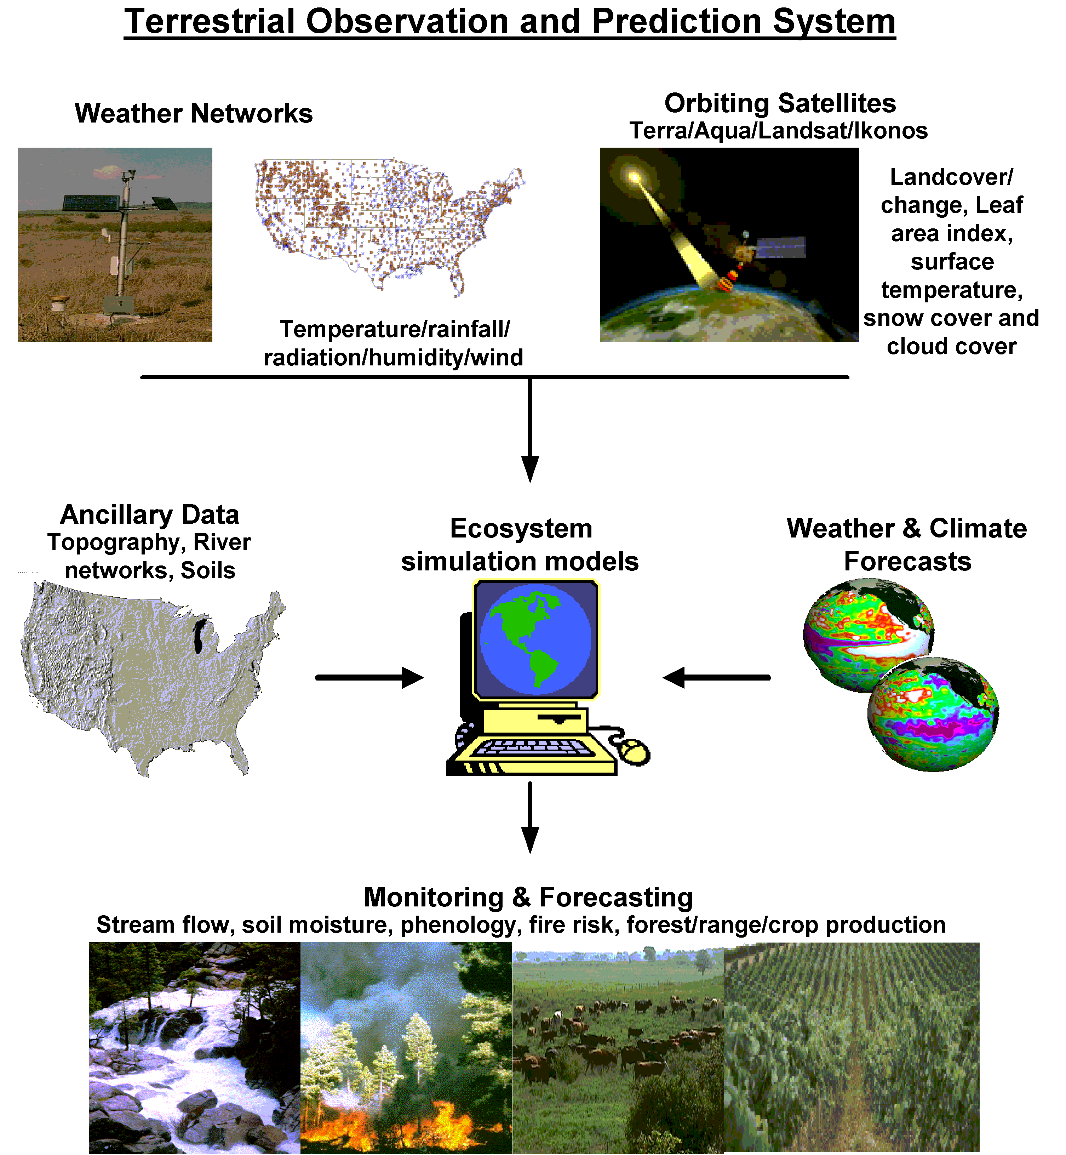
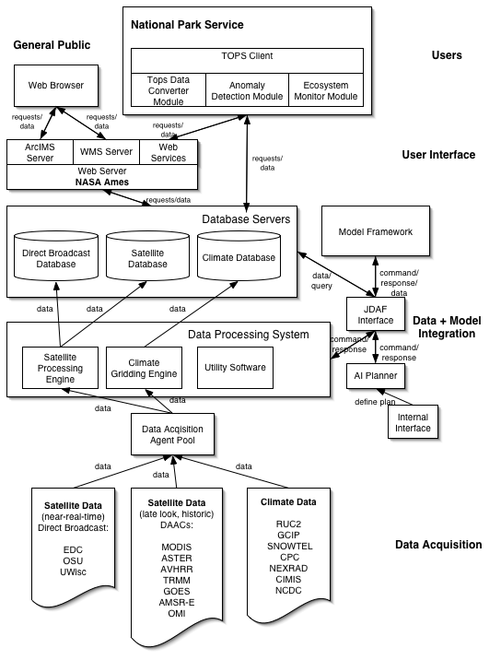
TOPS: Common Modeling Framework
Monitoring, modeling, and forecasting at
multiple scales
Nemani et al., 2003, EOM
White & Nemani, 2004, CJRS
Notes:
Predictions are based on changes in biogeochemical cycles

Slide 17
CURRENT BIOLOGY
FORCASTING
Monitoring programs
Range models
Integrative models
Species’ ability to adapt
Species’ ability to adapt
Genetic variation
Phenotypic plasticity
Migration
Community structure and dynamics
ECOSYSTEM MANAGEMENT

Slide 18
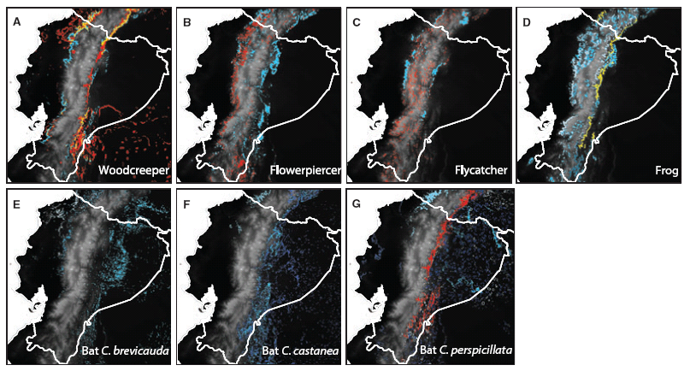
Genetic and morphological variation across taxa mapped using RS data (MODIS products, Q-scat)
Red – genetic diversity
Blue – morphological diversity
Yellow - both
Thomassen et al. 2011

Slide 19
CURRENT BIOLOGY
FORCASTING
Range models (species/functional group)
Correlative
Physiological
Population dynamics
Monitoring programs
Range models
Integrative models
Species’ ability to adapt
Community structure and dynamics
ECOSYSTEM MANAGEMENT

Slide 20
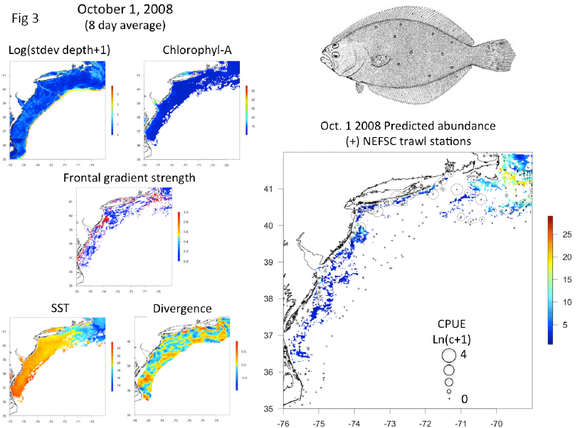
Sea surface temp
Divergence, HF radar
Manderson, Palamara, Kohut , Oliver in press. Marine Ecology Progress Series
Notes:
The model included log transformed standard deviation of bottom depth within a 2 km moving window Log(stdev depth +1); chlorophyll-A, sea surface temperature SST (oC) and frontal gradient strength derived from of satellite data; and divergence trend (upwelling (+) and downwelling (–) potential) derived from HF radar.

Slide 21
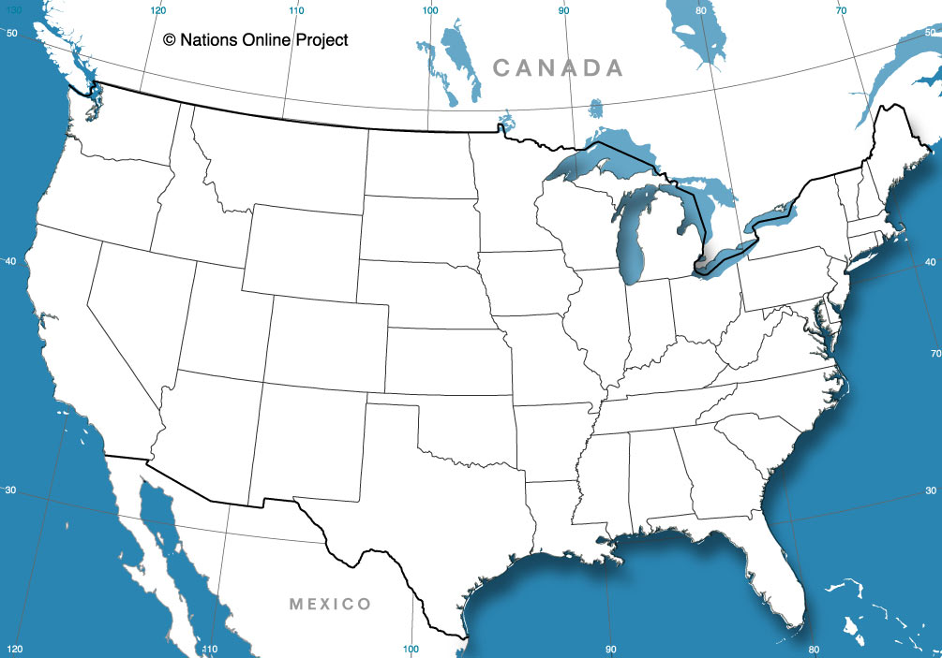
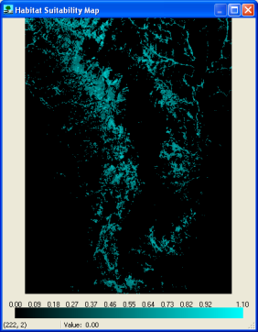
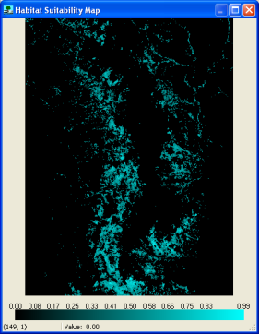
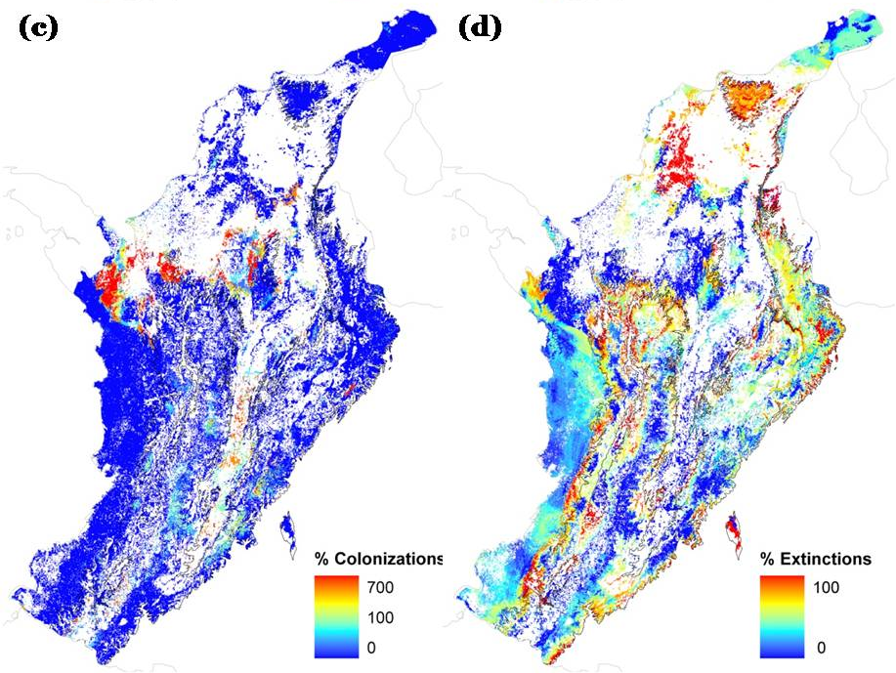
Dynamic layers
Climate model
2100
SDM
2010
Static layers
1.
Current occurrences
2.
Current environmental conditions
3.
Projected future conditions
4.
Future projected species habitat (time series of maps)
COLONIZATIONS
LOSSES
More Andean bird species are predicted to loose habitat than to gain it with climate
RS data used:
MODIS products
Q-Scat
Velasquez, Salaman and Graham

Slide 22
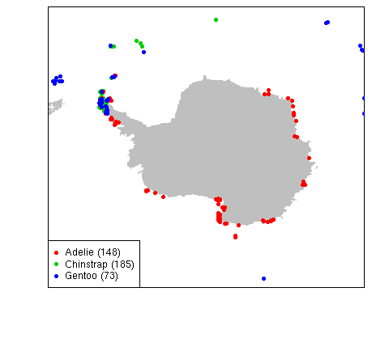
Distribution of Antarctic and sub- Antarctic penguin colonies
Rapid warming
Olivier and colleagues

Slide 23
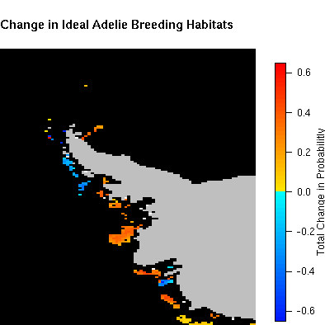
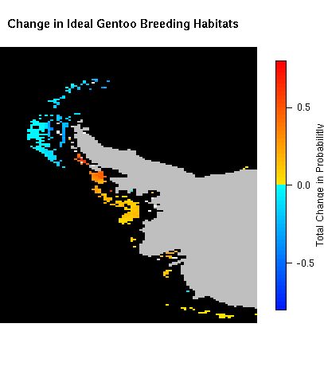
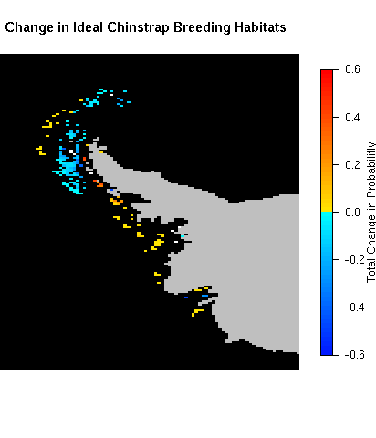
Significant Changes in Ideal Breeding Habitats: 1978-2010
Adelie Habitats
Gentoo Habitats
Chinstrap Habitats
Olivier and colleagues

Slide 24
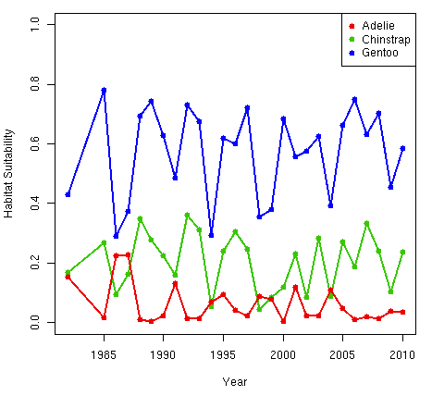
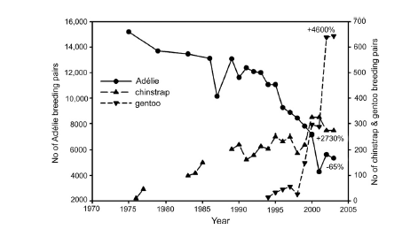
Changes in penguin habitat suitability correspond to empirical changes in abundance of penguins at the Palmer Station, Antarctica
Percent change in population trends from initial sampling (Ducklow et al. 2007)
Changes in habitat suitability within 75 km of Palmer Station.

Slide 25
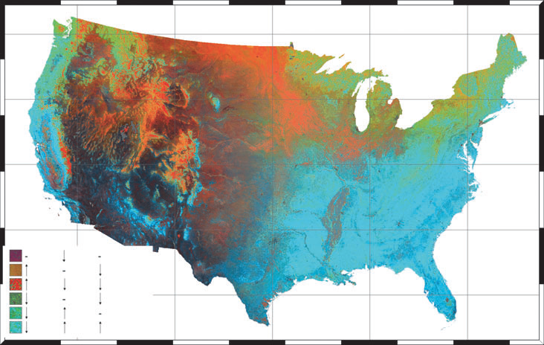
Can richness be monitored and forecasted?
Coops, Waring, Wulder, Pidgeon and Radeloff. 2010. Journal of biogeography
Dynamic Habitat Index
Based on the annual sum, the minimum, and the seasonal variation in monthly photosynthetically active radiation, fPAR from MODIS

Slide 26
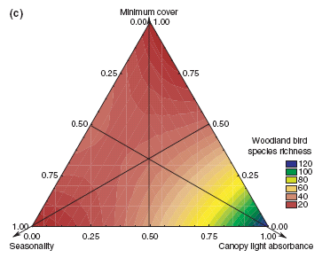
Woodland bird species richness can be predicted by the Dynamic Habitat Index

Slide 27
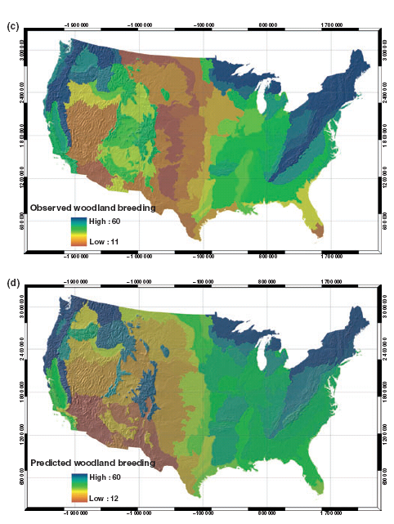
Dynamic habitat index can be used to forecast patterns of species richness of woodland/forest birds.
OBSER VED
PREDICTED
Coops, Waring, Wulder, Pidgeon and Radeloff. 2010. Journal of biogeography

Slide 28
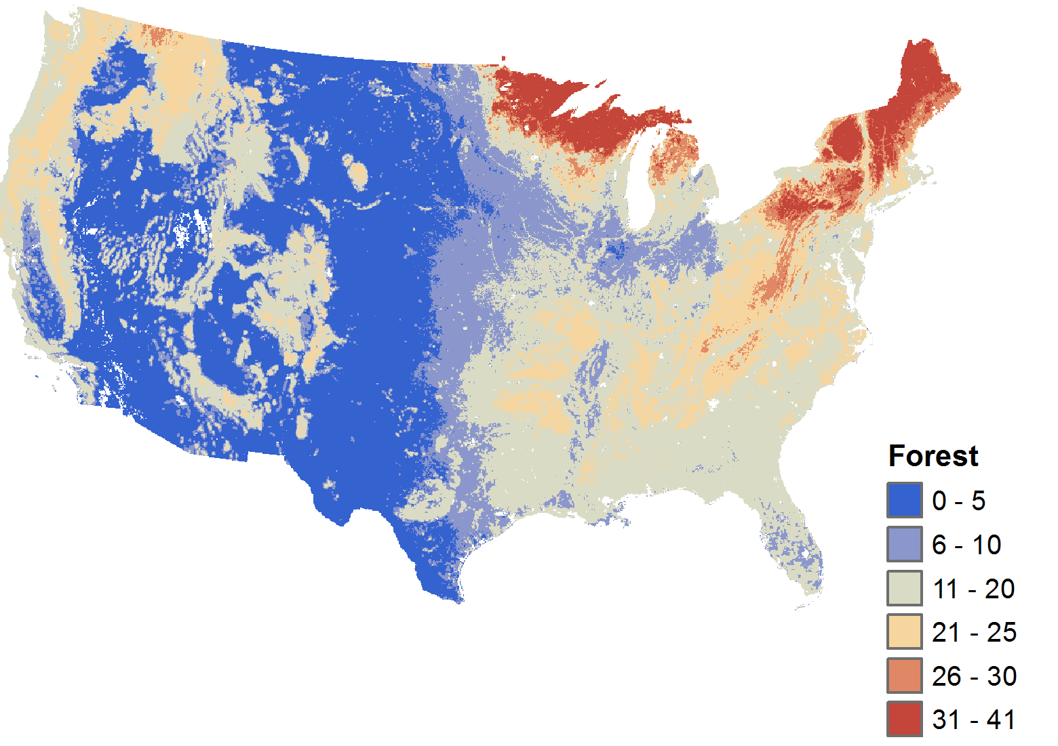

Broad scale estimates of forest bird species richness are consistent across studies
Models derived from BBS
RS data – Lidar canopy structure predictor variables, mODIS
Goetz et al. (forthcoming)
Global Ecology & Biogeography
Notes:
A model of National scale bird species richness was developed using Breeding Bird Survey observations and a suite of environmental and lidar canopy structure predictor variables.
At the national scale LIDaR canopy structure metrics are not selected as the most important variables – unlike at the more local scale (Hubbard Brook and Patuxent NWR)

Slide 29
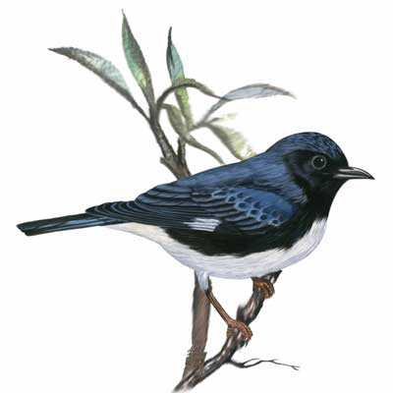
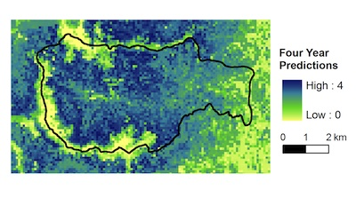
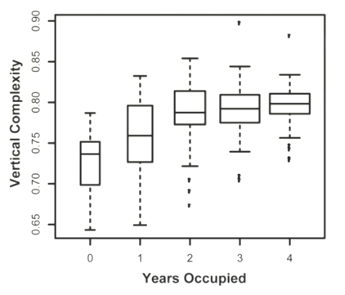
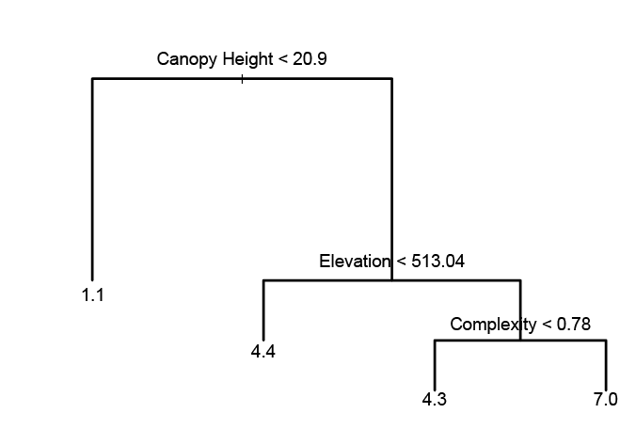

Lidar used to map multi-year prevalence / optimal breeding habitat..
Hubbard Brook Experimental Forest
Black throated
blue warbler
Goetz et al. (2010) Ecology 91:1569-1576
Notes:
The number of years that black-throated blue warblers occupied specific breeding habitat locations (between 0-4 years) was observed in the field and used to develop a model from remote sensing observations. Lidar metrics of canopy height and complexity were particularly useful predictors of breeding habitat. The developed model (part of which is shown here as a decision tree) was used to predict multi-year habitat use over the extent of the HBEF and environs (upper right image). A model based on 3 years of observations also had good skill at predicting site occupancy in the 4th year.

Slide 30
Building potential habitat models using nested habitat elements
Anna M. Pidgeon, Fred Beaudry, Volker C. Radeloff
Habitat group
Deciduous, evergreen forest(2001 NLCD)
Main modeling unit; general habitat requirements
Constraints
Edge & area sensitivity
Forest composition (FIA)
Housing density
Species-specific
modifiers
Intrinsic elements
Snags/logs
Understory vegetation
Forage/prey abundance
Habitat needs not mapped at large spatial scales; need to be maintained within each habitat group
Beaudry et al. 2010 Biological Conservation
Notes:
This slide shows the approach to building potential habitat models from our work in Landscape Futures modeling:
Habitat groups are main modeling unit. They are broad vegetation cover types, from NLCD. A species may rely on more than one habitat group.
Constraints are species specific modifiers. They refine the habitat requirements by taking into account the more specific conditions needed by many birds (for example edge sensitivity, exclusion of some stand types, and proximity to water).
Intrinsic elements are fine scale habitat selection requirements. These elements are not usually mapped at the regional scale, but most can be maintained within habitat groups with appropriate management (examples of these are snags, understory vegetation.
We combined habitat groups and habitat constraints into habitat distribution models that identified potential habitat.
Potential habitat can support species of conservation concern if land management provides the intrinsic elements.
We train models with Breeding bird atlas data
Validate with available empirical data from species specific studies.

Slide 31
Building potential habitat models using nested habitat elements
Anna M. Pidgeon, Fred Beaudry, Volker C. Radeloff
Habitat group
Deciduous, evergreen forest(2001 NLCD)
Main modeling unit; general habitat requirements
Constraints
Edge & area sensitivity
Forest composition (FIA)
Housing density
Species-specific
modifiers
Intrinsic elements
Snags/logs
Understory vegetation
Forage/prey abundance
Habitat needs not mapped at large spatial scales; need to be maintained within each habitat group
Beaudry et al. 2010 Biological Conservation
Notes:
This slide shows the approach to building potential habitat models from our work in Landscape Futures modeling:
Habitat groups are main modeling unit. They are broad vegetation cover types, from NLCD. A species may rely on more than one habitat group.
Constraints are species specific modifiers. They refine the habitat requirements by taking into account the more specific conditions needed by many birds (for example edge sensitivity, exclusion of some stand types, and proximity to water).
Intrinsic elements are fine scale habitat selection requirements. These elements are not usually mapped at the regional scale, but most can be maintained within habitat groups with appropriate management (examples of these are snags, understory vegetation.
We combined habitat groups and habitat constraints into habitat distribution models that identified potential habitat.
Potential habitat can support species of conservation concern if land management provides the intrinsic elements.
We train models with Breeding bird atlas data
Validate with available empirical data from species specific studies.

Slide 32
CURRENT BIOLOGY
FORCASTING
Range models (species/functional group)
Correlative
Physiological
Population dynamics
Monitoring programs
Range models
Integrative models
Species’ ability to adapt
Community structure and dynamics
ECOSYSTEM MANAGEMENT

Slide 33
Linking environmental data to physiological response over large scales
Survival, distribution
Environmental data
Biophysical (Heat Budget) Model
Dynamic Energy Budget Model
Growth, reproduction, size
Kearney, Simpson, Raubenheimer and Helmuth 2010, PTRS

Slide 34
More accurate predictions are made when daily remote-sensing data are used in models
0-50% shade, 10cm burrow
monthly data
daily data
size
size
reserve
reserve
mass/repro (8 clutches)
mass/repro (11 clutches)

Slide 35
CURRENT BIOLOGY
FORCASTING
Range models (species/functional group)
Correlative
Physiological
Population dynamics
Monitoring programs
Range models
Integrative models
Species’ ability to adapt
Community structure and dynamics
ECOSYSTEM MANAGEMENT

Slide 36
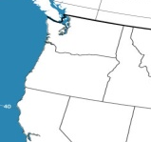
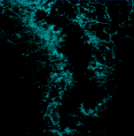
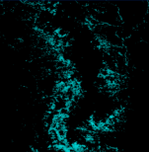
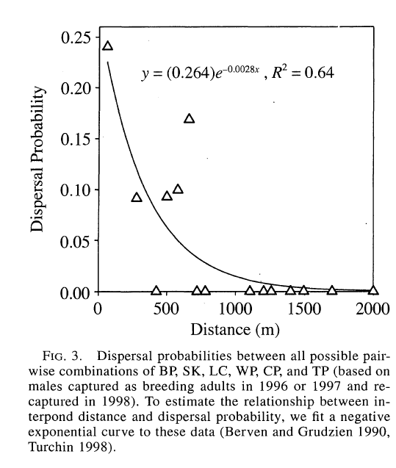
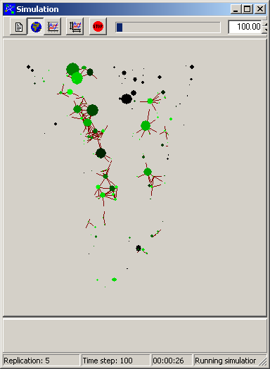
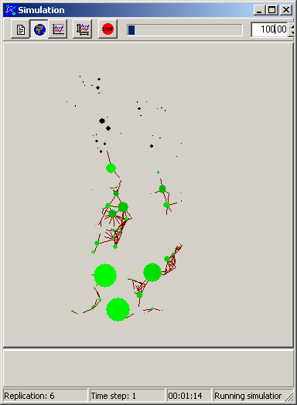
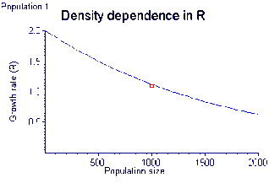
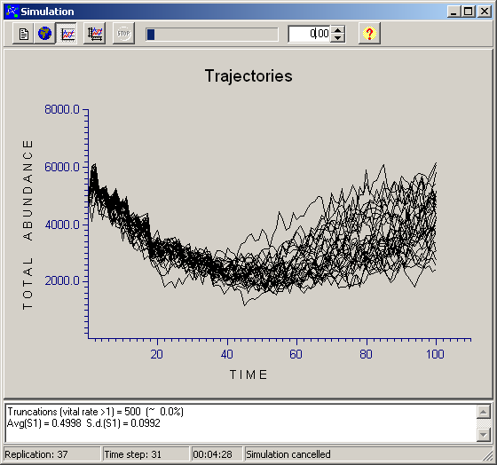
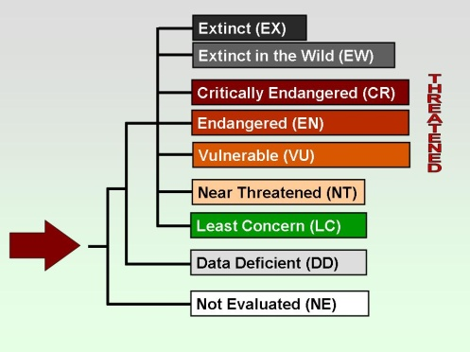

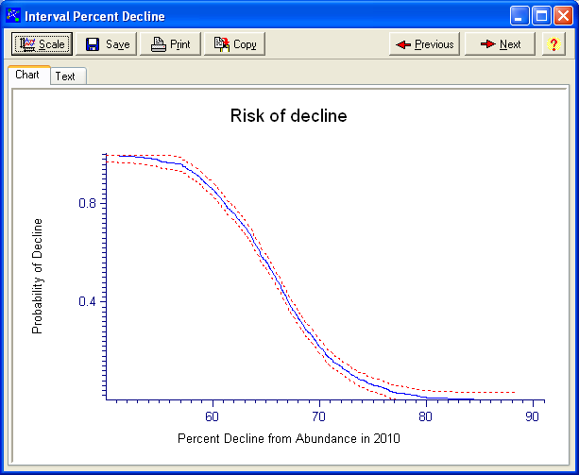

Predicting Extinction Risks under Climate Change
Akçakaya & Pearson
Dynamic layers
Climate model
2100
SDM
2010
Static layers
2100
2010
5.
Demographic model
6.
Metapopulation model with dynamic spatial structure
8.
Synthesis across species to inform IUCN Red List process
7.
Extinction risk assessment
Notes:
An outline of the approach used in the NASA-funded project “Integrating Remotely Sensed Data and Ecological Models to Assess Species Extinction Risks under Climate Change”, a collaboration between American Museum of Natural History (PI: Richard Pearson) and Stony Brook University (PI: H. Resit Akçakaya)

Slide 37
Predicting Extinction Risks under Climate Change
Akçakaya & Pearson
Dynamic layers
Climate model
2100
SDM
2010
Static layers
2100
2010
5.
Demographic model
6.
Metapopulation model with dynamic spatial structure
8.
Synthesis across species to inform IUCN Red List process
7.
Extinction risk assessment
Notes:
An outline of the approach used in the NASA-funded project “Integrating Remotely Sensed Data and Ecological Models to Assess Species Extinction Risks under Climate Change”, a collaboration between American Museum of Natural History (PI: Richard Pearson) and Stony Brook University (PI: H. Resit Akçakaya)

Slide 38
Predicting Extinction Risks under Climate Change
Akçakaya & Pearson
Dynamic layers
Climate model
2100
SDM
2010
Static layers
2100
2010
5.
Demographic model
6.
Metapopulation model with dynamic spatial structure
8.
Synthesis across species to inform IUCN Red List process
7.
Extinction risk assessment
Notes:
An outline of the approach used in the NASA-funded project “Integrating Remotely Sensed Data and Ecological Models to Assess Species Extinction Risks under Climate Change”, a collaboration between American Museum of Natural History (PI: Richard Pearson) and Stony Brook University (PI: H. Resit Akçakaya)

Slide 39
CURRENT BIOLOGY
FORCASTING
Monitoring programs
Range models
Community structure and dynamics
Species interactions –(disease, competition)
Food webs
Guild/functional group structure
Integrative models
Species’ ability to adapt
Community structure and dynamics
ECOSYSTEM MANAGEMENT

Slide 40

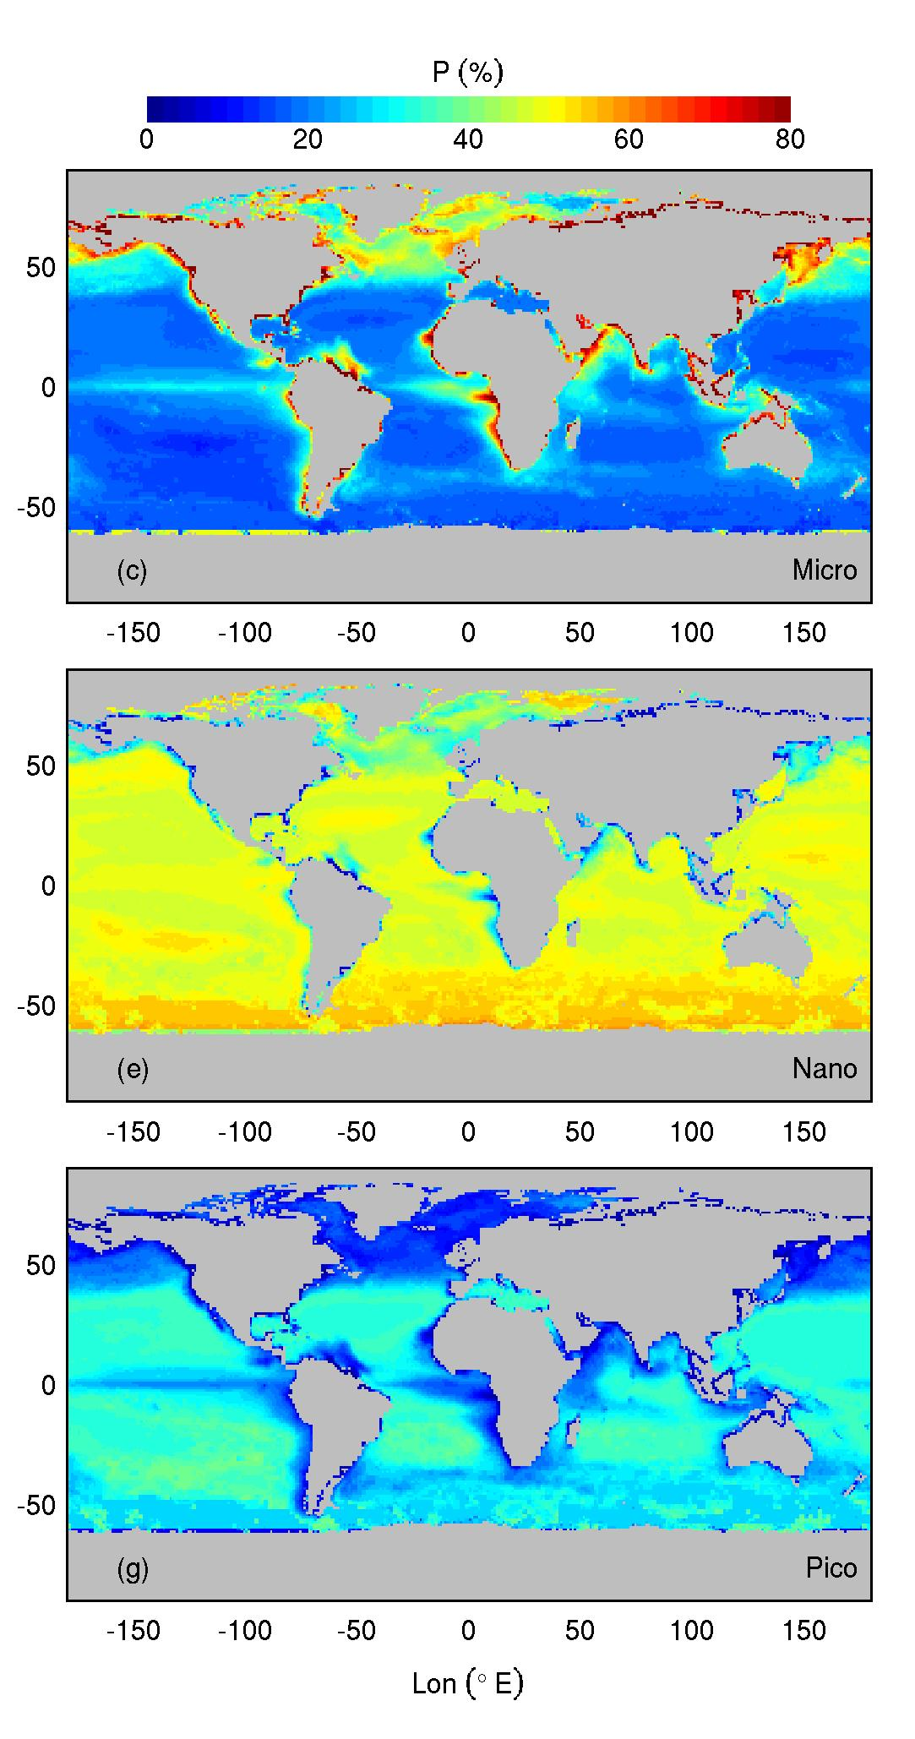
Phytoplankton diversity from ocean color
Contribution (%) to total primary production in boreal summer
Phytoplankton class-specific approach used in conjunction with SeaWiFS 10-year time series of surface Chl data in the global ocean
Microphytoplankton (mostly diatoms) are major contributors in temperate-subpolar regions (50%) and coastal upwellings (70%) during the spring-summer season
Nanophytoplankton (mainly prymnesiophytes) provide substantial ubiquitous contribution (30–60%)
The contribution of picophytoplankton reaches maximum values (45%) in subtropical oligotrophic gyres
Stramski and colleagues
Notes:
First ocean color-based patterns of phytoplankton class-specific primary production in the world’s oceans over seasonal to interannual timescales
Benchmark for monitoring responses of marine pelagic ecosystems to future climate change

Slide 41
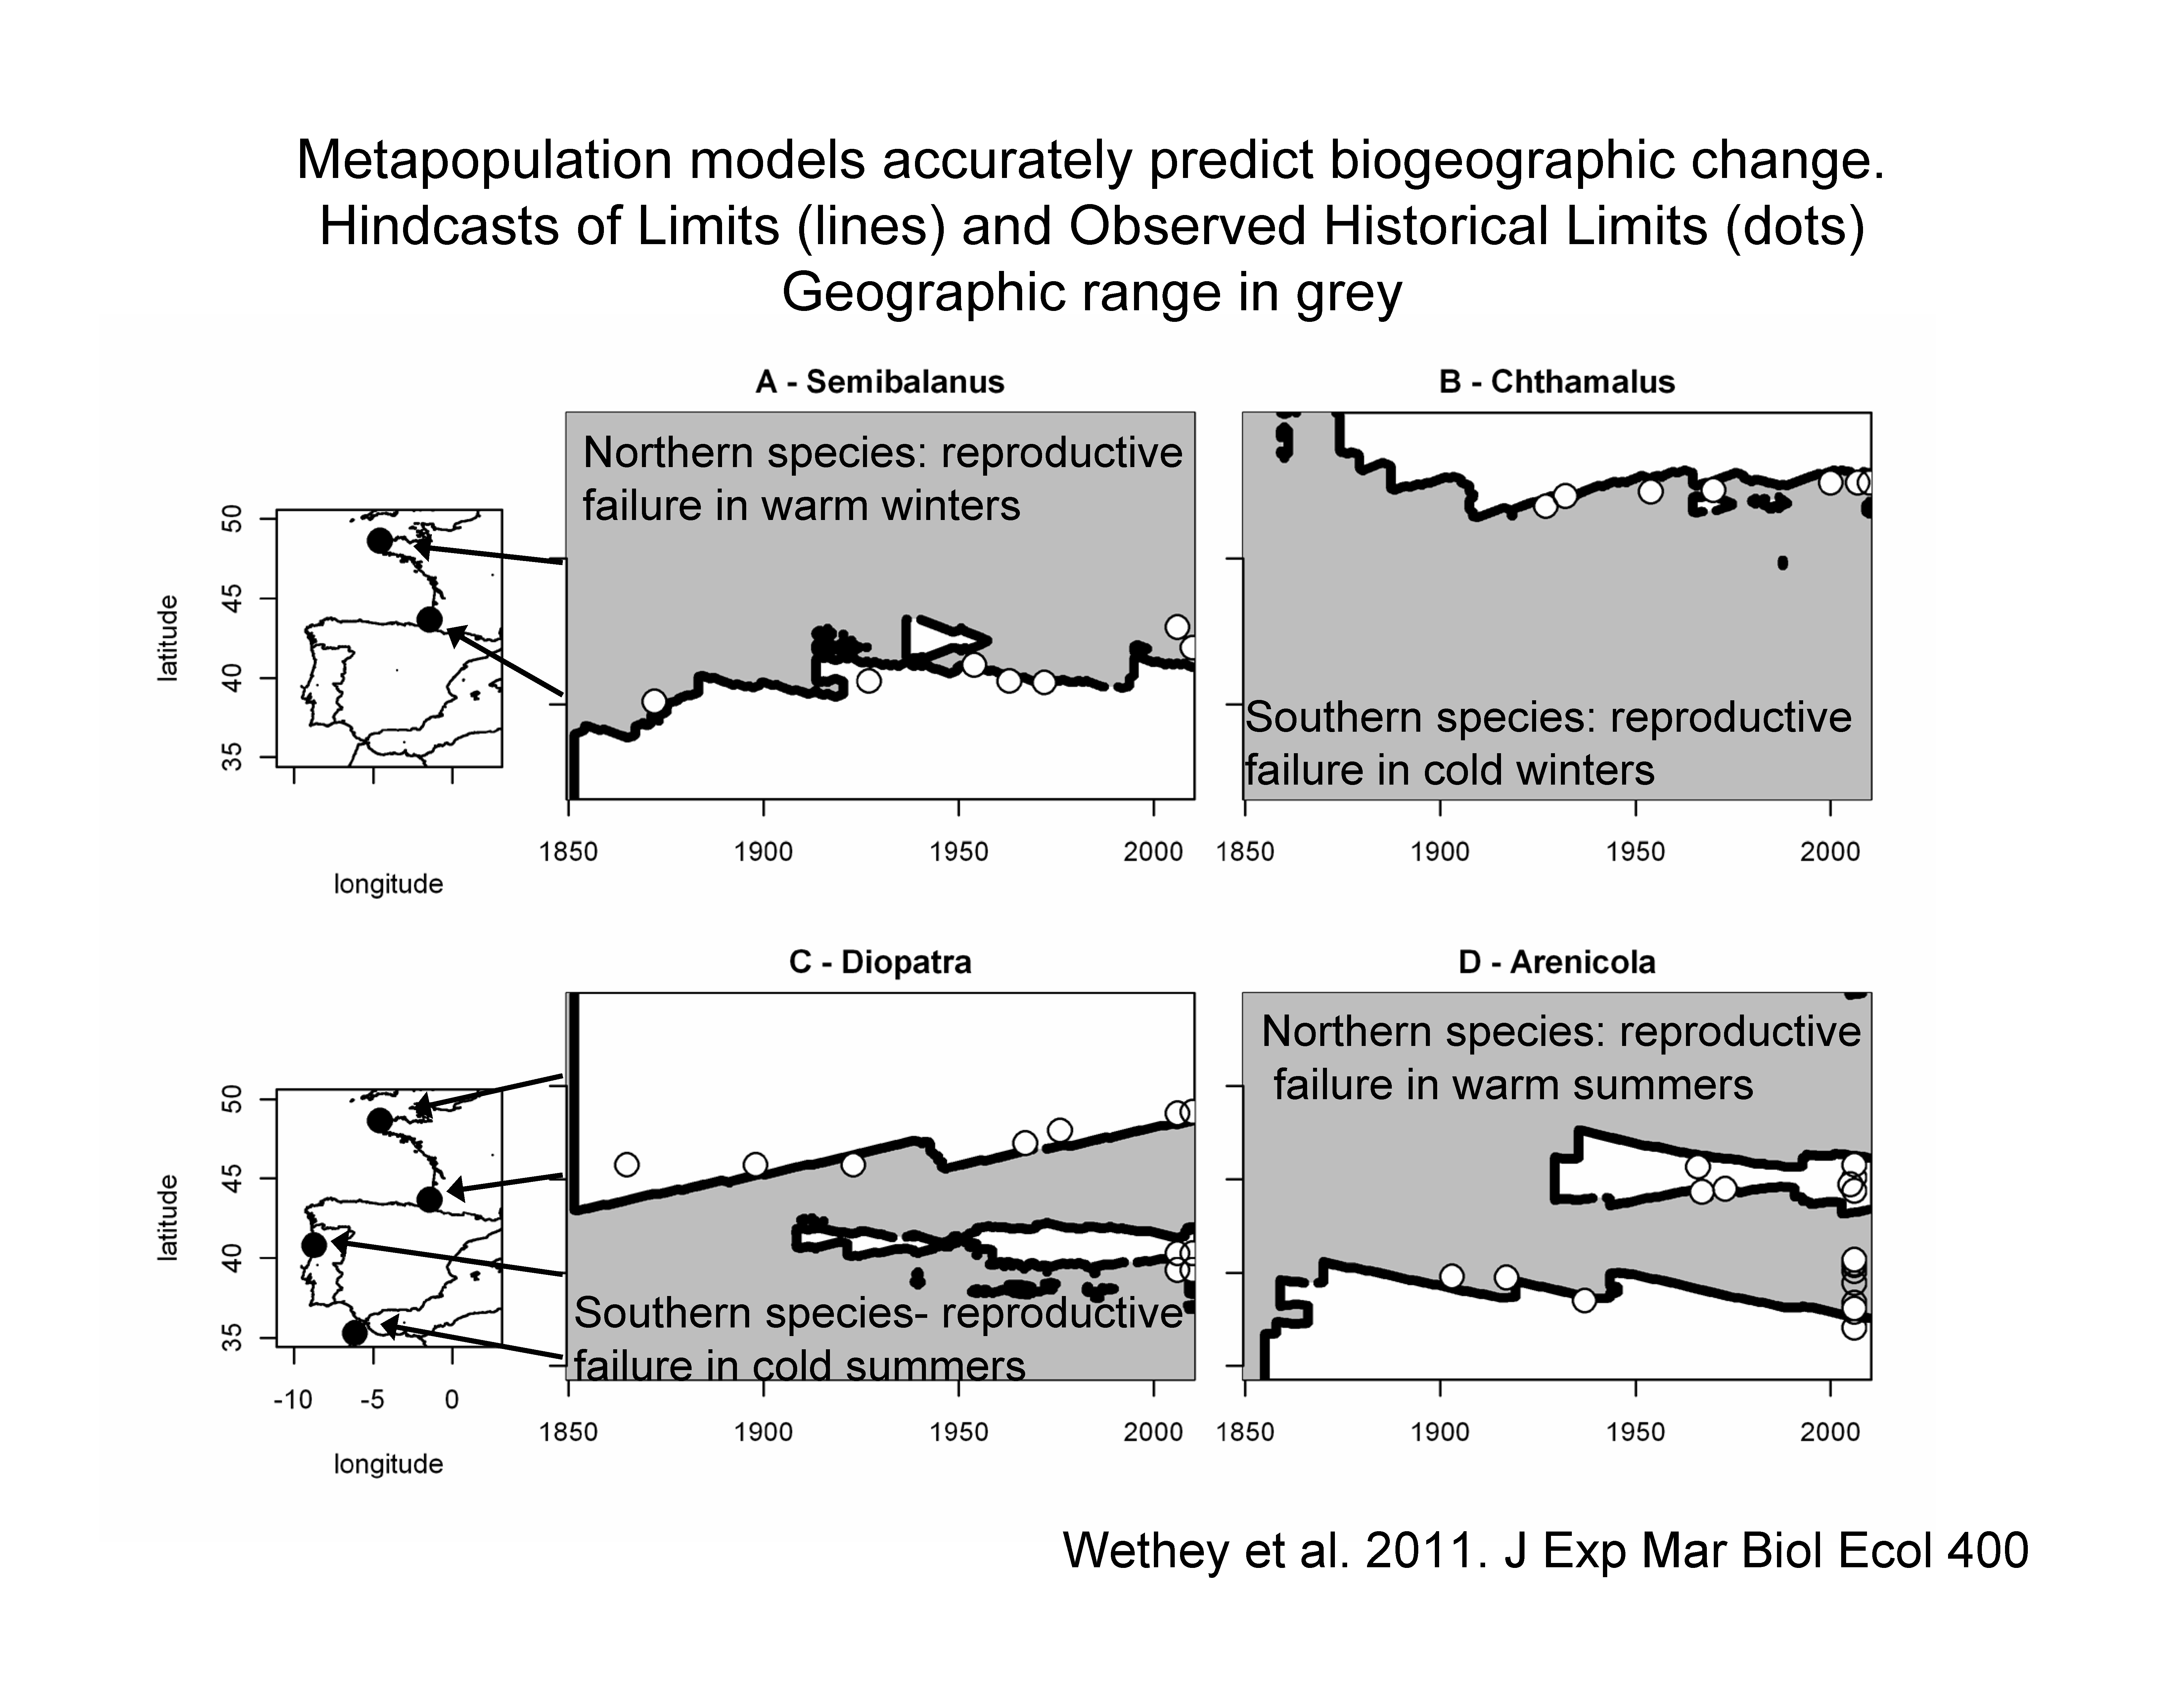
Models accurately predict change of ecosystem engineers
hindcasts of limits (lines) and observed historical limits (dots), geographic region in grey
Notes:
Lessons from hind casting:
Extreme events in particular are important for influencing species distributions.
When they went forward you see
Models accurately predict change of ecosystem engineers
Hindcasts of limits (lines) and observed historical limits (dots), geographic region in grey

Slide 42
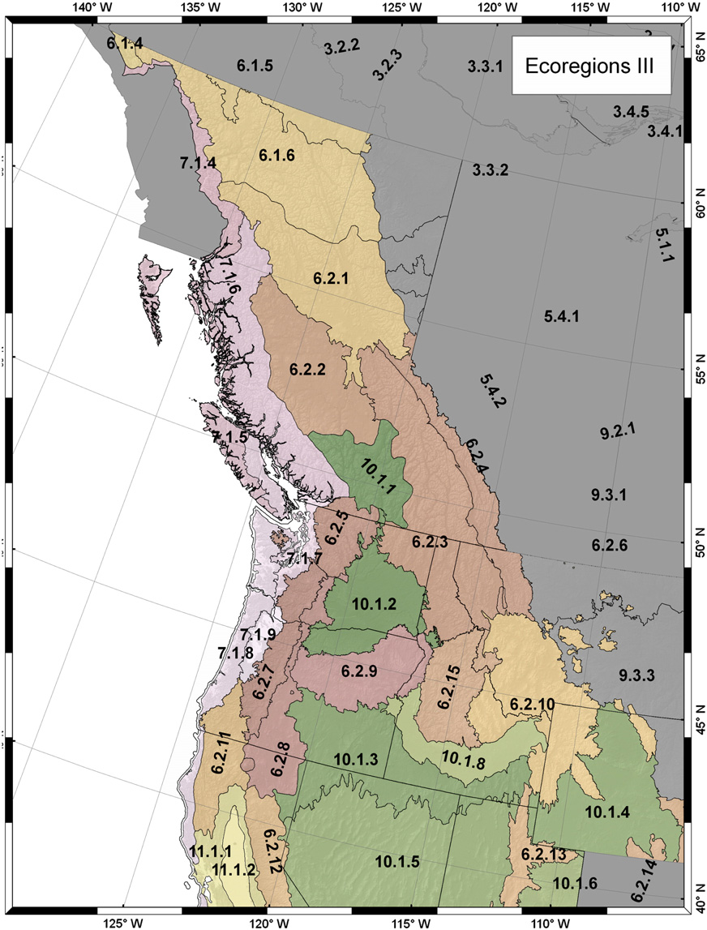
Predicting satellite derived patterns of large-scale disturbances in forests of the Pacific Northwest region response to recent climate variation
(Waring, Coops and Running)
Physiologically informed models of 15 species of conifers
Physiological models and remote-sensing provide similar insights into ecosystem function
Stress of species predicted using a physiological informed models corresponds to areas that Disturbance predicted using physiological basis

Slide 43
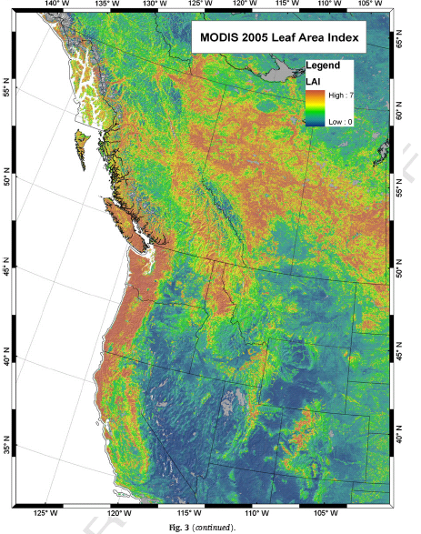
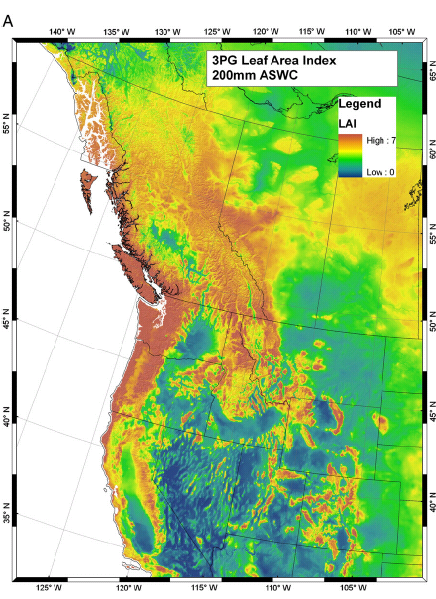
Physiological models and RS measures provide the same pattern in Leaf Area Index (correlated maximum growth potential)

Slide 44
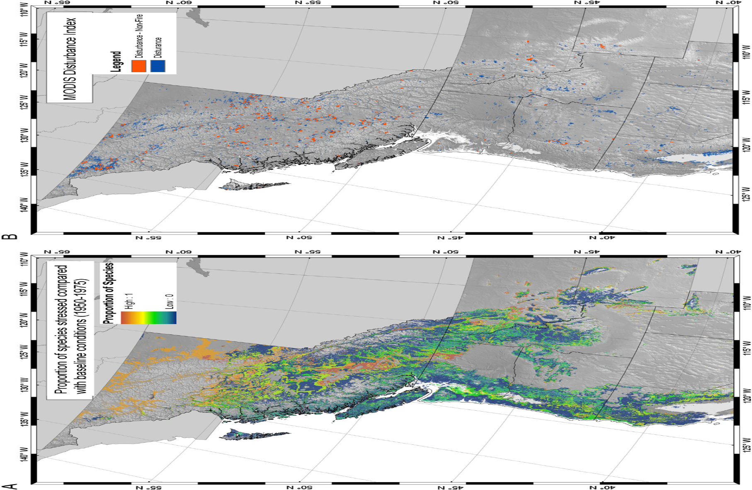
~70% variation explained
Proportion of species stressed between 2005-2009 compared to baseline conditions (1950-1975)
Land surface temperature & EVI
Mildrexler et al. 2009

Slide 45
CURRENT BIOLOGY
FORCASTING
Monitoring programs
Range models
Integrative models
Species’ ability to adapt
Community structure and dynamics
ECOSYSTEM MANAGEMENT
Modified (slightly) from McMahone et al. 2011 Trends in Ecology and Evolution

Slide 46
What next?
Linking RS time-series data biological data to better predict future biological diversity
  Key for decision making
  Key for inputs into biogeochemical models
Determining what RS data captures in terms of biological diversity or ecosystem stress

