Slide 1
Overview of the National Climate Assessment
2011 NASA Carbon Cycle and Ecosystems Joint Science Workshop
October 4, 2011
Hilton Alexandria Mark Center
Katharine Jacobs
Office of Science and Technology Policy
http://assessment.globalchange.gov

Slide 2
Global Change Research Act (1990), Section 106
…not less frequently than every 4 years, the Council… shall prepare… an assessment which –
integrates, evaluates, and interprets the findings of the Program and discusses the scientific uncertainties associated with such findings;
analyzes the effects of global change on the natural environment, agriculture, energy production and use, land and water resources, transportation, human health and welfare, human social systems, and biological diversity; and
analyzes current trends in global change, both human- induced and natural, and projects major trends for the subsequent 25 to 100 years.

Slide 3
What is New About the 2013 National Climate Assessment (NCA)
Sustainable process with multiple products over time
New topics, cross-sectoral studies
Consistent national matrix of indicators
Central coordination, multiple partners
Regional and sectoral networks building assessment capacity
Recognizes international context
Engagement and communications focus
Web-based data and tools for decision support
Process workshops to establish methodologies

Slide 4
The NCA Process
2013
2017
2011
2012
2014
Regional and sectoral assessments and stakeholder engagement
Initiate “topical” and assessment
process reports that will be
completed at a defined date post 2013.
Full draft of report available for public and expert review.
Full assessment reports
Sectors
Regions
Cross-cutting topics
4

Slide 5
Outline for 2013 Report
The scientific basis for climate change
Sectors and sectoral cross-cuts
Regions and biogeographical cross-cuts
Mitigation and adaptation
Agenda for climate change science
The NCA long-term process
Notes:
The scientific basis for climate change will include discussion of:
Scenarios, confidence and risk-based framing
Indicators
The agenda for climate change science will discuss research needs and gaps that need to be filled

Slide 6
Sectors
Water resources
Energy supply and use
Transportation
Agriculture
Forestry
Ecosystems and biodiversity
Human health
Notes:
*** Bold / change font color / enlarge font size to highlight relevant chapters / sections

Slide 7
Sectoral Cross-Cuts
Water, energy, and land use
Urban/infrastructure/vulnerability
Impacts of climate change on tribal, indigenous, and native lands and resources
Land use and land cover change
Rural communities, agriculture, and development
Impacts on biogeochemical cycles
Notes:
*** Bold / change font color / enlarge font size to highlight relevant chapters / sections

Slide 8
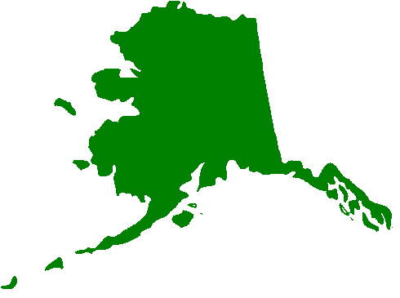
Regions
Northeast
Southeast and Caribbean
Midwest
Great Plains
Northwest
Southwest
Alaska and Arctic
Hawaii and Pacific Islands
+ Guam, Northern Mariana Islands, American Samoa and other minor outlying islands
+ Puerto Rico and US Virgin Islands
Notes:
Eventually this slide will be replaced with a prettier picture of the regions, similar to that used in 2009 report

Slide 9
Biogeographical Cross-Cuts
Oceans and marine resources
Coastal zone, development, and ecosystems, with case studies including
SF Bay Delta
Chesapeake
Gulf Coast
Drainage basins, with case studies including
Great Lakes
Colorado River
Columbia River
Notes:
Eventually this slide will be replaced with a map of the biogeographical cross-cuts

Slide 10
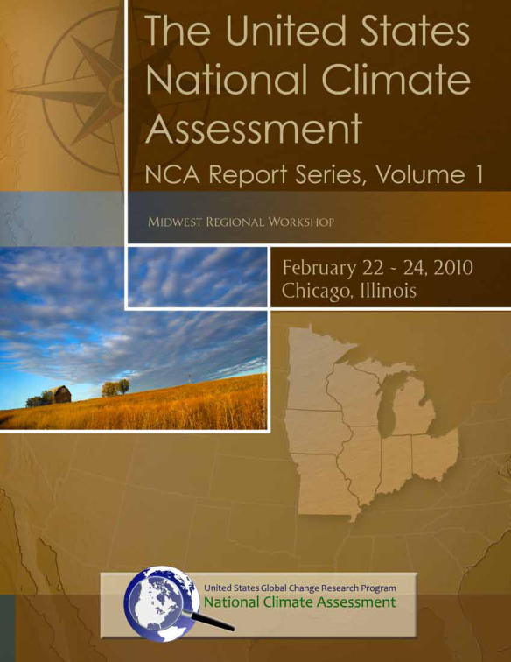
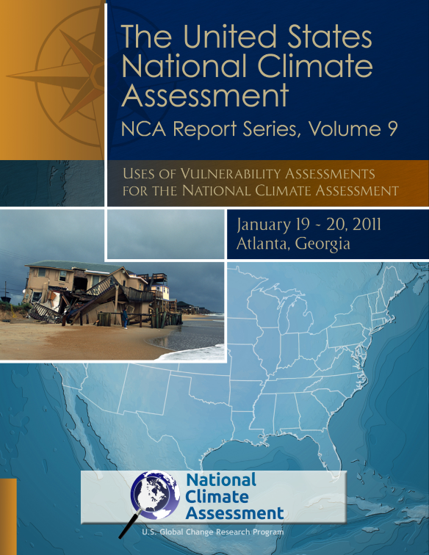
Process Workshops
Strategic Planning
Midwest Regional Workshops
Outline and Work plan
International Context
Communications
Knowledge Management
Regional and Sectoral Approach
Ecological Indicators
Scenarios
Modeling
Vulnerability Assessment
Valuation
Physical Indicators
Societal Indicators

Slide 11
Assessment Structure
CENRS/OSTP
US Global Change Research Program (Federal)
USGCRP Principals
Interagency National Climate Assessment (INCA) Task Force
Assessment Staff
Technical Support and Coordination units (e.g. NCDC)
National Climate Assessment Development and Advisory Committee (NCADAC)
a.k.a. Federal Advisory Committee
Network of Partners and Stakeholders
Regional Networks
Professional Societies
Citizen Groups
NGOs
NCADAC Teams
Regions (SW, NE, etc.)
Sectors (water, energy, etc.)
Data Management
Science
Scenarios
Models
Indicators
Etc.
11

Slide 12
NCADAC Working Groups
Scenarios and Regional Summaries
Request for Information
Peer Review, Information Standards, and Access
Engagement, Communication, and Evaluation
Regional Coordination
Sectoral Coordination
Science of Climate Change
Agenda for Climate Change Science
Adaptation and Mitigation
Indicators Development and Evaluation
International
Sustained Process

Slide 13
Assessment Team Structure
NCADAC Federal Advisory Committee (appointed by Secretary of Commerce)
Executive Secretariat (appointed by Under Sec. of Commerce)
Chapter Author Teams
Working Groups
Regional Teams
Sectoral
Teams
Other Teams
Notes:
Approval for

Slide 14
Opportunities for Participation
Responding to the Request for Information
Participating in assessment activities hosted by technical input teams
Participating in the NCA’s listening sessions, workshops, and other meetings related to developing process and content.
Responding to public comment and public review requests
To learn more about NCA activities and opportunities for involvement, sign up for our newsletter by sending an email to engagement@usgcrp.gov.

Slide 15
2013 Report Production Timeline
A
S
O
N
D
J
F
M
A
M
J
J
A
S
O
N
D
J
F
M
A
M
J
J
A
S
O
N
D
Oct 1, 2011
Mar 1, 2012
May 1 2012
Aug 1 2012
Oct 1 2012
Jan 1 2013
Feb
1
Mar
1
Jun1
Jul 1
Oct 1 2013
Expressions of Interest
Authors meeting
Development
Of technical input
Author teams incorporate Technical Input and other sources – draft chapters and suggest downstream products and processes to the NCADAC
Rough layout
CLAs and editors synthesize chapters and NCADAC reviews full document
NRC , Agency, and Public review
CLAs and NCADAC revise draft
FAC to make
Revisions \
N R C
JUL1: Request to NRC (and agencies) to hear preliminary presentations of potential key conclusions to identify potential “show-stoppers”
Agency
SIGN OFF
Were comments adequately
addressed?
Web and summary Layout and printing
NCADAC DRAFT, August 2011

Slide 16
Outcomes of the NCA
Ongoing, relevant analysis of scientific understanding of climate change impacts, risk, and vulnerability
Enhanced timely access to Assessment-related data from multiple sources
Systematic evaluation of progress towards reducing risk, vulnerability, and impacts
A sustained process for informing an integrated research program
Evaluation of the implications of alternative adaptation and mitigation policy options
Information that provides the foundation for a science-based national discourse on climate change

Slide 17
Questions and Comments
For more information, please visit http://assessment.globalchange.gov
Notes:
Additional slides follow – please feel free to use them as a part of the main presentation or as reference materials during discussions.

Slide 18
NCA Staff
OSTP and USGCRP / Washington, DC
Katharine Jacobs NCA Director, OSTP
Sheila O’Brien Chief of Staff
Emily Therese Cloyd Public Participation and Engagement Coordinator
Bryce Golden-Chen Program Administrator
Ralph Cantral Sectoral Coordinator (NOAA detailee)
Fred Lipschultz Regional Coordinator (NASA detailee)
Bill Emanuel Senior Scientist (DOE detailee)
Nancy Grimm Senior Scientist (NSF detailee)
Julie Maldonado Engagement Assistant
Melissa Kenney AAAS Fellow, NOAA
Chelsea Combest-Friedman Knauss Fellow, NOAA
Chelcy Ford Scientist (USFS detailee)
NOAA NCDC / Asheville, NC
Anne Waple NOAA Assessments Manager
Ken Kunkel Science Lead for Assessments
Brooke Stewart Assessments Services Scientific Coordinator
John Keck Web Developer
NOAA / Washington, DC and Silver Spring, MD
Cynthia Decker NCADAC Designated Federal Official
Kandis Wyatt NCADAC Designated Federal Official (Alternate)
Stephanie Herring NOAA Liaison to the National Climate Assessment

