Slide 1
New Uses and Approaches for Land Data Products
Jeffrey Masek, Biospheric Sciences
NASA Goddard Space Flight Center

Slide 2
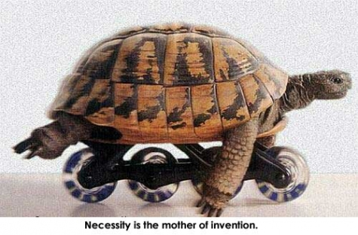
Necessity is the mother of Invention
- Plato, The Republic

Slide 3
1. Innovative Applications of Existing Data Products
Biodiversity – how to understand species richness and abundance from space?

Slide 4
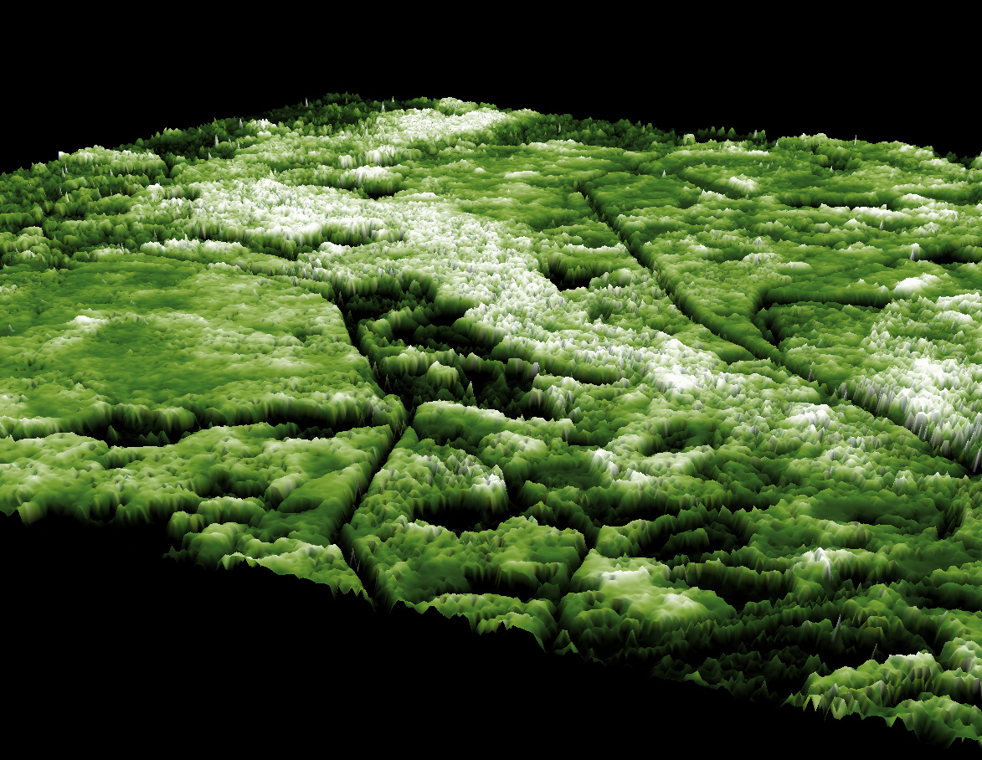
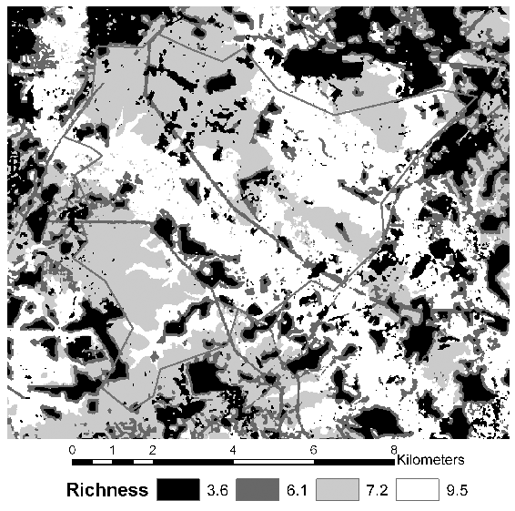
Waveform lidar used to map canopy structure & habitat metrics
Patuxtent Wildlife Reserve, USA (Goetz et al, 2007)
Lidar Canopy Height
Oblique View
Bird species richness predicted from regression tree model using lidar and optical RS metrics (Goetz et al. 2007)

Slide 5
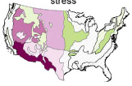
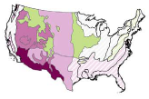
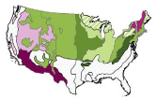
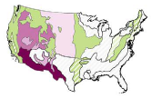
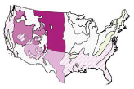

Change in bird community abundance in response to 100 year “droughtwave” (drought + heatwave)
Models combined MODIS Land Surface Temp. exceedances & standardized precipitation index (Albright/Pigeon, U. Wisconsin)
All land birds
Ground nesting species
Permanent residents
Short distance migrants
Neotropical migrants
-20% -15% -10% -5% -2% +2% +5% +10% +15% +20%
Significant
Non-significant
Albright et al. 2010, Global Change Biology

Slide 6
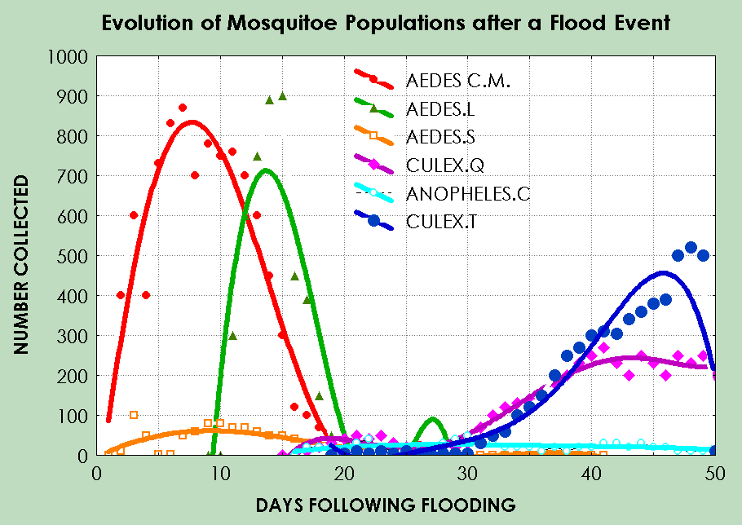


Biodiversity & Human Health: Rift Valley Fever Biology
Initial vectors
Amplification vectors

Slide 7
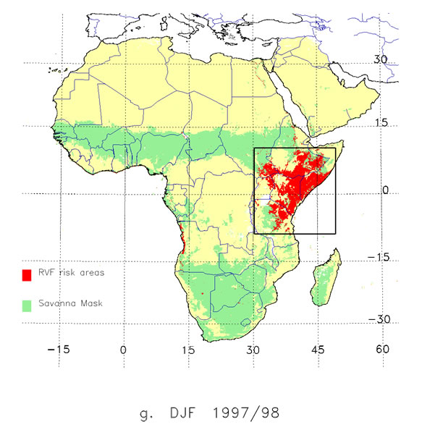
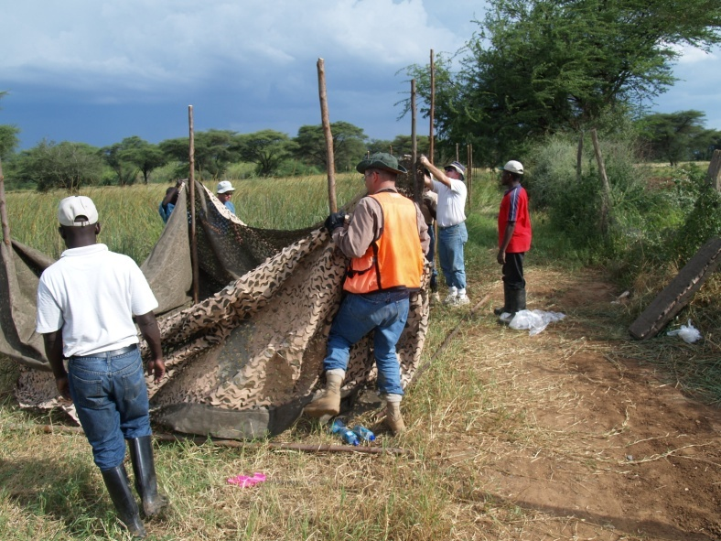



Operational Rift Valley Fever Risk Mapping
Information Dissemination
NASA/GSFC
http://www.geis.ha.osd.mil/RVFWeb/index.htm
GEIS-Hub
USAMRU-K
WHO
FAO
NAMRU3
KEMRI-KENYA
REGIONS & COUNTRIES
MIDDLE EAST

Slide 8
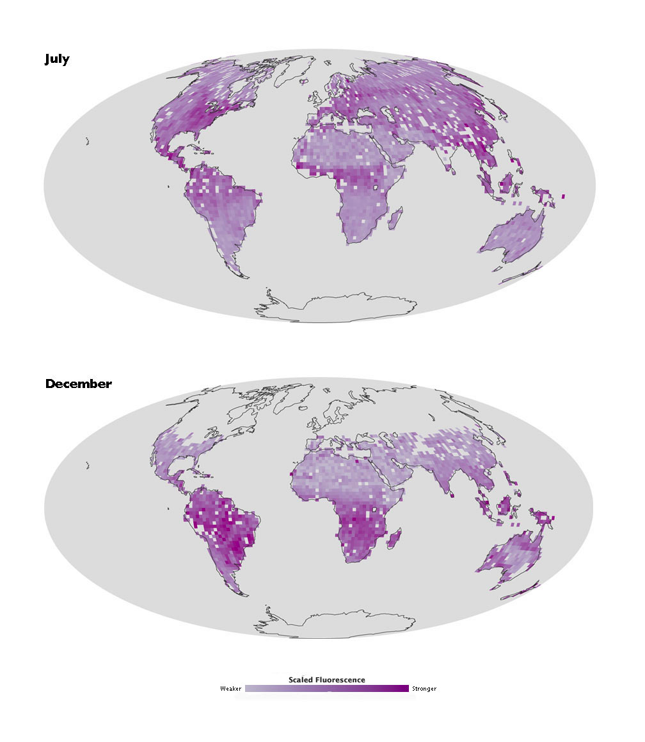
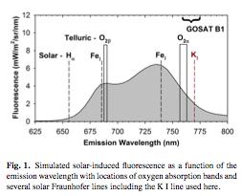
First Global Maps of Vegetation Fluorescence
(Joiner et al., Biogeosciences 2011)
Mapped global fluoresence from GOSAT data by measuring satellite signal in 770 nm Fraunhofer line

Slide 9
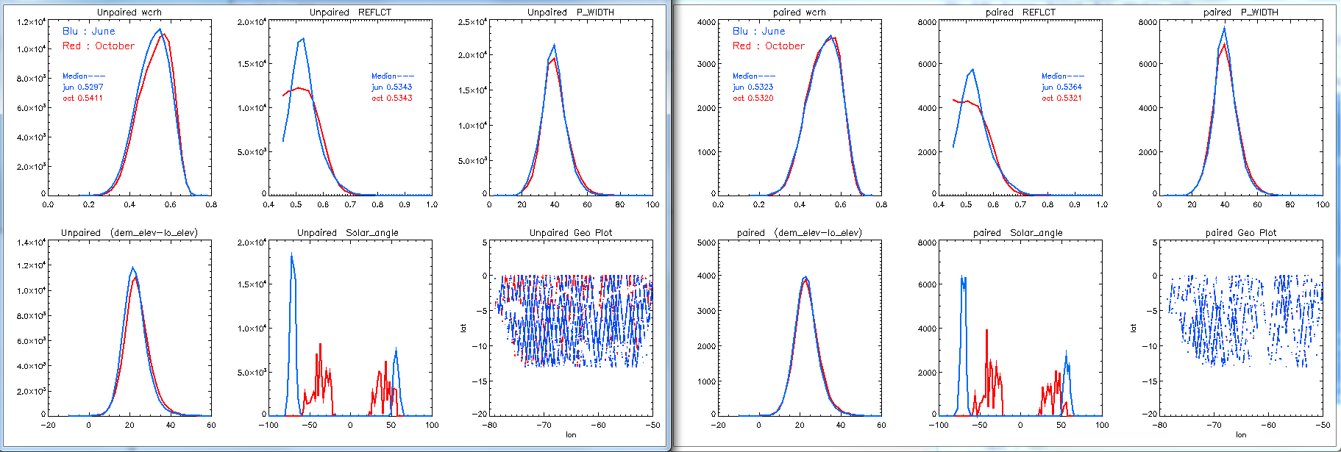
ICESat Evaluation of the Apparent Amazon Green-Up
D. Morton, J. Nagol, C. Carabajal, D. Harding, J. Rosette, B. Cook, M. Palace
GLAS is a radiometer: providing apparent reflectance and height of energy returns (Waveform Centroid Relative Height: WCRH)
No indication of seasonal change in canopy parameters based on ICESat, an active, nadir-looking instrument
WCRH
WCRH Apparent Reflectance Geographic Distribution
lat
WCRH
Apparent Reflectance (%)
lon
lon
37,319 Paired ICESAT shots from June (3c, 3f) & October (3a, 3i)
screened using MODIS AOD <0.1
Morton et al., unpublished data

Slide 10
2. Data Fusion
Improved estimates of physical parameters by using multiple sources of data
Using multiple sources of data to downscale or upscale a parameter (e.g. MODIS->ASTER, GLAS -> airborne lidar)
Direct fusion of radiometry to create “synthetic” products (e.g. STAR-FM)

Slide 11
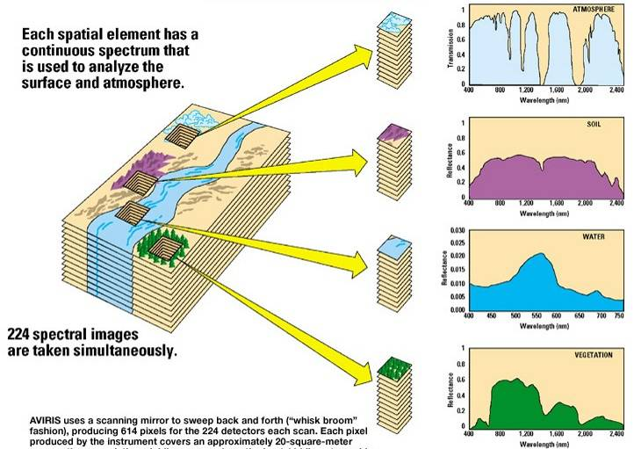
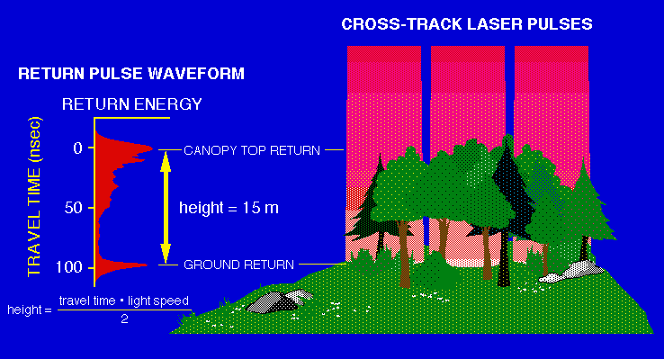
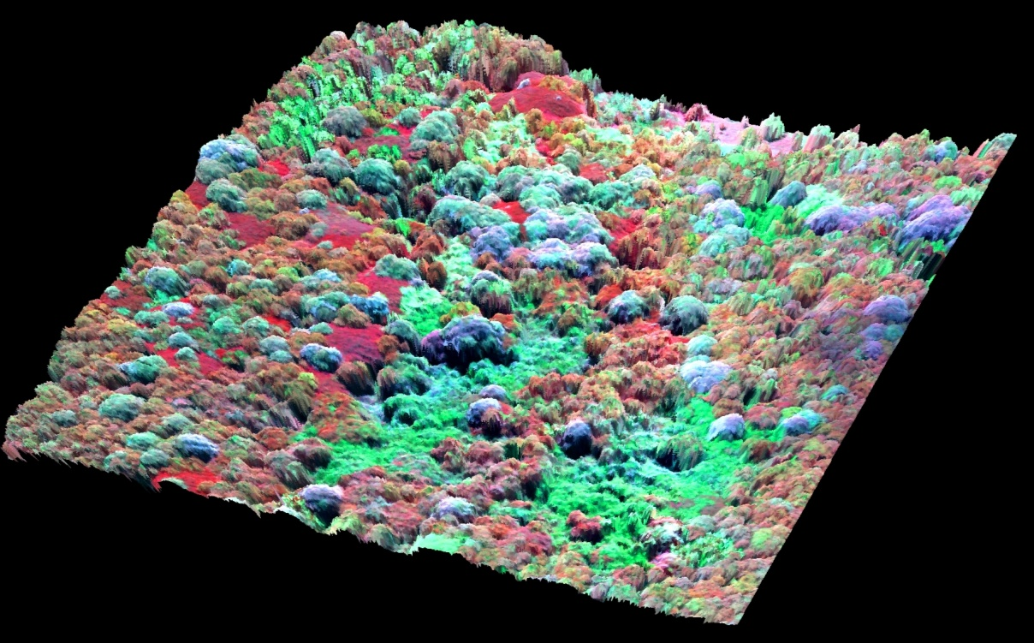
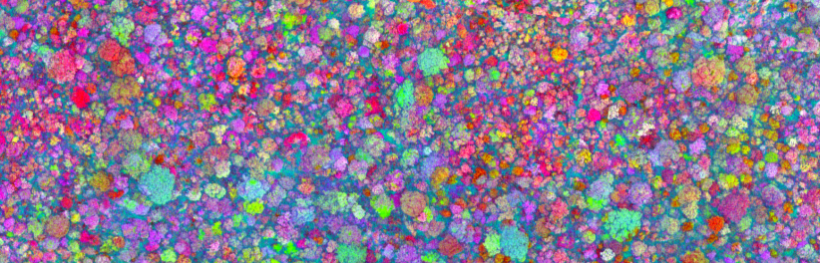
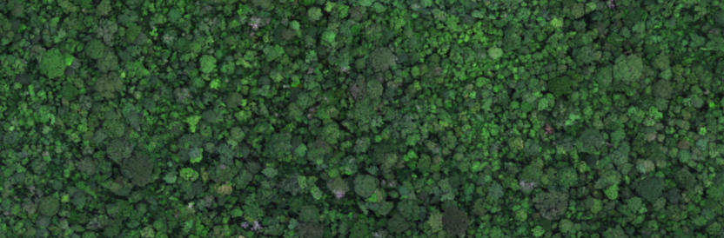
Carnegie Airborne Observatory (CAO):
3 Fully Integrated Subsystems
for 3-D Analysis of Ecosystem Composition, Chemistry and Physiology
VSWIR Hi-fidelity Imaging Spectrometer
Multi-pulse Waveform LiDAR
VNIR Zoom Imaging Spectrometer
440 spectral bands
144 spectral bands

Slide 12
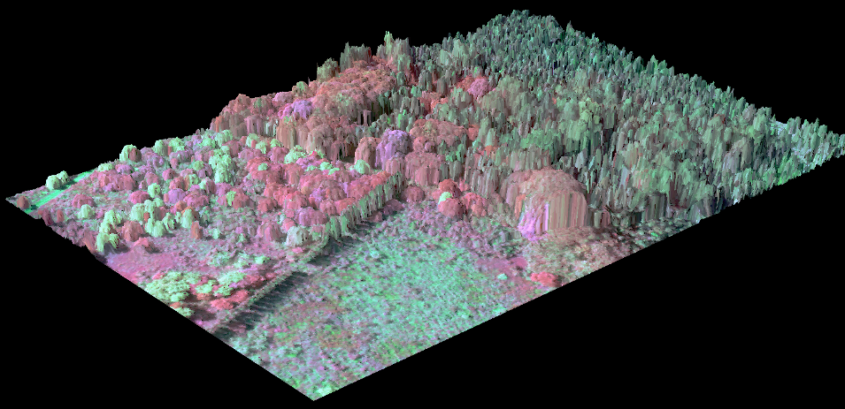
CAO Sample
Invasive Species Management in Hawaii

Slide 13
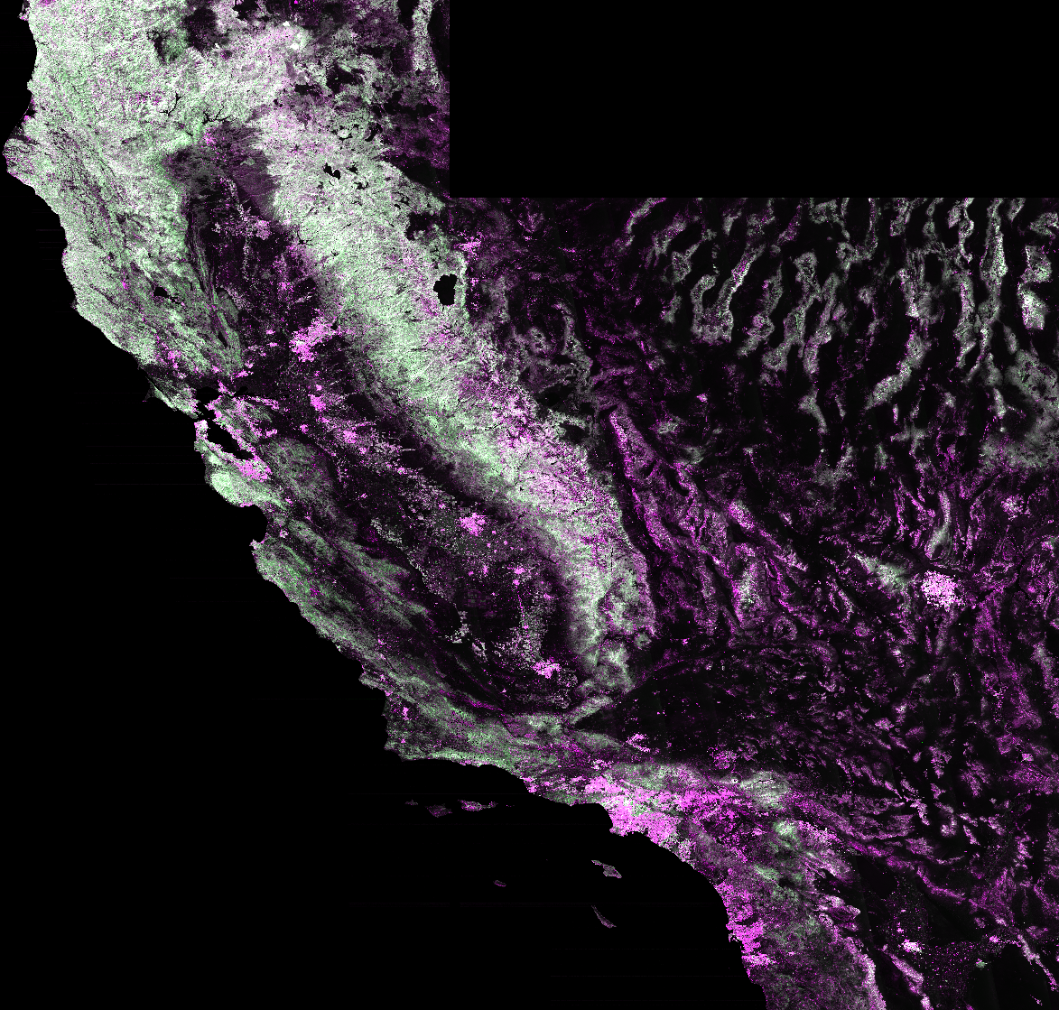
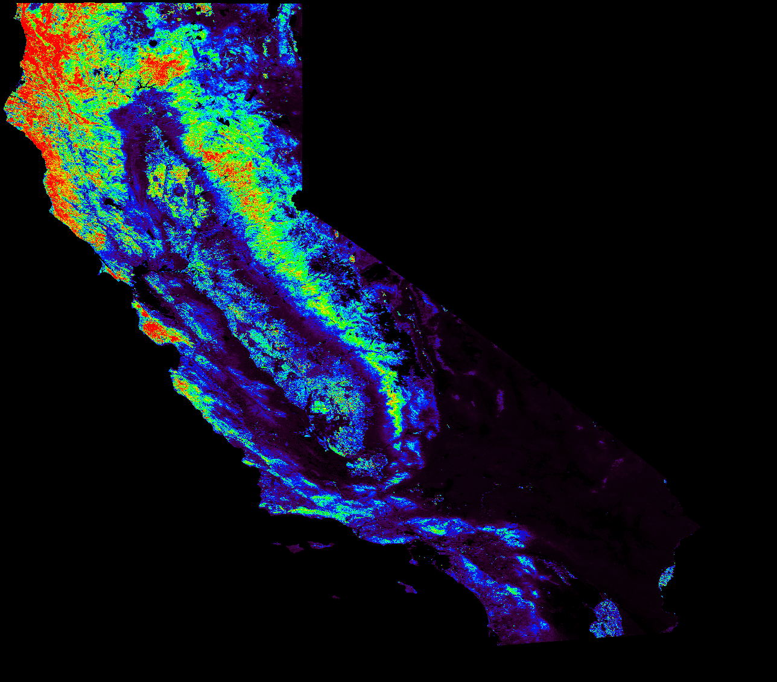
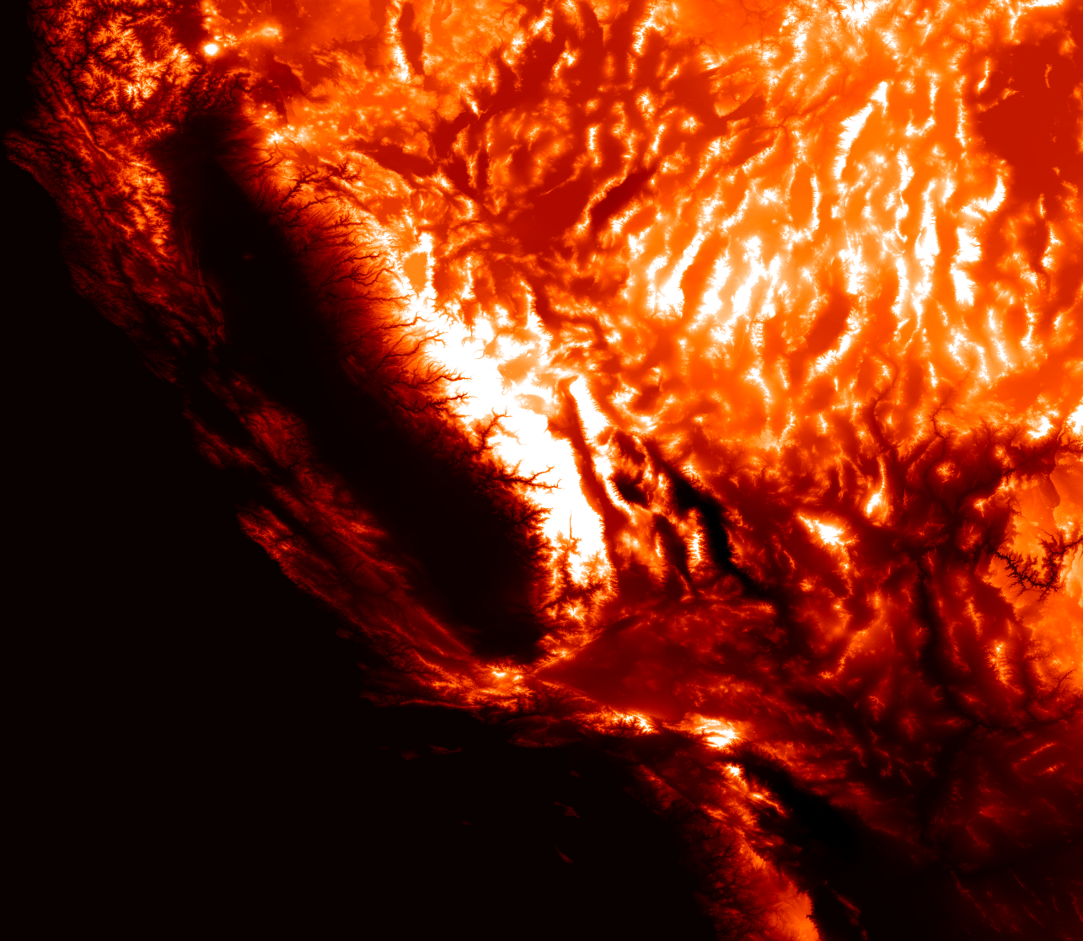
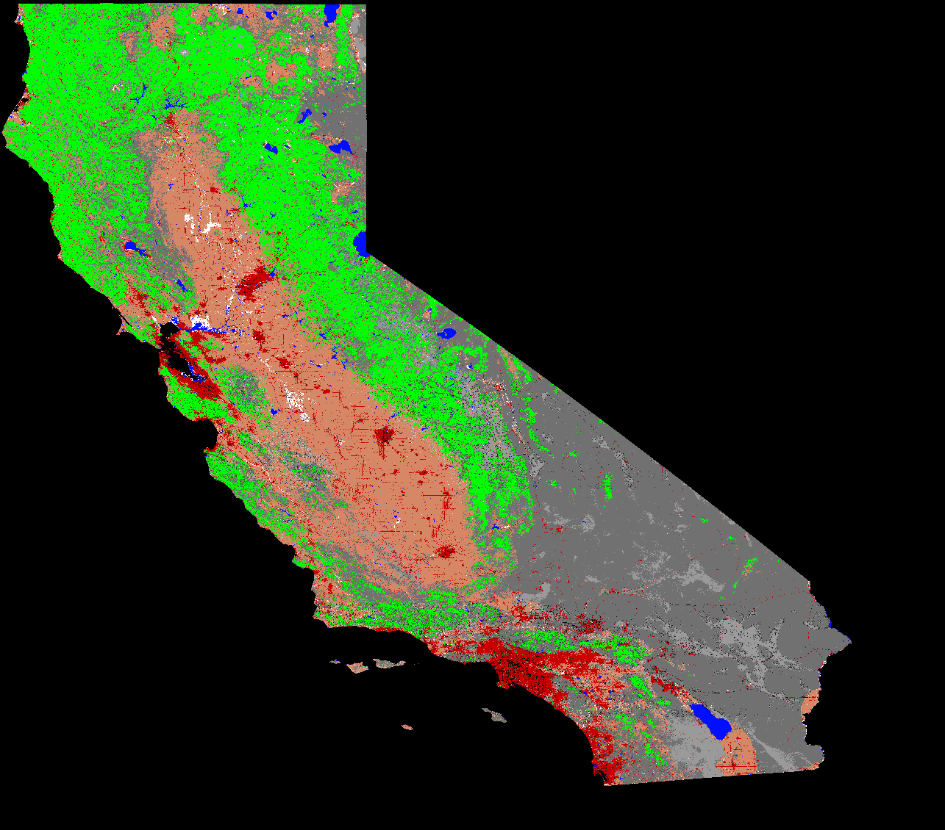
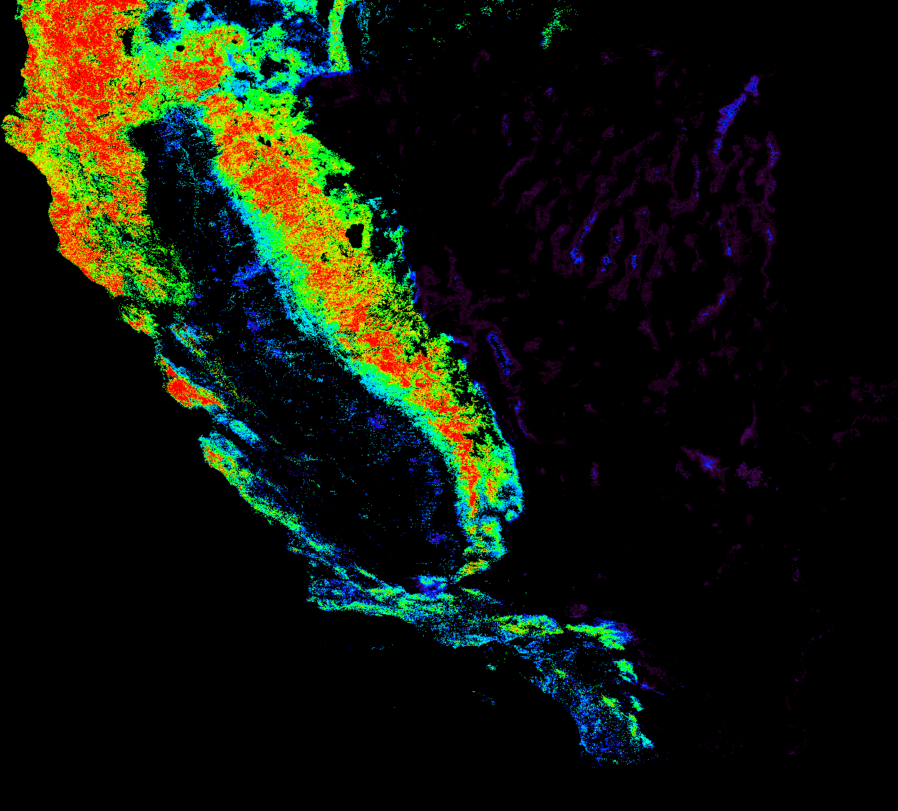
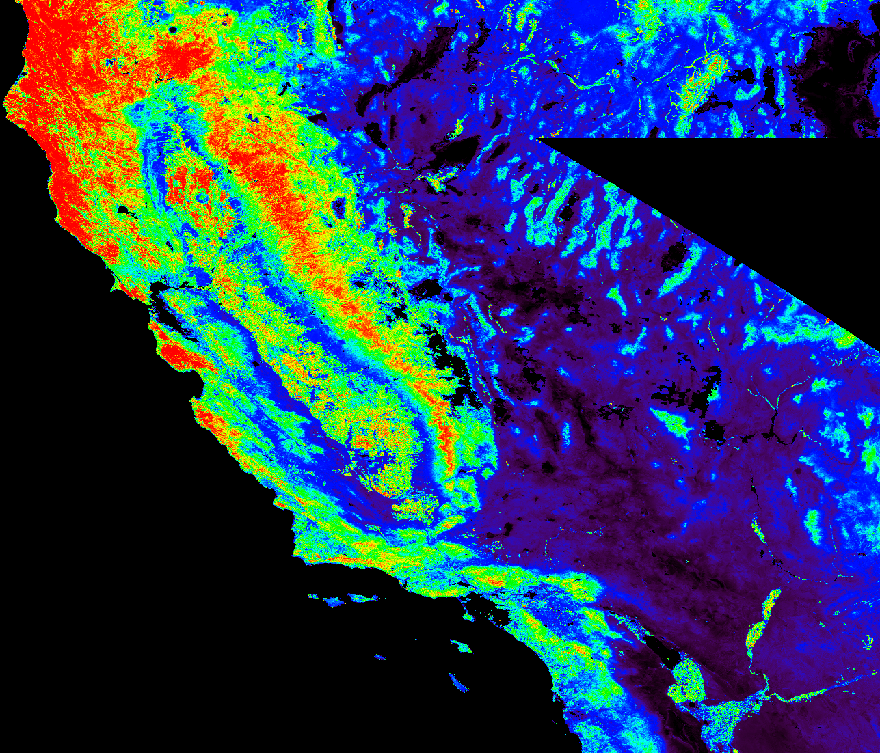
Biomass Mapping for California (Saatchi, JPL)
ALOS CA Mosaic
(HH-red & blue, HV-green)
LAI Layer
NED Layer
SRTM-NED
NDVI Layer
NLCD Layer

Slide 14
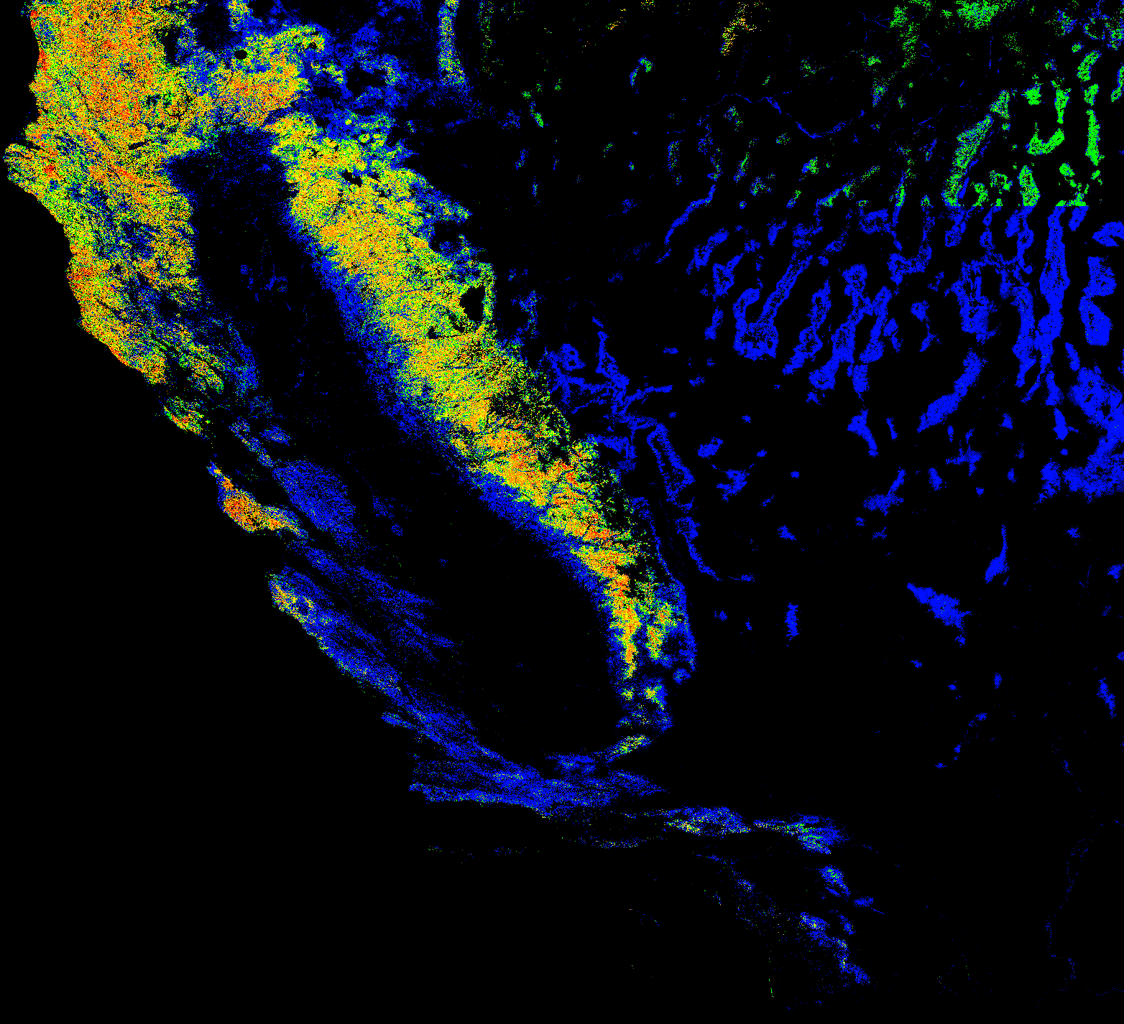
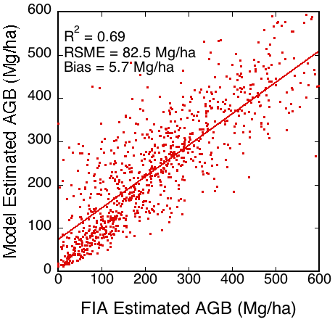
Aboveground Biomass Using Maxent with FIA Samples
(3 arcsec)
AGB (Mg/ha)

Slide 15
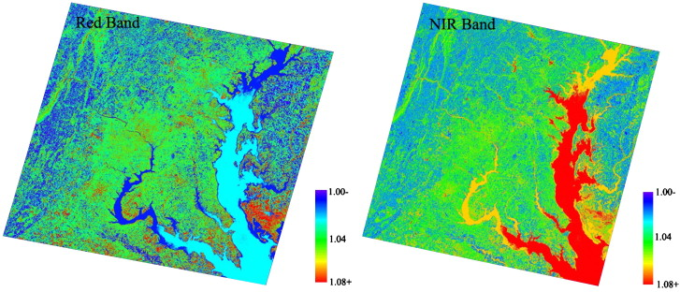
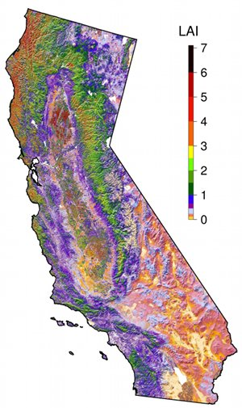
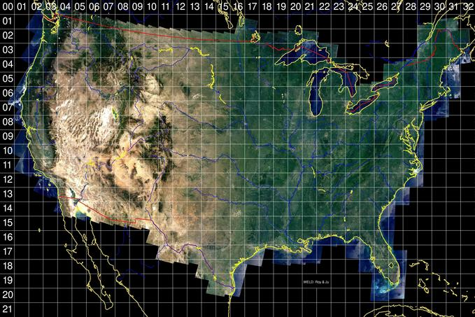
Higher Level Products from Landsat
Leaf-Area Index (Nemani/Ganguly), WELD composite radiometry&land cover (Roy/Hansen), Albedo (Masek/Shuai), fused MODIS/Landsat reflectance (Gao), Evapotranspiration (Anderson/Allen)
Generally use algorithms or data from MODIS

Slide 16
Conclusions
Evolving science needs drive innovation
Land research community is increasingly entrepreneural in developing and applying data products
Continued importance of uncertainty and error analysis

