Slide 1
Remote Sensing Product Continuity: Status, Challenges, Risks
3rd NASA Carbon Cycle & Ecosystems Joint Science Workshop
October 4, 2011
Chuck McClain & Compton Tucker
NASA/GSFC

Slide 2
Ocean & Land CDRs: What’s required
Well-conceived sensor performance specifications
  Polarization sensitivity, out-of-band response, temperature sensitivity, response vs. scan angle, stray light, cross-talk, etc.
Thorough prelaunch sensor characterization
  Mature/established test procedures and facilities
Vicarious calibration facilities & support infrastructure
Performance monitoring throughout mission lifetime
  E.g., monthly lunar calibrations (preferably at constant 7º phase angle)
Consistent algorithms across sensors/missions
  Backward compatible with earlier sensors (includes compatible bands)
Adequate in situ validation data
  Accuracy, data volume, global distribution
  Affordable & robust field instrumentation, calibration & measurement protocols
Periodic data reprocessing with improved algorithms
Overlap between missions time series
Close collaboration between processing group, cal/val team, & science community
Open data & processing software access (sensor & in situ)

Slide 3
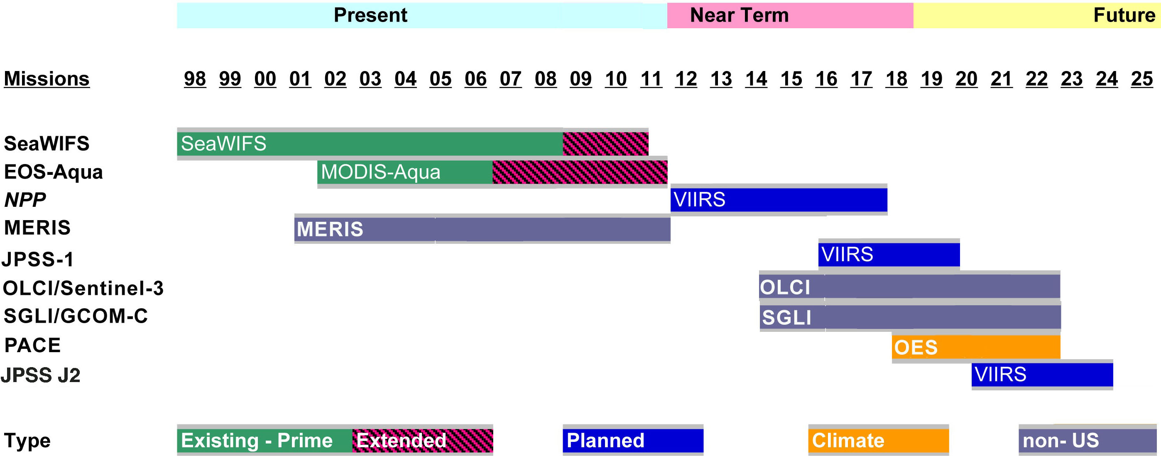
EVC - 15 Ocean Color:
Recommendations:
Evaluate VIIRS for SeaWiFS-MODIS CDR continuity &, if viable, assume CDR processing role
Work with international partners on sensor cross-calibration, product consistency, and data exchange
Strive to maintain the OES launch in CY2018
Continue development of advanced field instrumentation, measurement protocols, & bio-optical data collection/algorithm development

Slide 4
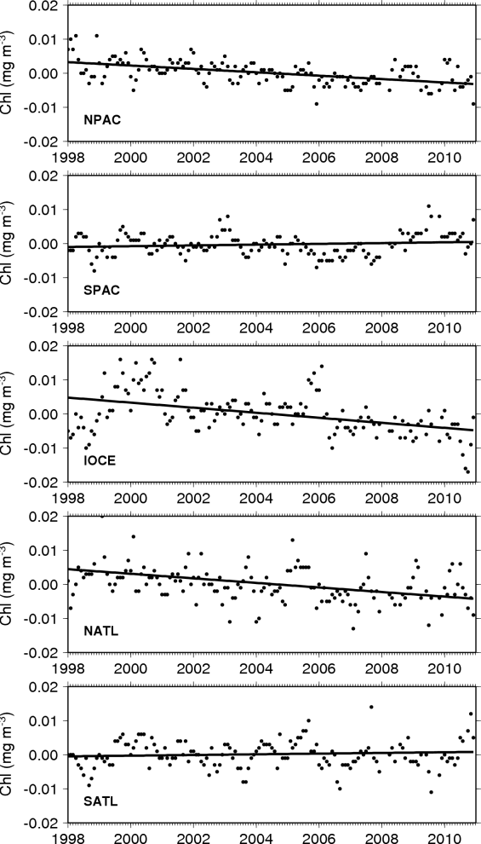
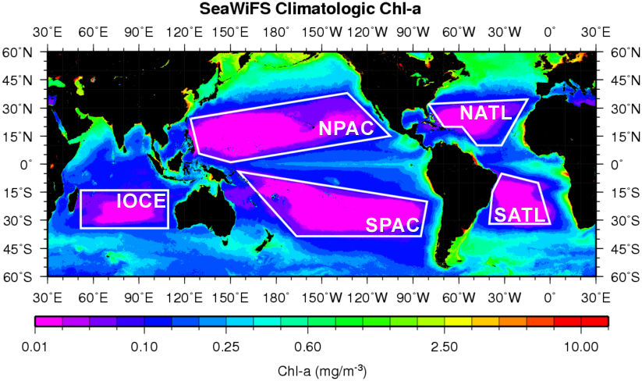
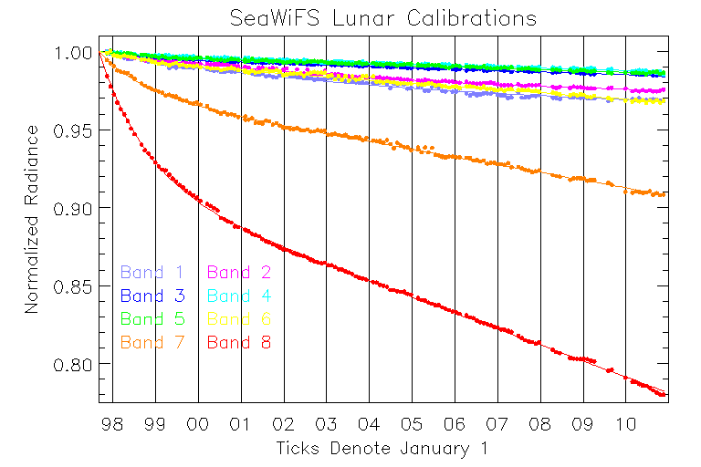
Ocean Trends: How to Establish Confidence
Signorini, S., C. R. McClain, Subtropical gyre variability as seen from satellites, Remote Sens. Lett., in press.

Slide 5
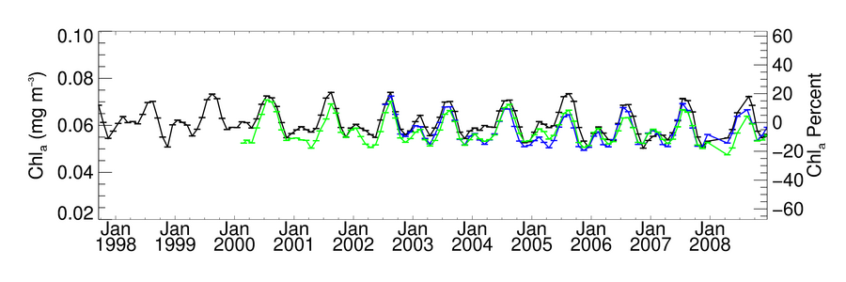
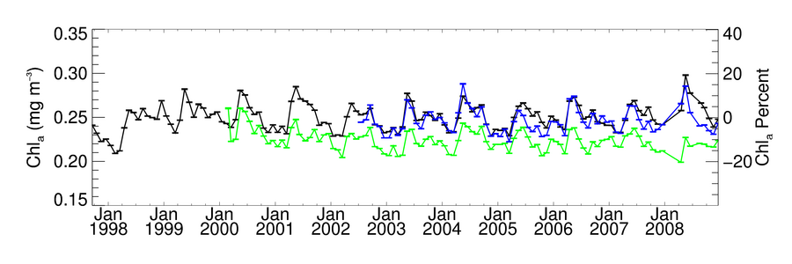
Global Chlorophyll Timeseries
Oligotrophic Subset
before reprocessing
SeaWiFS MODISA MODIST
Mesotrophic Subset
before reprocessing
SeaWiFS MODISA MODIST

Slide 6
NASA Ocean Biogeochemistry Derived Products & CDRs
CDRs drive sensor stability and derived product accuracy requirements
Ocean Products
  Normalized water-leaving radiances (±5%)
  Chlorophyll-a (± 35%)
  Diffuse attenuation coefficient (490 nm)
  Primary production
  Inherent optical properties (IOPs; spectral absorption & scattering coefficients)
  Particulate organic carbon concentration
  Calcite concentration
  Colored dissolved organic matter (CDOM)
  Photosynthetically available radiation (PAR)
  Fluorescence line height (FLH)
  Particle size distributions & composition (biogenic, mineral, etc.)
  Functional/taxonomic group distributions
  Phytoplankton carbon
  Dissolved organic matter/carbon (DOM/DOC)
  Physiological properties (e.g., C:Chl, fluorescence quantum yields)
  Other plant pigments (e.g. carotenoids)
  Export production
Current OBB CDRs
Candidate OBB CDRs
Research products

Slide 7
Ocean Color Sensor Spectral Coverage:
Number of ocean bio-optical & atmospheric correction multispectral bands
Time
OES (Ocean Ecology Sensor), as specified by the ACE ocean working group, is hyperspectral from 345-775 nm (5 nm resolution) with 5 other NIR/SWIR bands

Slide 8
NASA MODIS Land Products & Possible CDRs
  Surface reflectance
  Snow cover
  Land surface temperature
  Land cover and land cover change
  Vegetation continuous fields
  Vegetation indices
  Fires and burned area
  LAI/fPAR
  GPP/NPP
30 years minimum
High quality/validated
Errors known/no bias
Complete metadata
One CDR one physical parameter
Current MODIS Land Products
CDR Requirements

Slide 9
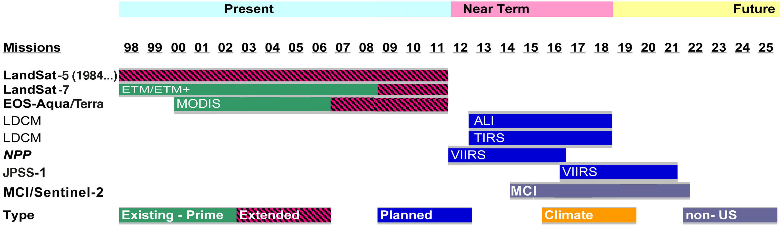
EVC - 23 Land Cover & Biomass:
Recommendations:
(1) Biomass-- Reinstate DesDYn lidar & put GEDI laser on ISS.
Move Landsat into the time domain & use Landsat for forest disturbance.
Continuity crucial—multiple instrument builds.
Billion dollar missions are death spiral.

Slide 10
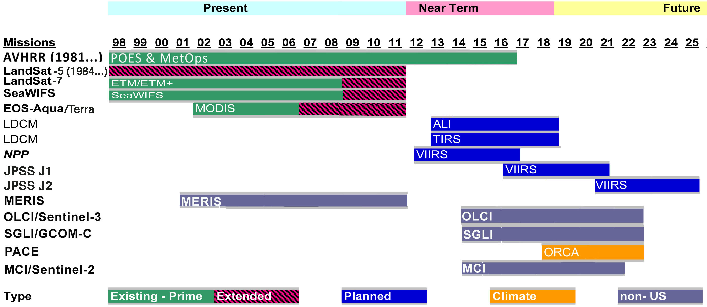
EVC – 24 VI, fPAR, & LAI:
Recommendations:
(1) VIIRS must be AVHRR of next 30 years…
Move Landsat into time domain.
Continuity crucial—multiple instrument builds.
(4) Billion dollar missions are death spiral.

Slide 11
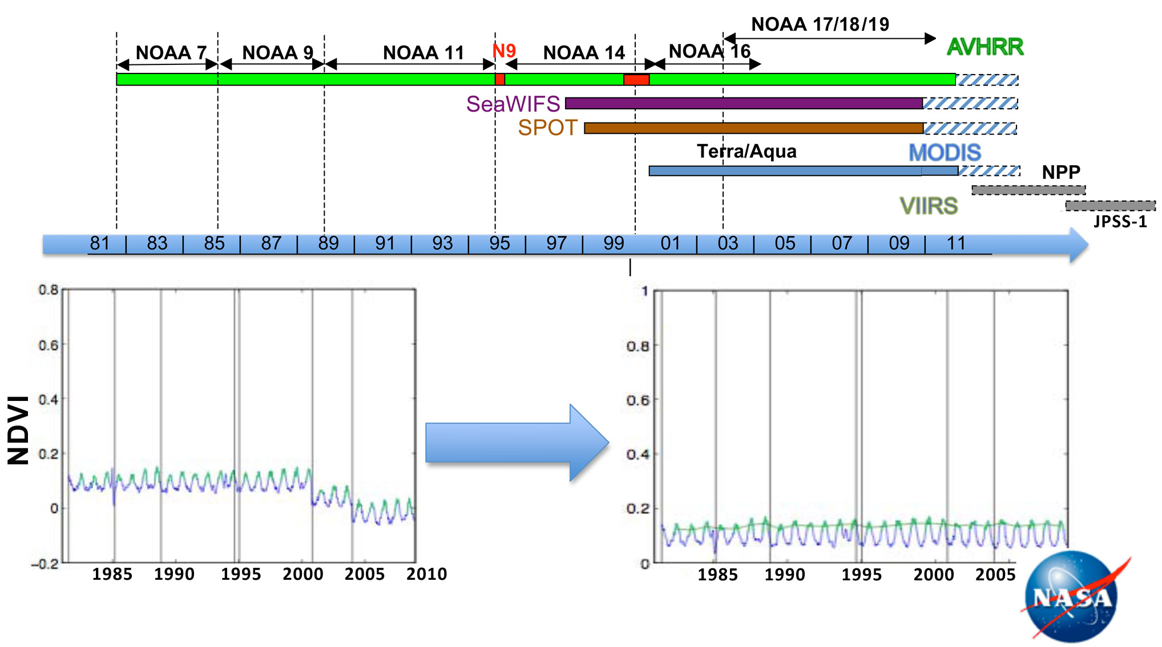
Improving Spectral Sensitivity & Reducing Temporal Discontinuities

Slide 12
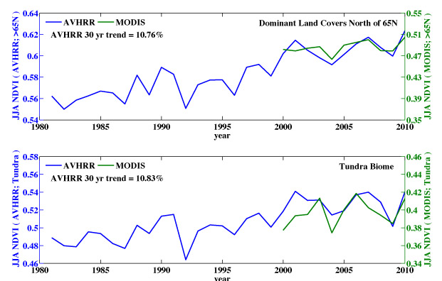
JJA NDVI MODIS-AVHRR 3g
Myneni et al. 2011 in prep.

Slide 13
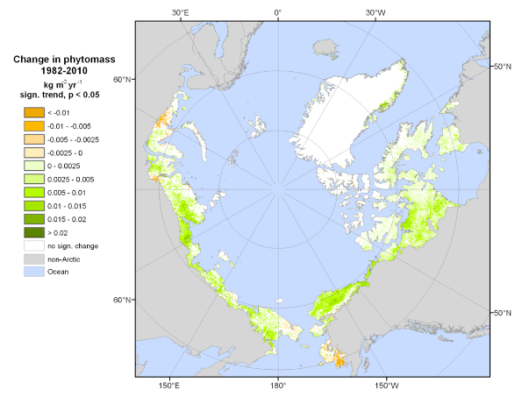

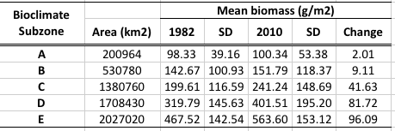
Change in Arctic tundra phytomass
Assuming biomass is 50% carbon: Arctic sink is about 0.014 Pg C y⁻¹
Estimated sink of northern permafrost areas 0.3-0.6 Pg y⁻¹ (McGuire et al. 2009)
Estimated northern hemisphere carbon sink (2002-2004) = 1.7 Pg (Ciais et al. 2010)
Estimated total land sink for carbon = 2.3 Pg C y⁻¹ (Le Quéré et al. 2009)
Epstein et al. submitted. Environmental Research Letters.

Slide 14
Ocean Biology Heritage Missions/Measurement Progress
8
OES
(2018 - )
Key
7
Few science products
Extensive science
products
Maturity Index *
no known use for
measurement
measured
operationally
Quality Index *
potential science
return
approaches limits
on performance
Climate Data
Record Quality
6
Desired Trajectory
SeaWiFS
(1997 - 2010 )
5
1=
Measurement Quality Index
*
Current trajectory
MODIS
(2002 - )
8=
4
VIIRS
(2011 - )
Insufficient for Climate Data Record
1=
3
CZCS
(1978-1986)
8=
2
* See definitions on next chart
* NOTE: MODIS Aqua climate-quality ocean biology data have only been achieved because SeaWiFS data were available for comparison
1
1
2
3
4
5
6
7
8
Measurement Maturity Index

Slide 15
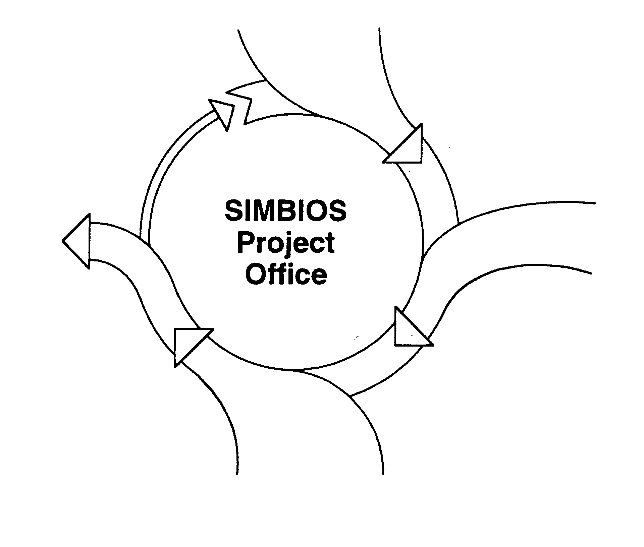
An International Approach for Ocean Biology/Biogeochemistry Data Records
Satellite Data from Calibrated Sensors
(2010)
Calibration Strategy
Prelaunch
  Lab. characterization & calibration (SI-traceable)
  Solar calibration (transfer-to-orbit)
Postlaunch (operational adjustments)
  Solar calibration (daily)
  Lunar calibration (monthly)
  Multiple sites L_{wn} time series for vicarious calibration
Mission Feedback
Science community input (ESA CCI)
Comparison with other appropriate products
New Missions (Sentinel 3 OLCI, OCM-2)
Protocol development
Feedback
Improved Products & Algorithms
Reprocessing due to improvements in calibration, masks, binning schemes, product compatibilities, etc. (ESA CCI; ISRO-NASA-NOAA JST)
New products from bio-geochemical fields, atmospheric fields, etc.
Data distribution interface
IN SITU – OCR OFFICE
(NASA?)
In Situ Data
Collection of required bio-optical and atmospheric measurements (INSITU-OCR PIs; ESA Aero. N. Africa)
in situ instrument calibration (Project round robin SI-traceable, IOPs, AOPs; ESA Radiance Project)
Data collection following NASA Ocean Optics protocols (ISRO Kavaratti)
Archive of calibrated QC in situ data (NASA SeaBASS)
Calibrated instrument pool
Develop new instrumentation
Product & Algorithm Validation
Land
Match-up analysis via Aeronet-OC sites, satellite QC, time series evaluation, Bio-Argo , ChloroGIN, etc.
Earth System/Climate Model data assimilation
SeaDAS, ODESA, BEAM…
Satellite data processing software (ACE, OCM-2, MERIS, OLCI, SGLI, GOCI, …..)

Slide 16
An International Approach for Land Carbon Cycle
& Ecosystem
Data Records
Mission Feedback
Science community input (US-ESA)
Comparison with other appropriate products
New Missions (Sentinel 2, NPP, LDCM)
Protocol development
Calibration Strategy
Prelaunch
  Lab. characterization & calibration
  Solar calibration (transfer-to-orbit)
Postlaunch (operational adjustments)
  Solar calibration (daily)
  Lunar calibration (monthly)
  Multiple sites L_{wn} time series for vicarious calibration –
Feedback
Improved Products & Algorithms
Reprocessing due to improvements in calibration, masks, binning schemes, product compatibilities, etc.
New products from bio-geochemical fields, atmospheric fields, etc.
Data distribution interface
Climate-Quality Satellite Data from Calibrated Sensors
In Situ Data
Collection of required land and atmospheric measurements
in situ instrument calibration
Data collection following NASA EOS protocols
Archive of calibrated QC in situ data (NASA, NOAA, ESA)
Calibrated instrument pool
Develop new instrumentation
Satellite Data
Satellite data
Derived/modeled products
Satellite data processing software
Product & Algorithm Validation
Atmospheric & bio-optical algorithm validation and development (Pis, NASA, NOAA, USGS, ESA, etc.)
Match-up analysis via flux tower sites, satellite QC, time series evaluation, etc.
Earth System/Climate Model data assimilation

Slide 17
BACK-UP

Slide 18
Comparison of “Heritage Sensors” and ACE Ocean Ecosystems Senor (OES)
spectral coverage for ocean color applications
“Multispectral”
Ocean Bands
CZCS: 4
SeaWiFS: 8
MODIS: 9
VIIRS: 7
OES: 26
HERITAGE SENSORS OES
86 “hyperspectral” bands + 3 SWIR bands
CZCS
(1978-1985)
SeaWiFS
(1997- )
MODIS
(2002- )*
Products
VIIRS
Absorbing aerosols
Dissolved organics
Phytoplankton pigments
Functional groups
Particle sizes
Physiology
Pigment fluorescence
Coastal biology
Atmospheric correction
(clear ocean)
Atmospheric
Correction
(coastal) &
Aerosol/cloud properties
Products
Ultraviolet
Ultraviolet
No Measurements
Total pigment or Chlorophyll-a
but major errors due to absorption by dissolved organics
Atmospheric Correction/ MODIS chlorophyll
fluorescence
Visible
Visible
5 nm resolution (345 – 775 nm)
26 required “multispectral” bands
Atmospheric
Correction
(clear ocean)
NIR
NIR
Atmospheric
Correction
(coastal)**
SWIR
3 SWIR
bands
*
SWIR
MODIS on Terra was launched in 2000, but does not yet provide science quality ocean data
MODIS/Visible Infrared Imaging Radiometer Suite (VIIRS) SWIR bands are not optimized for oceans
**

Slide 20
NPP Ocean Color Climate Data Record Issues
Programmatic Concerns
Potential Solutions
Reprocessing - Lack of mission-level reprocessing capabilities within IDPS or elsewhere in the program precludes climate-quality data processing, products, research.
Algorithms – IDPS algorithms are scientifically outdated and inconsistent with those used in the current current climate record; operational program lacks experience with algorithm tuning/refining.
Radiometric Calibration - Sensor calibration approach for VIIRS SDR generation is driven by operational constraints (latency and forward-stream processing) and is not consistent with Ocean Color climate research requirements.
Cal/Val Resources - Funding reductions have limited or threaten viability of key calibration and validation assets.
Designate a climate research system (CRS) separate from the operational system.
Capable of repeated full-mission reprocessing.
Using current state-of-the-art algorithms (SeaWiFS/MODIS heritage).
Linked to the existing climate data archive.
NPP CRS can be absorbed into the current NASA Ocean Data Processing facility immediately, and at minimal cost.
Establish a plan and organization to ensure VIIRS radiometric consistency comparable to heritage (MODIS and SeaWiFS)
Final approval of lunar roll maneuvers.
Mission-long calibration reanalysis.
Vicarious Calibration.
Revitalize support for Cal / Val teams and in-water assets.
The Structure of NPP/JPSS is Inconsistent with the Fundamental Requirements for Climate Data Generation.

Slide 21
NPP Ocean Color Climate Data Record Issues
Sensor Issues
Potential Solutions:
NPP VIIRS radiometric performance comparable to heritage in many respects, however :
Optical and Electronic Crosstalk – filter effects reduced in flight model, still a concern.
Solar Diffuser Degradation – lack of a door predicts rapid degradation as seen in Terra MODIS.
JPSS-1 VIIRS – mirror characterization indicates issues with stray light.
Science Advancement – Smaller band set precludes new science applications introduced during EOS era.
Build upon established evaluation efforts (as per MODIS) to assess effects of sensor issues and test correction techniques.
Maintain temporal calibration accuracy by co-analysis of diffuser and lunar calibration data (as per MODIS).
Substantial reprocessing capability (as per previous slide) is a necessary component of any solution.
Require vendor to install new mirror with performance that at least matches NPP VIIRS.
PACE / ACE (2018/9 launch) will provide capabilities for new science.
Although VIIRS performance might be similar to heritage, an experienced calibration/validation team and proven data processing infrastructure will be required to achieve climate quality time-series. The NPP Program does not have a VIIRS calibration strategy to maintain radiometric accuracy or consistency at the level required for Ocean Color.

Slide 22
VIIRS Ocean Color Climate Science Limitations
  VIIRS data quality is lower than of SeaWiFS (SeaWiFS quality needed for NASA Earth system and climate research)
    Assessment based on pre-launch data (cross-talk, polarization sensitivity, etc.)
  VIIRS ocean color spectral coverage less than SeaWiFS and MODIS
    Consequences of reduced spectral coverage:
      No improvement in chlorophyll-a retrievals in open ocean (CDOM contamination remains a problem; solution requires a UV band)
        May continue SeaWiFS/MODIS chlorophyll-a time series in non-turbid water
      Less accurate chlorophyll retrievals in turbid water (no SeaWiFS 510 nm band
        Impacts coastal applications
      No fluorescence data to continue MODIS fluorescence line height time series –
        Required for studies of ecosystem dynamics and nutrient stress
      Reduced accuracy of inherent optical properties (IOPs)
        IOP retrievals improve with additional spectral bands

Slide 23
VIIRS Ocean Color Climate Science Limitations
  VIIRS provides no new science
    No ecosystem structure or plankton functional group information
    No HAB detection
    Minimal carbon cycle science
VIIRS is presently the best option available for continuing the SeaWiFS/MODIS time series. It is the only option that can guarantee full insight into the pre-launch data, allow NASA to use common algorithms and techniques,
accommodate a lunar calibration (even if not ideal), and provides a
sequence of missions with a common sensor. While the foreign missions
might be another option, there are concerns about many aspects of achieving
Data access and consistency.
    Next slides have detail on key science questions/research/data products for NASA that would both continue heritage SeaWiFS/MODIS observations and research as well as facilitate new research.

Slide 24
