Slide 1
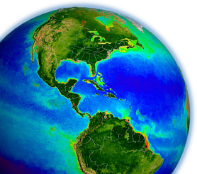
New uses for data products & coordinated networks of observations:
OCEANS
Jeremy Werdell
4 Oct 2011
NASA Joint Science Workshop

Slide 2
Contributors
Steve Ackleson (Consortium for Ocean Leadership)
Barney Balch (Bigelow)
Watson Gregg (NASA)
Stephane Maritorena (UCSB)
Mary Jane Perry (UMaine)
David Siegel (UCSB)
some additional authors cited:
S Alvain, C. Anderson, M. Behrenfeld, S. Doney, Duforet-Gaurier, C. Fichot, A. Gnanadesikan, T. Kostadinov, A. Mannino, D. McGillicuddy, W. Miller, J. Polovina, W. Shi, I. Soto, C. Wilson, J. Yoder

Slide 3
Overview
data talks 1 & 2 reviewed existing data products, “climate data records,” & plans for the future
data talk 3 will advertise cutting edge data products from existing sensors & assimilation of multiple products
2. merger with in situ data
existing satellite time-series continue to provide an opportunity to further our understanding of the global biosphere
1. new data products
3. modeling efforts

Slide 5
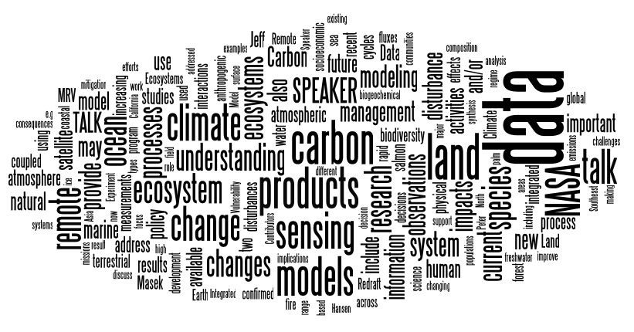
frequency of appearance of words in JSW abstracts
http://www.wordle.net

Slide 6
Stephane
ocean products under development
dissolved organic carbon
particulate organic carbon
slope of the particle size distribution
phytoplankton community structure
Mannino et al., 2008
µmol C L⁻¹
Duforêt-Gaurier et al., 2010
Kostadinov et al., 2009
Alvain et al., 2005, 2008

Slide 7
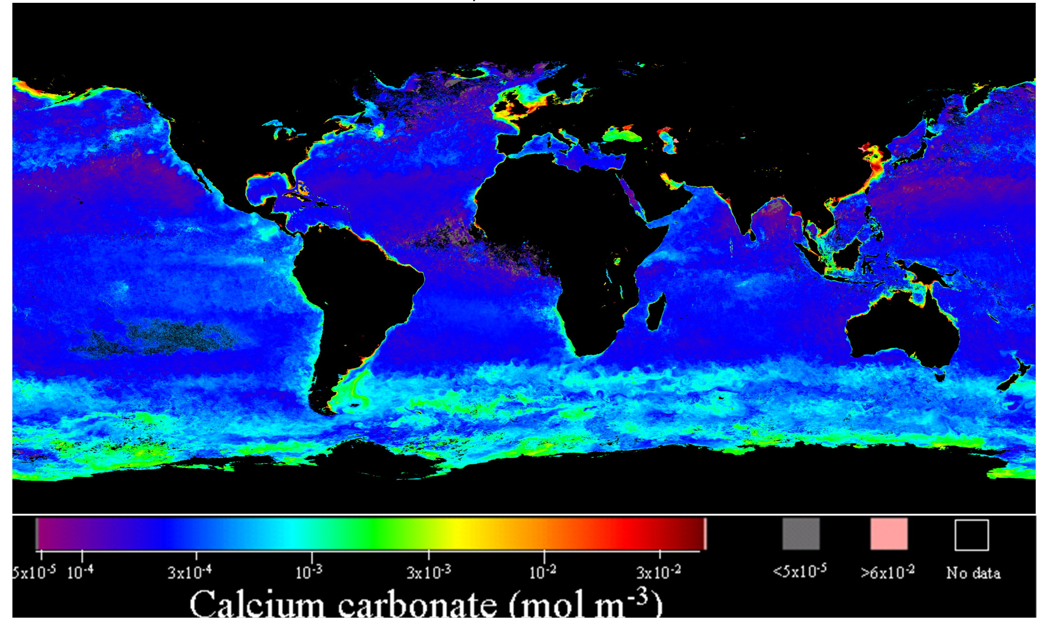
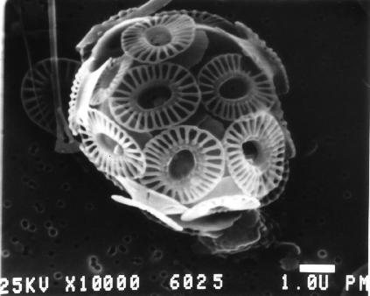
ocean products under development
NASA’s MODIS and SeaWiFS missions have documented (and ships have now validated) the “Great Calcite Belt” a region of enhanced reflectance that covers ~1/4 of Earth’s ocean
1 μm
the source are coccolithophores
MODIS Aqua; Dec 2010 to March 2011
Balch, Bigelow Laboratory

Slide 8
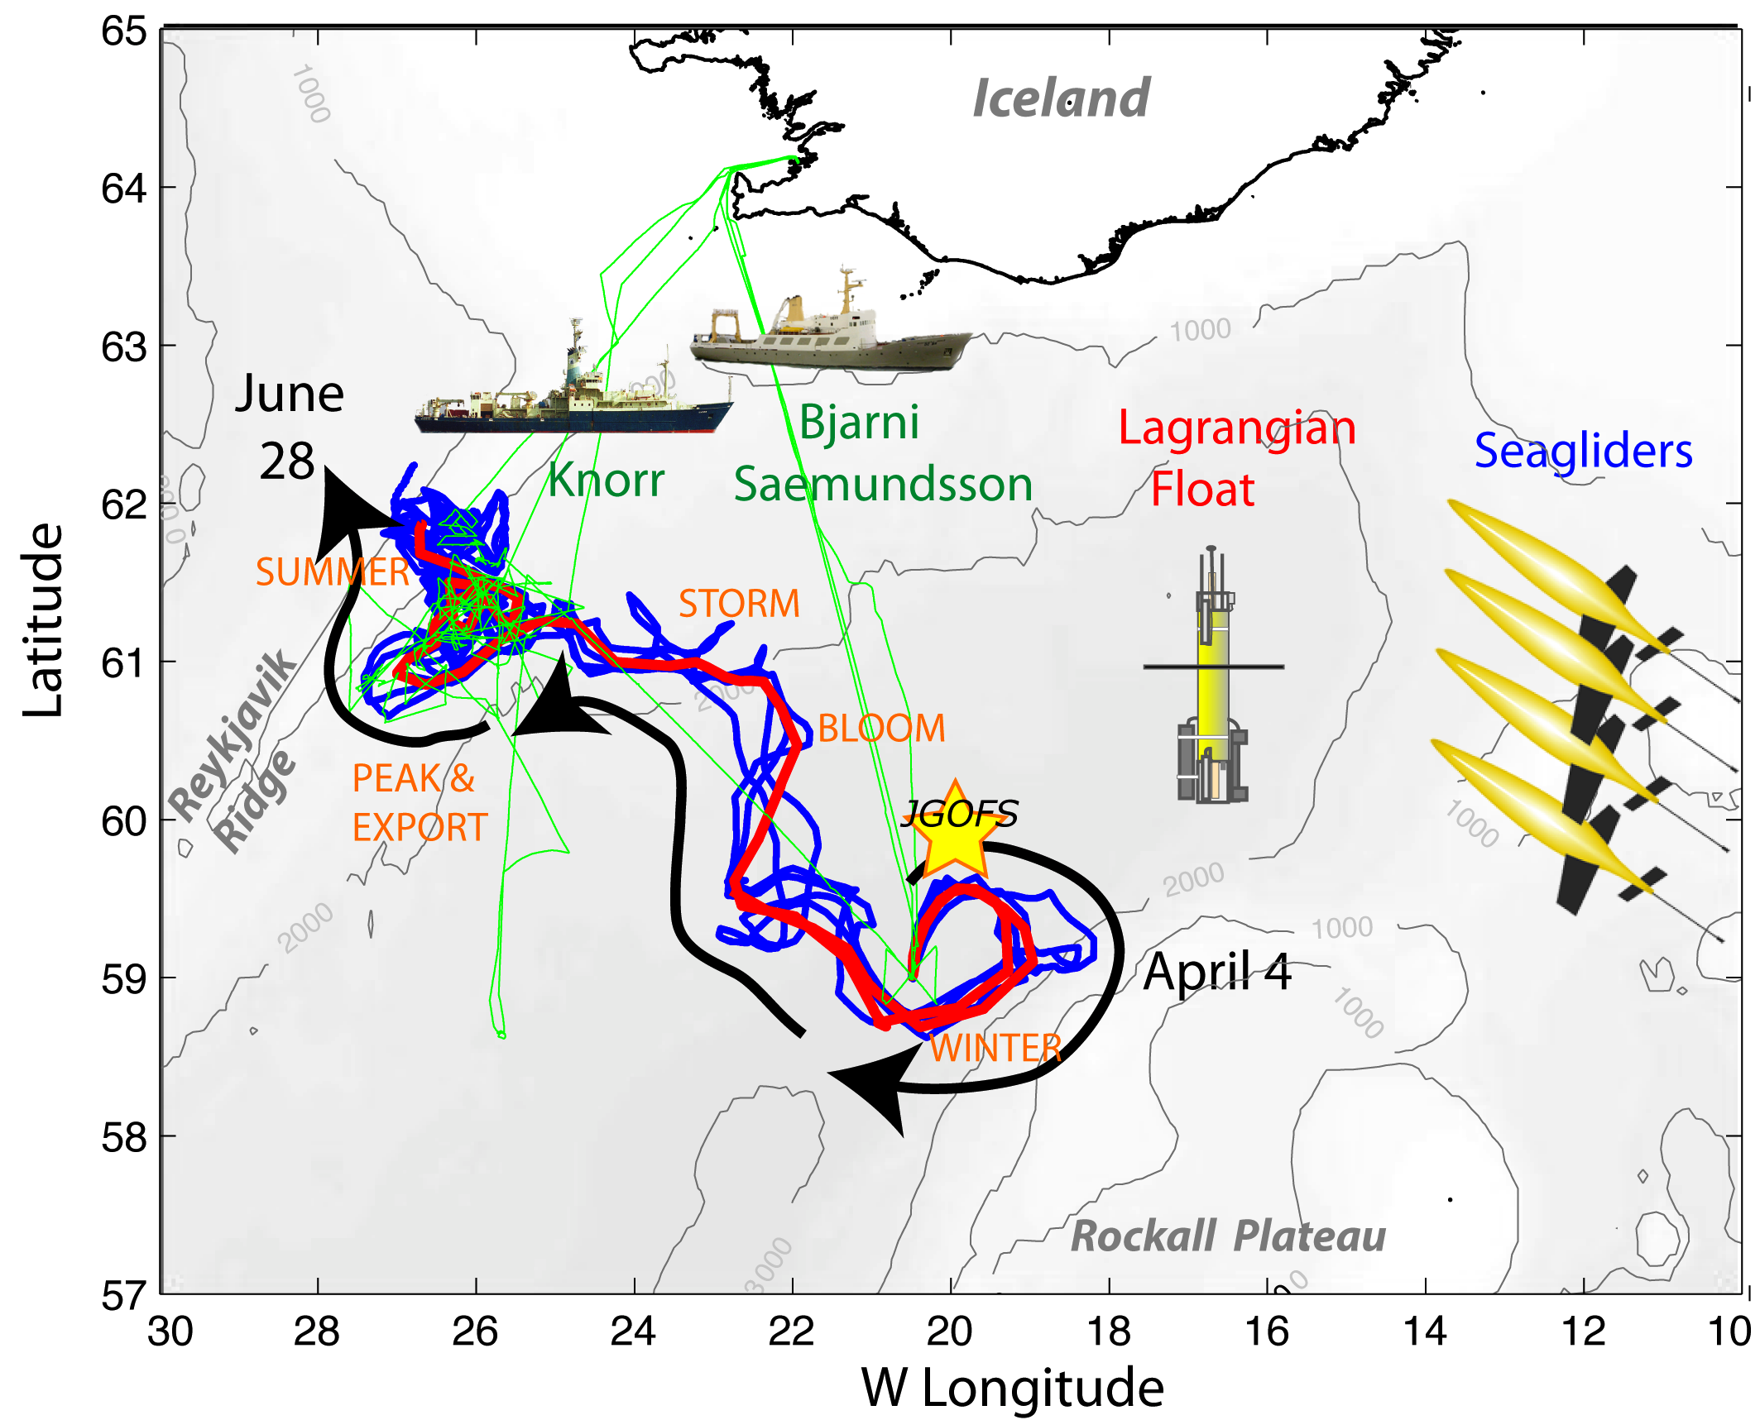
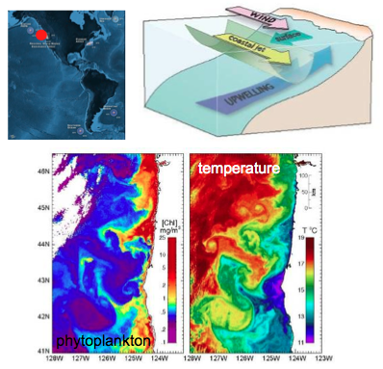
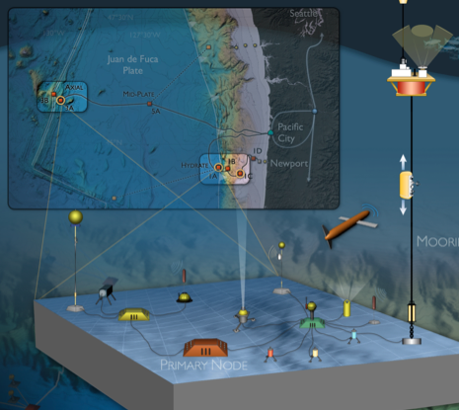
Mary Jane & Steve
ties to in situ measurements
support for satellite time-series & support for in situ studies
See
North Atlantic Bloom (NAB) 2008
courtesy of Eric D’Asaro, Craig Lee, and Mary Jane Perry
see also Briggs et al. 2011, Deep Sea Research I
courtesy of Steven Ackleson

Slide 9
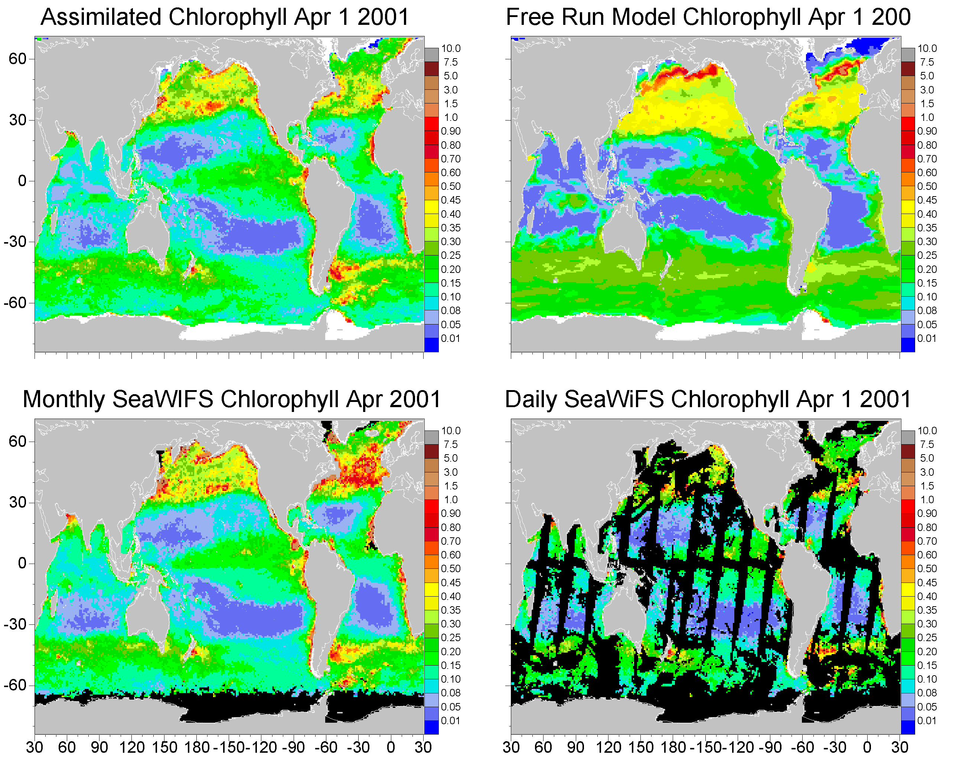
Watson
data assimilation & modeling
1
mg m⁻³
data assimilation:
* improves a model by forcing agreement with data & reducing model biases
* improves the data by filling in missing data & reducing sampling biases
comparison with in situ data:
bias uncertainty
free-run model -1.4% 61.8%
assimilation 0.1% 33.4%
Gregg, 2008, Journal of Marine Systems

Slide 10
data assimilation & modeling

Slide 11
http://oceancolor.gsfc.nasa.gov Ocean Color
http://disc.sci.gsfc.nasa.gov/giovanni/ Giovanni
http://podaac.jpl.nasa.gov PO.DAAC @ JPL
http://wiki.icess.ucsb.edu/measures/index.php/Main_Page MEaSUREs O/C
http://www.science.oregonstate.edu/ocean.productivity/ Ocean Productivity

