Slide 1

Operational Forest Carbon Assessment and Management
Rich Birdsey
Sean Healey
and our many colleagues

Slide 2
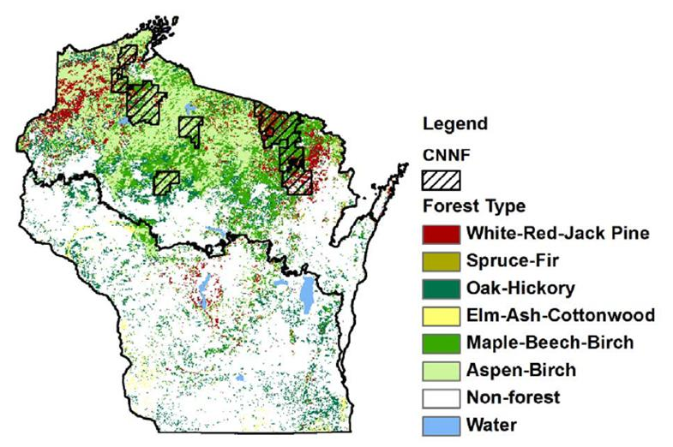
Objectives of forest carbon assessment and management
Assess historical trends in carbon stocks in forest biomass, soils and wood products
Support strategic carbon management analysis at operational scales
Public Lands
Chequamegon-Nicolet National Forest

Slide 3
Approaches to Forest Carbon Assessment
Eastern U.S.
  Successive forest inventories for assessing changes in C stocks
  Remote sensing: extensive use of LEDAPS (disturbance) and MODIS (LAI) data
  Climate and disturbance-driven biogeochemistry model for analysis and projections
Western U.S.
  Initial forest inventory for assessing C stock
  Remote sensing: Landsat used to determine trends in C stocks
  Disturbance-driven “Forest Vegetation Simulator”
  Stochastic simulations of management/disturbance scenarios

Slide 4
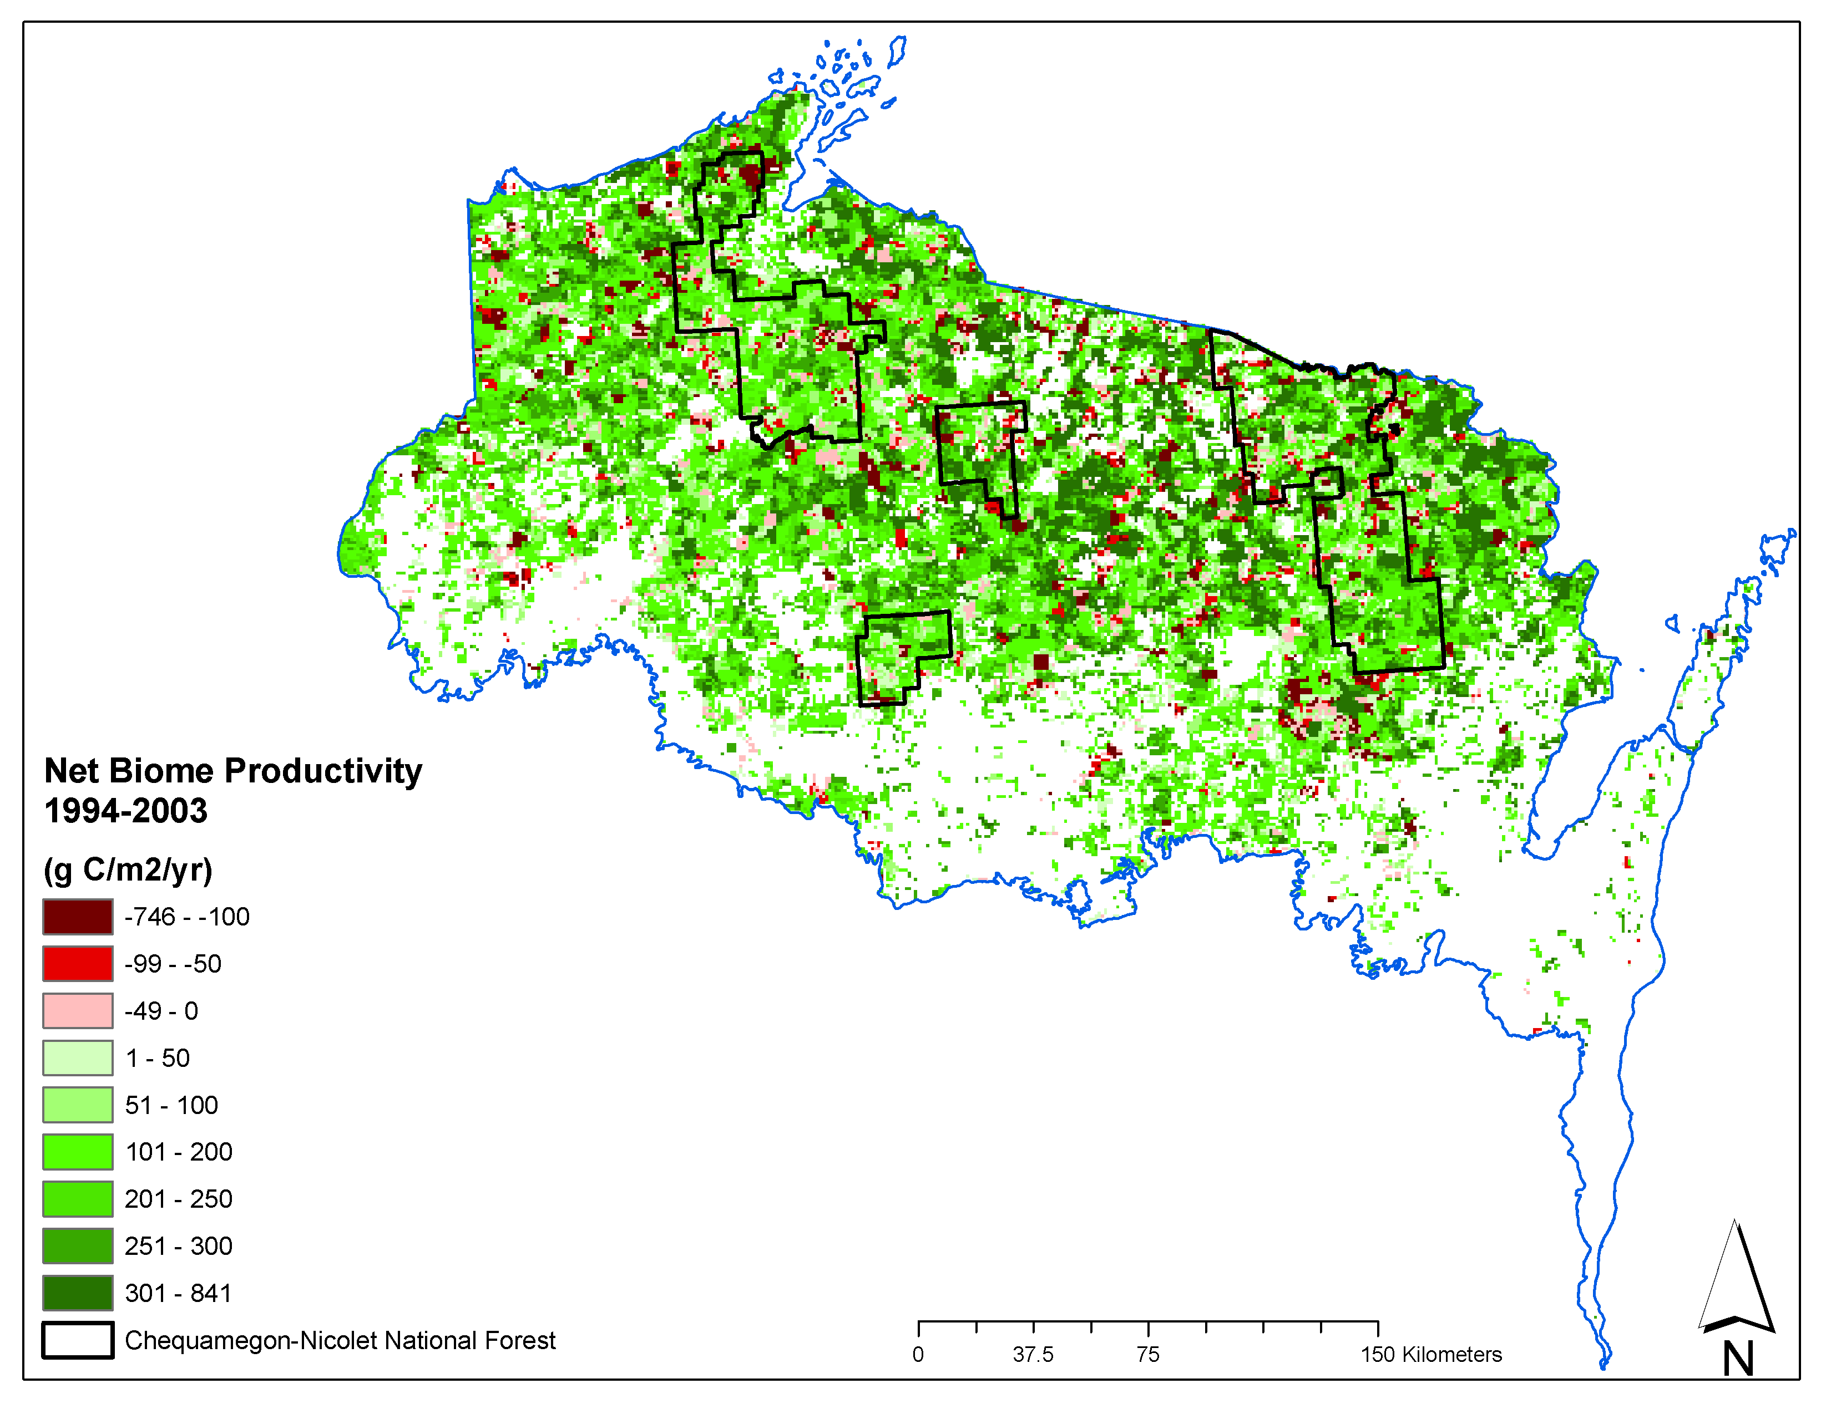
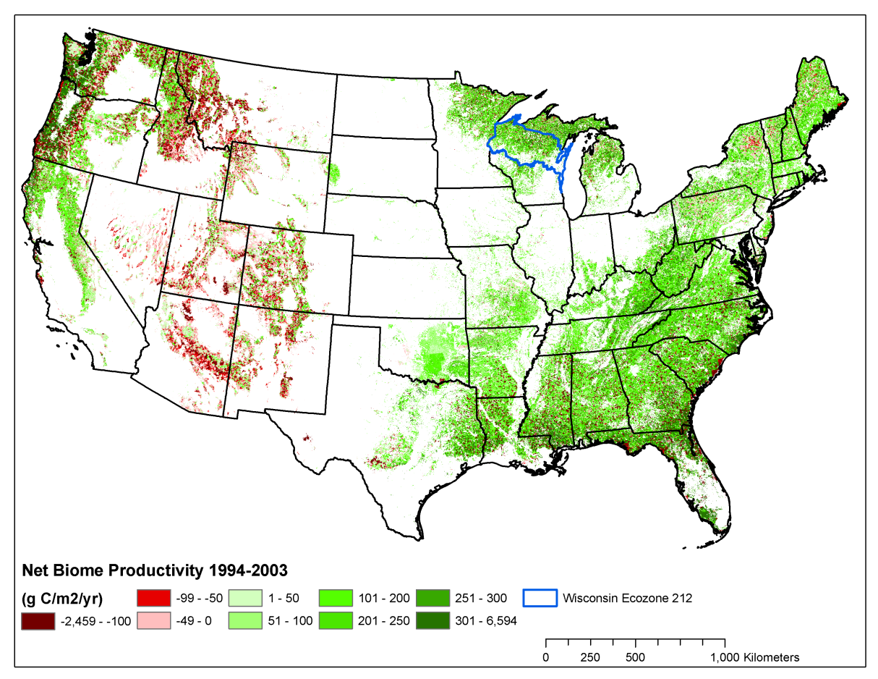
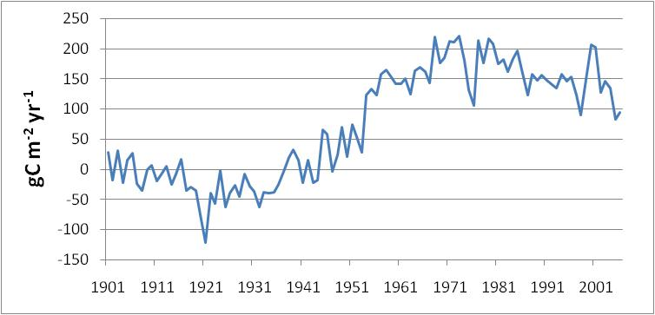
Spatial and Temporal Change in Carbon Stocks, Northern Wisconsin and Chequamegon-Nicolet National Forest
CNNF Productivity
InTEC Model (Zhang et al.)

Slide 5
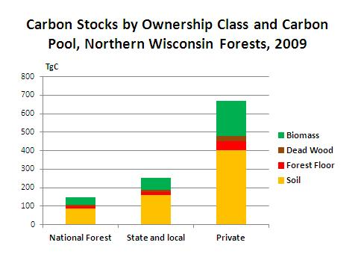
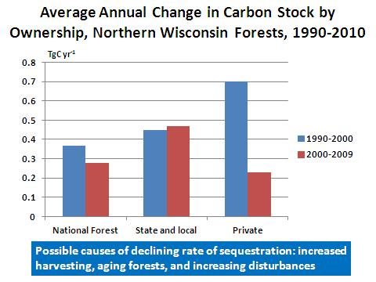
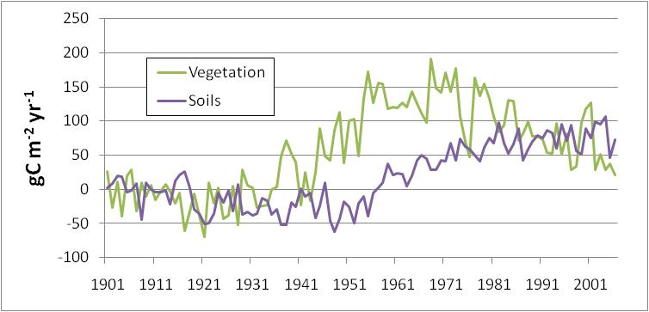
Inventory data
Remote sensing + BGC

Slide 6
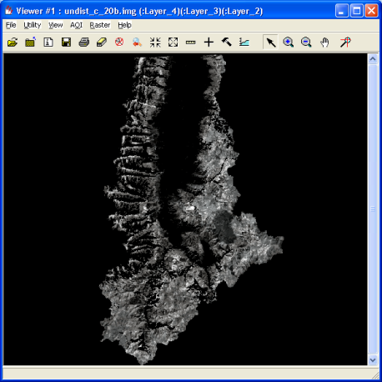
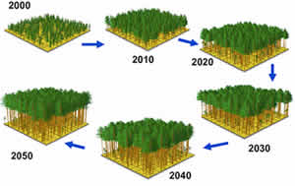
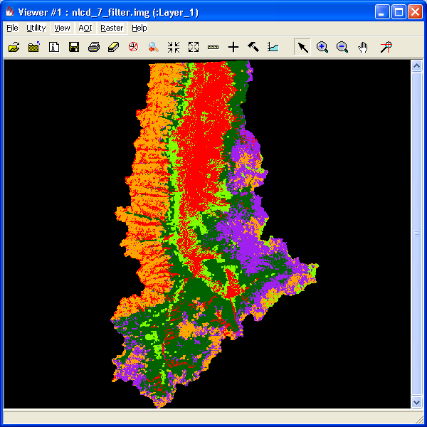
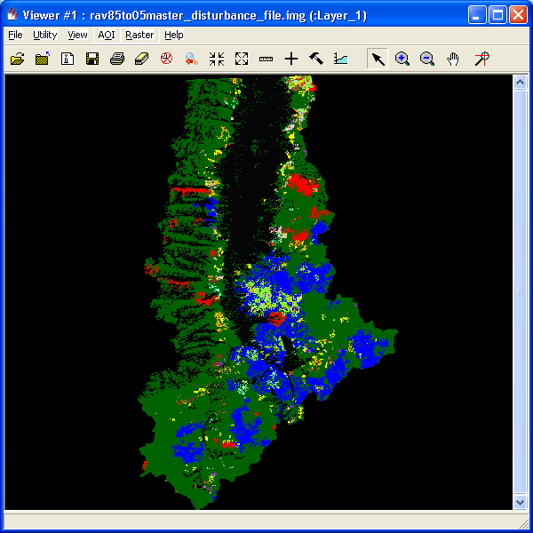

ForCaMF (Forest Carbon Management Framework)
Landsat can support projection of carbon storage under different management scenarios, IF:
1. Landsat maps of vegetation and disturbance can be linked to a carbon model designed to address local management concerns
FoCaMF developed a spatial adaptation of a widely used decision support tool
Forest Volume
Maps
Forest Type
FVS (Forest Vegetation Simulator)
Disturbance

Slide 7
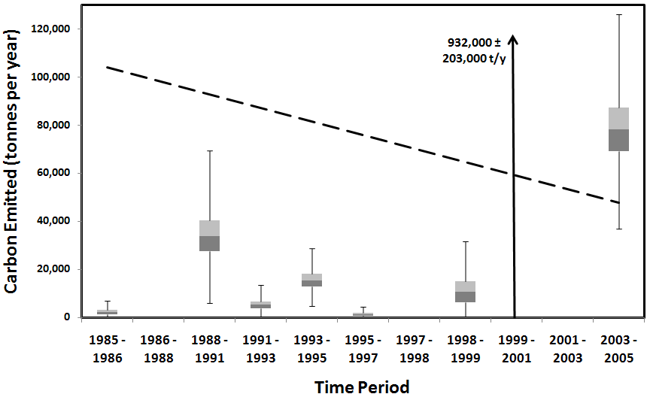
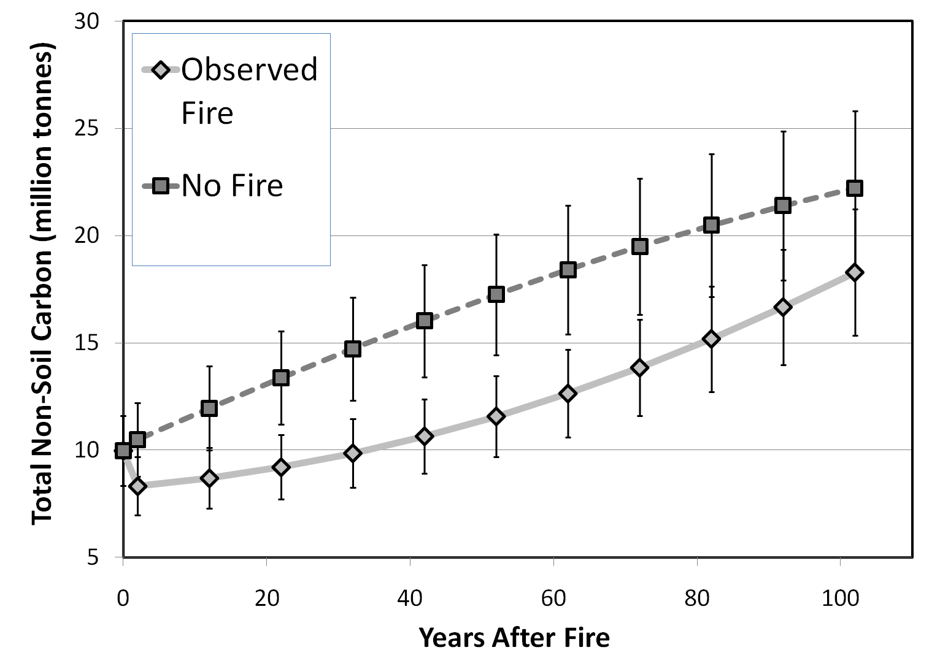
ForCaMF (Forest Carbon Management Framework)
Landsat can support projection of carbon storage under different management scenarios, IF:
2. The uncertainty of satellite-based data can be understood and communicated as defensibly as decision support from other sources.
FoCaMF probabilistically alters map data to empirically measure uncertainty of estimated stocks and fluxes
Carbon flux due to fire and harvest
Stocks under observed and “no fire” scenarios
Bars represent standard deviation of 2000 simulations

Slide 8
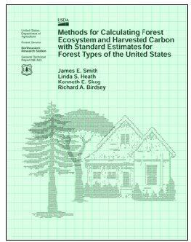

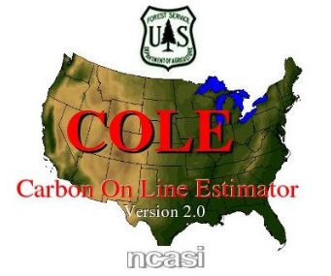
Decision-support for Land Managers
National Forest System carbon reporting and planning
State and private landowners strategic mitigation analysis
Linking mitigation and adaptation

Slide 10
Thanks! Please visit our posters….
124: Operational Forest Carbon Assessment and Management (Richard Birdsey, Yude Pan, Fangmin Zhang, Chen Chen, Craig Wayson, Kristofer Johnson)
166: ForCaMF - Decision Support for Landscape-Level Forest Carbon Management (Sean P Healey, Shawn Urbanski, James Morrison, Chris Garrard, Alicia Peduzzi, Alex J Hernandez)

