Slide 1
A Decision Support System for Ecosystem-Based Management of Tropical Coral Reef Environments
F. Muller-Karger, M. Eakin, L. Guild,
M. Vega, R. Nemani, T. Christensen, L. Wood, C. Ravillious,
C. Hu, C. Nim, J. Li, C. Fitzgerald, J. Hendee, L. Gramer, S. Lynds
NOAA Coral Reef Watch
University of South Florida
NASA Ames
UNEP-WCMC
U. Colorado-CIRES

Slide 2
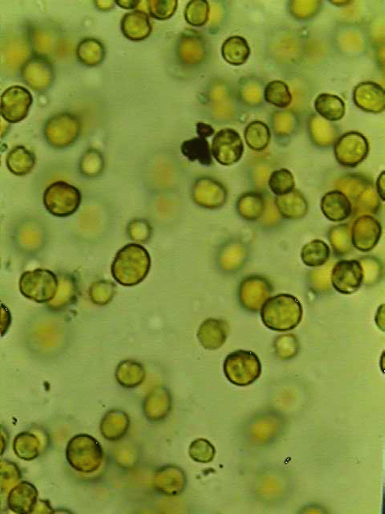
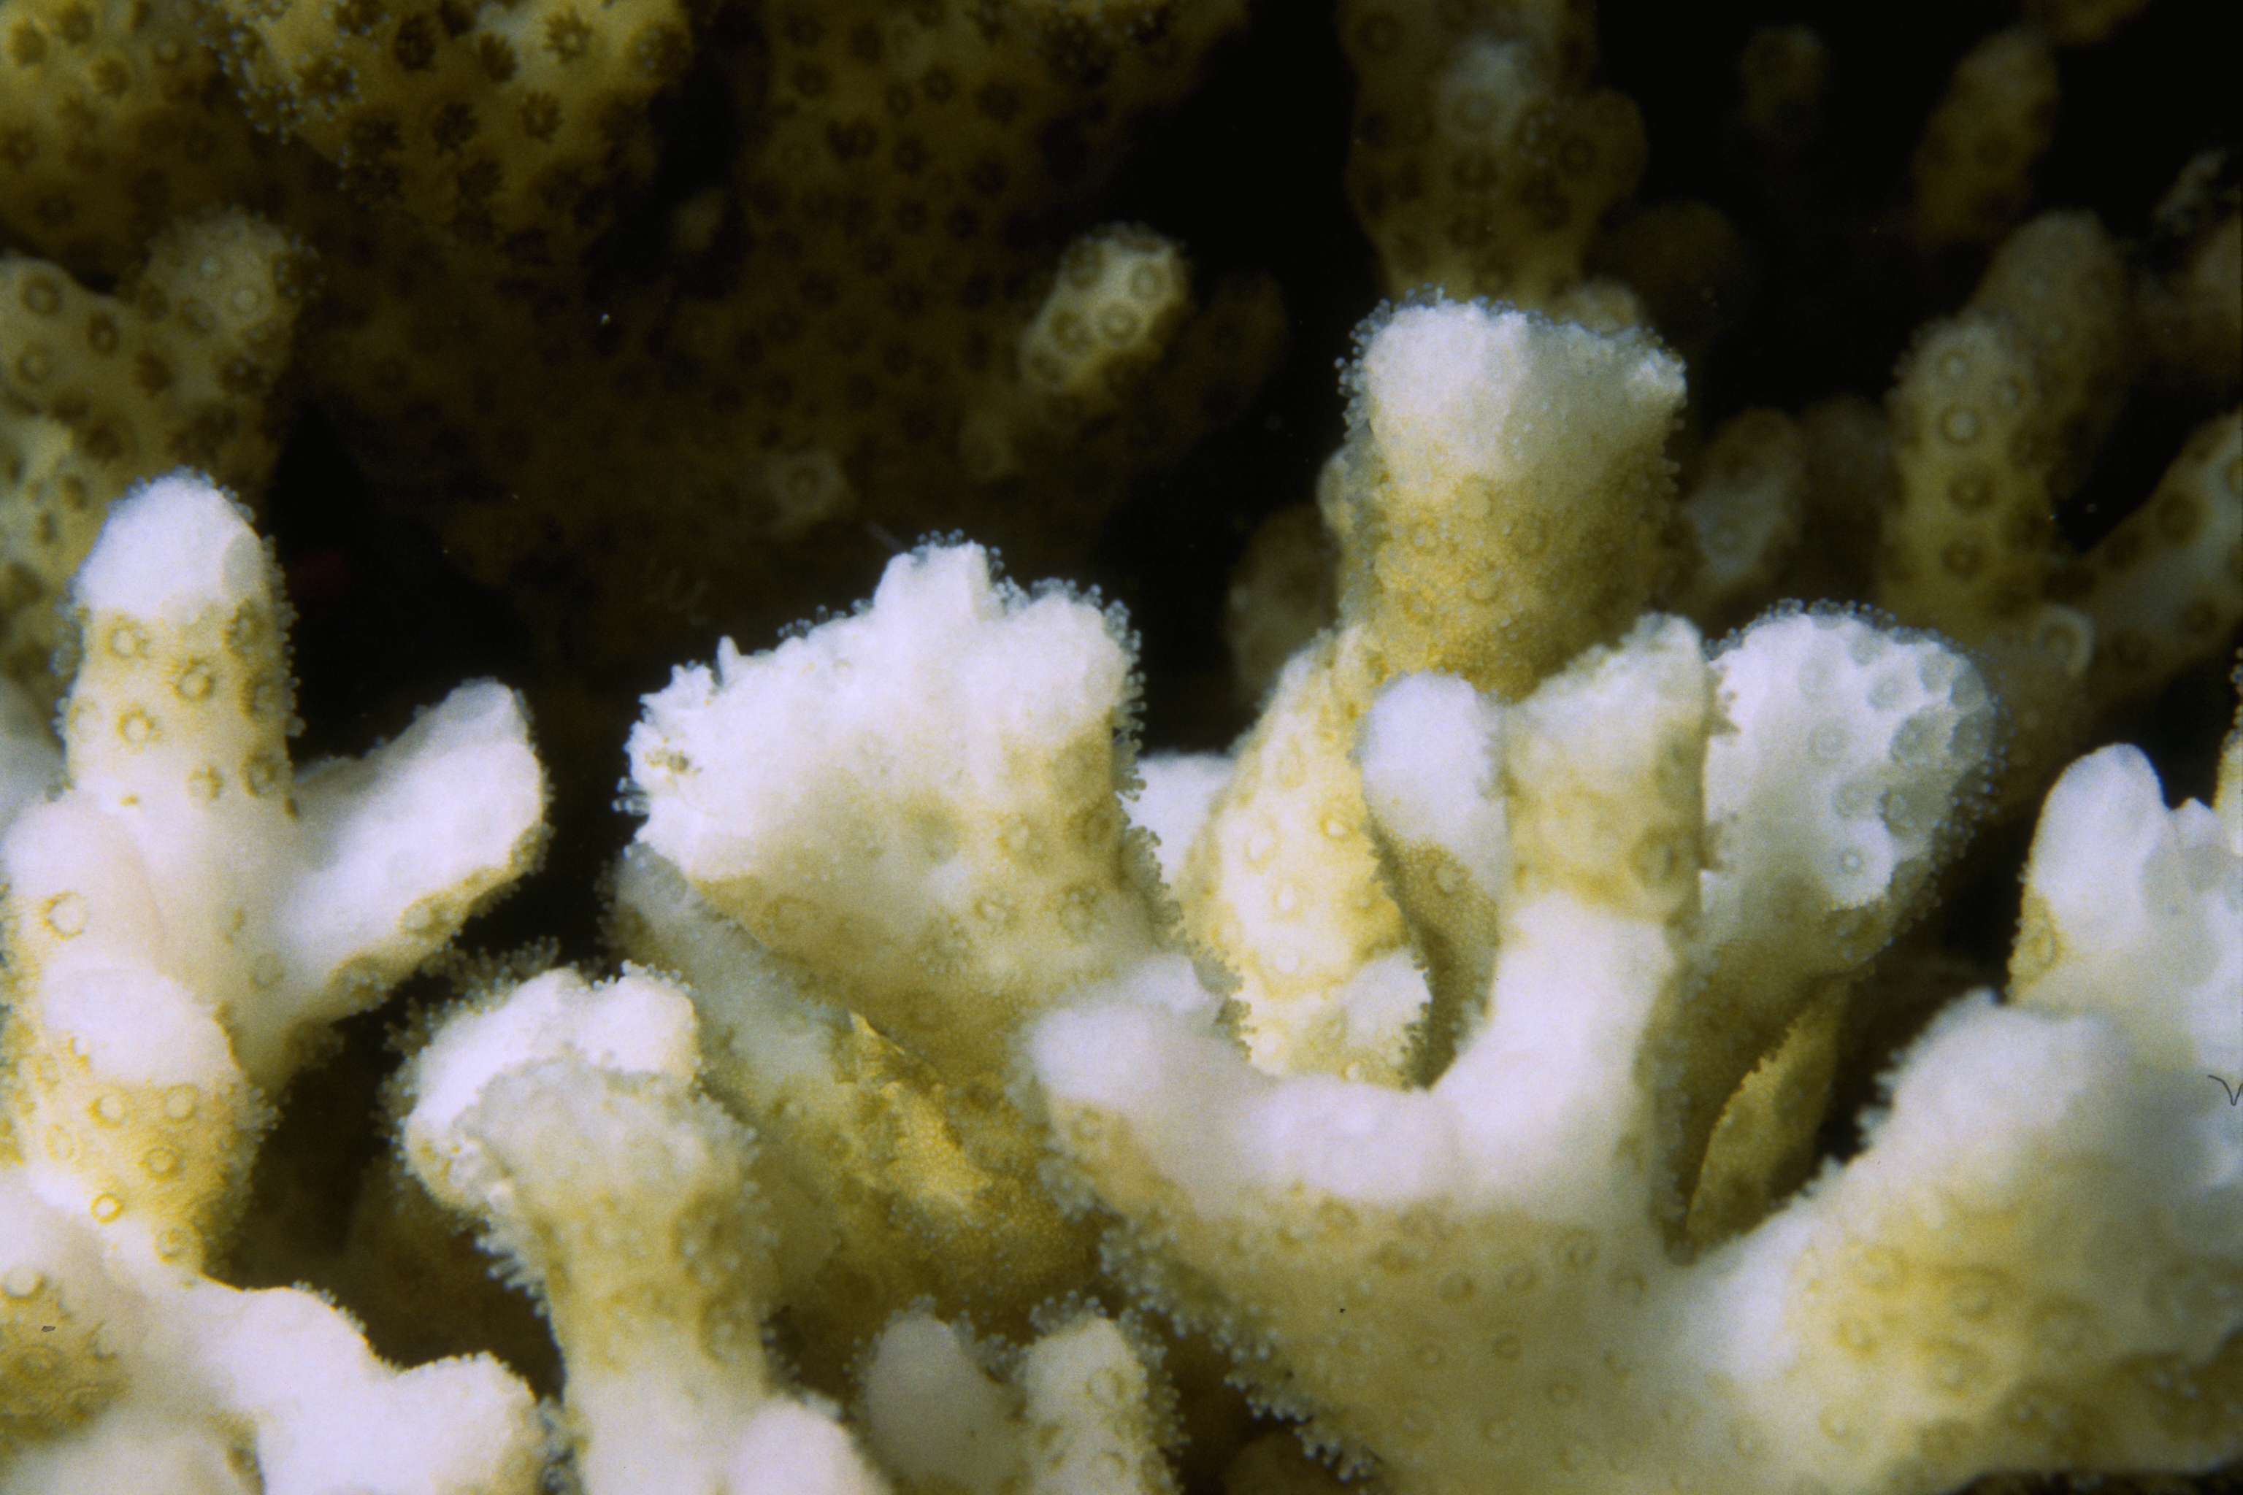
Coral Bleaching: Impact of Climate Change
zooxanthellae
High temperatures stress corals
Corals eject their algae; coral appears “bleached
If stress is mild or brief, corals recover, otherwise they die
Scott R. Santos
Symbiotic algae

Slide 3
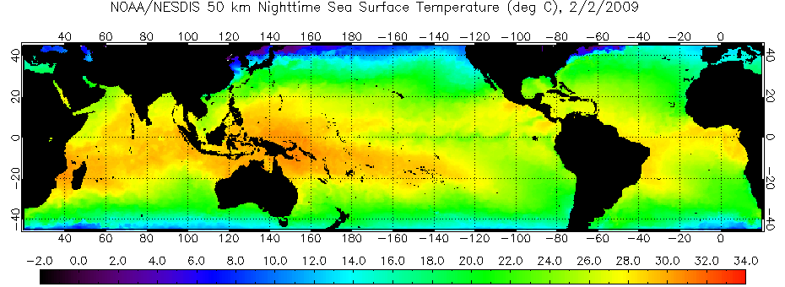
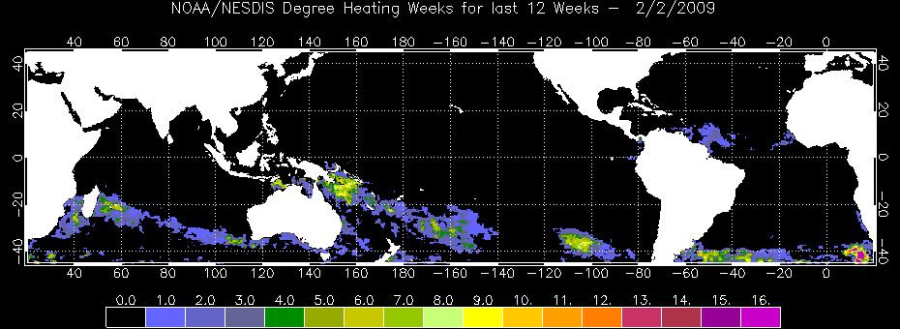
Coral Reef Watch Satellite-Based Products
Primary Products: SST-based
50km Nighttime Sea Surface Temperature (SST)
Coral –
specific
Degree Heating Week

Slide 4
NOAA Coral Reef Watch: New Decision Support System
Approach:
Develop and test new, high-resolution climatologies
Global 4 km Pathfinder daily SST data
Application of NEX for handling large data volumes
Develop 5-11 km global products
11 km GOES-POES Blended data (28-100 scenes/day)
Develop 1 km regional products (Caribbean, Australia)
Develop full suite of high-resolution tools for coral reef managers

Slide 5
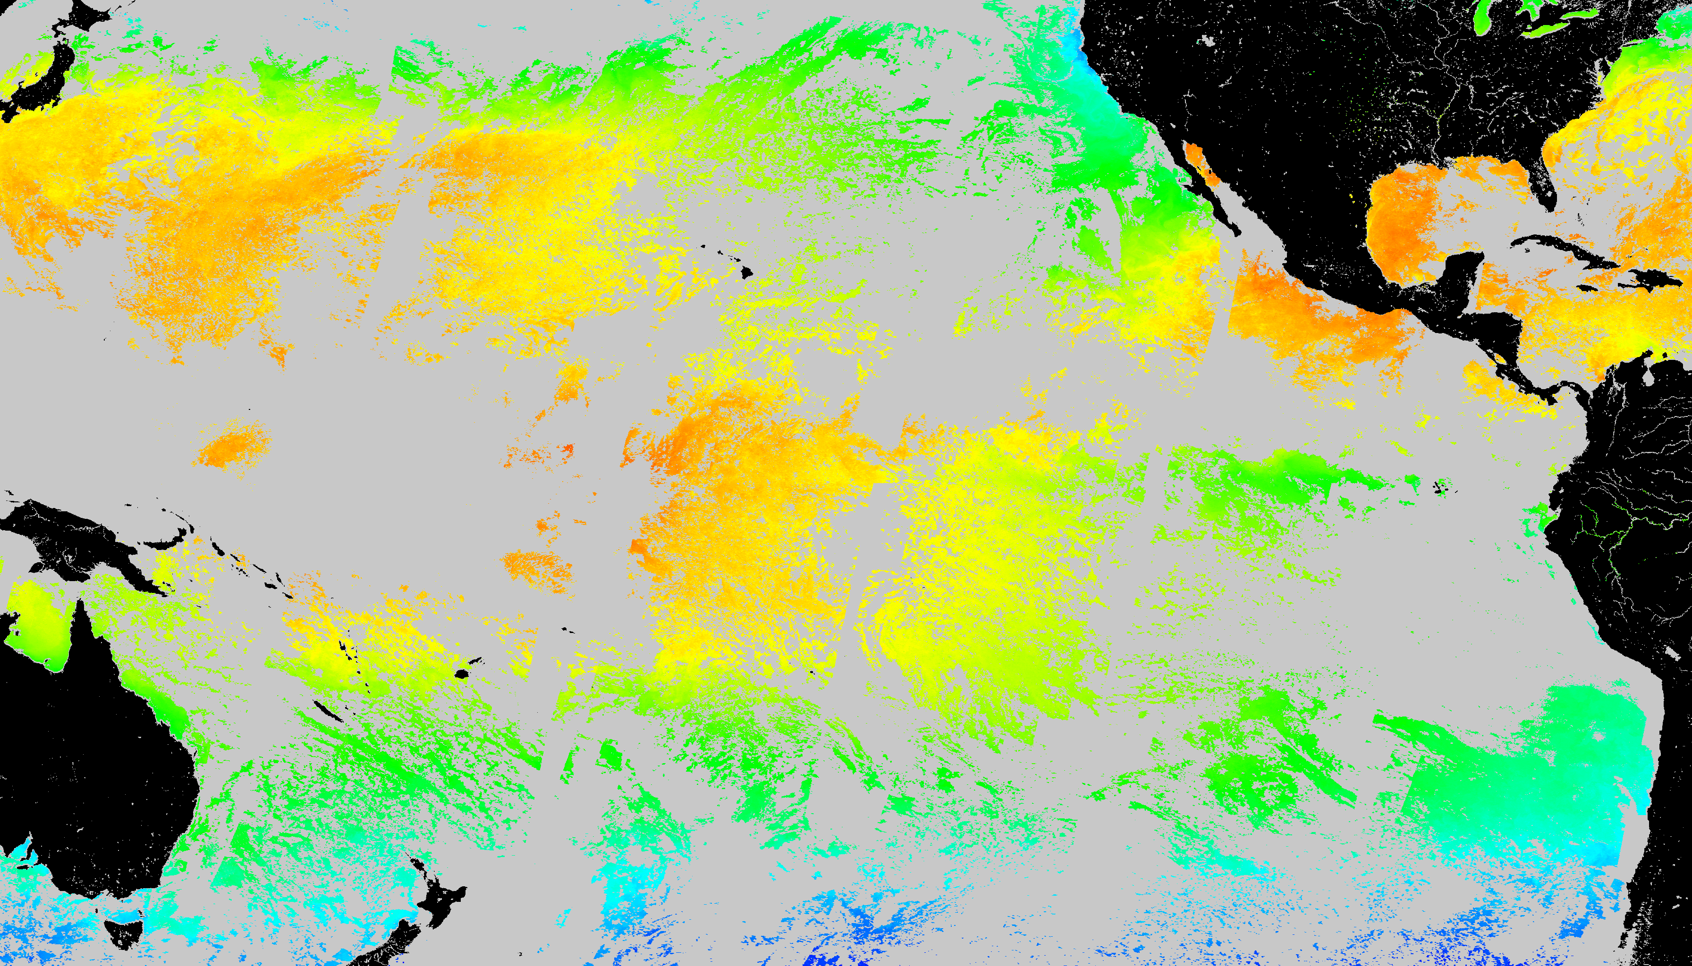
SST Coverage (August 10 2002)
Pathfinder v5.0 Daily Nighttime only SST

Slide 6
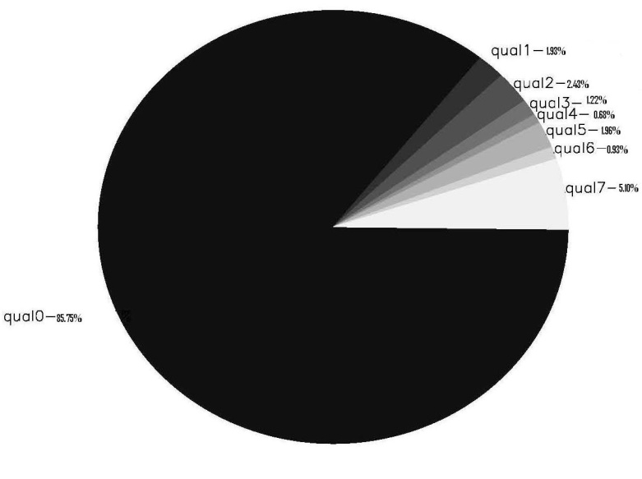
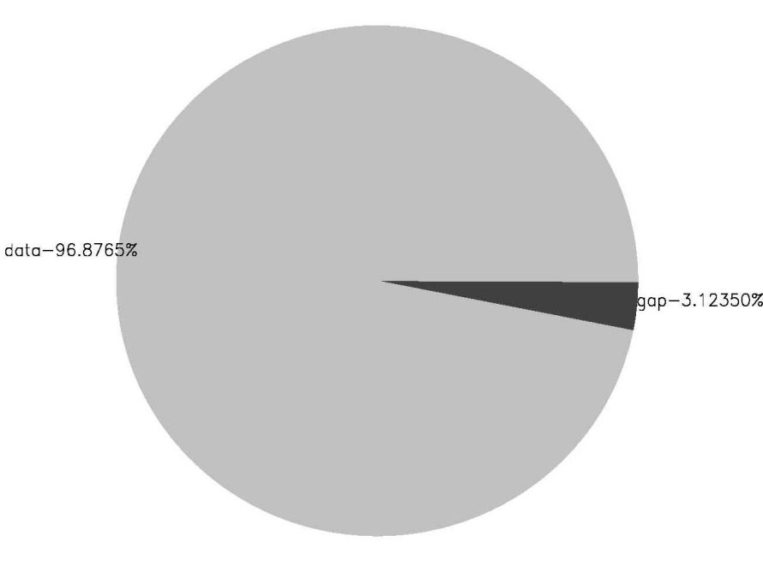
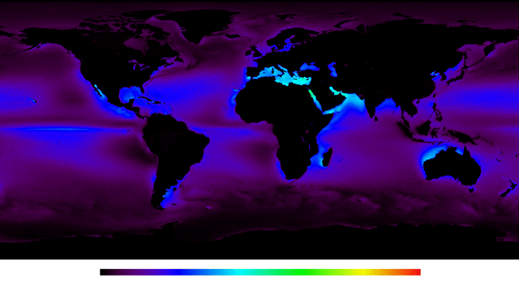
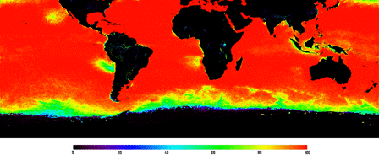
Data Density
4km-Resolution PF v5.0
Daily Nighttime only SST
Non-Gap
96% in ”tropics”
35°N-35°S
Data Gaps
> 90% globally
0
20
40
60
80
100
0 20 40 60 80 100
% Data Available

Slide 7
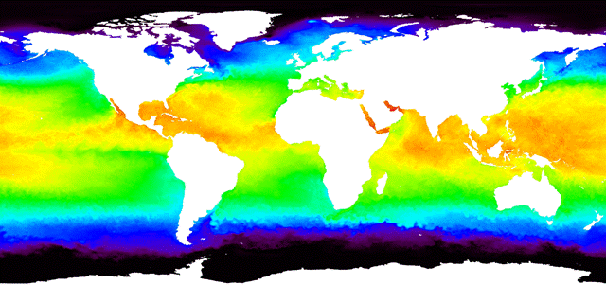
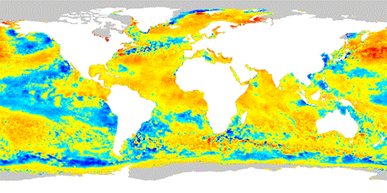
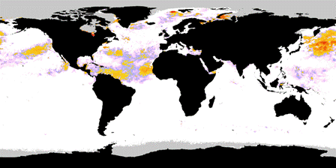
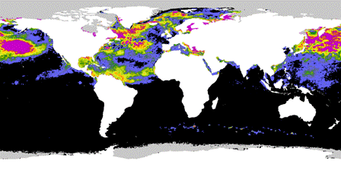
11 km – Resolution, Global
Coral Thermal Stress Products
Based on NOAA Operational GOES-POES SST, 09/25/11
SST
SST Anomaly
HotSpot
DHW
7

Slide 8
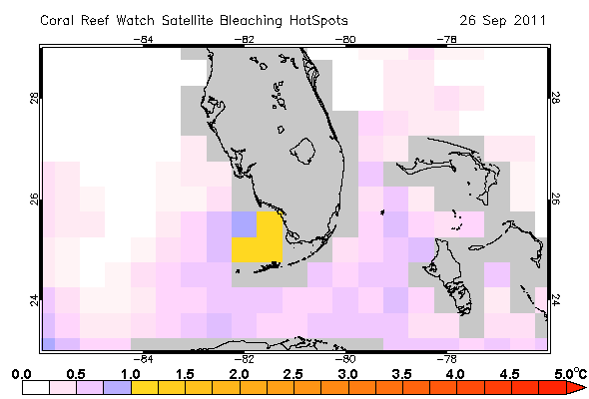
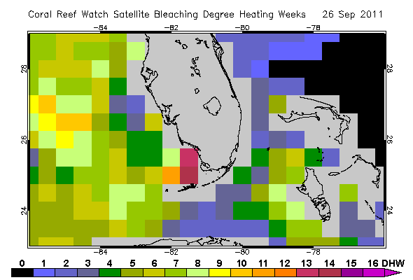
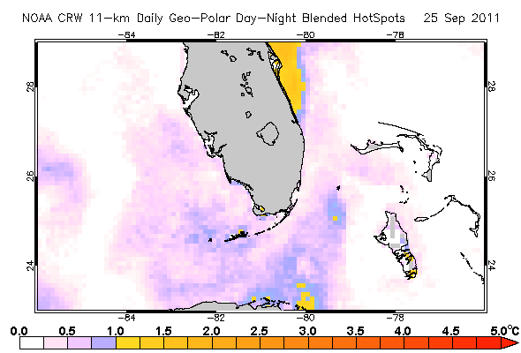
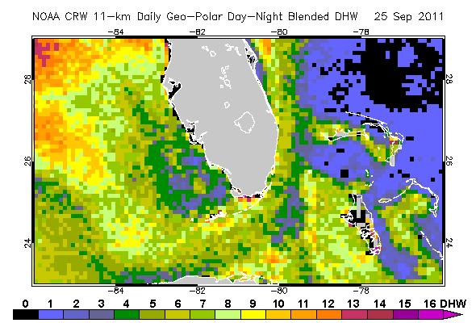
11 km – Resolution, Global
Coral Thermal Stress Products
Based on NOAA Operational GOES-POES SST, 09/25/11
50 km
11 km
HotSpot
DHW
8

Slide 9
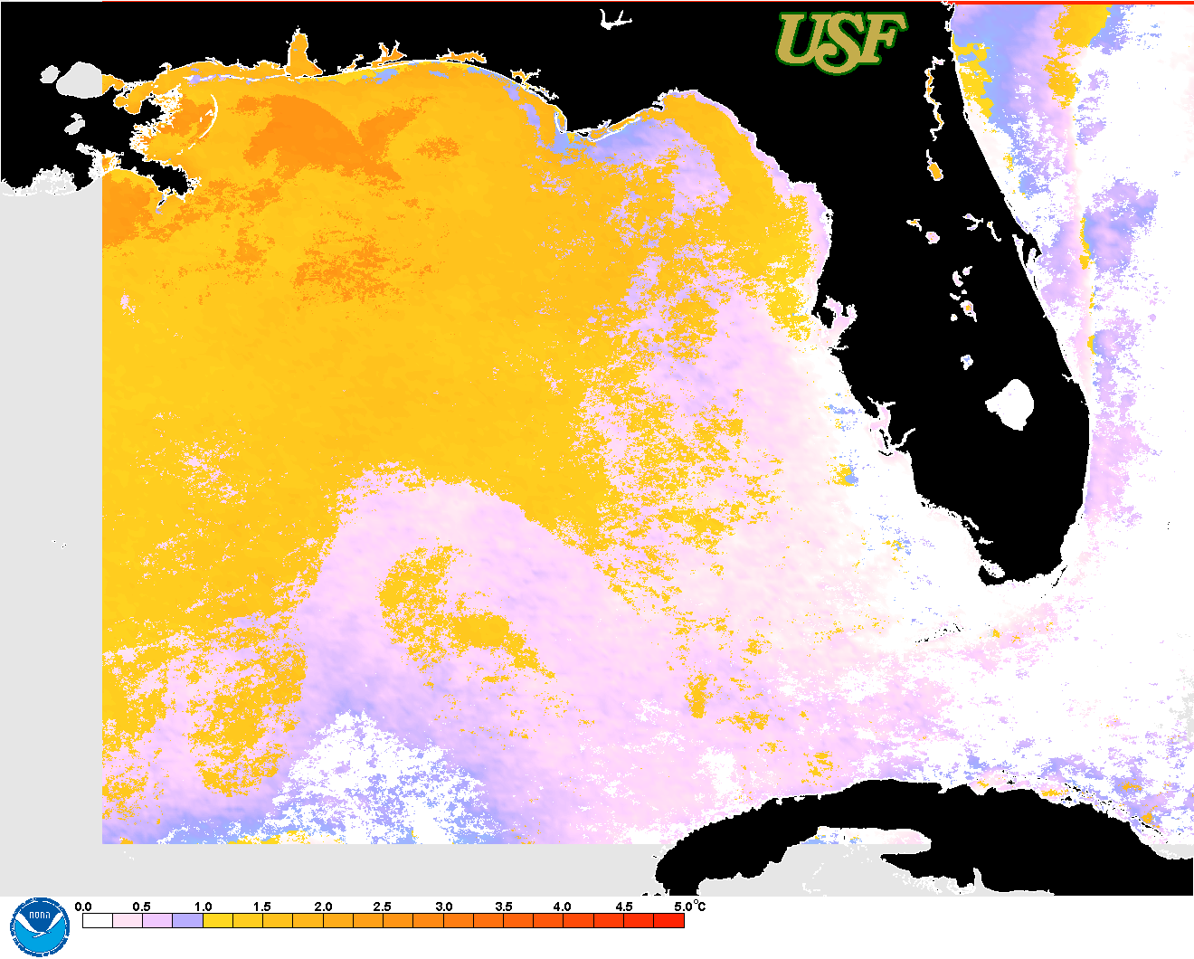
1 km HotSpot products for the West Florida Shelf from USF (August 29, 2011)
NASA MODIS SST
Based on Pathfinder 4km MMM
USF AVHRR SST
Based on Pathfinder 4km MMM

Slide 10
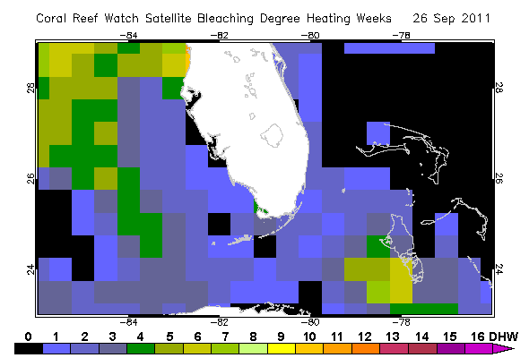
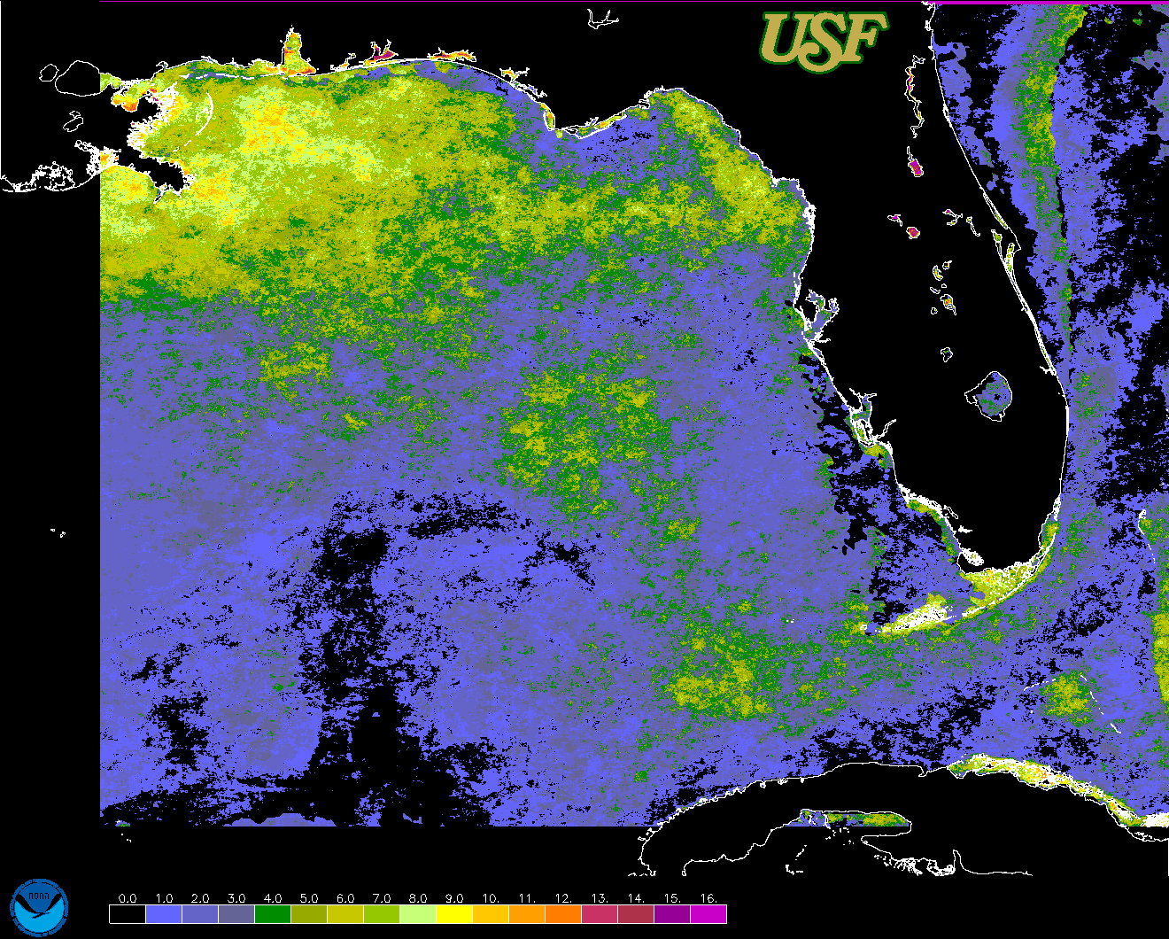
1 km DHW products for the West Florida Shelf from USF
(September 15, 2011)
Enhanced 50 km NOAA product

Slide 11
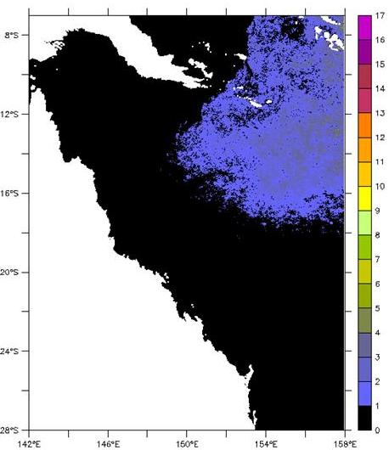
1 km DHW product for Australia (May 3, 2011)
1 km DHWs on May 3, 2011 for the Great Barrier Reef
based on 1 km AVHRR data 4km PF climatology
Product of Coral Reef Watch-Australia and
Australian Institute of Marine Science

Slide 12
‘So what?’ Linking science and management
Improve alerts reef managers around the world use to respond to coral bleaching events
Visit our Posters!!!
#138 Eakin et al.
#198 Vega-Rodriguez et al.

