Slide 1
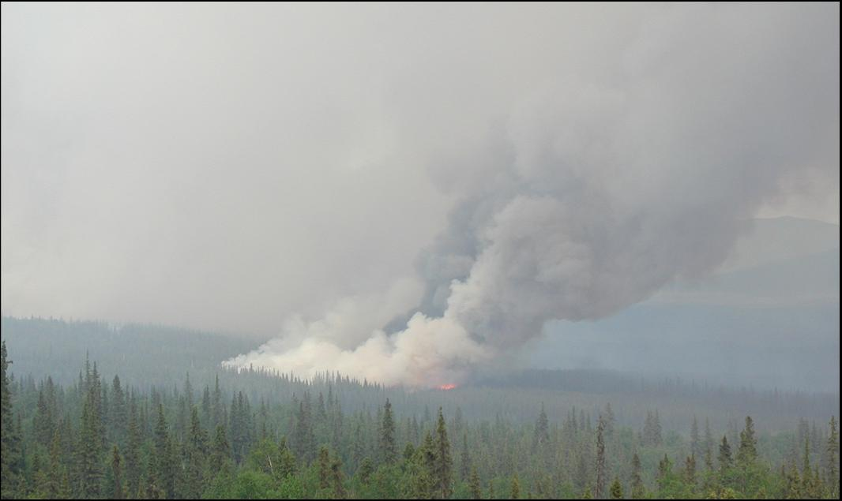



Development and use of the Wildland Fire Emissions Information System for quantifying and mapping fire emissions for North America
Nancy HF French, Don McKenzie, Tyler Erickson
Poster # 301 with on-line demo – Wednesday

Slide 2
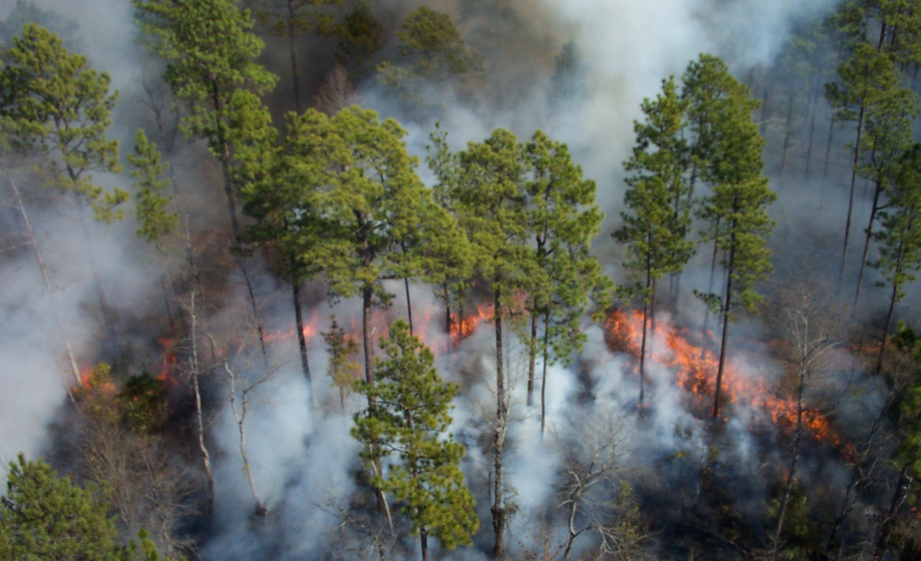
Fire & Carbon
GFED: The global amount of carbon combusted through fires is about 2.0 Pg C year⁻¹, or about 22% of global fossil fuel emissions.
van der Werf et al. 2010. Atmos. Chem. Phys. Discuss.,10:16153-16230, www.atmos-chem-phys-discuss.net/10/16153/2010/
CBM-CFS3: From 1990 to 2006 Canada’s managed forest was a Carbon Sink on
average, but it was a
Carbon Source
in years with large
burned area.
Kurz, W.A. et al. 2008.
PNAS 105:1551-1555.

Slide 3
Fire Emissions Project
Purpose:
Improve access to emissions model inputs and results
Provide best estimates of total carbon emissions to user community
  Geospatially at 1km resolution
  At daily to annual temporal resolution
  For recent fire years (1980’s to 2009)
Result:
Improvement in data sets & model for emissions estimation
Development of a prototype web-based system (WFEIS)
Regional-scale estimates of emissions based on two burn area data sets
Supported by a 3-year grant from NASA Carbon Cycle Science Program – Applied Sciences Program

Slide 4



WFEIS Project Team
Nancy French, Mike Billmire
Tyler Erickson, Ben Koziol
Don McKenzie
Roger D. Ottmar
Ernesto Alvarado
William de Groot
Eric S. Kasischke
Pacific Northwest Research Station, USDA Forest Service
Great Lakes Forestry Centre, Canadian Forest Service
Department of Geography, University of Maryland

Slide 5
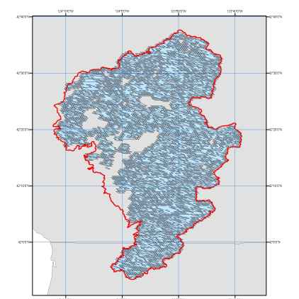
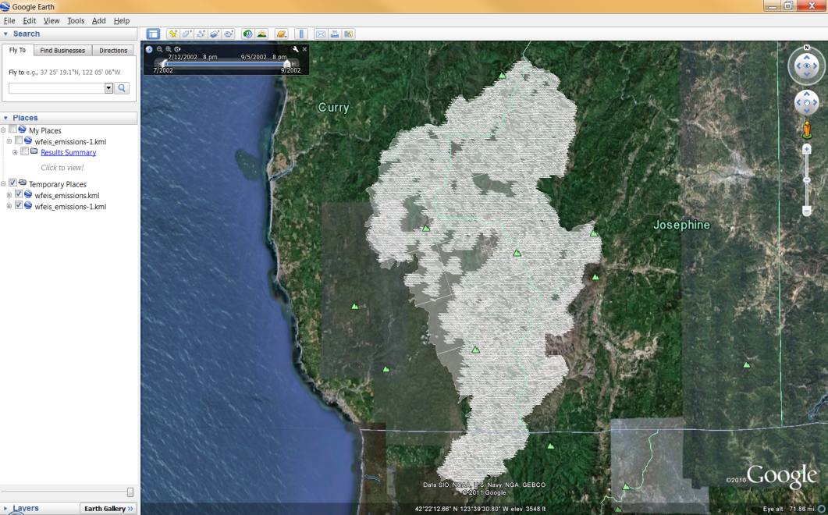
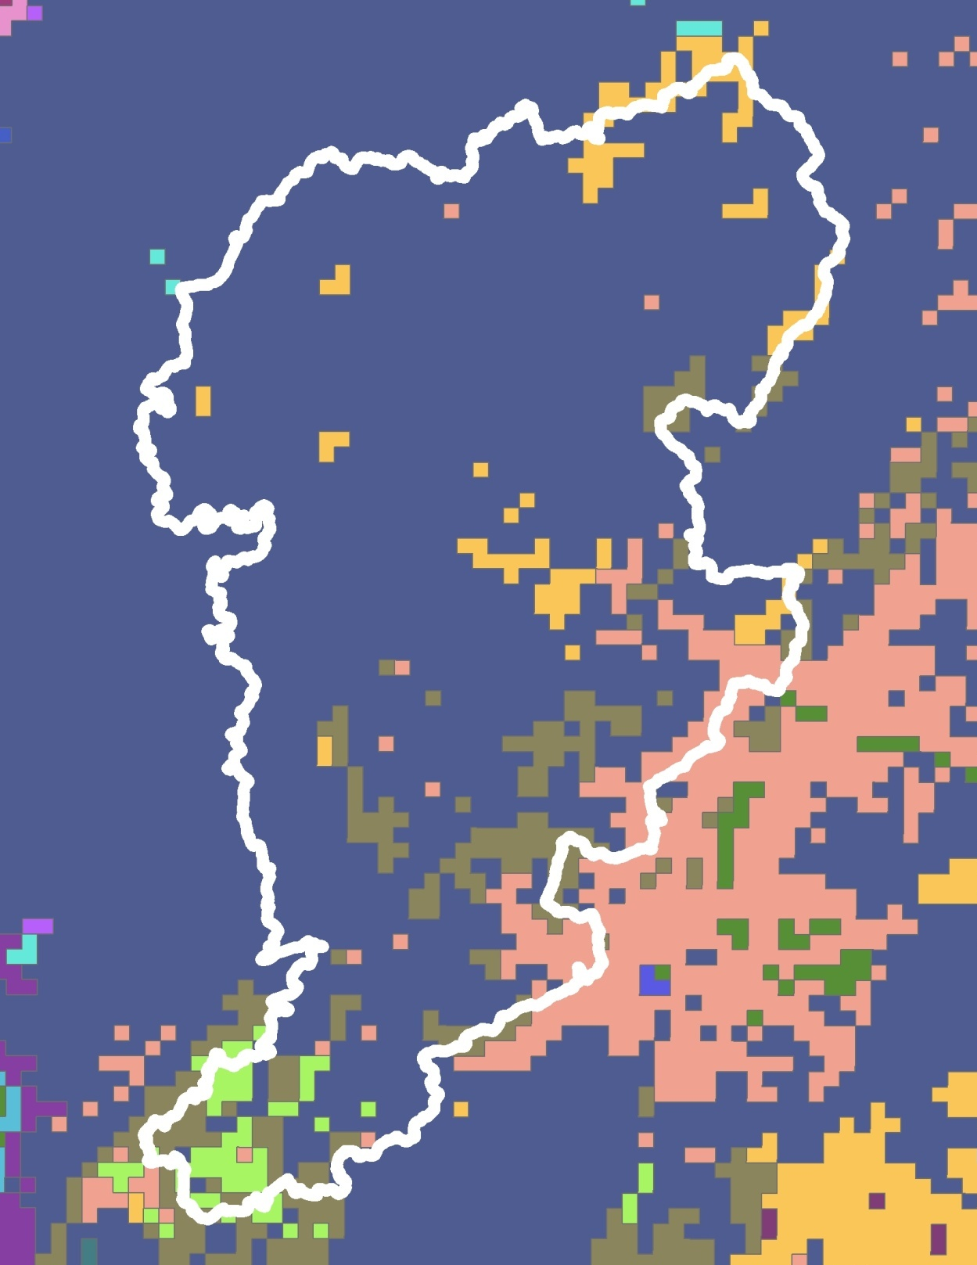
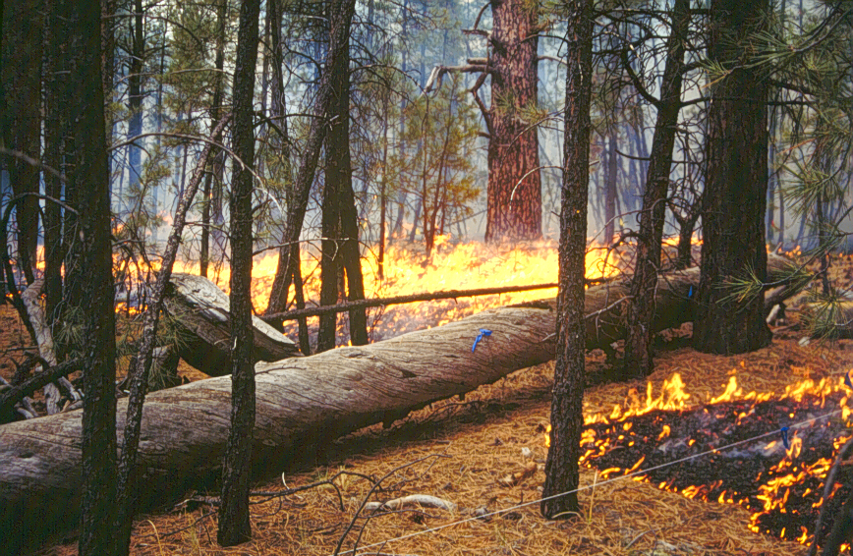
WFEIS Estimation of Fire Emissions
Location and day of fire
Consumption & Emissions model (Consume)
Daily weather
→ Fuel moisture
Output: Spatial representation of emissions
Fuel load (biomass) and fire behavior
Fuel (vegetation) type (FCCS)

Slide 6
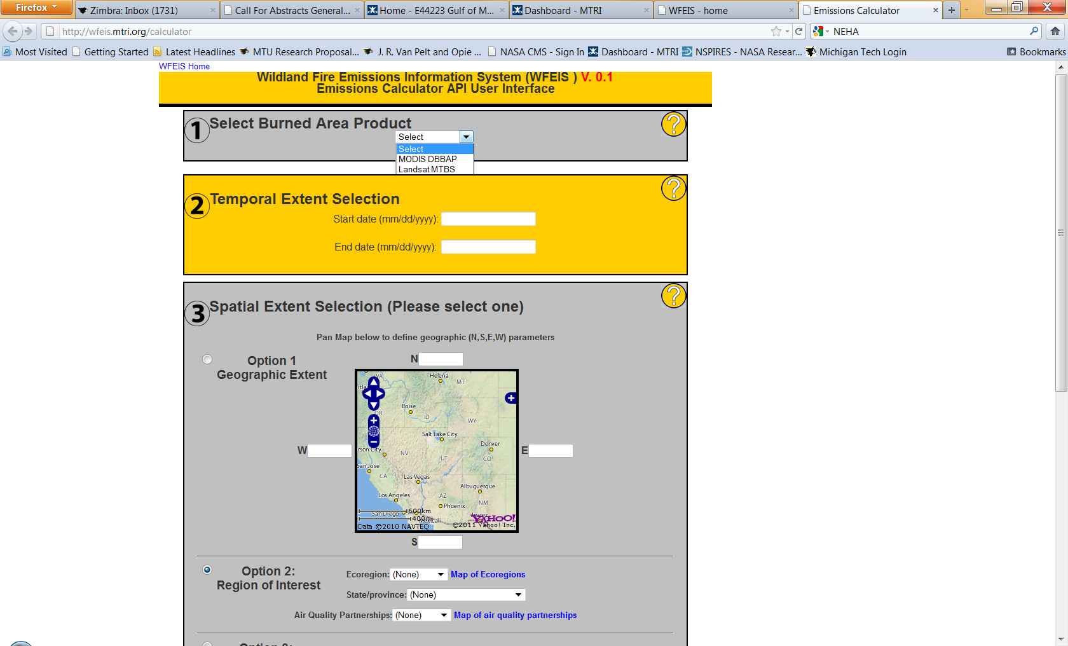
WFEIS Web-accessible Framework
The WFEIS website allows for two approaches for making fuel consumption and emissions estimates
Method #1:
WFEIS Emissions Calculator:
http://wfeis.mtri.org/
Method #2:
WFEIS responds to queries submitted via properly encoded URL requests (it implements a RESTful Web API).

Slide 7
WFEIS Framework
URL-formatted QUERY
http://wfeis.mtri.org/api/emissions/fuelbed=fccs1km/burnedarea=mtbs/ecoregion=western/1000hr_FM=None/Duff_FM=None/CanopyPerConsume=None/PercentBlack=50/combustion_stage=total/stratum=total/output_units=tonnes/emistype=carbon/map.kml?DRNG=2002-07-01,2002-07-31&ROI=StateProvince,usa-OR
Web Browser
Access
Django Web Framework
User Interface
RESTful Interface
HTTP Access
CONSUME
Backend
Python Scripts
Spatial Database

Slide 8
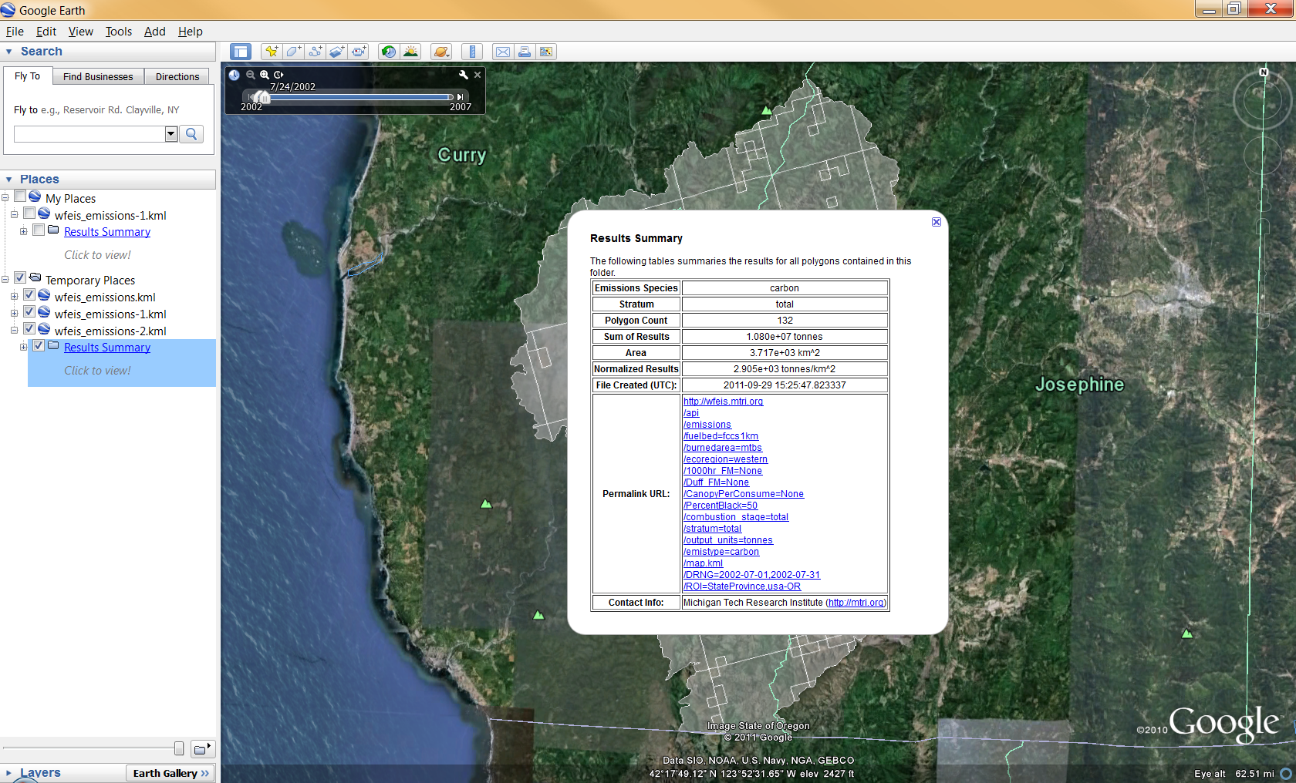
WFEIS Output

Slide 9
Comparison of Models
Other fire emissions models:
Area Burned - A
Fuel Loading - B
-- CONSUME 3.0 (USFS)
-- FOFEM 5.7 (USFS)
-- CanFIRE
-- Canadian FBP
-- GFED (NASA)
-- FINN (NOAA)
Combustion
Factors - ß
Fuel Consumption
Non-spatial, plot-level
(Consume 3.0, FOFEM 5.7)
Semi- or Pseudo-spatial
(Canadian FBP, CanFIRE)
Global-scale (GFED)
Active fire estimates of burn area (FINN) vs. burn area
WFEIS uses moderate resolution data of burn area and biomass to make regional-scale fire emissions estimates
Emission
Factors - EF
Emissions

Slide 10
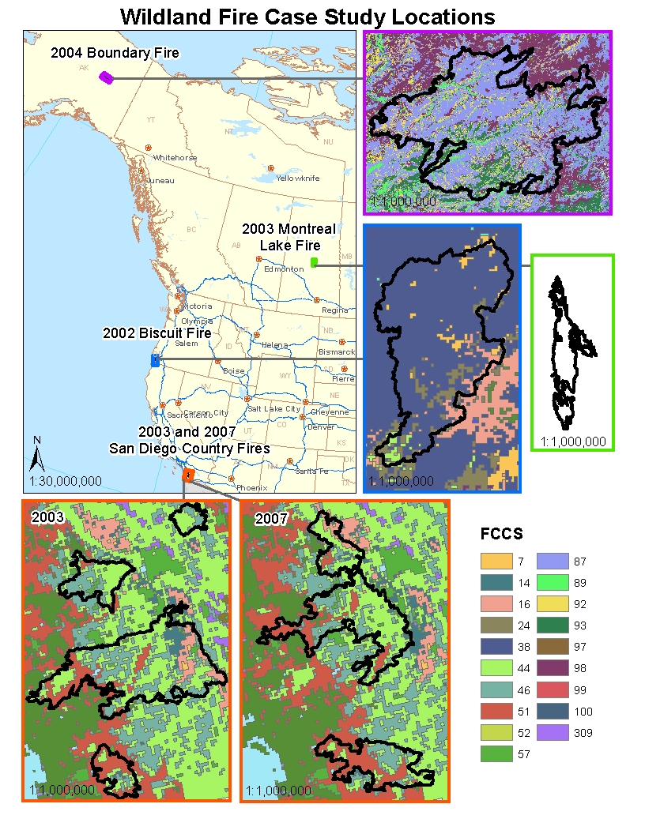
Comparison of Models
Five fire events:
-- 2002 Biscuit fire in southern Oregon
-- 2003 Montreal Lake central Saskatchewan
-- 2004 Boundary fire in interior Alaska
-- San Diego County, California 2003 and 2007
Results:
-- Models generally agree (within 25% of each other) but vary due to model assumptions
-- Vegetation fuel density, structure, and condition (fuel moisture) are important drivers of emissions variability
-- Global-scale GFED modeled emissions are consistent with landscape/regional-scale estimates
French, N.H.F. et al. (2011), "Model comparisons for estimating carbon emissions from North American wildland fire," Journal of Geophysical Research, 116, G00K05.

