Slide 1
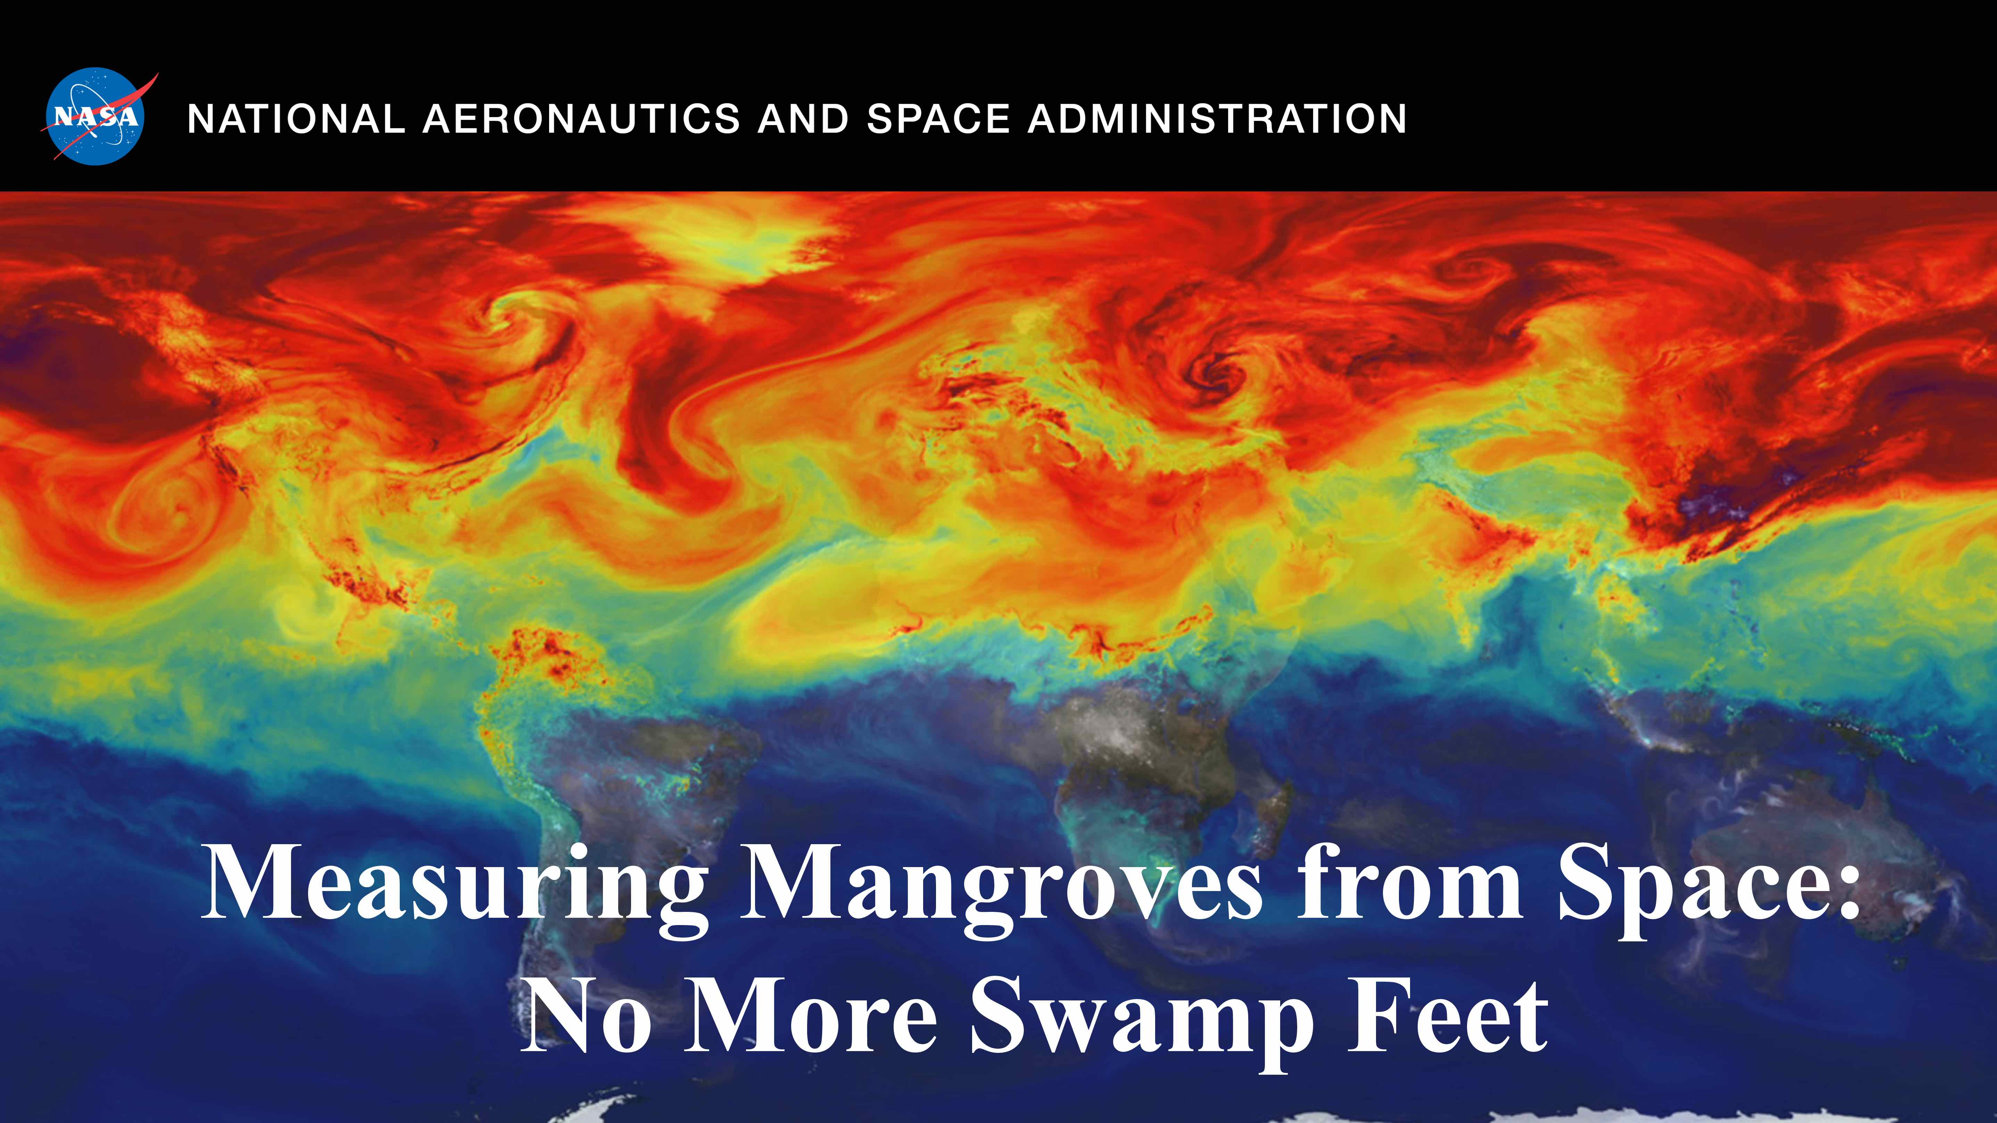

Slide 2
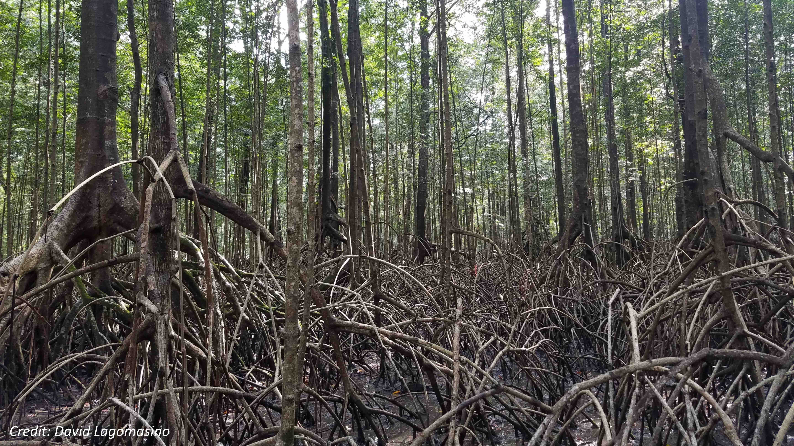
Notes:
Measuring Mangroves from Space: No More Swamp Feet
Blue Carbon is the name given to a group of productive vegetation species that grow near shallow coastal areas and have the capacity to store large amounts of carbon. These include seagrasses, marshes, and mangroves. For many coastal communities, mangroves are the first line of defense against hurricanes and storm surge. But these ecosystems also provide materials for shelter, food, fuel, and medicine.

Slide 3
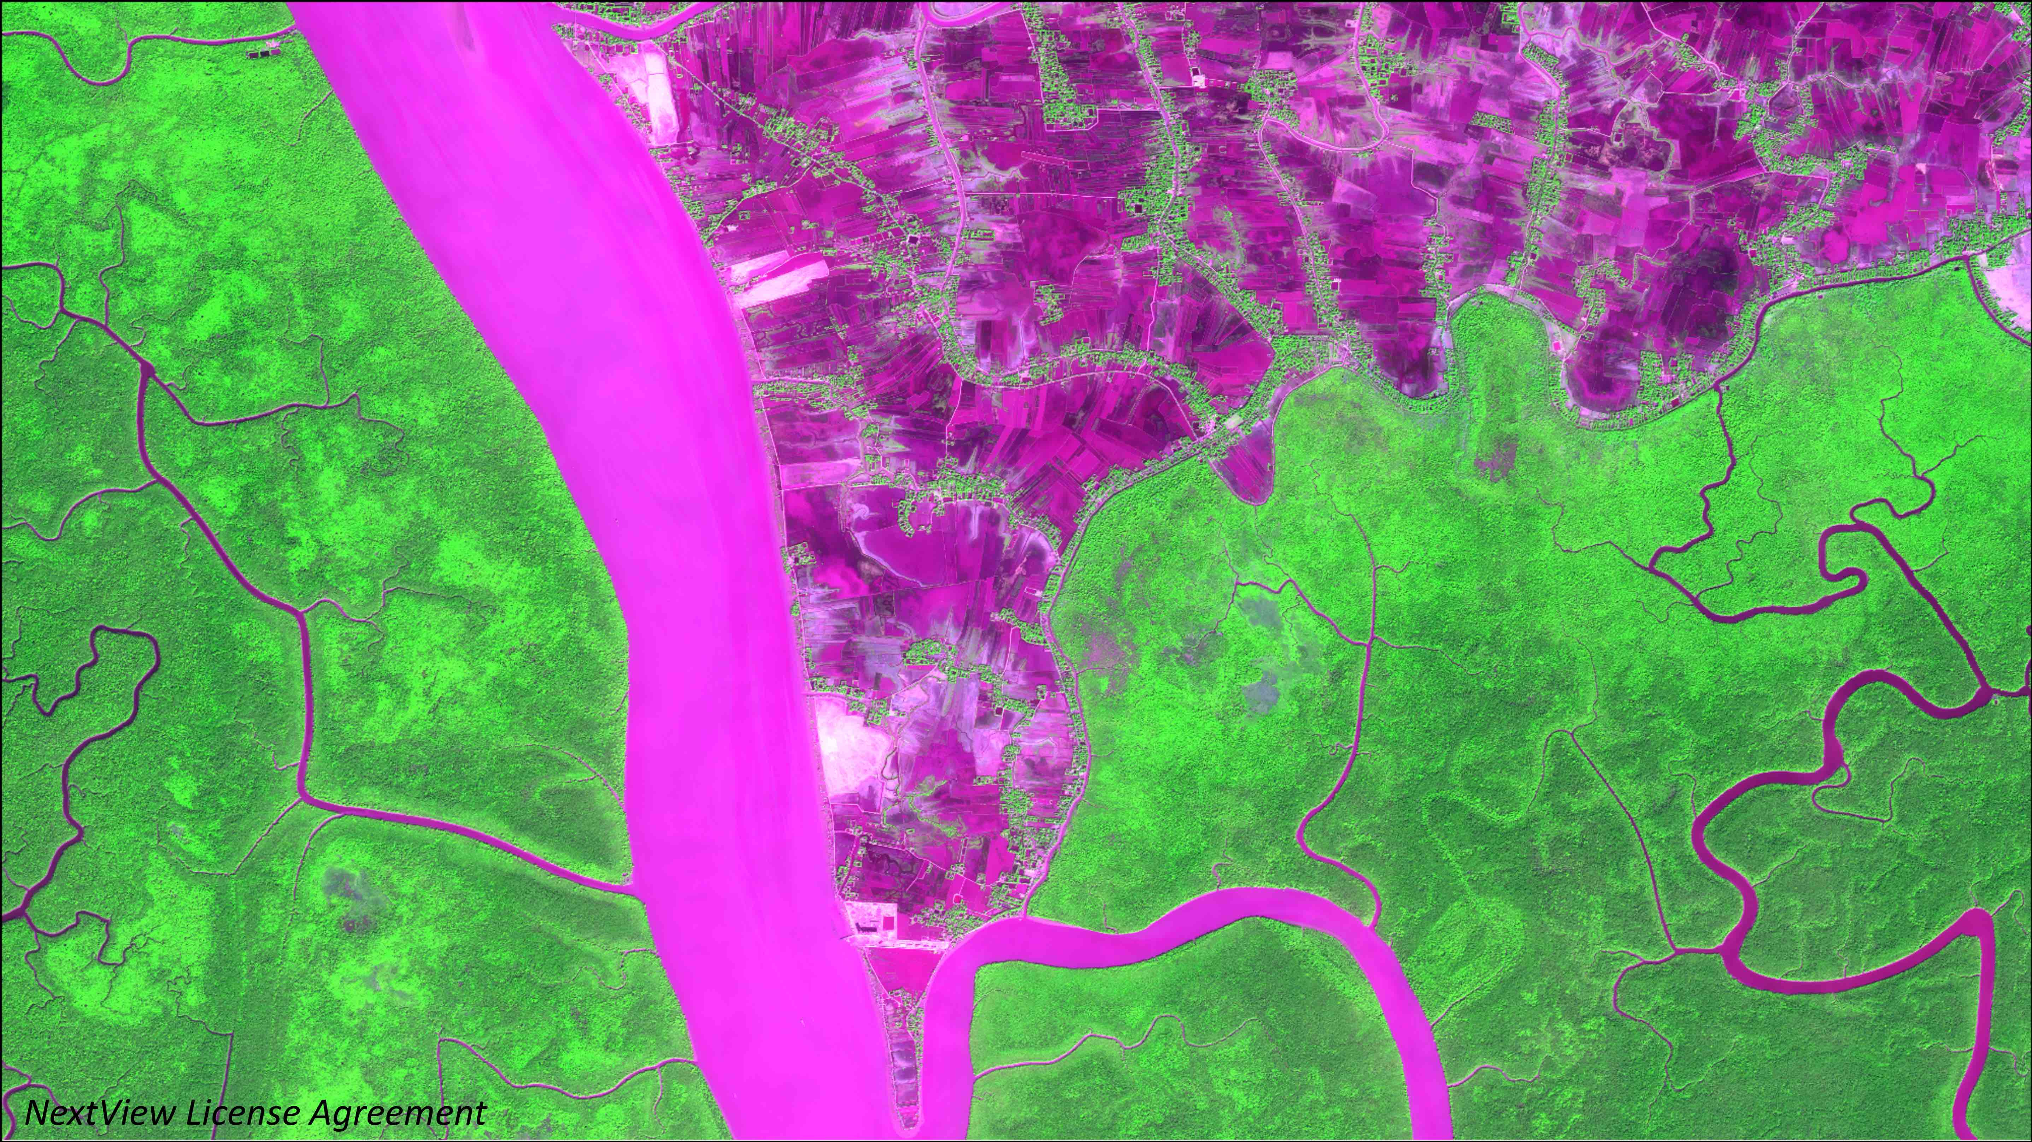
Notes:
Measuring Mangroves from Space: No More Swamp Feet
The land that mangroves occupy is also preferable for harvesting timber and cultivating shrimp, rice, and oil palm. Because of this, engineered landscapes have been replacing mangrove ecosystems in many parts of the world at an alarming rate. This project is improving the ways we can monitor these important ecosystems through remotely sensed data, as many of these areas can be extremely inaccessible. For three countries in Africa (Mozambique, Tanzania, and Gabon), we are mapping the extent, change, and canopy height of mangroves to help improve the inventory of forest resources.

Slide 4
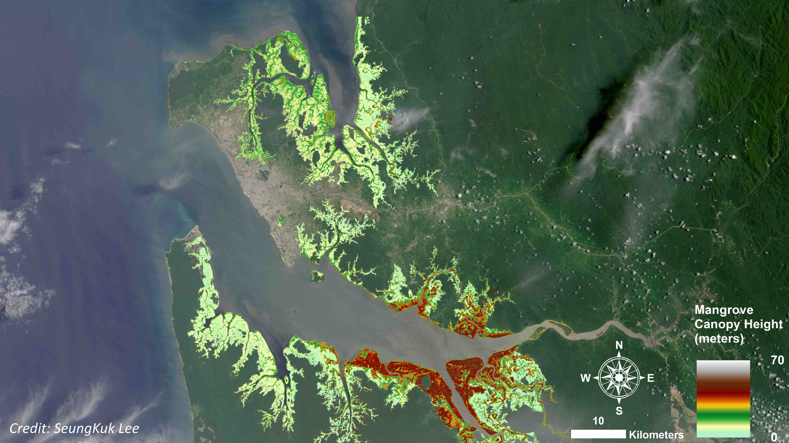
Notes:
Measuring Mangroves from Space: No More Swamp Feet
TanDEM-X, is a relatively recent satellite mission lead by the German Space Agency (DLR) that collects data from two satellites that fly in close formation. The satellite launched in 2010 with the goal of mapping a new global Digital Elevation Model (DEM). The near-instantaneous measurements captured from the satellites overcome many programmatic issues and can be used to estimate canopy height. Because TanDEM-X is global mission, data is available in most places so multiple acquisitions can then be merged together to provide regional, and country-wide estimates of mangrove canopy. For this project we have used TanDEM-X data to create canopy height maps across Mozambique, Tanzania, and Gabon. Here we are looking at Pongara (center) and Akanda (top) National Parks in Gabon. Some of the tallest mangroves in the world grow here in Gabon.

Slide 5
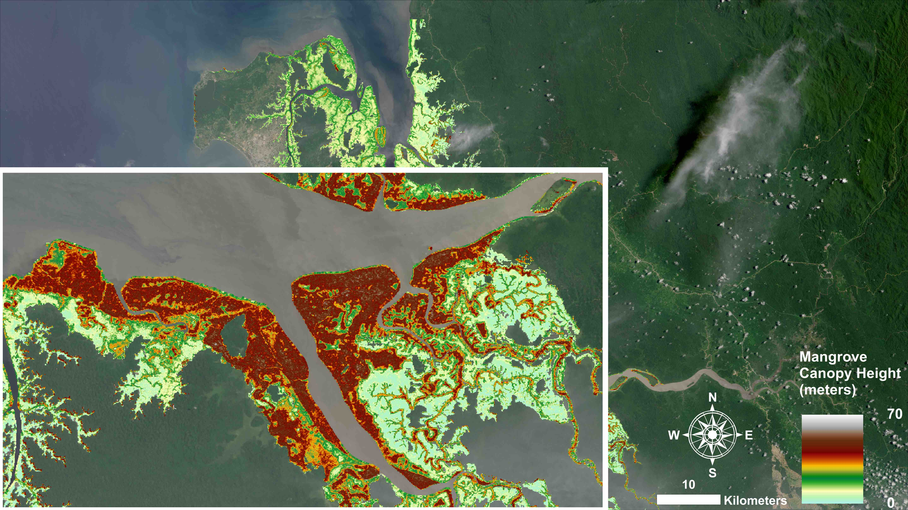
Notes:
Measuring Mangroves from Space: No More Swamp Feet
Mangrove canopy height is functionally related to biomass, and therefore can be used to provide a sound basis for stratification, or identifying different height classes. An objective forest inventory is fundamental to quantifying the distribution of carbon stocks in these ecosystems. Remote sensing data can be used effectively to stratify the assessment area and provide a platform for applying a spatial decision support system to allocate measurement plots which can help to assess the uncertainties in the measurements.

Slide 6
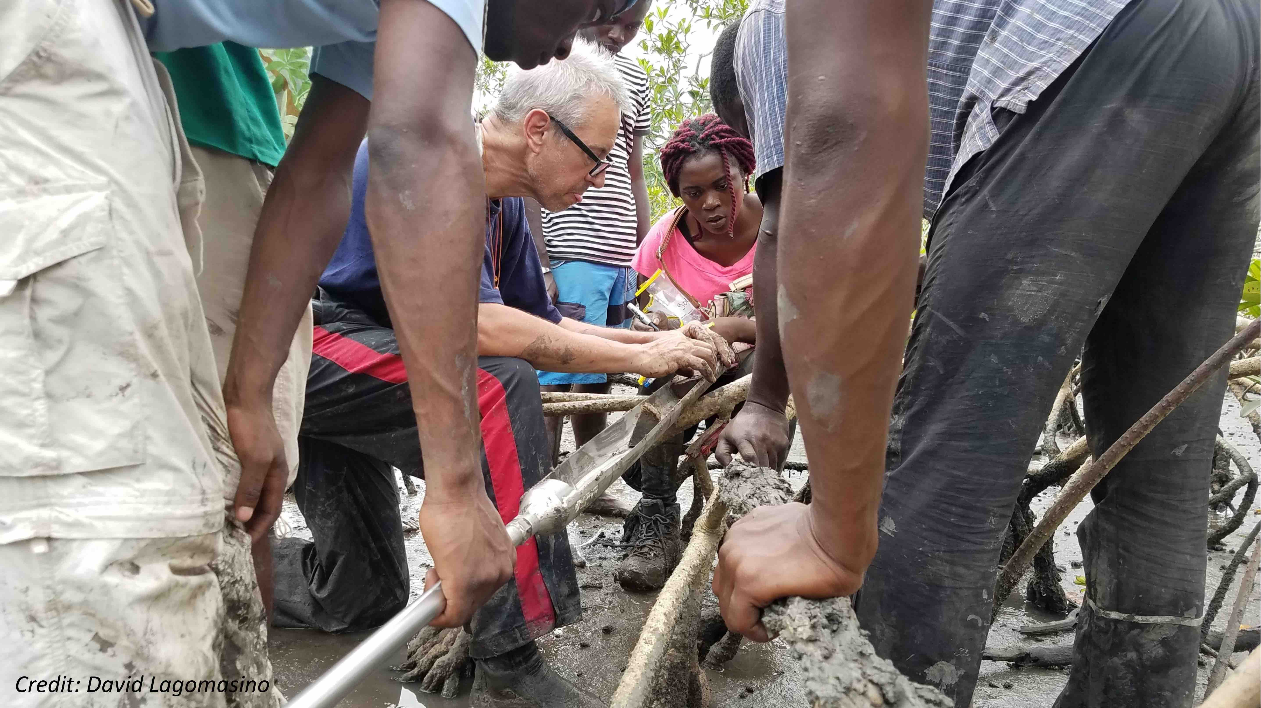
Notes:
Measuring Mangroves from Space: No More Swamp Feet
Field measurements of forest attributes, like height, and soil samples are needed quantify mangrove carbon stocks. Recent field inventories of mangrove carbon stocks were supported by U.S. Agency for International Development and NASA, and it was implemented in collaboration between the USDA Forest Service, Universidade Eduardo Mondlane, University of Dar es Salaam, Omar Bongo University, and World Wildlife Fund – Mozambique. Soil is typically the largest carbon pool in mangrove forests, while the aboveground biomass carbon is the most spatially variable. The remote sensing tools that we are developing are helping to improve the aboveground biomass estimates and reduce the uncertainties in our measurements.

Slide 7
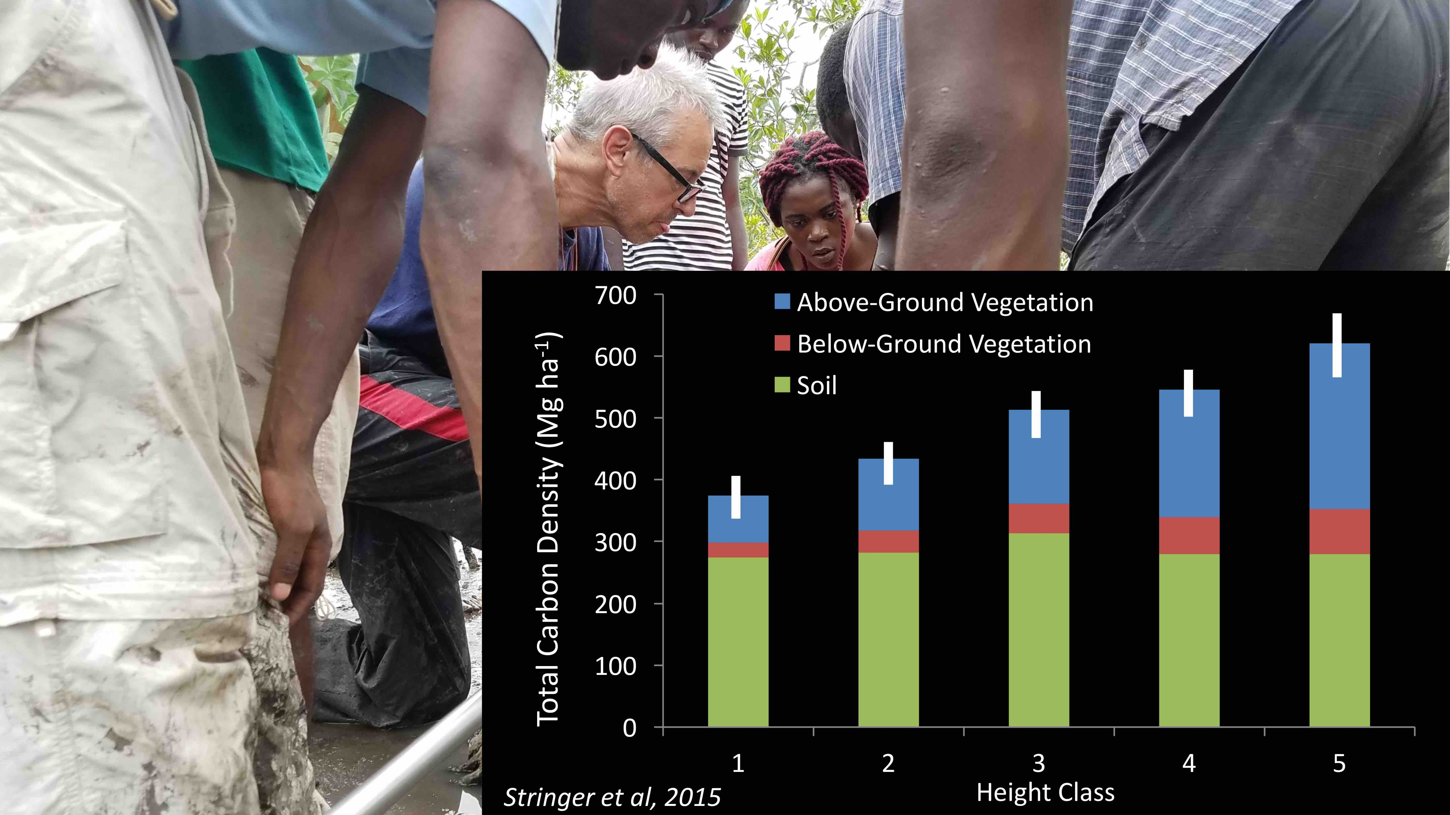
Notes:
Measuring Mangroves from Space: No More Swamp Feet
Application of canopy height data to stratify the assessment area was effective at improving the efficiency of the inventory design. Because of this, estimates of the total mangrove carbon stocks within the Zambezi River Delta had an error of 6% at a 95% confidence level, a level of precision well within the 15% guidelines for programs like the Reduced Emissions from Deforestation and Forest Degradation (REDD+)

Slide 8
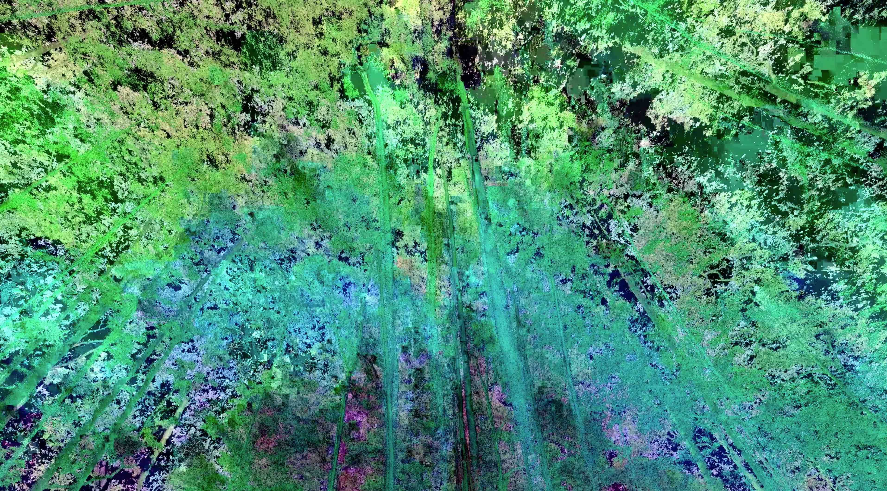
Notes:
Video Link: https://cce.nasa.gov/cce/powerpoints/hyperwall/lagomasino2017_videos/G1.mp4
Measuring Mangroves from Space: No More Swamp Feet
Carbon estimates of trees rely on the relationship between trunk size and height to tree weight, or biomass, built from a limited global dataset of cut and weighed trees. These relationships allow us to indirectly estimate tree carbon without harvesting, but at a high uncertainty that may not be accurate at local scales needed for management. We are developing a new, more precise method of indirectly weighing trees with terrestrial laser scanners, or TLS. TLS captures the three dimensional structure of the forest with billions of points and millimeter detail. We use this cloud of points to digitally reconstruct individual trees and estimate volume, along with biomass. Since this TLS method does not require cutting of trees, we can estimate the biomass of hundreds of trees and create updated biomass relationships that will be more accurate in mangrove forests.

Slide 9
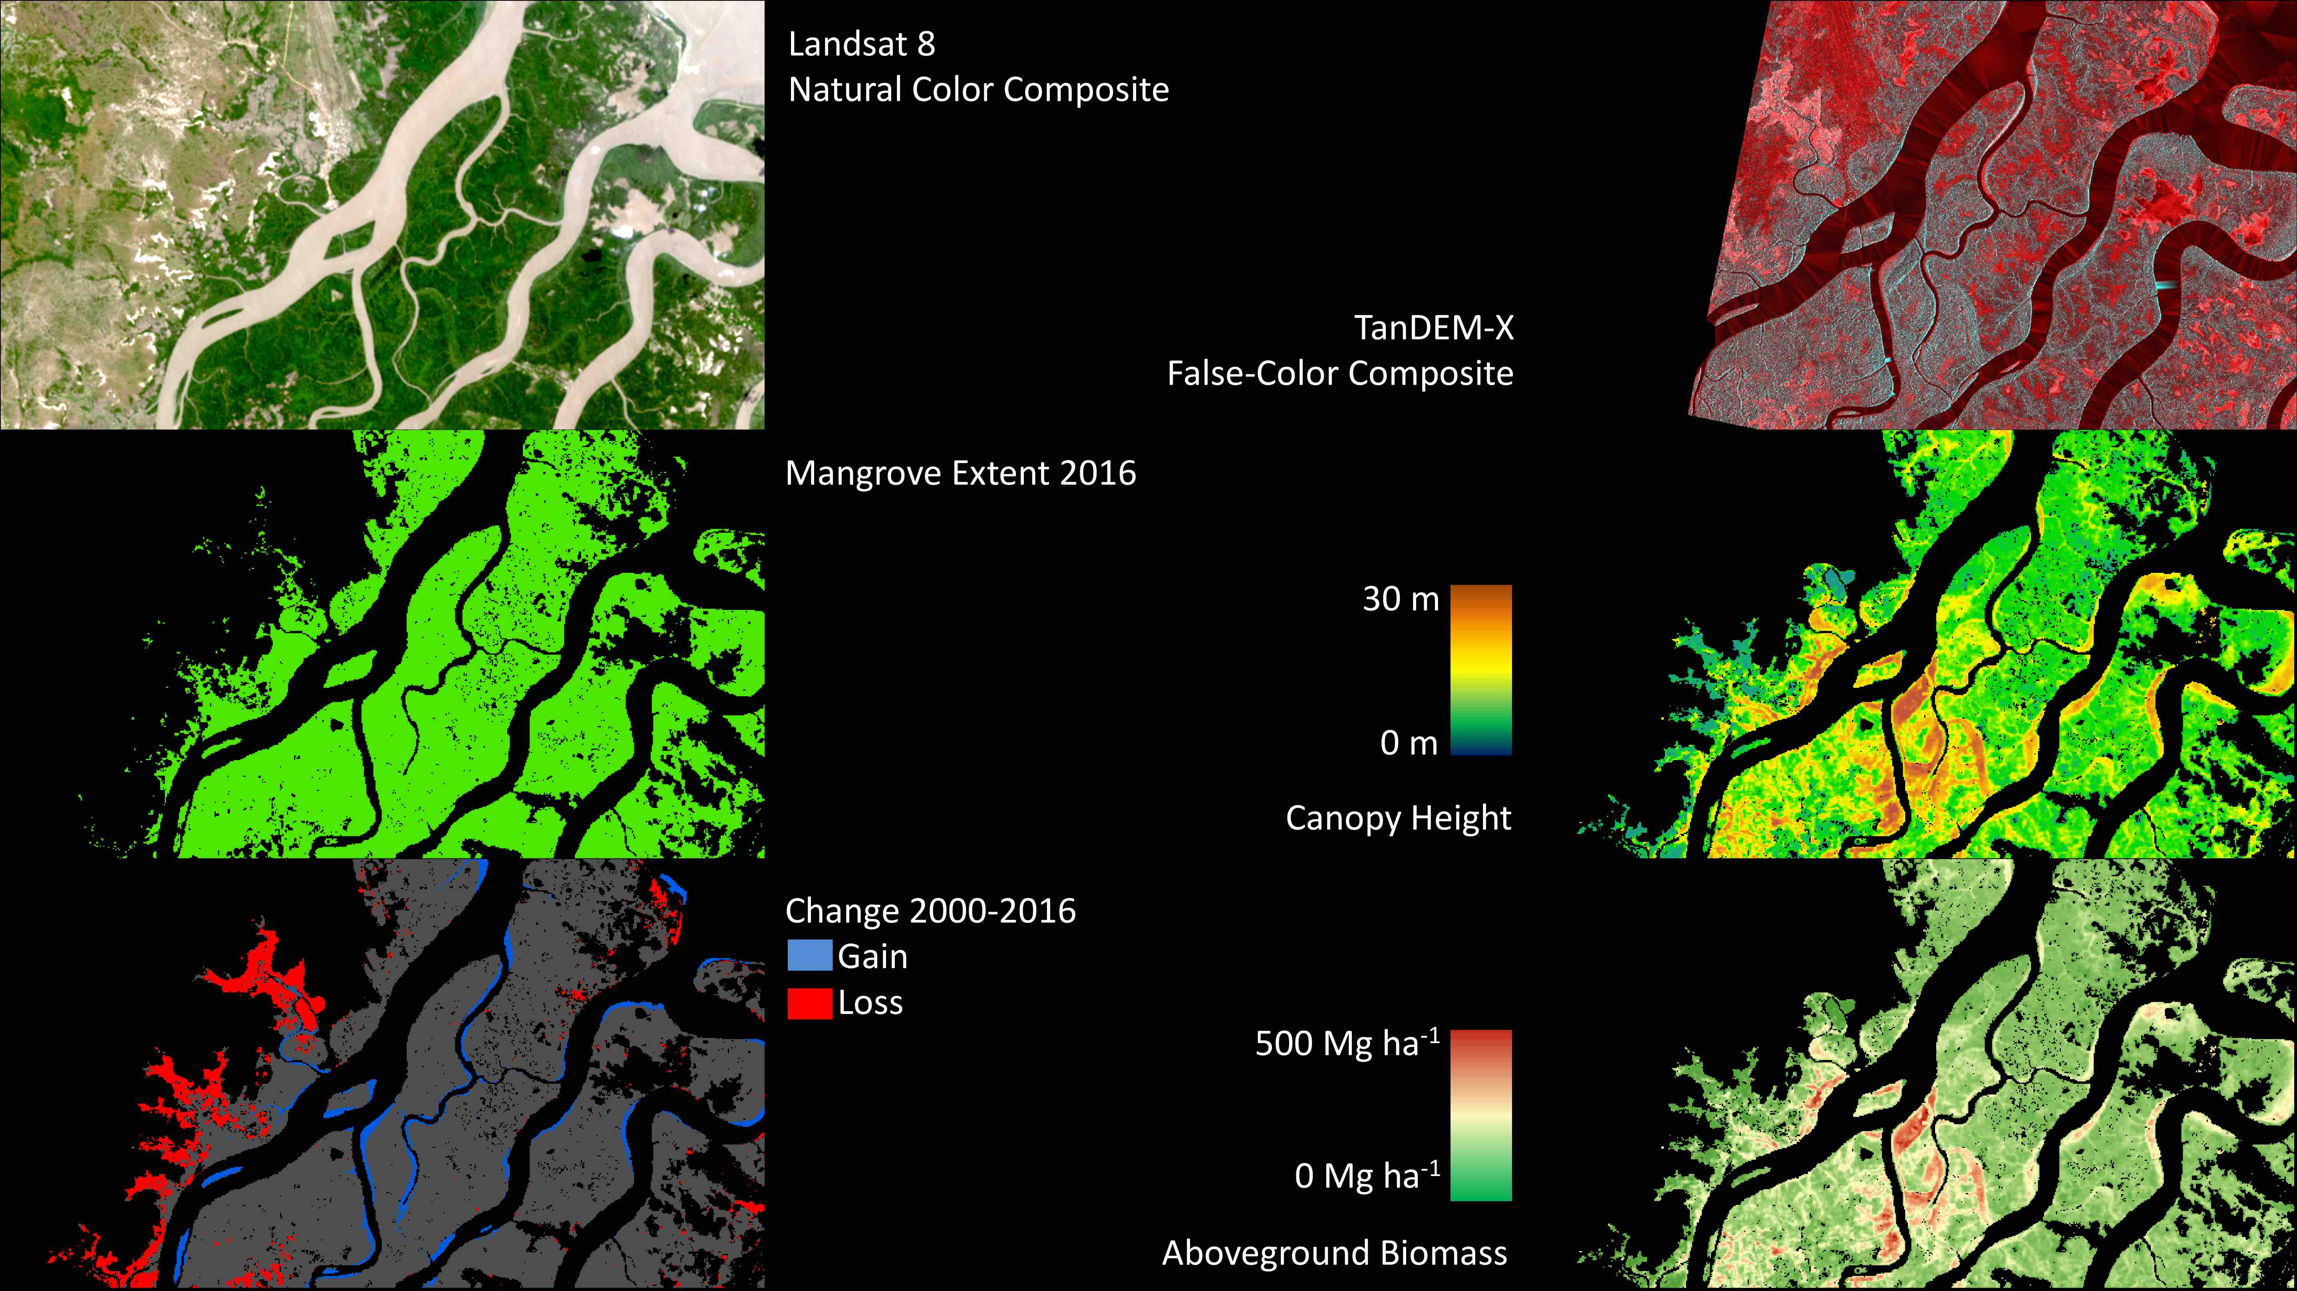
Notes:
Measuring Mangroves from Space: No More Swamp Feet
Combining imagery from remotely sensed optical and radar satellites, we can derive a variety of spatially-explicit data products that are useful for forest management and ecosystem valuation. Using optical data from Landsat, we can use different band combinations to provide a “natural color” view of the landscape. Here we are showing a portion of the Rufiji River Delta located in Tanzania. We can run classification algorithms that can segregate the landscape into different land cover types and then analyzing the full record of Landsat imagery from 2000-2016, we can also clearly identify areas of mangrove loss and gain. Radar data is extremely useful to help us understand the 3-Dimensional structure of the forest. Applying sophisticated algorithms we can now estimate the height of the mangrove canopy. Because of the strong relationship between canopy height and biomass, we can then use the canopy height maps to determine the density of biomass across the region. Ultimately, the combination of mangrove extent, change, canopy height, and biomass can provide us information about how much carbon is entering or leaving the ecosystem.

Slide 10
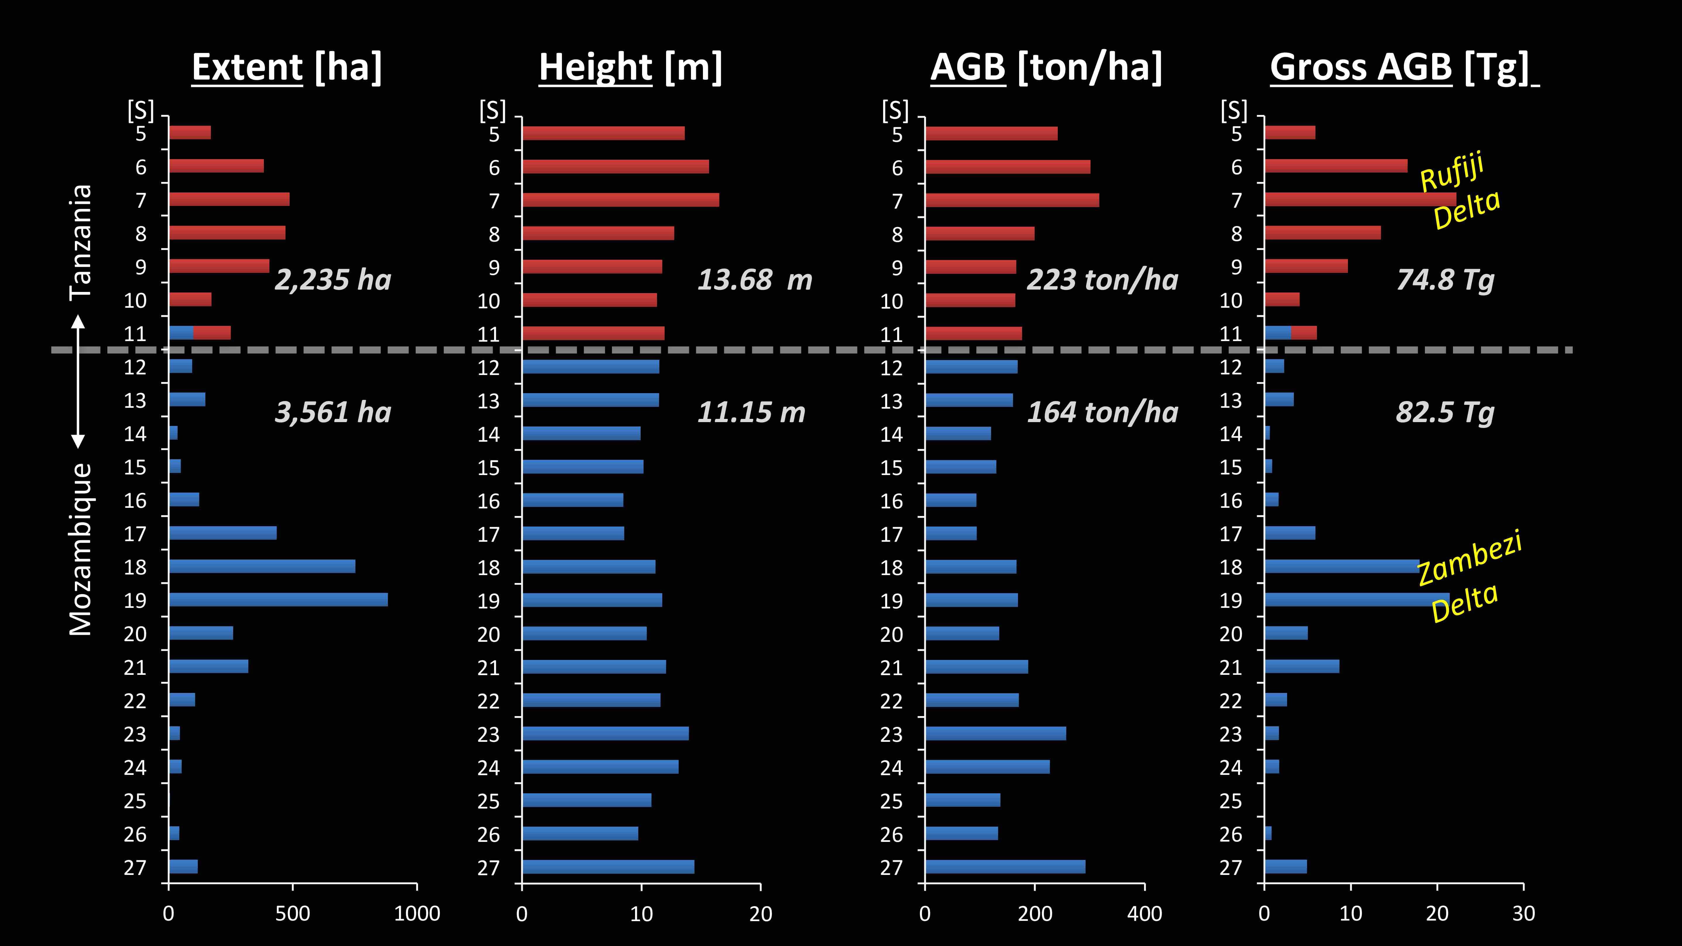
Notes:
Measuring Mangroves from Space: No More Swamp Feet
The advantage of using remotely sensed data is that we can begin to look at landscape patterns at regional, national, and global scales. In particular, we can investigate how the mangrove extent, canopy height, biomass density and total aboveground biomass changes with respect to latitude. When we examine mangrove structural attributes along Tanzania and Mozambique, we notice that there is not specific patterns across the region, expect when we identified major delta regions across East Africa. Where there are river deltas, there is a larger extent of mangroves which then contributes to a higher total (gross) aboveground biomass.

Slide 11
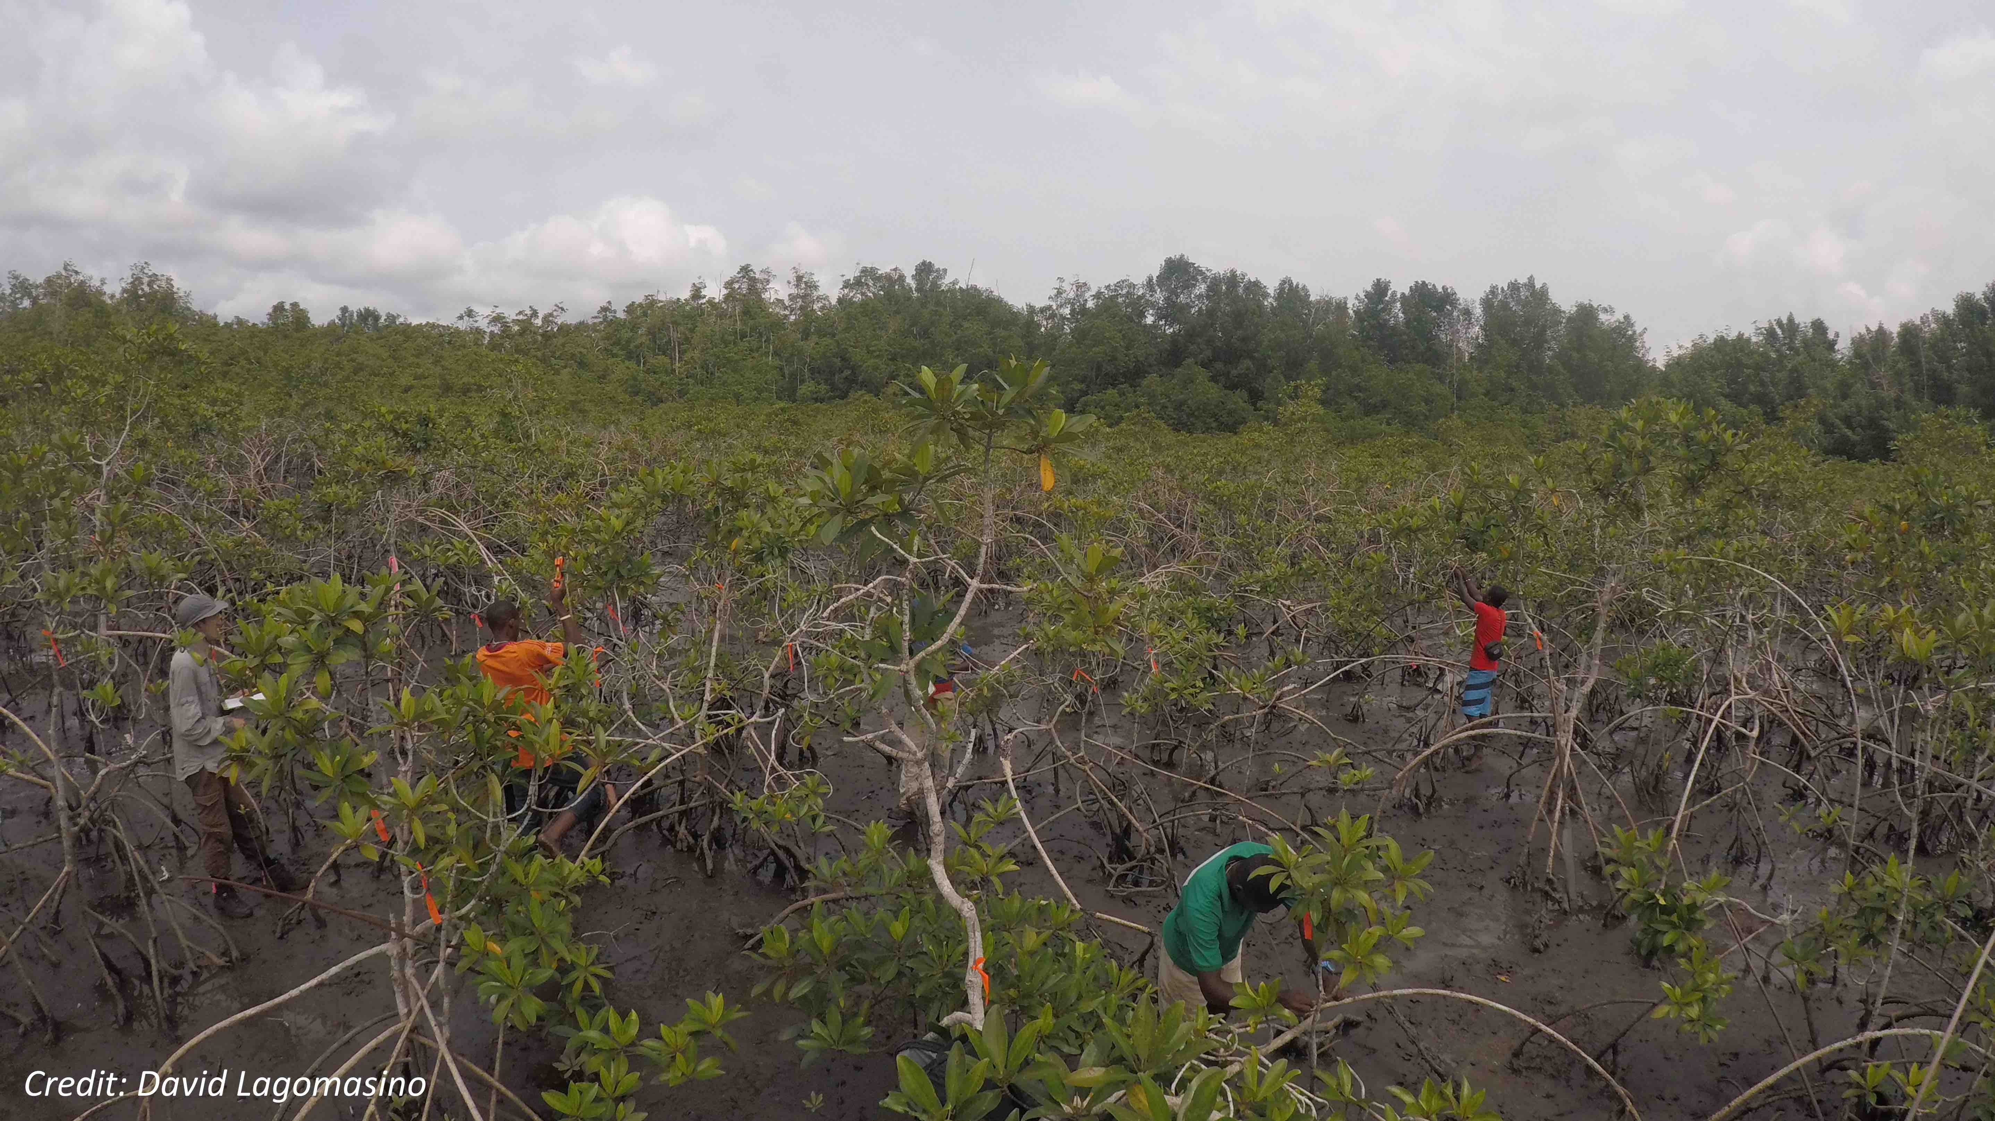
Notes:
Measuring Mangroves from Space: No More Swamp Feet
Mangrove forests are being squeezed by natural ocean-land processes and human-intervention. The improvement in measuring and monitoring these ecosystems with remotely sensed data will be a powerful tool for protecting and managing its ecosystem services. However, we are also improving the technical capabilities of measuring forest structure from space, and improving how we estimate tree volume and biomass from the ground.

Slide 12
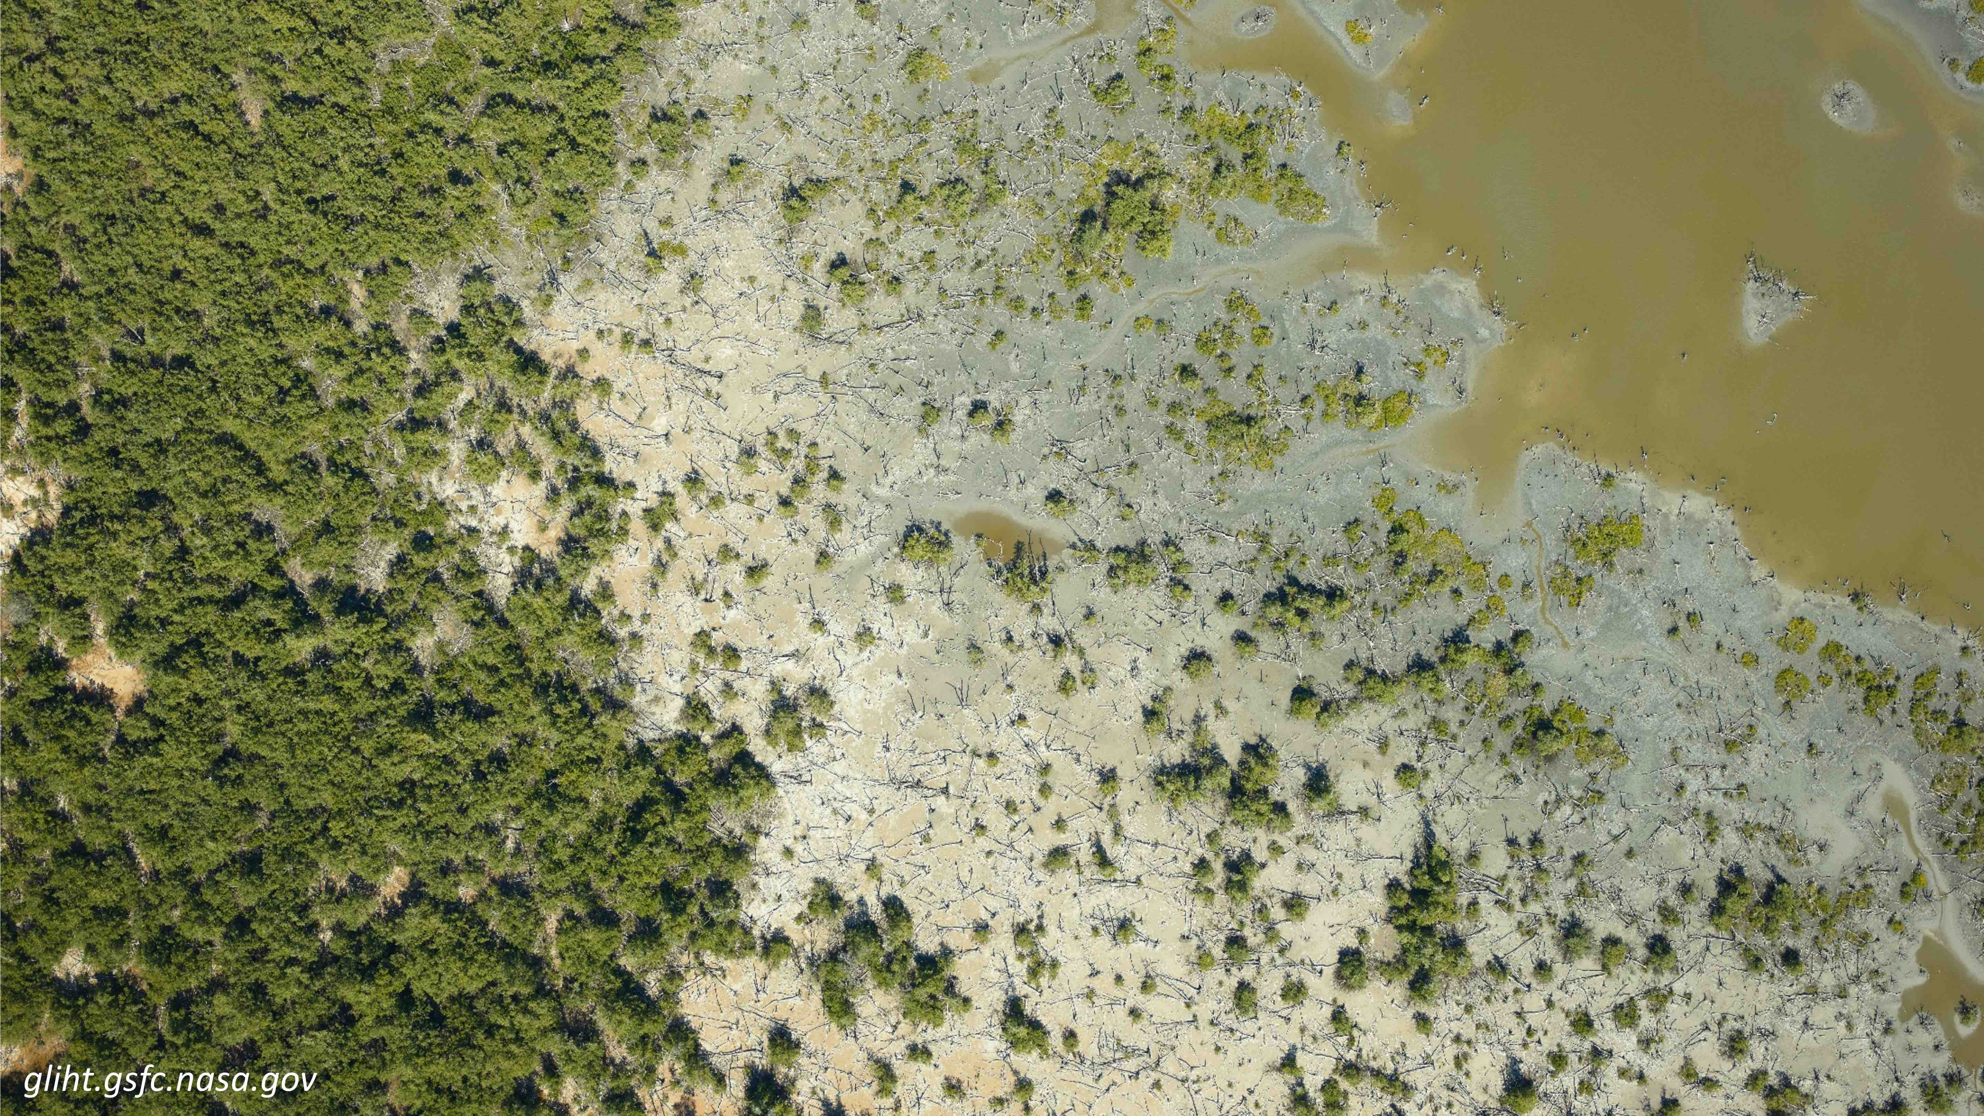
Notes:
Measuring Mangroves from Space: No More Swamp Feet
Virtual ExploreR Site Assistant (VERSA), will be a unified and interoperable collaborative tool suite for enhancing the value, accessibility, and understanding of science data connected with Earth Science Field Campaigns using mobile, Virtual Reality (VR) and Augmented Reality (AR) technologies. VERSA will support the entire lifecycle of a field campaign, from planning to in situ field work to research and analysis after the field campaign. Our project will enable NASA to maximize the value of expensive Earth Science field campaigns. It will enhance the understanding and use of science data by using mixed reality technologies to layer sensor data over actual terrains during the campaigns as well as virtually exploring and analyzing field sites later “in situ.”

Slide 13
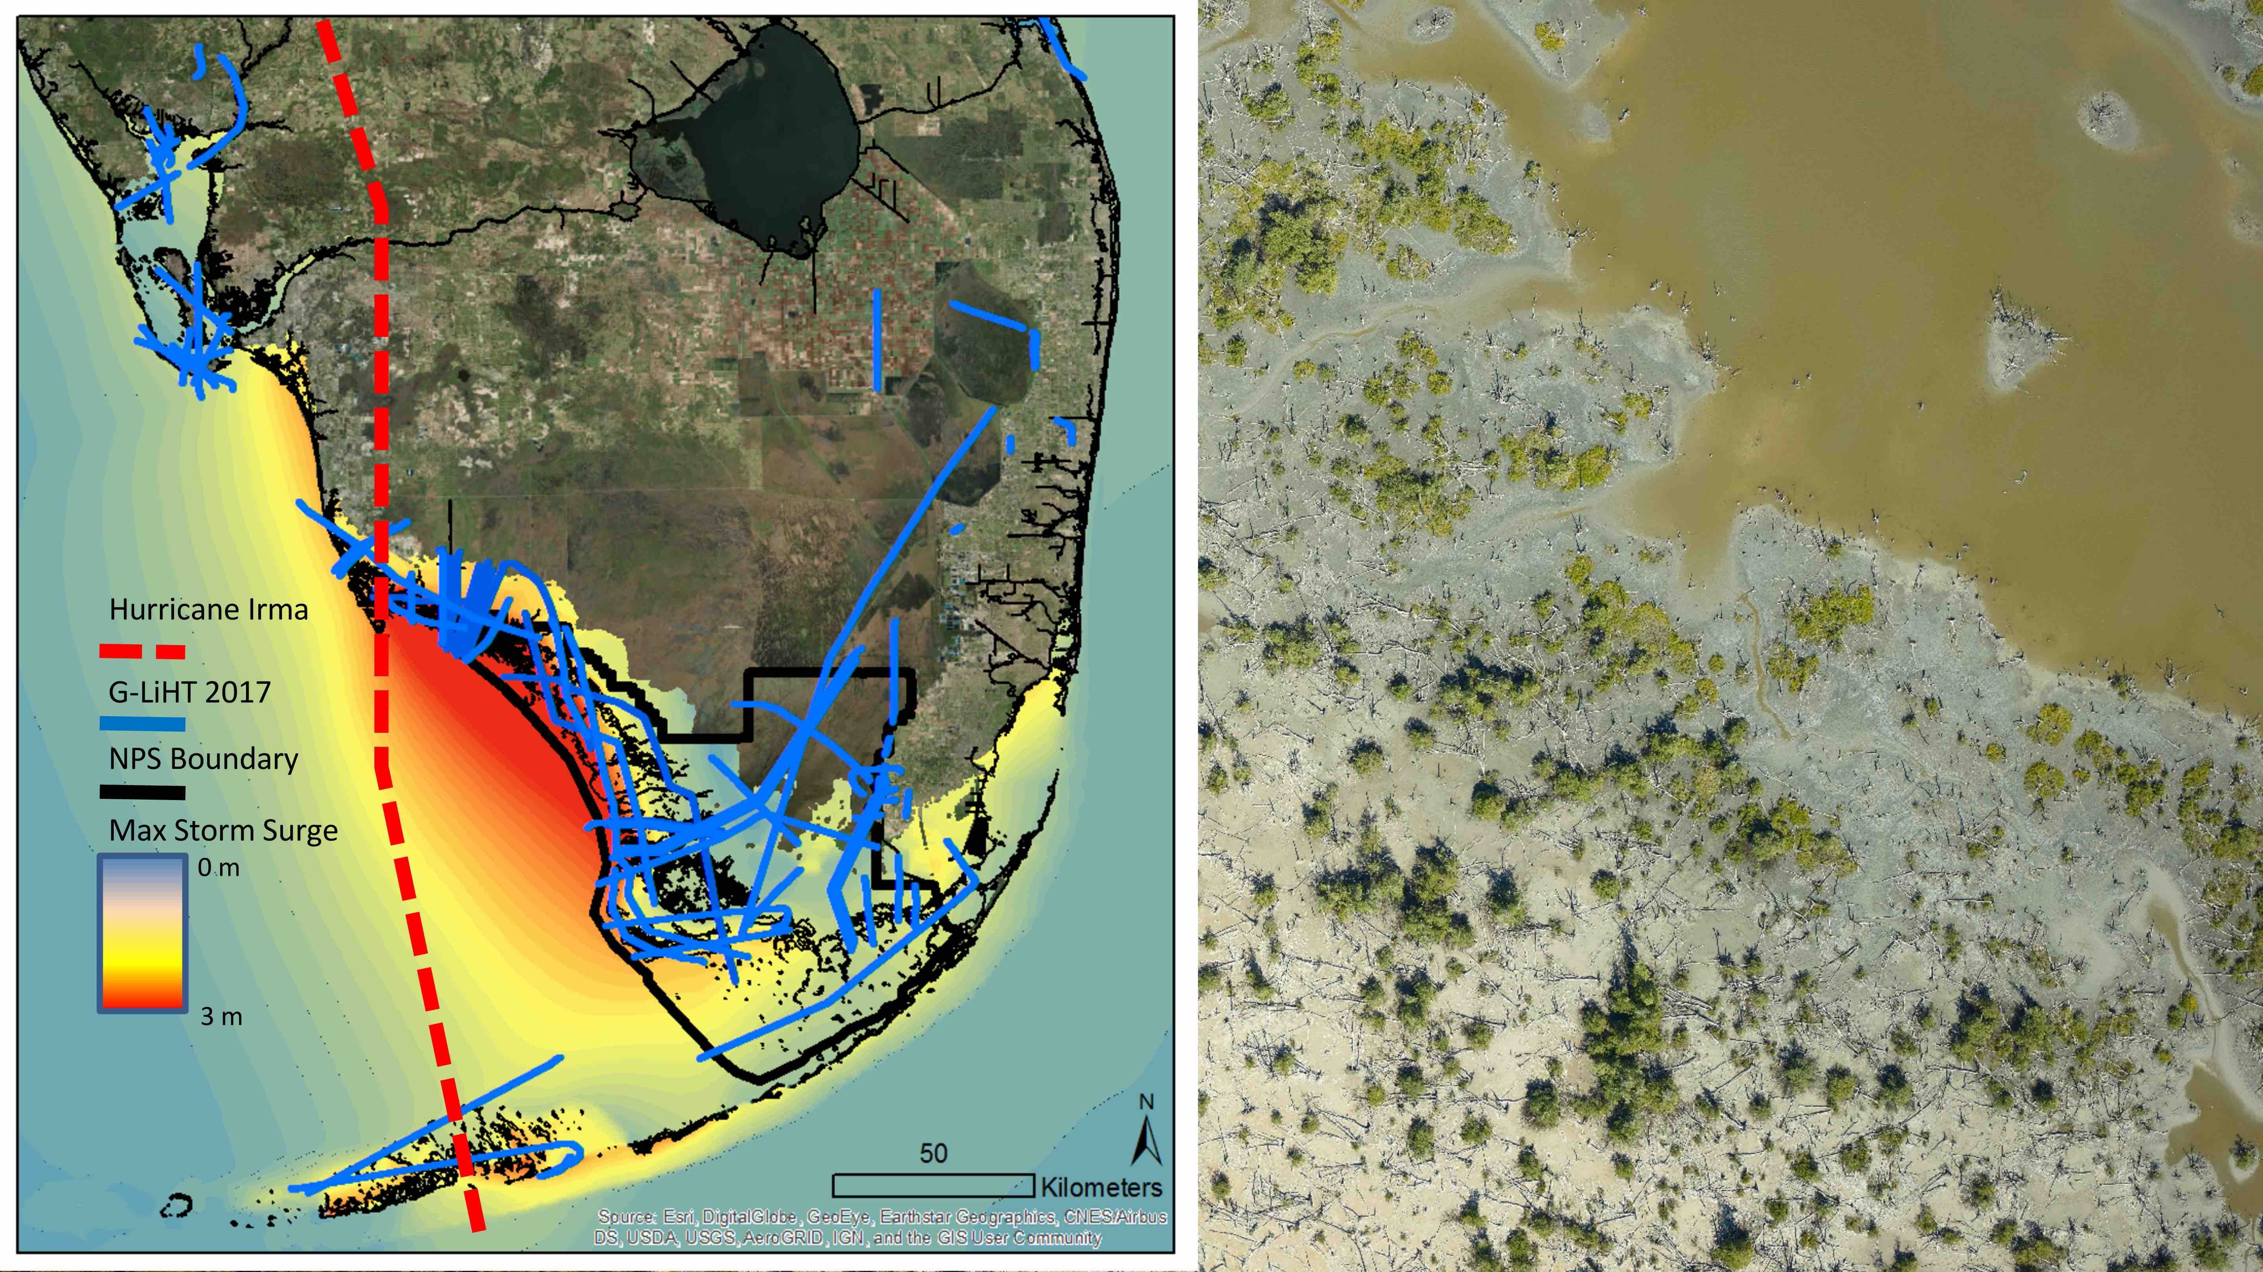
Notes:
Measuring Mangroves from Space: No More Swamp Feet
In April 2017, the Goddard's Lidar, Hyperspectral, and Thermal (G-LiHT) Airborne Imager conducted an extensive airborne campaign in South Florida, including >130,000 ha of high-resolution data collection in the areas most heavily impacted by Hurricane Irma. Rapid assessment of storm impacts is critical to characterize sedimentation, erosion, and changes in ecosystem structure and composition. Using G-LiHT's unique lidar and optical instrument suite we can address fundamental science and application needs arising from Hurricane Irma that will help to inform South Florida environmental agencies of urgent restoration, mitigation, and water management needs. Moreover, the this new data will provide crucial details on the differential resilience of coastal vegetation directly after catastrophic storm events.
Data will be available at the G-LiHT webpage and interactive Data Center (https://gliht.gsfc.nasa.gov).

Slide 14
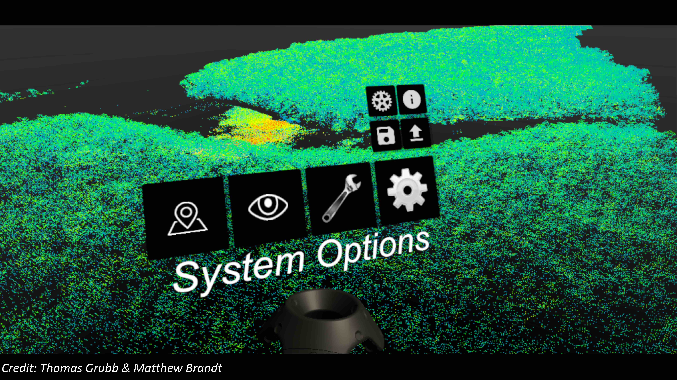
Notes:
Measuring Mangroves from Space: No More Swamp Feet
Virtual ExploreR Site Assistant (VERSA), will be a unified and interoperable collaborative tool suite for enhancing the value, accessibility, and understanding of science data connected with Earth Science Field Campaigns using mobile, Virtual Reality (VR) and Augmented Reality (AR) technologies. VERSA will support the entire lifecycle of a field campaign, from planning to in situ field work to research and analysis after the field campaign. Our project will enable NASA to maximize the value of expensive Earth Science field campaigns. It will enhance the understanding and use of science data by using mixed reality technologies to layer sensor data over actual terrains during the campaigns as well as virtually exploring and analyzing field sites later “in situ.”

